Slide 1
The top 1 percent – wealth inequality, taxation and “superstars”
David J. Deming
SUP-206, Fall 2019

Slide 2
The plan
Overview of trends – current and historical perspective
Thinking critically about the role of wealth concentration
  Separate the positive from the normative
  Superstars, or rent-seekers?
  Who are the 1 percent?
Income inequality and taxation
Bonus: Offshore tax havens

Slide 3
Source: World Inequality Report (2018)

Slide 4
Source: World Inequality Report (2018)

Slide 7
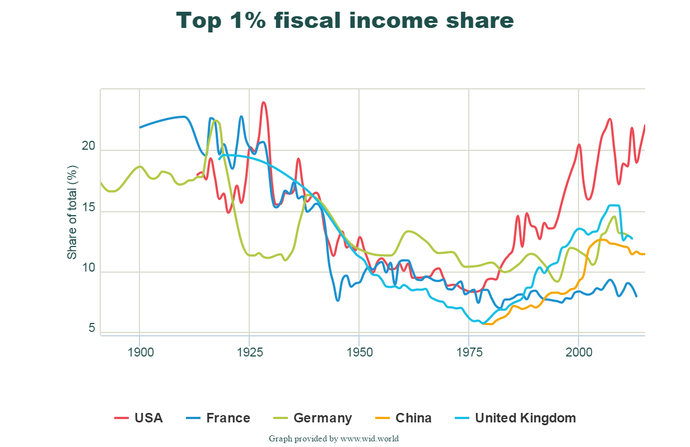

Slide 8
Distributional National Accounts (DINA)
National Income = sum of all labor and capital income that accrues to U.S. residents
Combines fiscal, survey, wealth and national accounts data sources
  Survey data – collected from everyone, but can be inaccurate (especially at the top)
  Administrative data – only works for people who pay taxes and report them accurately
    Non-filers (low income); Tax evaders (high income)
Labor income, capital income, implied value of wealth

Slide 9
DINA Method
Start with public-use samples of tax returns 1962 onward, supplemented with age, gender, household structure
Supplement with CPS survey data on nonfilers, weighted to match US population
Compute payroll taxes, fringe benefits (impute using CPS, compare to IRS data post-1999)
Capital income – distribute total household wealth from Financial Accounts data (interest, dividends and cap gains, rents business profits, etc.)
  Obtain home values from property tax paid and mortgage debt from itemizers
  Impute other sources (pensions, homes for non-itemizers) from Survey of Consumer Finances
Compute a yield by dividing capital income by the total value of assets, then multiply each wealth component by yield
  Ensures that individual capital income adds up to total economy capital income (e.g. dividends and cap gains get weighted up to match macro-measured flow of corporate profits
Pretax to Post-tax – deduct taxes and add back in government spending (from survey data and rules)

Slide 16
Patterns
Some growth in top 5%, but it’s mostly a top 1 percent (even top 0.1 percent) phenomenon
  Growing top 1% share is pre-tax, so it can’t directly be about falling top MTR
Bottom 50% - no growth in real incomes, falling income share
Top 1% share is double 1960 levels, and highest since 1929
Growth in top 1% share since 1970s in all Anglophone countries, but most pronounced in the U.S.
  UK – 9 percent to 14 percent; US – 10 percent to 20 percent
  Very different patterns in Western Europe

Slide 17
Pre-tax vs. Post-tax; Labor vs. Capital Income
Increasing importance of transfers
  Direct monetary transfers (e.g. welfare, EITC, social security)
  In-kind transfers (health care, SNAP, subsidized housing)
Capital income – flow income from ownership of assets (e.g. dividends, capital gains, rental income)
  Wealth is the stock; capital income is the flow

Slide 18
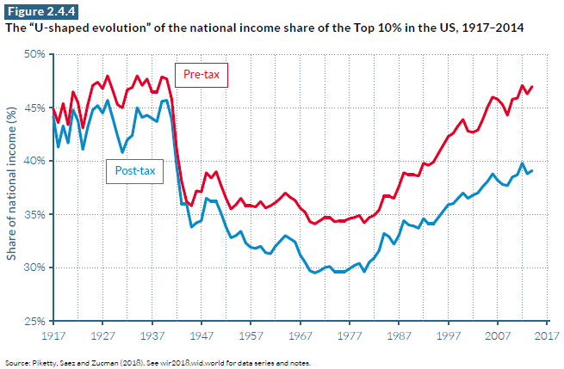

Slide 26
Wealth
How to calculate the value of held assets?
  Saez and Zucman (2016) outline a method for imputing wealth based on capital income flows
Start with IRS reported capital income – compute a “capitalization factor” that maps tax income to recorded wealth from US Financial Accounts
  Ex: if total bond values in Financial accounts equal 100x the flow of interest income, a household with $1,000 in bond interest income gets bond wealth of $100k
  This allows for an imputed distribution of wealth, based on capital income flows
Variety of imputation methods for capital that doesn’t generate income stream (e.g. houses, pensions)
Excludes nonprofit ownership, social security, and human capital

Slide 31
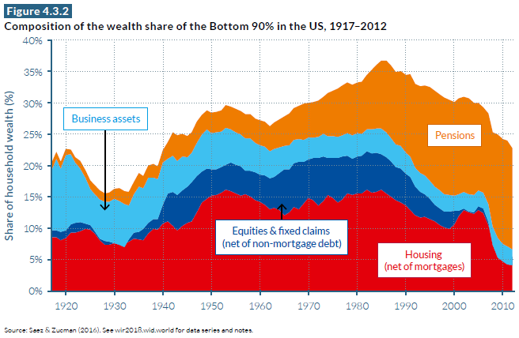

Slide 32
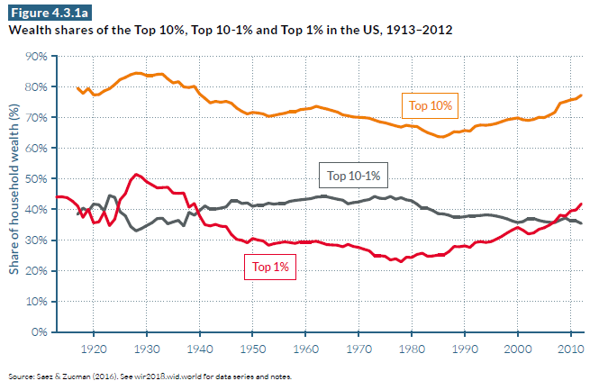

Slide 35
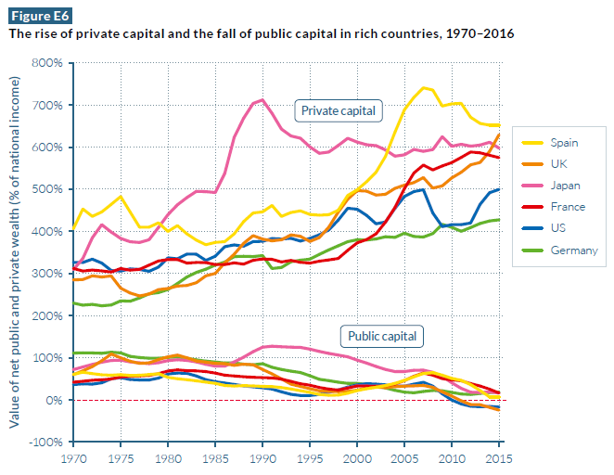

Slide 36
How should we think about the rising concentration of income and wealth?
First – put aside your normative views on what “should” happen
Important question – to what extent is concentration of wealth tied to concentration of value creation?
Are the wealthy highly productive superstars, or opportunistic rent-seekers?
  How level is the playing field?
  And if it tilted, when does this tilting happen?

Slide 37
Competitive pay determination, or wage bargaining?
Fundamental assumption – workers are paid their marginal product
  Wages = productivity (at least on average)
Works when markets are “thick” and competitive
  “Law of one price” – if one employer is paying too little, you can switch to another one that pays you your worth
  Likewise for firms
What about “thin” markets?
  Scarce talent and company towns
  Match between employer and employee generates some surplus, or “rents” – who gets it?
Is the market for talent competitive? If not, do higher-paid workers have more bargaining power?

Slide 38
Who are the top 1 percent?
Two common “rent-seeking” stories
  CEOs cozy up to their boards, executive pay increases even when companies perform poorly
    CEOs rewarded for luck too (Bertrand and Mullainathan 2001)
  Wealth is protected across generations via tax avoidance, inherited by the “undeserving rich”
How much of the rise in the top 1 percent is driven by CEOs and by inherited wealth?

Slide 39
Could we talk more about who the 1% and 0.1% are composed of? Is it mostly people who have inherited wealth, or middle/upper-middle class who have risen up based on their profession, or entrepreneurs?

Slide 47
Kaplan and Rauh – it’s the market
Increase in top pay has happened everywhere, not just among CEOs
  Lots of variation in the mechanisms that determine top pay across fields
  Bivens and Mishel (2011) – so what? Rent-seeking is everywhere too!
Inherited wealth less important than it used to be
Share of the Forbes 400 that never attended college dropped from 17 percent in 1982 to 5 percent in 2011

Slide 48
Theory of Superstars (Rosen 1982)
Extreme concentration of income/wealth among a talented few
  “A typical player in the National Basketball Association is reported to earn somewhere in the vicinity of $250,000 per year in salary equivalent alone, and this figure will soon rise to $300,000.”
  This is only the success stories – inequality within “superstar” professions is vast
Two conditions for superstars
  Poor talent an inadequate substitute for superior talent
    Quality an important differentiator (bushels of wheat vs. musicians)
    Can I substitute quantity for quality?
  Services can be delivered to many buyers simultaneously
    Importance of media

Slide 49
Are CEOs superstars?
The value of good decision-making is greater at the top
  CEOs pay and firm size
  The most successful firms can sell their product all around the world
Importance of product variety
  Sports – wins are close to the only metric of success
  What makes a good book?
Do talented CEOs and managers create more value?
  Not inconsistent with being paid for luck

Slide 50
How do we think about “superstars” and income inequality when it seems like the driver of inequality is actually people who make a lot more than these “superstars” (i.e. tech giants) and the stagnation of the bottom of the distribution? Sometimes I think that the focus on these people is kind of a red herring (and/or racist since a lot of athletes tend to be people of color). Thanks!
The paper about the economics of superstars is intriguing, especially considering that the author argues that much of the increase in superstar income can be attributed to technology, media attention, changes in society, etc. Is the same thing happening here in the normal “wage labor” world? Are CEOs and capital owners and bankers making more in the 1% because of the same thing? Are higher IQs and higher skill levels just more rare or is it that society has less room for them, so only the cream of the crop can make superstar income? Or is it beyond ability and mostly something else?
Social media led to an increase of competition among stars / superstars / influencers. However, despite this increasing supply, earnings do not seem to drop. Why is that?

Slide 51
Bivens and Mishel – it’s “rents”
Bivens and Mishel (2013) advance a broader interpretation of “rents”
  Compensation in excess of what is needed to induce economic activity
  Doesn’t need to be tied to observed “rent-seeking” behavior
This is an empirical claim – would raising the top marginal tax rate reduce economic activity among top earners?
  What is the impact of higher tax rates on GDP growth?

Slide 52
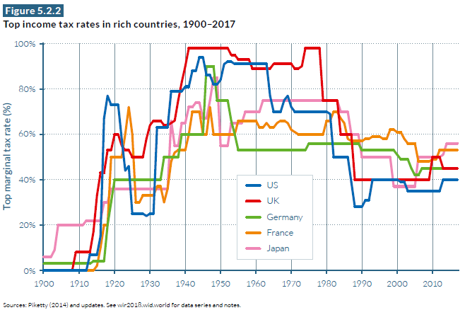

Slide 53
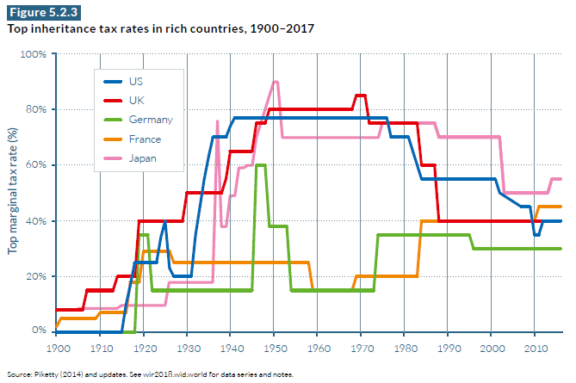

Slide 54
Empirically, what is the tradeoff between inequality and inefficiency? The Mankiw mentions that the marginal income tax rates were as high as 91 % in the US during the 1950s. Was US GDP Growth slower during this period as opposed to periods with lower marginal tax rates?

Slide 55
Income inequality and taxation
What happens when you increase the top marginal tax rate?
Direct effect – more money out of the paychecks of rich people
  Easy to measure – pre-tax vs. post-tax income shares
Indirect effect – higher tax rate = activity that never happens
  Do lower tax rates encourage effort and innovation?
  What is the responsiveness of economic activity to taxation?

Slide 56
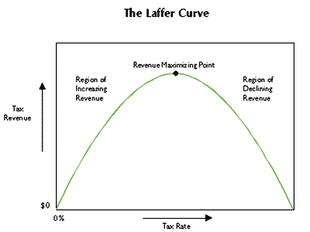
What if we set an income tax rate of 100%?
At some point, higher tax rate decreases total revenue due to reduction in economic activity.
The question is where we are on the Laffer curve.
What should be the top marginal tax rate?

Slide 58
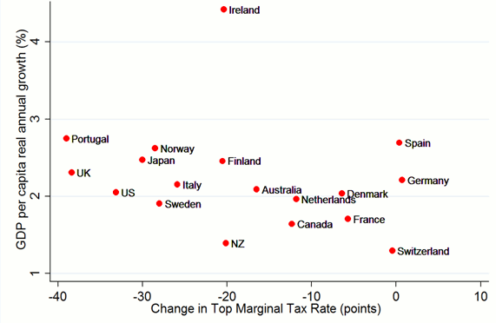

Slide 59
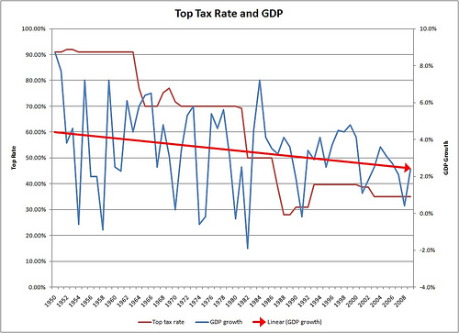

Slide 60
What is the evidence on tax rates and growth?
Modest, positive cross-country correlation between cuts in top tax rates and GDP growth
  No correlation within US, over time
Lots of changes happening in the 1980s alongside tax cuts
  Deregulation, computers, social norms (Wall Street and “greed is good”
Positive case for “trickle down economics” is somewhat weak
  But where is the burden of proof?

Slide 61
Mankiw – defending the one percent
Argues that there is little evidence that rent-seeking by the top 1 percent has increased since 1970
  Where rent-seeking exists, let’s root it out, rather than just raising tax rates
  Don’t prevent entrepreneurs from becoming rich, but try to ensure they become rich in a socially productive way
  CEO pay has increased more in closely-held firms where there is no principal-agent problem between shareholders and boards
Note that Bivens and Mishel (2011) have a different definition of “rents”
  For Mankiw, if compensation reflects higher productivity then it is “just deserts”
  This is a normative argument

Slide 62
What is your take on Piketty’s proposal of the global progressive taxation on net wealth? Could you address the constitutionality of the wealth tax, as well as the economic outcomes that caused several European nations to abolish the wealth tax?
After completing the readings, I’m still unsure what to make of policy proposals by presidential candidates who say they will fund programs like medicare for all by raising taxes on the rich - what consequences should we consider when we hear plans like those?
Point blank: what do you think of Elizabeth Warren’s proposed wealth tax? Should the state take wealth from the wealthy and invest it in higher education/pre-k/etc.?
Saez and Zucman on wealth taxation; score of Warren proposal
Kopczuk response
Summers and Sarin op ed

Slide 63
We often suggest progressive taxes to help mitigate problems of economic inequality, but taxes have become significantly less progressive over time. Why should we believe that there is a chance that taxes will change enough to make socioeconomic change? What would it take?
Why is it hard to pass policies in the U.S. that help address income and wealth inequality? Is this an issue (or combination) of misinformation, false consciousness, the wealthy’s political power, something else?

Slide 64
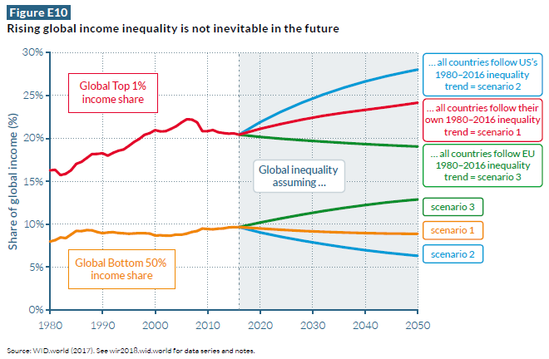

Slide 65
Summing up
Theory of superstars does have some explanatory power
  Seems clear that returns to being very productive have increased disproportionately
Yet the case for the impacts of tax cuts on GDP growth is weak
  Implication is that top 1 percent growth might be “rents” by the Bivens-Mishel definition
  Still, are tax increases a blunt instrument?
Views on the growing concentration of income and wealth too often fail to recognize these two perspectives together
  It’s easy to argue that the rich are evil
  It’s also easy to argue that tax cuts are a “free lunch”
Superstars may exist, but does the opportunity to become a superstar exist for everyone?
  Argument that the rich should pay more because “they don’t need the money” is illiberal
  Better to argue that increased tax revenue will boost opportunity for future superstars, “lost Einsteins”

Slide 66
Bonus – Offshore Tax Havens
In 2016, Bank for International Settlements (BIS) began collecting bilateral information on offshore bank deposits
  Offshore banking centers like Luxembourg, Switzerland, Hong Kong
  Bank deposits in country X owned by residents of country Y
  Retrospective
Alstadsater, Johannsen and Zucman (2017) use BIS data to construct estimates of the amount of wealth held by residents of each country in all the world’s offshore tax havens

Slide 70
Fun comparison – the Panama Papers
Leaked names and addresses of all the owners of shell companies created by the Panamanian firm Mossack-Fonseca
  Major provider of offshore financial services
Compare offshore tax haven data reported to BIS to Panama Papers leak

