Slide 1
Elite Influence, Mass Media, and Money in Politics
David J. Deming
SUP-206, Fall 2019

Slide 2
The plan
Democracy and the median voter theorem
Inequality in political participation
Self-interest, ideology and political preferences
Mass media and persuasion
Citizens United and big money in politics

Slide 5
Why doesn’t democracy slow rising inequality?
With one person/one vote – inequality should be unstable
  “Democracies….have ever been found incompatible with personal security or the rights of property.” (Madison, Federalist 10)
  Karl Marx thought democracy was the road to socialism
Turnout and electoral accountability
  Income gradient in turnout and other aspects of political participation
  Lower responsiveness to constituents (e.g. gerrymandering)
Voter preferences
  Ideological acceptance of capitalism, perceived equality of opportunity
    less support for social insurance when societies get richer
  Mass media, persuasion and money in politics

Slide 6
“One person, one vote”
What policies get adopted under democratic systems with majority rule voting?
Democracy pushes toward ideological moderation
Median voter theorem

Slide 7
Median Voter Theorem
Two candidates, each wanting to win by maximizing vote share
Assume policies can be described along a single dimension (left → right; liberal → conservative)
  Citizens have “single peaked” preferences along this dimension
  Perfect information – everyone knows candidate policies and voter preferences
Each citizen votes for the candidate who proposes a policy closest to her ideal point

Slide 8
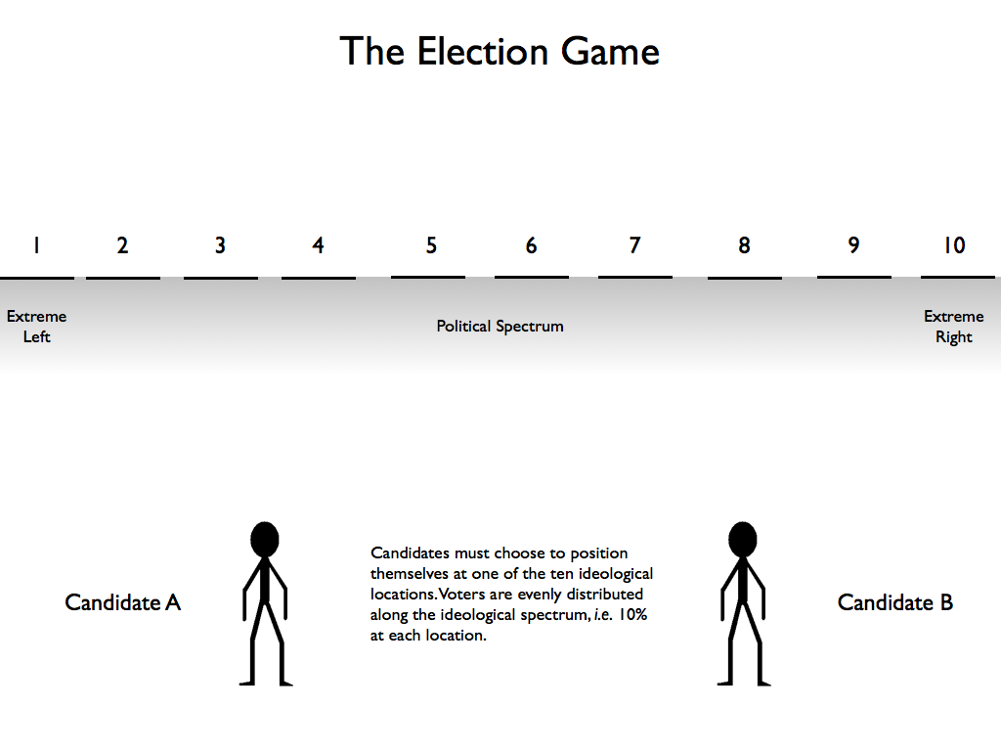

Slide 9
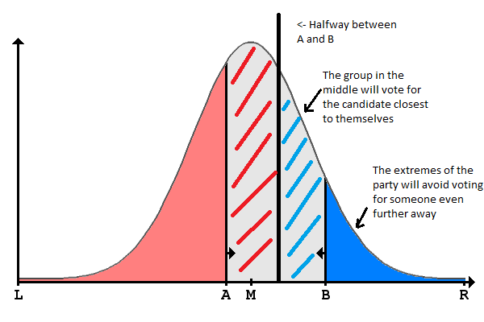

Slide 10
MVT implies that expanding the franchise will shift policy behavior in the direction of new voters.
Miller (2008) - women’s suffrage and political responsiveness

Slide 12
Reasons why MVT would not hold
Process objections - third parties, primaries, electoral college etc…
  Would MVT hold under direct democracy?
Behavioral explanations
  Limited attention, preferences are weakly held
    strictly speaking, it is irrational to vote
  Turnout and abstention – if candidates don’t share your views, why show up?
  Persuasion
Political behavior reflects group membership and social identity – new information used to rationalize, not challenge beliefs (Achen and Bartels 2017)

Slide 13
Inequality in political participation
In the U.S., policy responds disproportionately to the concerns of the rich (Bartels)
  Senators’ voting patterns – on both parties – more closely track preferences of higher income voters
  Holds even for social issues (e.g. abortion)
A simple explanation? The rich are more likely to vote

Slide 15
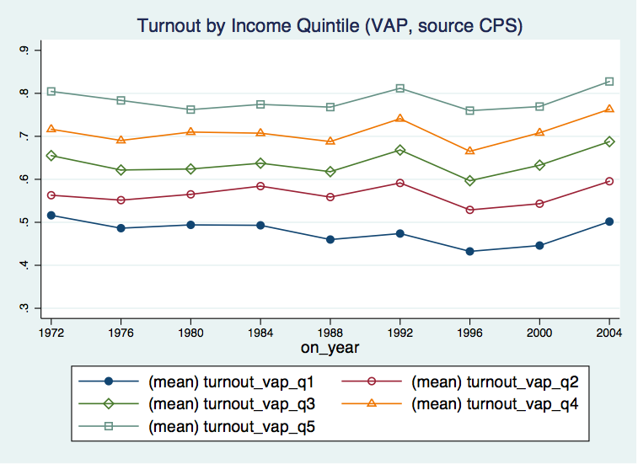

Slide 16
Inequality in political participation
Income strongly predicts voter turnout
  Also holds for other measures of political participation – donations, contacting your representative, etc..
  Impact is magnified in midterms, local elections
However, income gaps in voting have held constant for 35 years
  Hard to draw a direct line between gaps in political participation and rising economic inequality
Do the poor actually favor more redistribution? How might inequality affect political preferences?

Slide 17
Meltzer and Richard (1981)
Citizens vote on level of taxation and redistribution
Tax rate – and size of government – is increasing in the difference between mean income and median income (e.g. “right-skewed” income distribution)
Why? When income distribution is bell-shaped, median voter gets back exactly what they pay in taxes (assuming no efficiency loss)
When income distribution is skewed, median voter gains from redistribution
Implies that increasing political participation among low-income citizens will increase redistribution

Slide 18
Hidden assumption – voters are (narrowly) self-interested
Robin Hood paradox – countries with more pre-tax/transfer inequality redistribute less
  Why does the median voter favor redistribution in Sweden, but not in the US?
Voters may be ideological (i.e. not just self-interested)
Critical role of preferences – are low-income voters more likely to support redistribution?

Slide 19
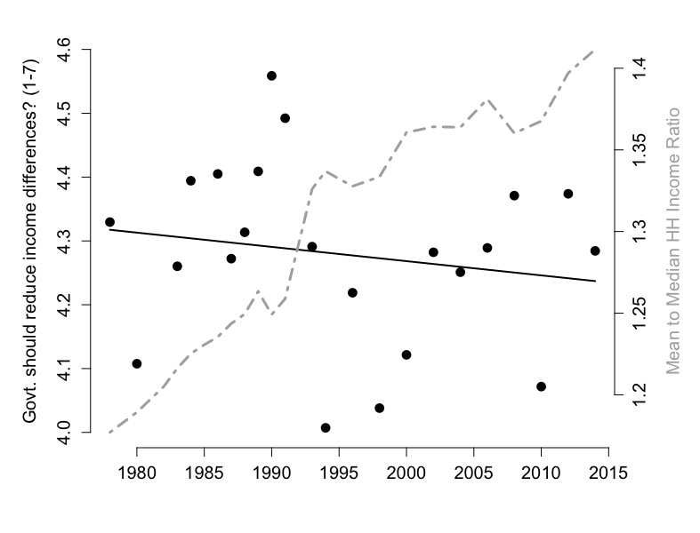
Test of Meltzer-Richard model…..

Slide 21
Why haven’t preferences responded to rising inequality?
No change in preferences for redistribution since 1980
  if anything, the opposite
  voter preferences appear fairly moderate and constant over time
Yet the electorate has become more polarized – why?
Who is polarizing?
  Boxell, Gentzkow and Shapiro (2017)

Slide 26
Bottom line – polarization is increasing among the elderly, not the young
Given generational patterns of media consumption, internet may not be the culprit…
  Unless the elderly are more persuadable…
Facebook and “fake news”

Slide 27
“Social Media and Fake News in the 2016 Election”, Allcott and Gentzkow (2016)

Slide 31
Both parties are more likely to believe “fake news” when it aligns with their prior beliefs
This tendency is increasing in media consumption and ideological segregation
Some evidence that education inoculates against “fake news” (not shown)

Slide 36
How have political systems around the world adapted to an influx of migrants?
My question is how can immigration be turned into a positive for both parties involved now? One key thing is that the poorer countries must rise to a level where fewer people would like to leave, but how can this truly be feasible in reality? With attitudes as they are, I don’t see it as very likely that these types of economic and political policies will take flight.
What leads to the misconceptions that exist regarding the trends and composition of immigration?

Slide 37
Does providing information about inequality affect preferences for redistribution? (Kuziemko et al)
Information increases concern about inequality
  But has little impact on specific policy preferences – income tax rates, minimum wage, food stamps etc…
Trust in government
  If politicians let it get this bad, they can’t be trusted to fix it
Make explicit the connection between policies and impacts on “people like you”
Suggests that voters can be persuaded. How to make the connection between policies and impacts explicit?

Slide 38
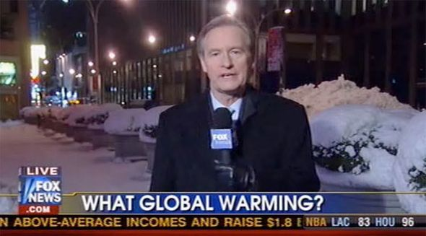

Slide 39
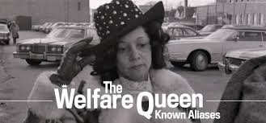

Slide 41
Source: Martin and Yurukoglu (2017)

Slide 45
Given that some private cable channels can be so explicitly tilted, how has the U.S. government responded to maintain the political objectivity of these media?
Are there any studies linking news coverage and acts of discrimination?
Is the horse out of the barn or can we reform the 24hr news cycle?

Slide 46
Persuasion, preferences and money in politics
Citizens United v. FEC (2010)
Freedom of speech prohibits the government from restricting independent political expenditures by an organization
  Citizens United wanted to advertise for Hillary: The Movie during TV broadcasts
  Violation of McCain-Feingold (BCRA), which prohibited “electioneering communication” within 60 days of general / 30 days of primary
  Supreme Court struck it down, ruling that nonprofits, for-profits, labor unions etc. are “people” with 1st amendment rights
Why super PACs?
  Still a federal limitation on direct contributions from orgs to candidate campaigns or political parties

Slide 48
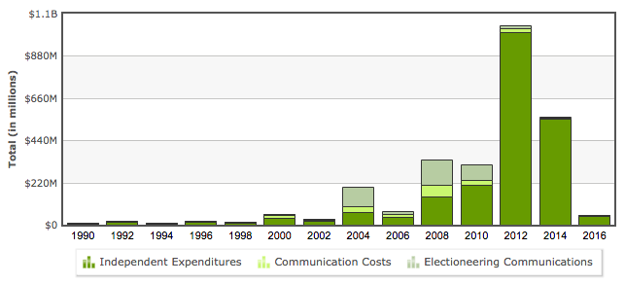
Citizens United decision in 2010….

Slide 49
What is the impact of Citizens United?
Big increase in political spending after 2010
  Yet is it just the continuation of a trend?
Are donors’ preferences markedly different than voter preferences?
  If anything, big money contributors tend to be business-friendly and moderate
Does spending affect outcomes in either direction? Does spending affect outcomes at all?
  Money in politics also includes lobbying, regulatory capture, etc…

Slide 50
How to make democrats and republicans less reliant on the top 0.01% of donors? What campaign contribution laws are needed?
If you were to compare Citizen’s United to a Supreme Court decision of similar gravitas, how would you put this in perspective for the students?

Slide 52
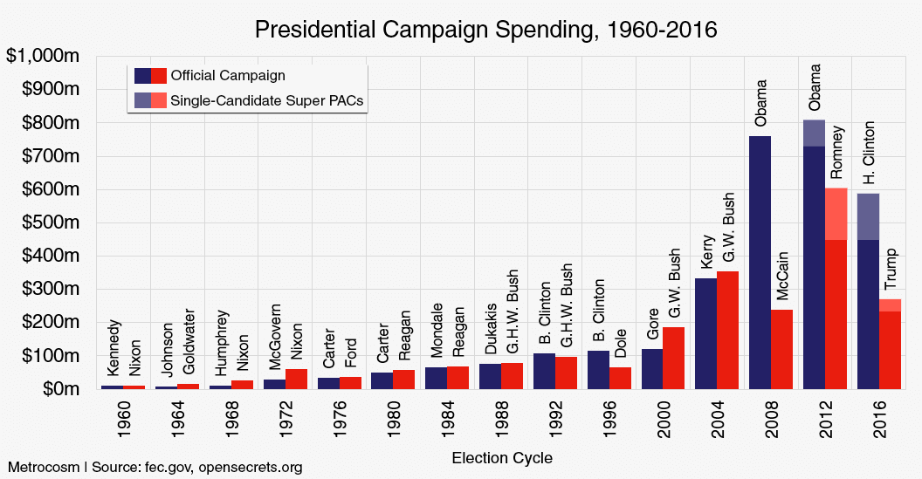

Slide 53
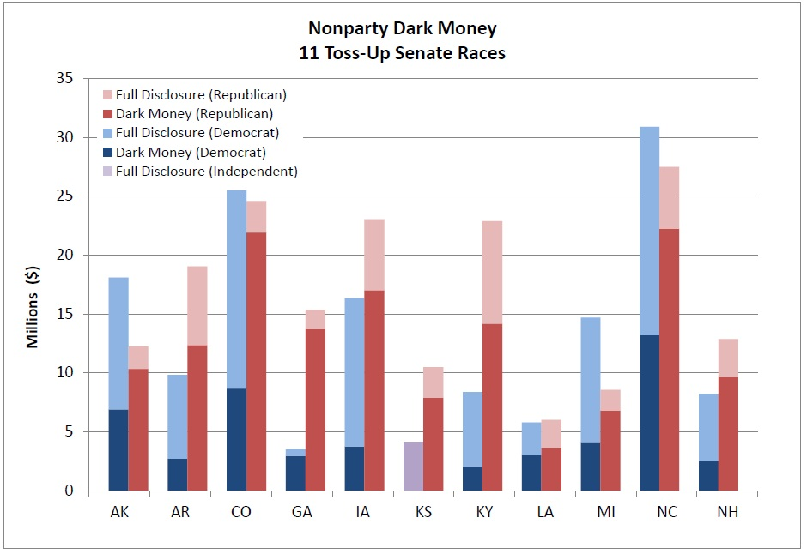

Slide 54
Where does all the “dark money” go?
The Koch Network and other “donor consortia”
  Coordinated and sustained efforts existing outside the traditional political party structure
  Distinct from think tanks, interest groups/constituencies (e.g. the NRA, Planned Parenthood)
Skocpol and Hertel-Fernandez (2016) document the rising importance of outside donor consortia (especially in the GOP, but Dems too)
  Several conservative groups (American Crossroads, Heritage Action,etc.)
  Mostly (75-80%) the Koch network
  Kochs are “idea-driven” – politicians reflect rather than create ideology

Slide 55
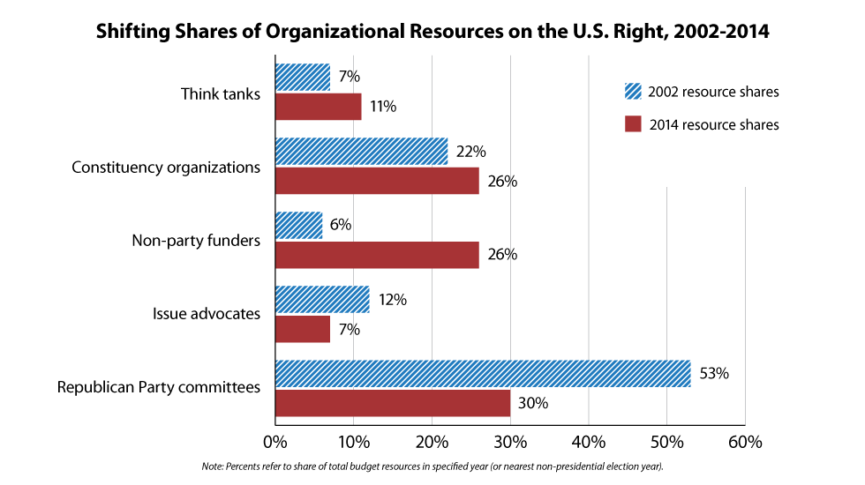

Slide 56
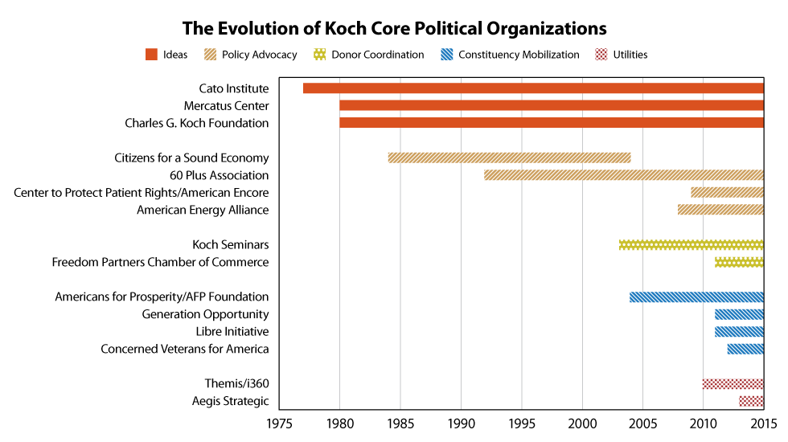

Slide 57
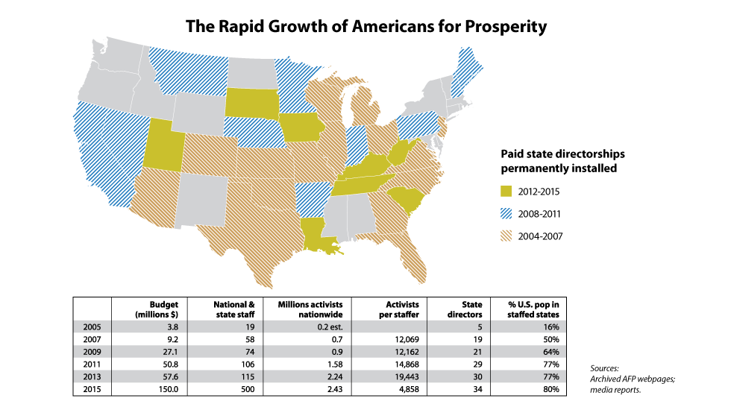

Slide 58
Who are the members and donors?

Slide 59
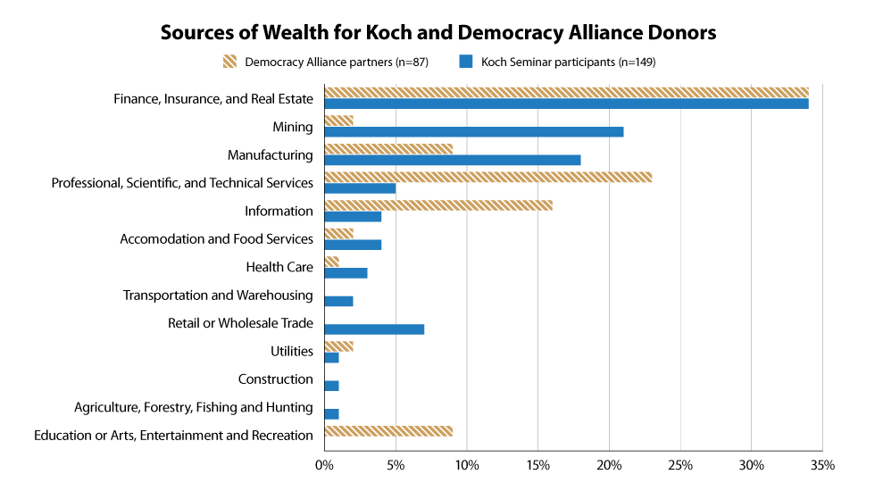

Slide 60
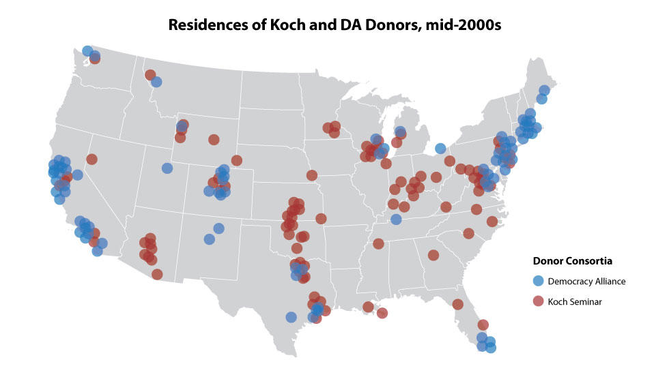

Slide 61
Is polarization in domestic politics a US-specific or a global phenomenon? Are other developed nations also experiencing a dramatic shift in the political terrain which aggravates income inequality?
Should we expect that the right/conservatives will continue to move towards the extreme as a result of these forces? Is there a way to turn this around?
Is there a Democratic equivalent to the Koch brothers?
When is lobbying good and when is lobbying bad?

Slide 62
Summing up
Democracy promises egalitarianism
  Yet it has increasingly failed to deliver – politics is more polarized, less responsive to the median voter
Politicians respond more to higher-income voters and elites
  But this has probably always been true
Voters are ideological, not just self-interested
  Exceptions for “kitchen table”, “pocketbook” issues
  Salience and persuasion
  The important role of mass media
Donor influence – it’s not just about money, but how the money gets spent
  Ideology + money is a powerful combination
Does politics drive economics, or vice versa?

