Slide 1
The Future of Inequality: A World Without Work?
David J. Deming
SUP-206, Fall 2019

Slide 2
The plan
Technological advances and recent labor market trends
  Will robots really take all of our jobs?
Is this time different? Automation and economic growth in historical perspective
How is the labor market changing? Social interaction, knowledge work and meaning
Universal Basic Income

Slide 3
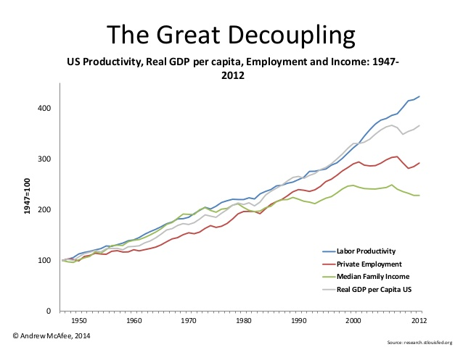

Slide 4
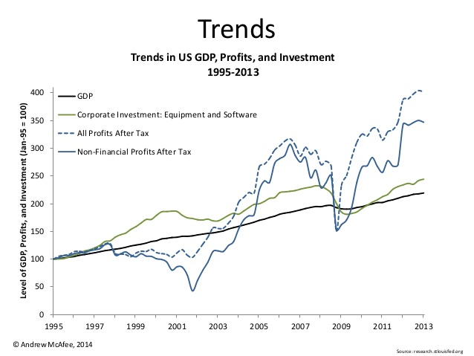

Slide 5
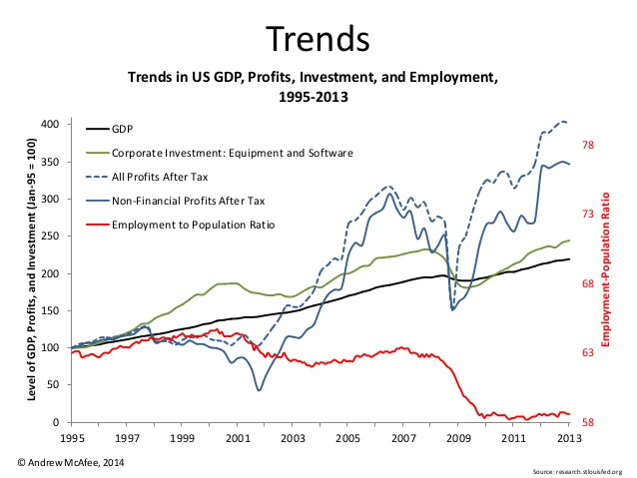

Slide 6
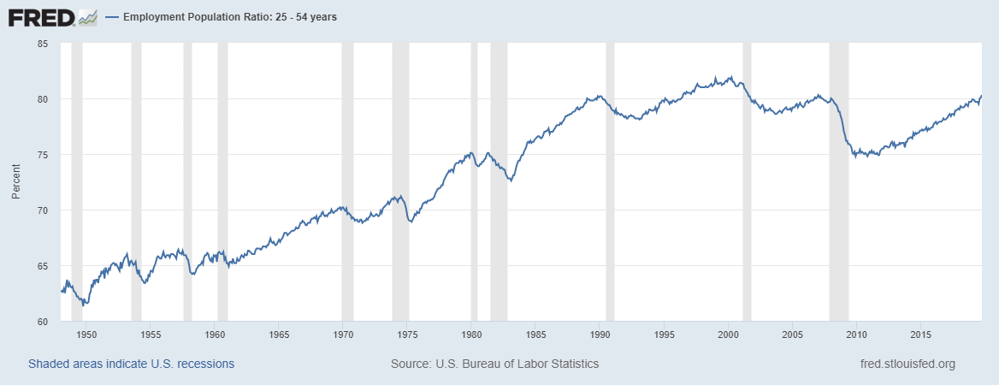
Since 2013……

Slide 7
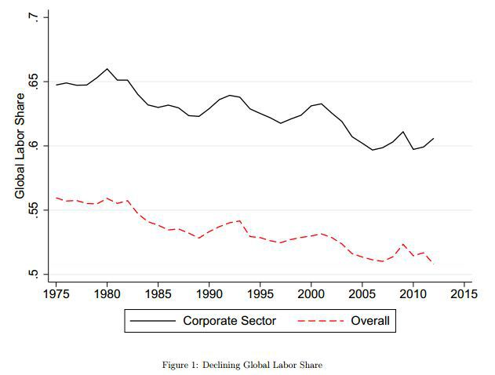

Slide 8
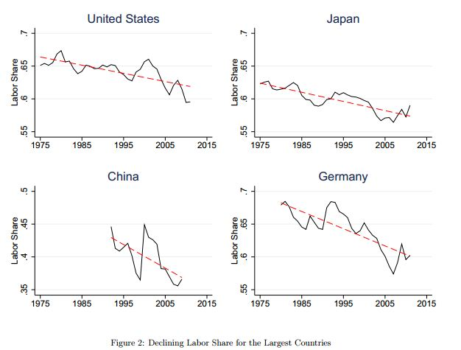

Slide 9
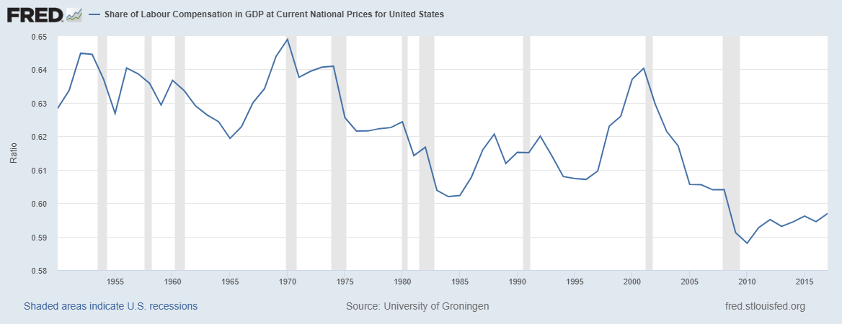
Since 2013…..

Slide 10
Source: Acemoglu and Restrepo (2019)

Slide 11
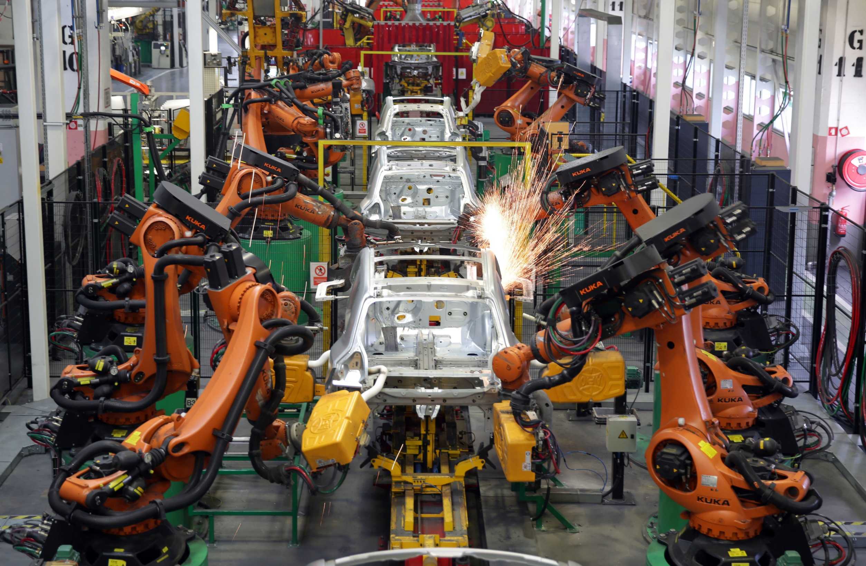

Slide 13
Source: Acemoglu and Restrepo (2019)

Slide 14
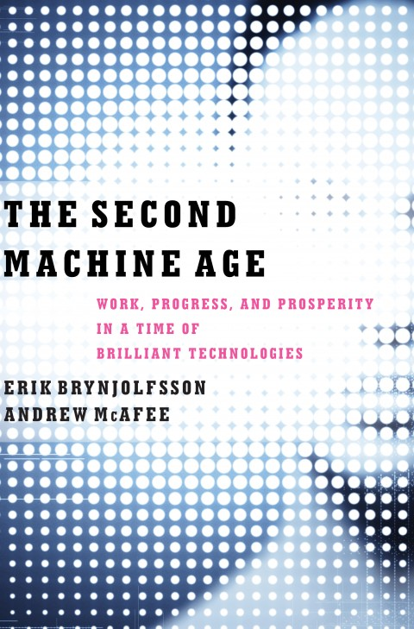
The “Second Machine Age” (Brynjolfsson and McAfee 2012)
First machine age – the Industrial Revolution
  Automation replaced human physical power
  Bulldozer, steam engine, etc..
Second machine age – computers and big data
  Automation replacing human mental power
  Math, organization and categorization, chess, etc.

Slide 15
Progress of labor-replacing technology…..
The consensus as of Levy and Murnane (2004) was that humans were unique in terms of:
  Mobility and fine motor control (walking down stairs, navigating a crowded restaurant, left turns into traffic)
  Language processing and complex communication
  Pattern recognition and matching; unstructured problem solving

Slide 16
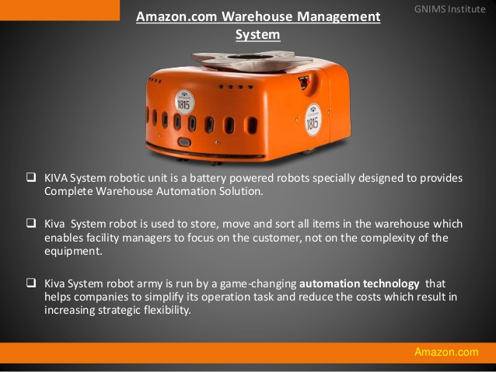

Slide 17
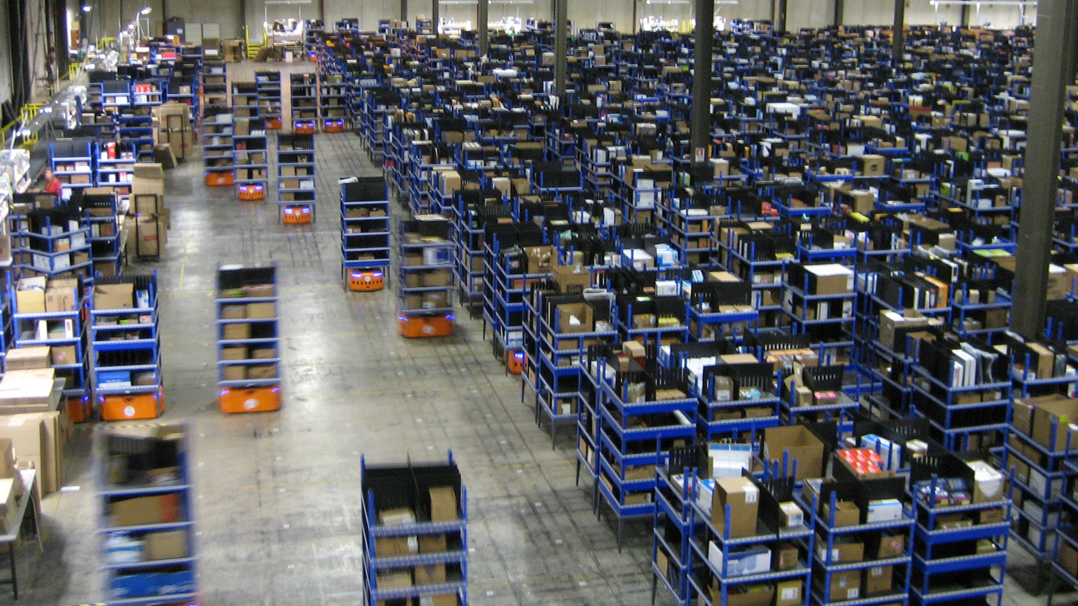

Slide 18
Amazon Video
“Amazon’s one day delivery service depends on the work of thousands of robots”
“Amazon debuts a pair of new warehouse robots”

Slide 19
Industrial robots
Capabilities and uses developing rapidly
Replacing some jobs, but more importantly, major categories of workplace tasks
  Walking around a warehouse
  Finding items
  Organizing into groups
  Packaging
  Delivering
Robot work is modular
  Environment carefully controlled

Slide 20
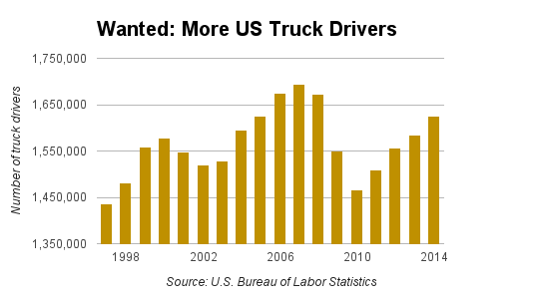
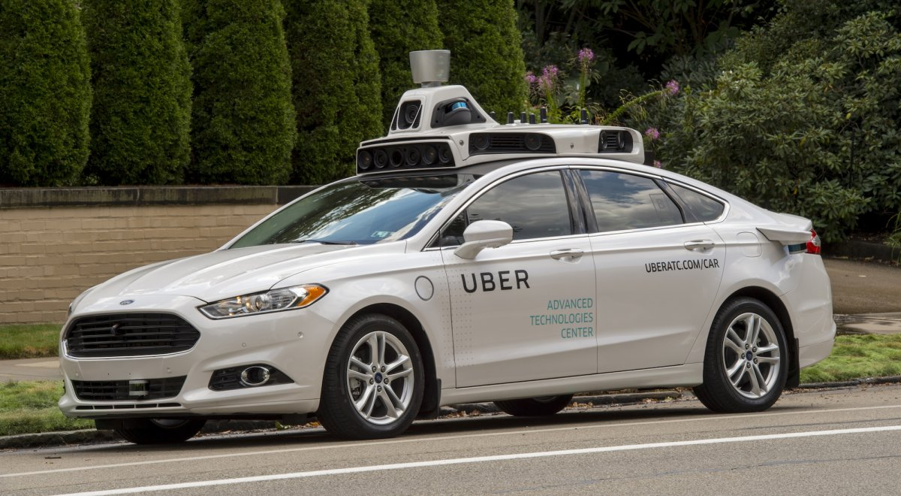
“Heavy Truck Drivers” is the 13th largest U.S. occupation. Light Trucks is 37th. >4 million driving-related jobs in the U.S. in 2014.

Slide 21
Progress of labor-replacing technology…..
The consensus as of Levy and Murnane (2004) was that humans were unique in terms of:
  Mobility and fine motor control (walking down stairs, navigating a crowded restaurant, left turns into traffic)
  Language processing and complex communication
  Pattern recognition and matching; unstructured problem solving

Slide 23
Turn data into narratives – automatic translation
Google smart compose / smart reply

Slide 27
Progress of labor-replacing technology…..
The consensus as of Levy and Murnane (2004) was that humans were unique in terms of:
  Mobility and fine motor control (walking down stairs, navigating a crowded restaurant, left turns into traffic)
  Language processing and complex communication
  Pattern recognition and matching; unstructured problem solving

Slide 28
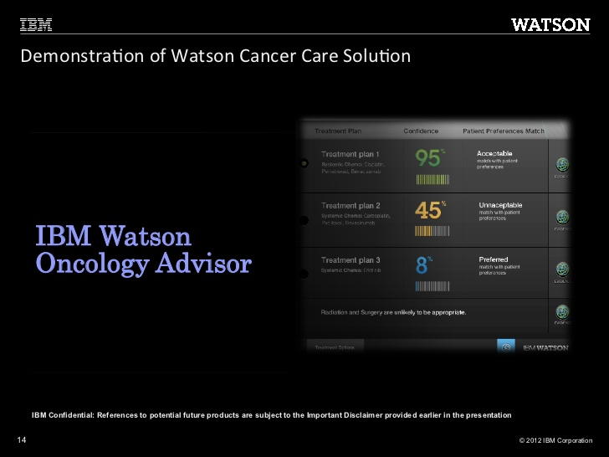

Slide 29
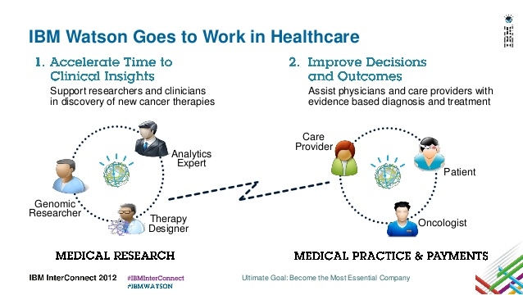

Slide 30
“How IBM Watson overpromised and underdelivered on healthcare”
“the products that have emerged from IBM’s Watson Health division are nothing like the brilliant AI doctor that was once envisioned: They’re more like AI assistants that can perform certain routine tasks.”
“Watson learned fairly quickly how to scan articles about clinical studies and determine the basic outcomes. But it proved impossible to teach Watson to read the articles the way a doctor would. “The information that physicians extract from an article, that they use to change their care, may not be the major point of the study,” Kris says. Watson’s thinking is based on statistics, so all it can do is gather statistics about main outcomes, explains Kris. “But doctors don’t work that way.”
“Some success stories are emerging from Watson Health…. Watson takes in the file that lists a patient’s genetic mutations, and in just a few minutes it can generate a report that describes all the relevant drugs and clinical trials. Watson has a relatively easy time with genetic information, which is presented in structured files and has no ambiguity—either a mutation is there, or it’s not.

Slide 31
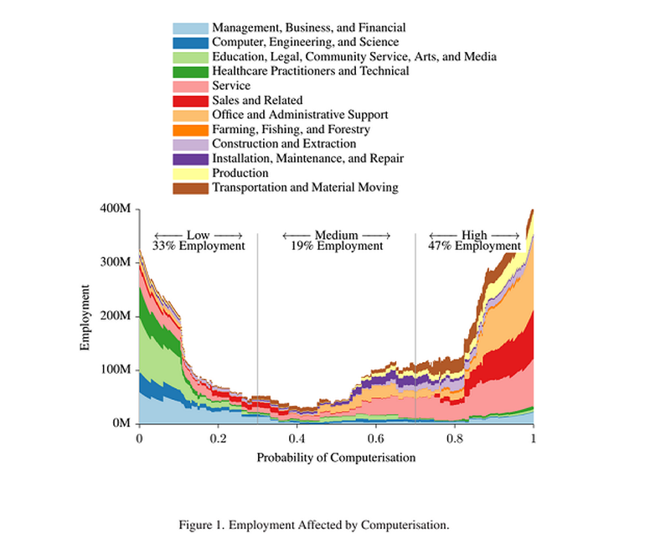
Frey and Osborne (2013) claim that 47 percent of U.S. jobs are at risk of automation.
They identify 3 bottlenecks to automation:
1. Perception and manipulation
2. Creative intelligence
3. Social intelligence

Slide 32
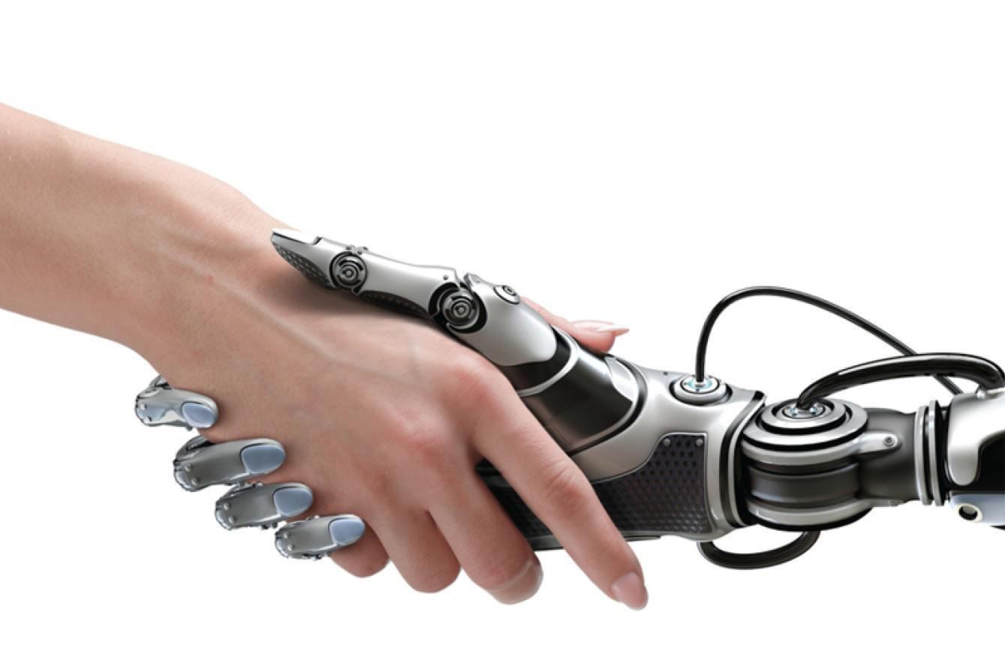
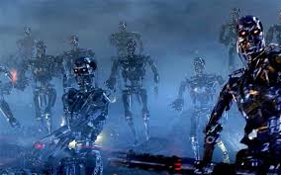
Will robots take all of our jobs?
Or….

Slide 33
“The number of jobs lost to more efficient machines is only part of the problem. What worries many job experts more is that automation may prevent the economy from creating enough new jobs. ... Throughout industry, the trend has been to bigger production with a smaller work force. ... Many of the losses in factory jobs have been countered by an increase in the service industries or in office jobs. But automation is beginning to move in and eliminate office jobs too. ... In the past, new industries hired far more people than those they put out of business. But this is not true of many of today's new industries. ... Today's new industries have comparatively few jobs for the unskilled or semiskilled, just the class of workers whose jobs are being eliminated by automation.”
-”The Automation Jobless”, TIME Magazine, 1961

Slide 34
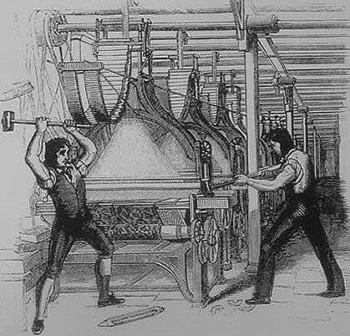
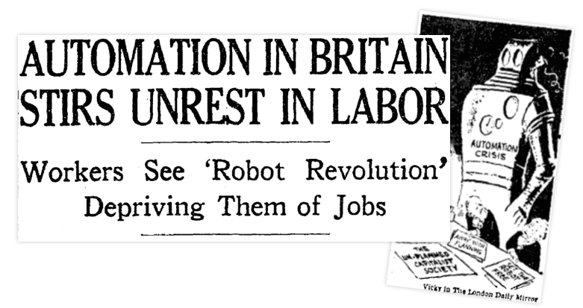
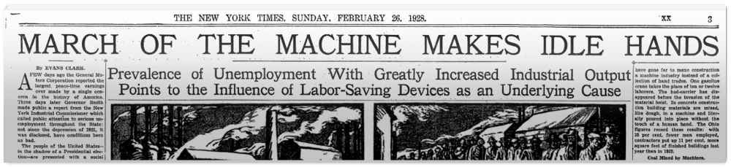
Déjà vu all over again…

Slide 35
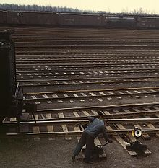
“A pointsman’s back straightened itself upright suddenly against a tramway standard by Mr. Bloom’s window. Couldn’t they invent something automatic so that the wheel itself much handier? Well but that fellow would lose his job then? Well but then another fellow would get a job making the new invention?”
-Leopold Bloom in “Ulysses”, James Joyce, 1922

Slide 36
National Commission on Technology, Automation and Economic Progress
Created by President Lyndon Johnson (1966)
Recommendations
  14 years of free public education
  Regional technical institutes help with economic development
  “Floor under family income”
  Public service employment program
  Relocation assistance for displaced workers
  Computerized job matching system
Sound familiar?

Slide 37
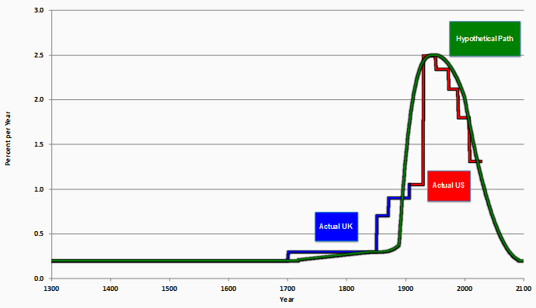
Is economic growth inevitable?
You can see computer age everywhere but in the productivity statistics.”
– Robert Solow, 1987

Slide 38
Gordon – is economic growth over?
First Industrial Revolution (1750-1830) – steam engine, cotton gin
  Growth was halting
Second Industrial Revolution (1870-1900) – the golden age of growth
  Electricity – a general purpose technology
  Transportation - internal combustion engine and motor power
  Health - fresh running water and indoor plumbing
  Communication - telephone, phonograph, motion pictures
  Downstream innovations – machinery, consumer appliances, cars and airplanes, highways, air conditioning….
Third Industrial Revolution (1960-?) – the computer age

Slide 39
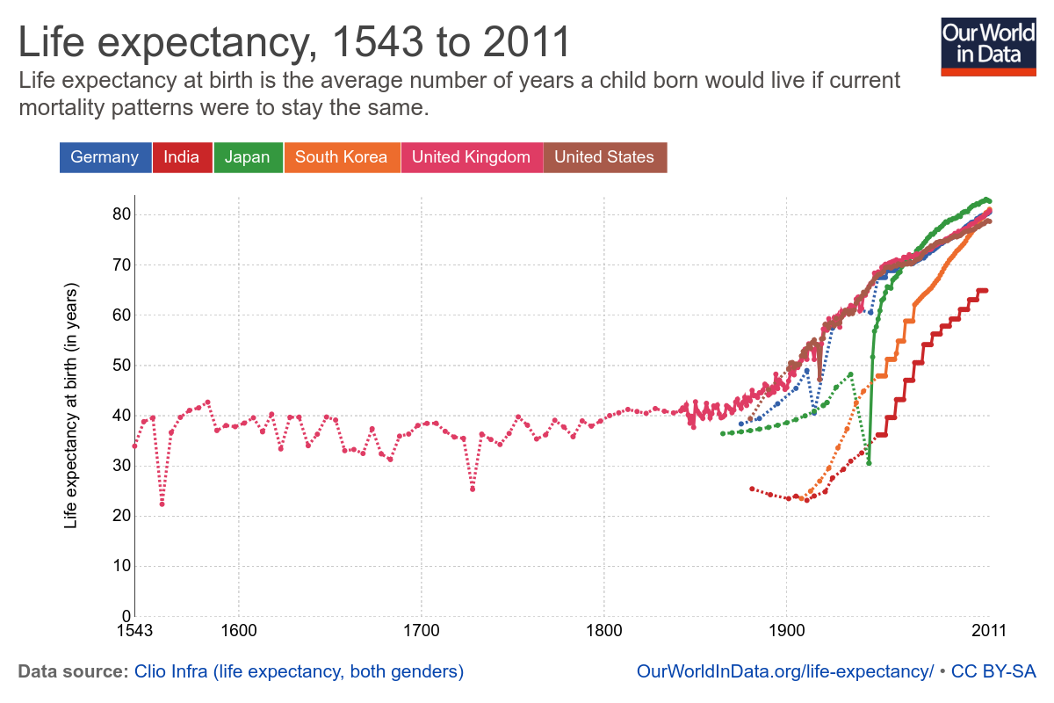

Slide 41
How have computers changed the labor market?
Computers execute procedural, rules-based logic with ruthless efficiency
  Substitute for human labor in such “routine” tasks
Can also make non-routine tasks (and the workers who perform them) more productive
Is this out-of-date, like Levy and Murnane (2004)? Is technology redefining what it means for work to be routine?

Slide 42
In David Autor’s text, he highlights that technology eliminates jobs - not work. This is also seen in the figures. But I am still not sure exactly what kind of work is created from technology? I can see the new jobs - or the shift in importance of different occupational positions. But what specific work has been created by technological development?
Earlier on in the course we learned that the wages to high paying jobs have increased drastically in the past, but based on the David Autor article it seems that that is not the case. In particular, figure 4 shows that wage growth has been the largest for low skilled jobs in the most recent period that they study (2007-12).
Why doesn’t automation decrease the share of low-skill occupations when it’s decreasing the share of middle-skill occupations? Can’t manual tasks of low-skill occupations easily be replaced by machines?

Slide 45
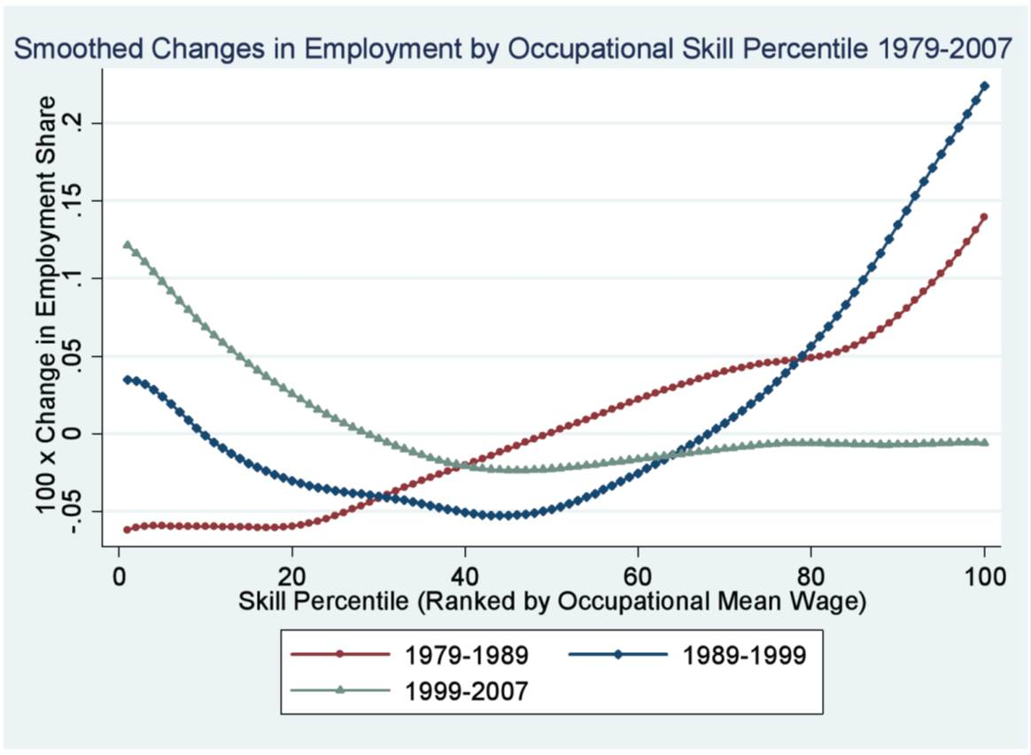
Source: Acemoglu and Autor (2012)

Slide 46
U.S. Employment Growth in high-skilled occupations, 2000-2012

Slide 47
U.S. Employment Growth in high-skilled occupations, 2000-2012

Slide 50
The growing importance of social skills
Employment and wage growth since 1980 in social-skill intensive occupations
  Slower growth for STEM jobs
Lower down the income distribution, service jobs are growing as well
Why are people jobs (and people skills) more important than ever?

Slide 51
Where do these social skills come from? Is it early interaction with others? Is it something else? Why do women excel at social perceptiveness over men?
Has there been any research done investigating the development of social skills. Particularly, can social skills be taught or learned through experience at any point in our lives or are they learned early on in our lives and they stay pretty much constant?
Given that the returns to social skills are increasing, how can we restructure the educational system to maximize emotional intelligence?
Is it possible to re-train workers who have lost their jobs to have more of the social skills discussed in “Why What You Learned in Pre-School is Crucial at Work?” It seems like most of the opportunities that were mentioned to teach those skills are for young kids– but could it be incorporated into re-training programs?
In your paper on social skills in the labor market, you modeled social skill as reducing worker-specific cost of coordination or trading tasks with others - is there another way of modeling social skills? If so, what are the trade-offs in how we measure/model social skills?

Slide 52
Polanyi’s Paradox – “we know more than we can tell”
Also called Moravec’s Paradox
  Interpersonal interaction and sensorimotor coordination have evolved over thousands of years
  Calculus and formal logical reasoning much more recent
Environmental control
  (Re)define the problem space to something more manageable, and humans do the rest
  Roads and railroad tracks; Kiva; airline pilots and automation
Machine learning
  Inductive reasoning based on human judgment and “ground truth”
  Can machine learning techniques simulate intuitive skills like conversation, common sense and creativity?
“Ultimately, what makes an object a chair is that it is purpose-built for a human being to sit upon. Machine-learning algorithms may have fundamental problems with reasoning about “purposiveness” and intended uses….One is reminded of Carl Sagan’s (1980, p. 218) remark, “If you wish to make an apple pie from scratch, you must first invent the universe.”

Slide 53
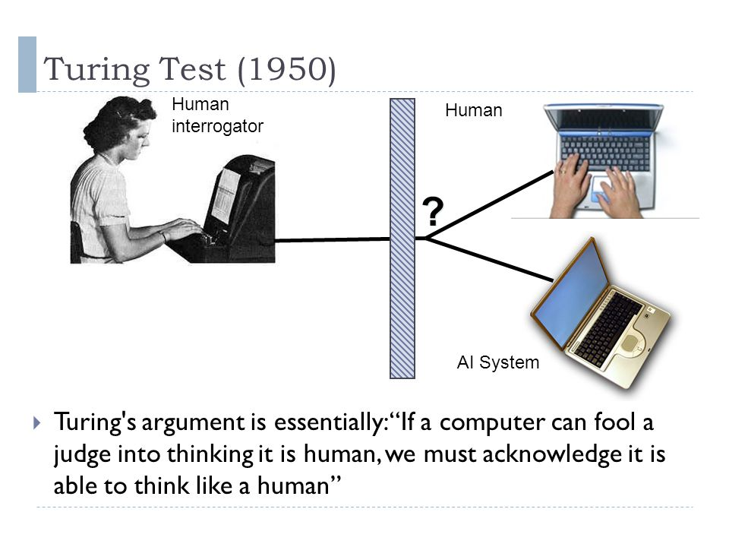
Gary Marcus on the failure of the Turing test:
“the winners aren’t genuinely intelligent...It has turned out, in fact, that the winners tend to use bluster and misdirection far more than anything approximating true intelligence.”

Slide 54
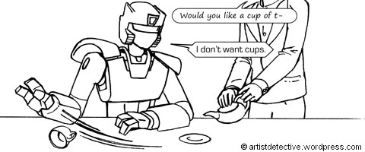
The elusive definition of “common sense”…
Can an alligator run the 100 meter hurdles?

Slide 55
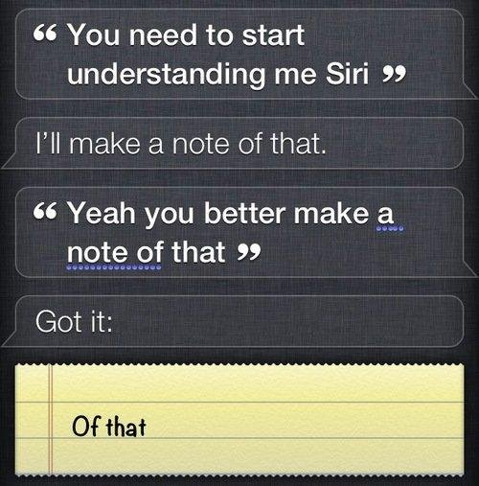

Slide 56
The Winograd schemas
Statements that are:
  Easily disambiguated by the reader (i.e. common sense)
  Not solvable through logical restrictions (if-then statements)
  “google-proof”
The town counselors refused to give the angry demonstrators a permit because they feared (advocated) violence. Who feared (advocated) violence?
Joan made sure to thank Susan for all the help she had given (received). Who had given (received) the help?
$25,000 prize to programmers that can achieve 90 percent accuracy
  Highest score in 2016 was 58 percent (on a/b questions!)

Slide 57
Can social interaction be automated?
Requires theory of mind - the ability to attribute mental states to others based on their behavior, or more colloquially to “put oneself into another’s shoes”

Slide 58
Can social interaction be automated?
Scientists are working on building empathetic robots that can recognize and respond to human emotion
Yet this is an impoverished theory of mind
  We search our own minds for clues about the motivations of others
  Empathy, judgment, common sense and creativity– all require shared understanding
  They specifically require us to think like other humans

Slide 59
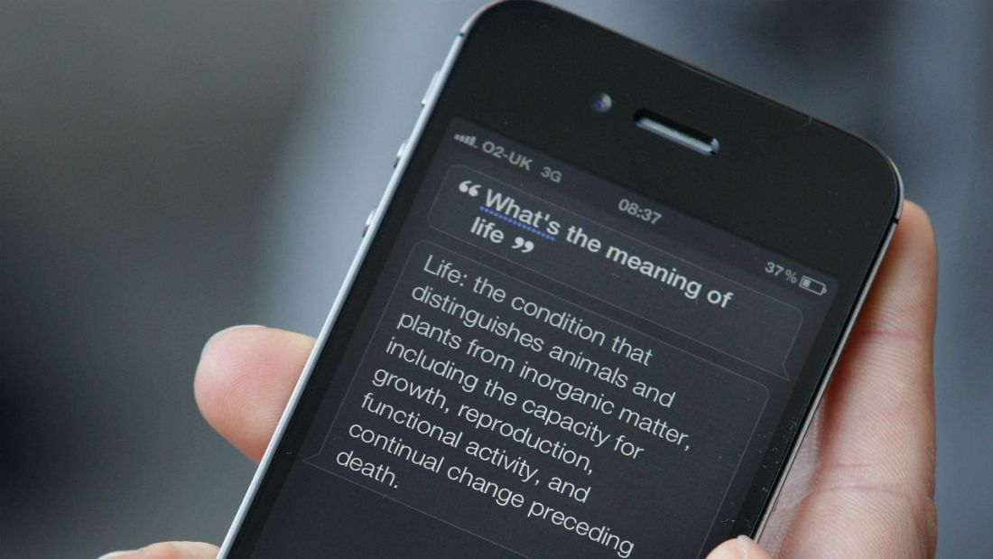

Slide 60
How can modern welfare states be sustained/financed with growing automation of jobs?
Do you think that automation of jobs will actually cause citizens to not work or do you simply think our role in society will change in response. What areas of work life and leisure do you see as growing as a result of technology?
The article discusses the various ways lives may structure themselves to keep busy when jobs are no longer the primary form of social organization. However, the article does not talk about how these lives will be funded. Will we see a basic income? Will we become a feudal society again? Working in the services of the wealthy few? Or will there be a new form of social organization we cannot imagine?
The idea of a “robot dividend” is remarkable - sending dividends to humans for the productivity and work automation and digitization could bring. If the purpose of technology is to make things more efficient and bring society as a whole up, despite the winners and losers, it follow that the winners could compensate the losers and everyone could be better off. Why does this not happen more often - with trade, education, inequality - anything?
Would taxing the productivity of robots/software be able to finance an unconditional basic income?

Slide 61
A world without work?
Thompson (2015) asks - what happens to society if work disappears?
  My answer – it already has
  Most of our jobs are not strictly necessary for survival
  The issue is when some types of work – and some types of people – are displaced more than others
Work provides a source of income, but the best jobs also provide meaning
  Leisure, unemployment and social isolation
  Knowledge work is fundamentally social and interpretive
Katz (2014) - the “new artisans”
  Production and consumption of artisanal products is not purely instrumental; it involves meaning
Might the disappearance of production jobs foster creativity and entrepreneurship?

Slide 62
Universal Basic Income (UBI)
No-strings-attached cash – for every citizen
Has been proposed as a solution to technological unemployment
How expensive? Paying for a basic income of X% of national income requires taxes to be X percentage points higher (Tobin, 1970)
  U.S. GNI per capita was $54,960 in 2015
  All else equal, a UBI of $10,992 (20% of GNI) would require a uniform tax increase of 20 percentage points
  Estimated social security + welfare (fed/state/local) = $4,451 per capita
  $10,992 UBI would require a 12 percentage point tax increase, if you zero out all other non-health spending
Universal Basic Income in the US and Advanced Countries

Slide 63
How might UBI affect labor markets?
Is UBI efficient?
  Yes, in the sense that it is unconditional - encourages work relative to other forms of social assistance like UI
  No, in the sense that it is unconditional – most people probably don’t need it
Arguments for UBI usually involve efficiency, transparency and fairness
  Alaska Permanent Fund
  A “robot dividend”
But this stands in direct contrast with the “robot apocalypse” argument
UBI might encourage risk-taking by turning ordinary people into “job creators”
  Freedom to pursue risky endeavors and passion projects
  Employers also have more freedom to let you go….

Slide 64
What is the best advice one can give to a friend or family member whose job is at risk of being made defunct by automation?
What is society’s biggest misunderstanding about inequality? What can be done to better inform public perception?
If you were POTUS, with a majority in each legislative chamber, what would your first 100 days look like? What policies would you prioritize?
If you were sitting in our seats as a student, what do you know now that you would want to tell your past self?

Slide 65
Summing up
Technological progress is inexorable, and disruptive
Is this time different? Usually not. Until, it is.
Recent labor market trends are a product of the combination of technological change and inequality.
  In other words, computerization increased inequality because of how it interacted with our social institutions. This was not inevitable, nor will it be in the future.
I choose to believe – perhaps without much evidence – that a world where jobs (and schools) evolve to favor empathy and meaning is a better world - for us, and for our children.
Robots don’t vote.

