Slide 1
Inequality in the U.S. and around the World
David J. Deming
SUP-206, Fall 2019

Slide 2
The Plan
Inequality and human welfare in (very) long-run perspective
Wage/income inequality in the recent past
The top 1 percent
Measuring inequality within and across countries

Slide 3
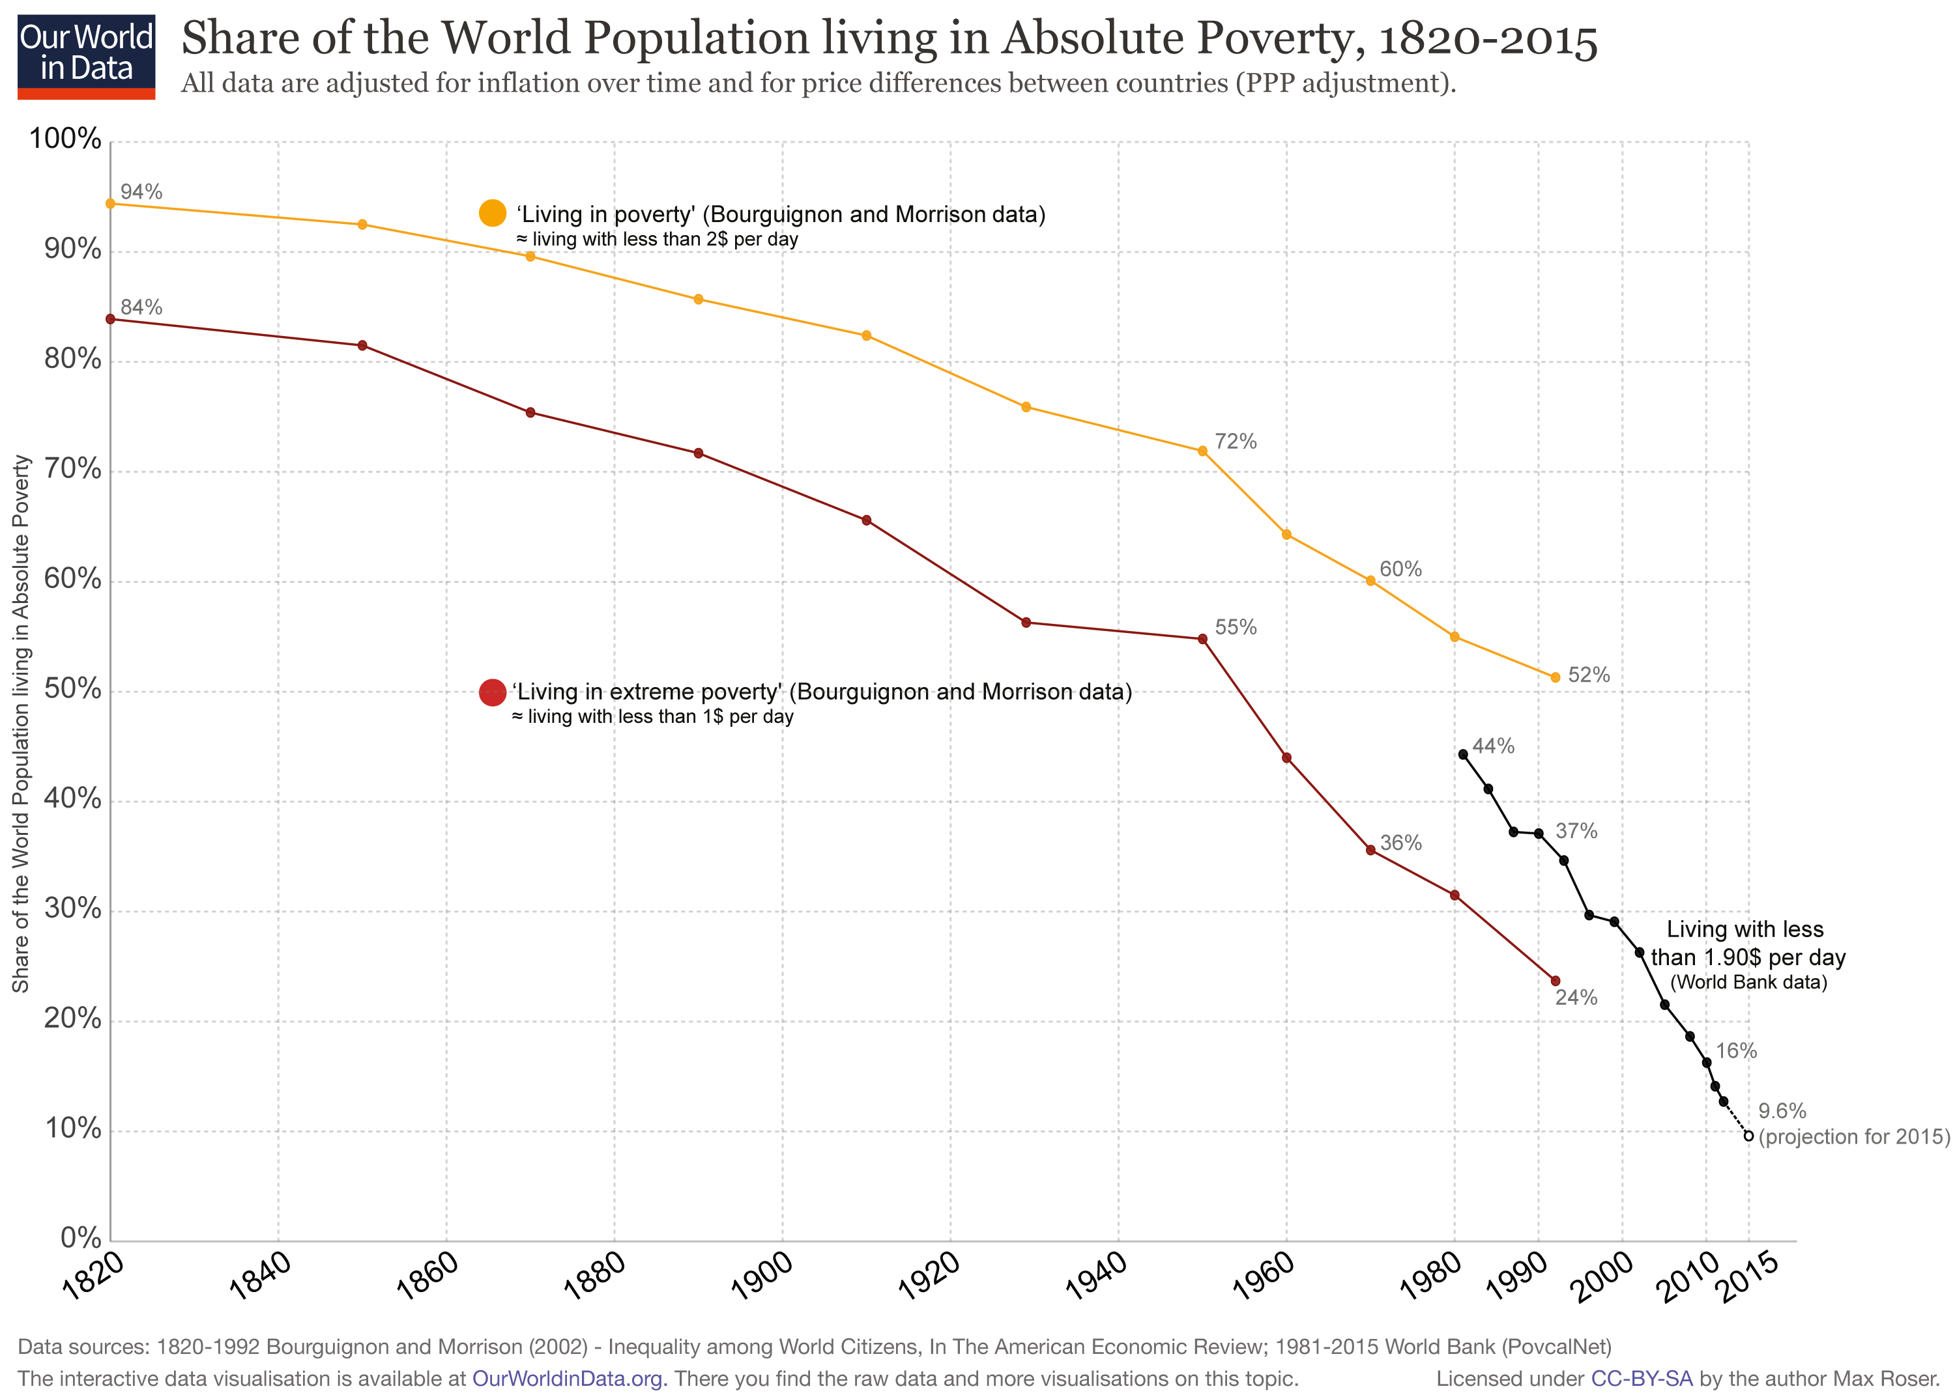

Slide 4
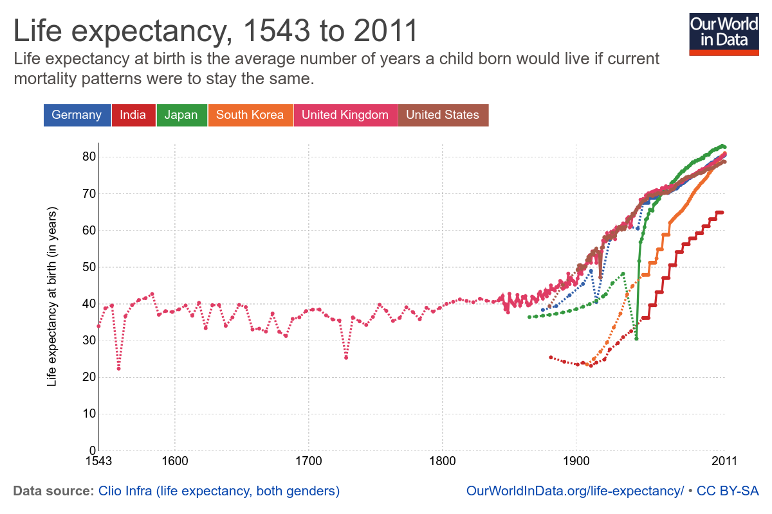

Slide 5
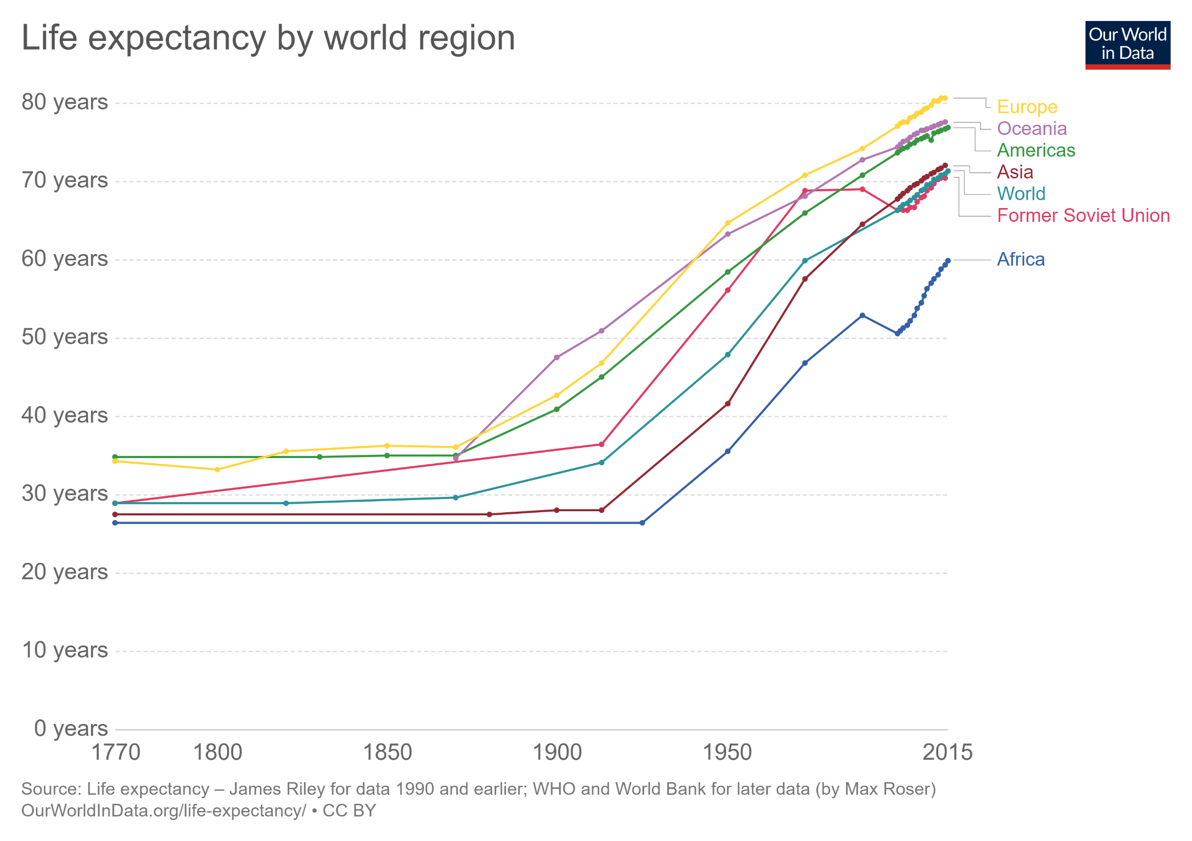

Slide 6
Breaking free from the Malthusian Trap
“The power of population is so superior to the power in the earth to produce subsistence for man, that premature death must in some shape or other visit the human race.”
“The perpetual tendency of the race of man to increase beyond the means of subsistence is one of the general laws of animated nature, which we can have no reason to expect to change.”
– Thomas Malthus, “An Essay on the Principle of Population”, 1798.
For most of human history, Malthus was right. But something changed about 250 years ago…

Slide 7
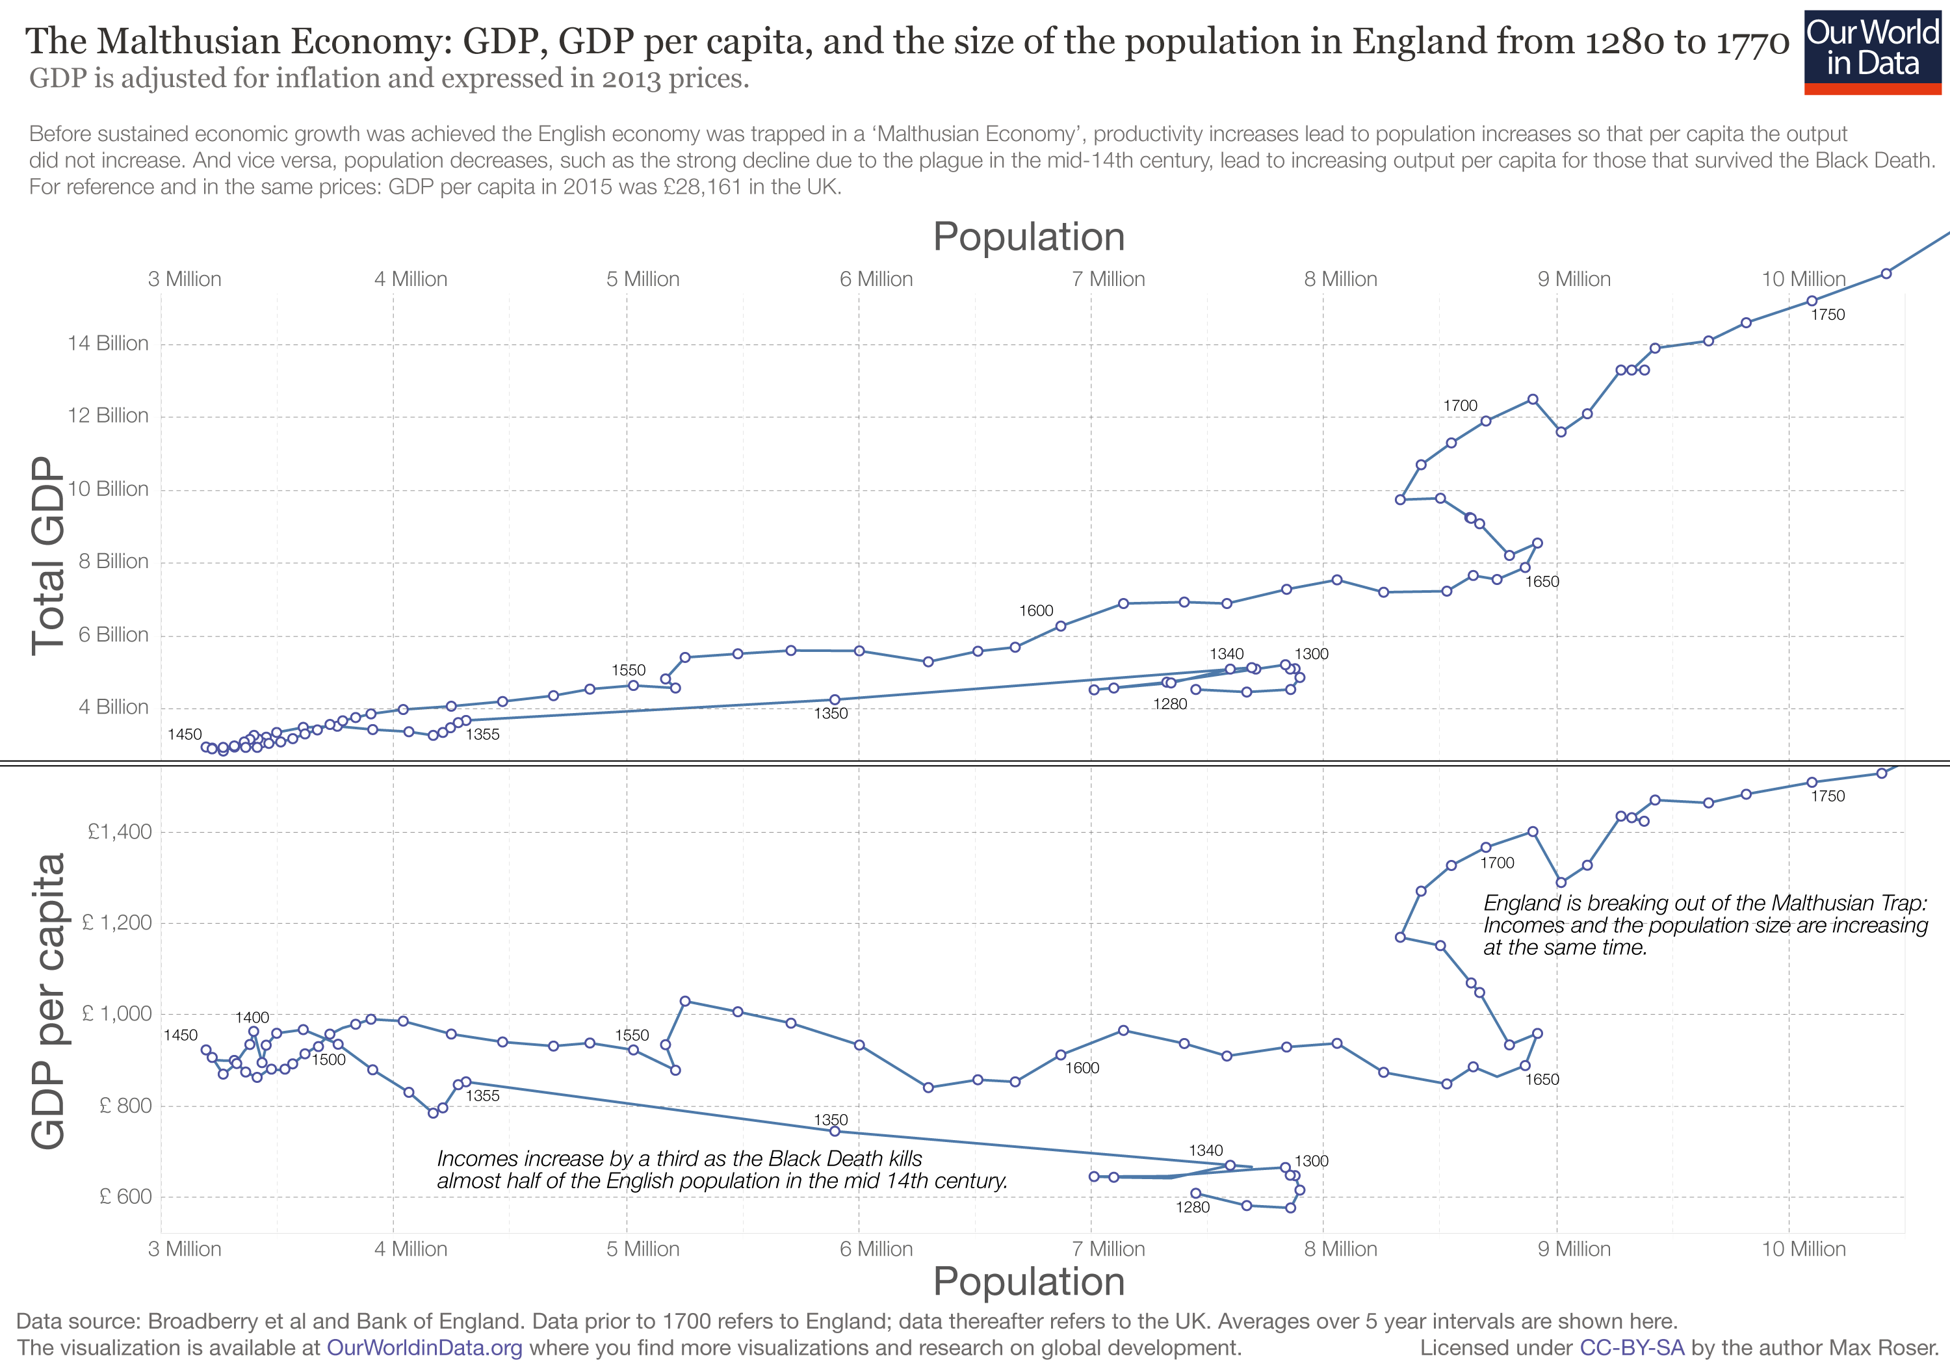

Slide 8
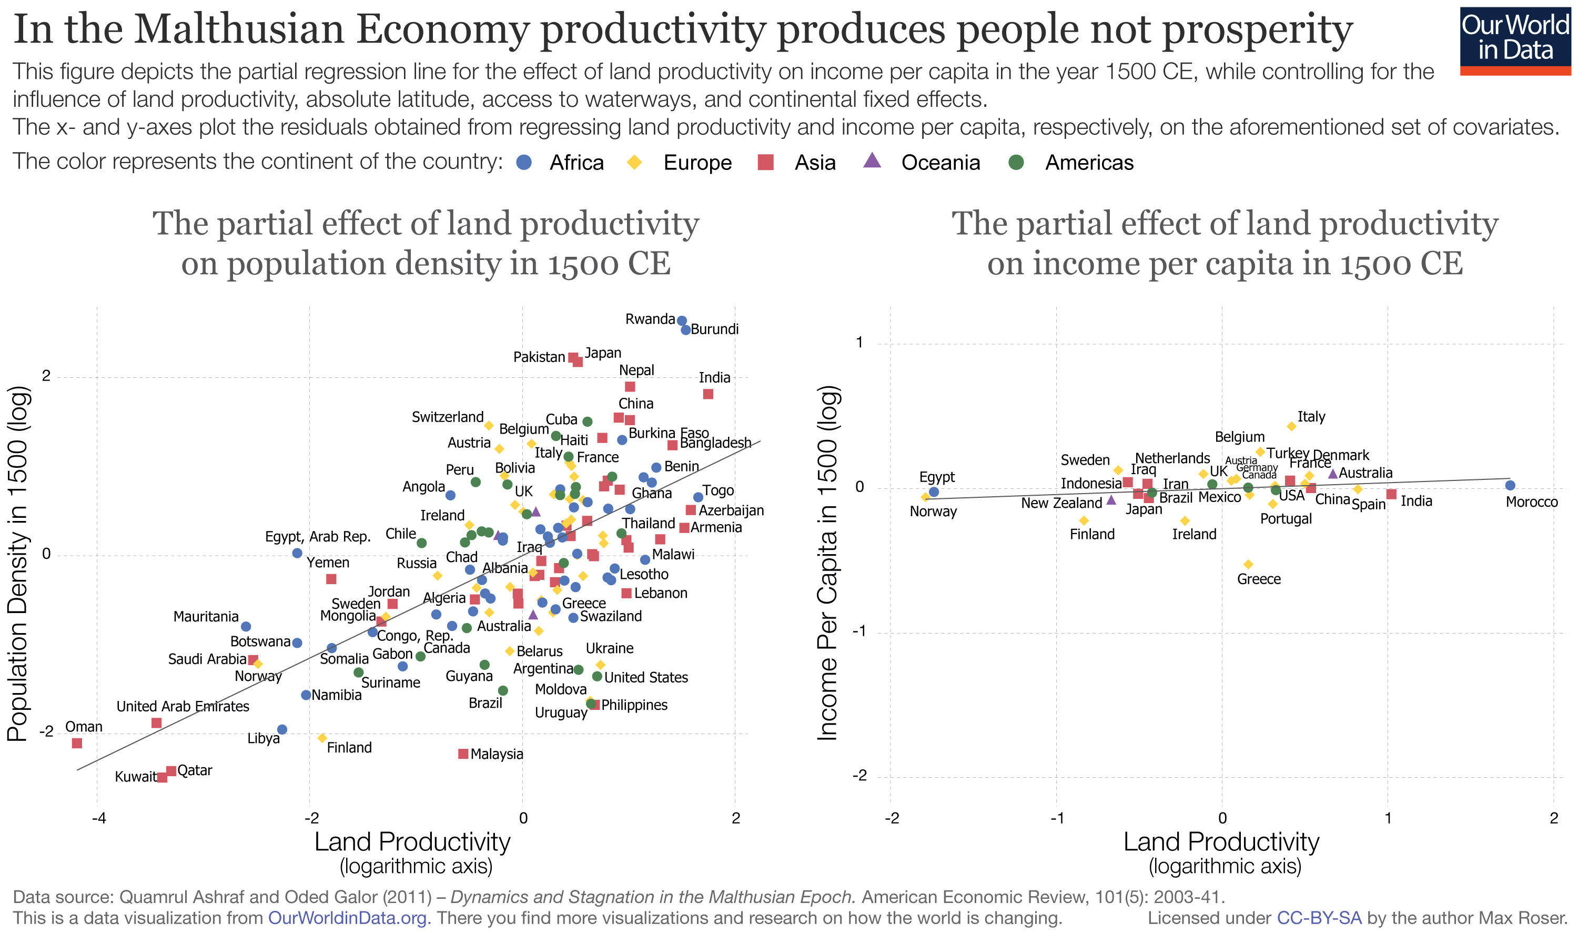

Slide 9
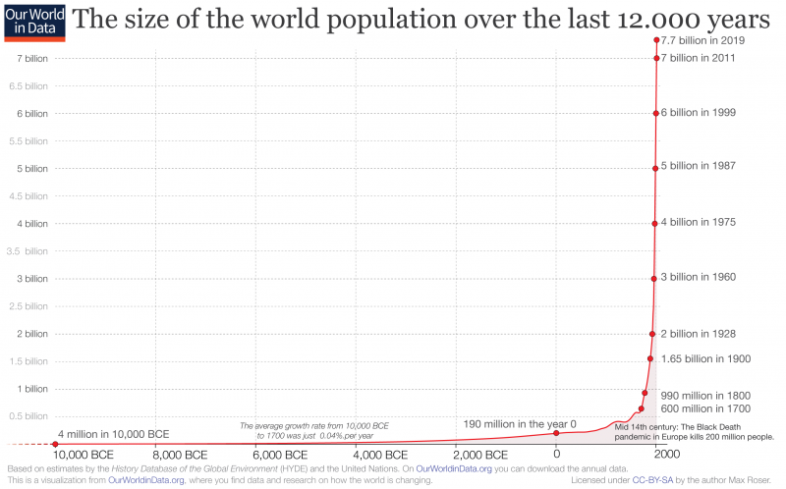

Slide 10
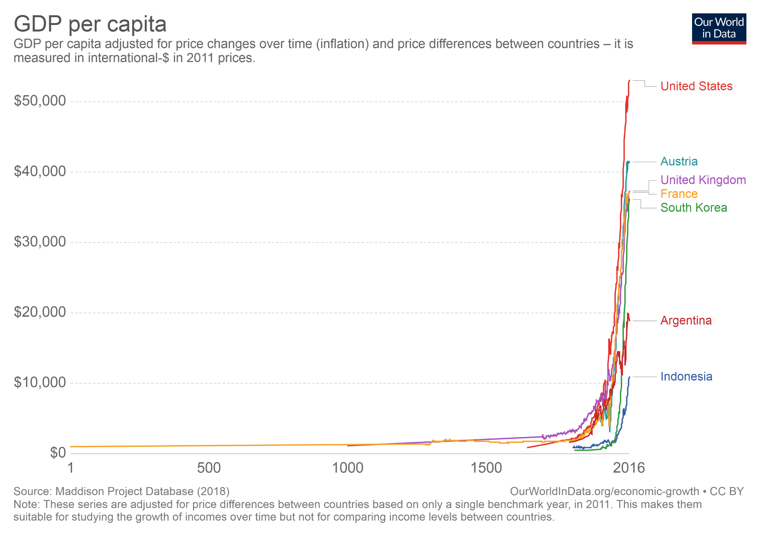

Slide 11
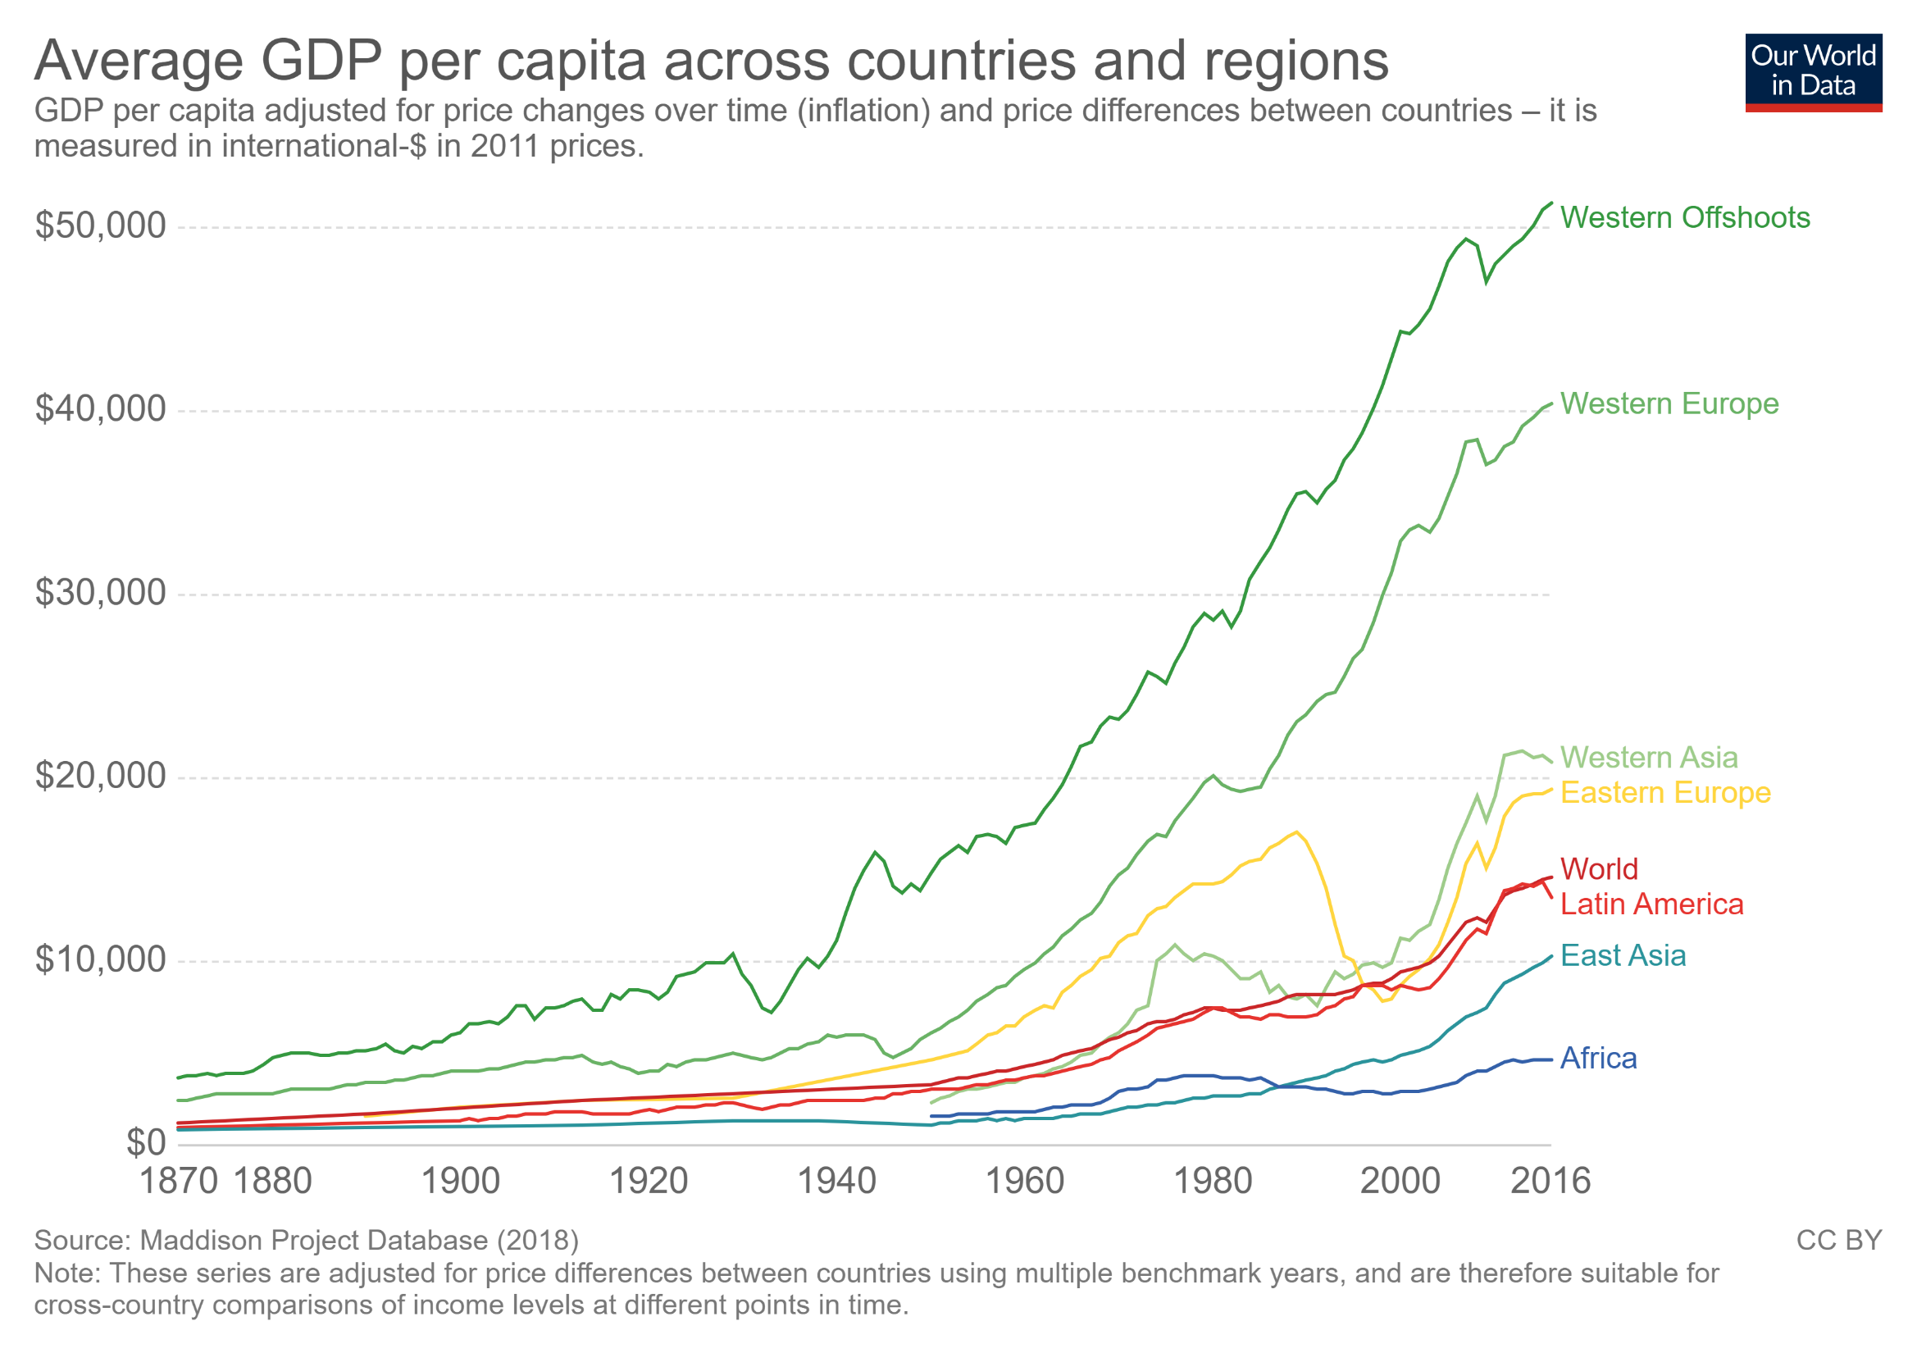

Slide 12
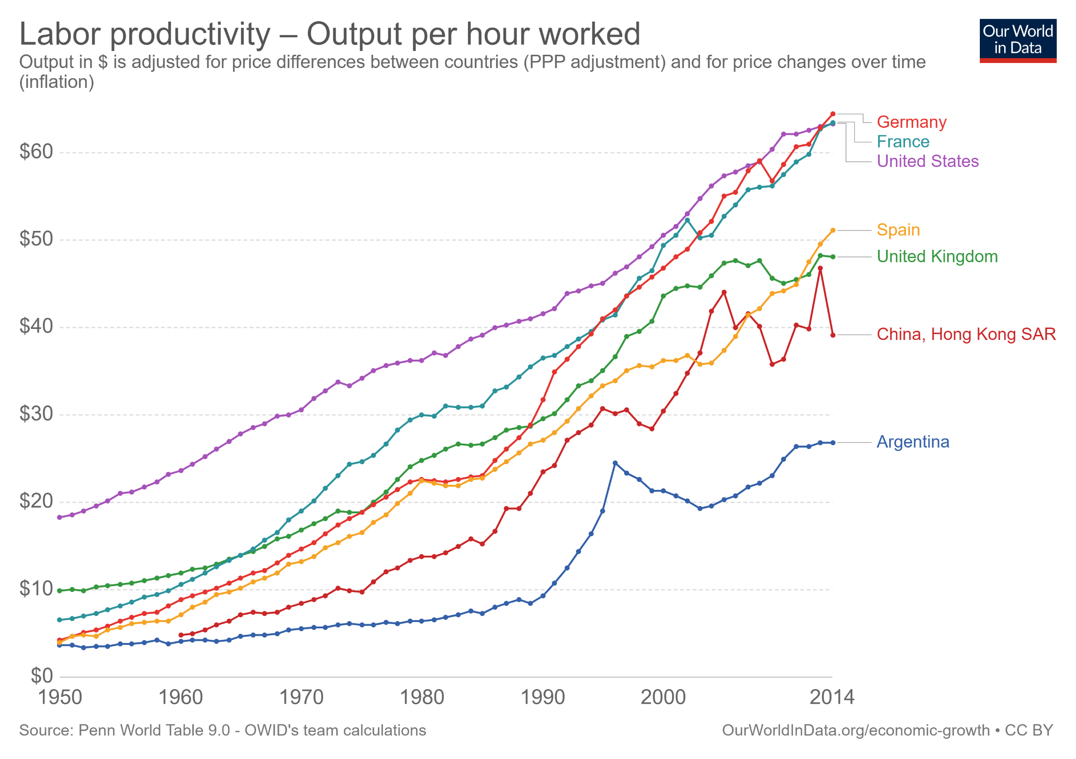

Slide 13
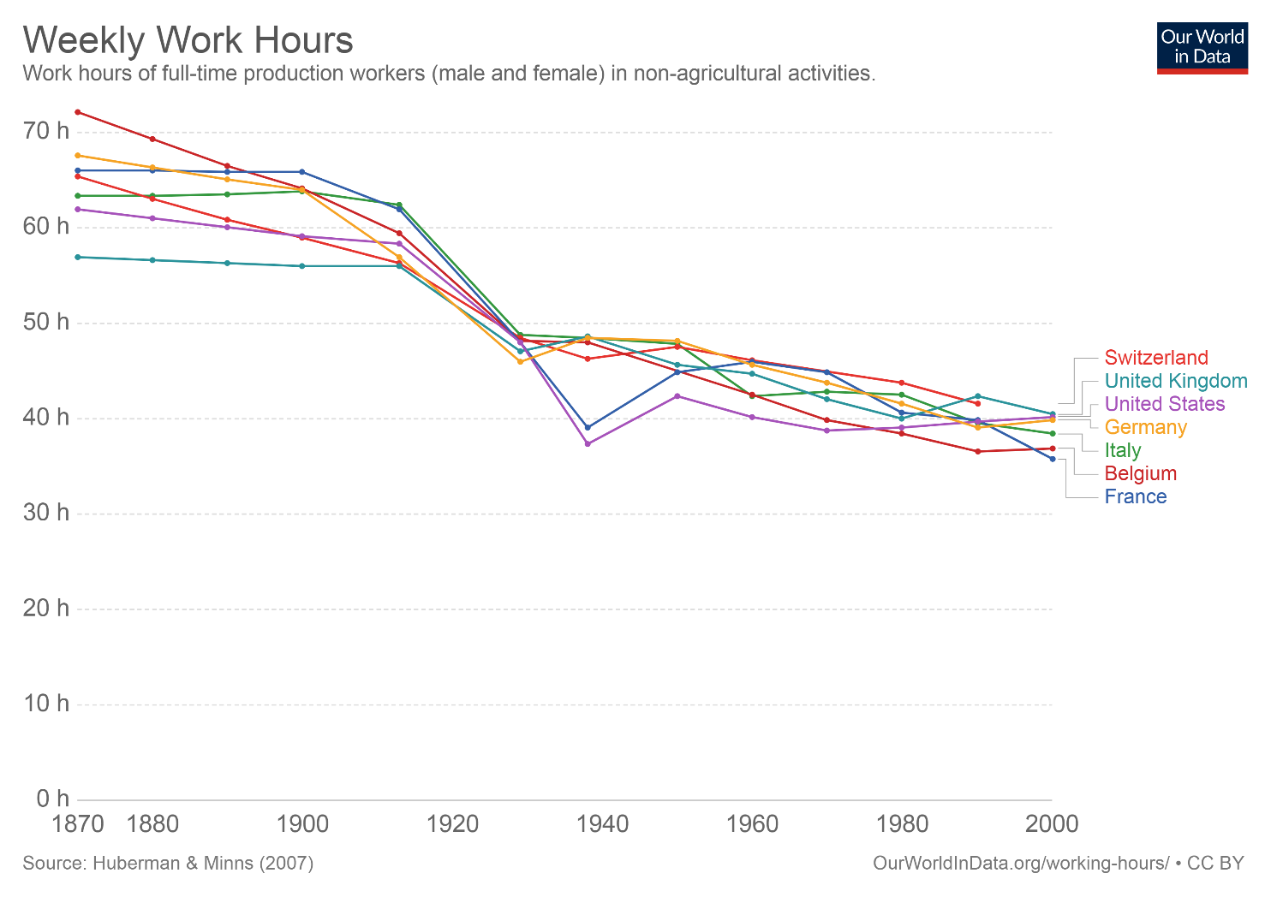

Slide 14
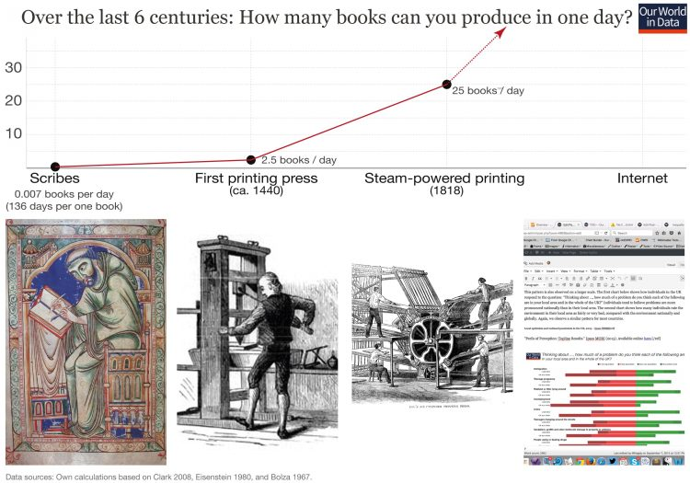

Slide 15
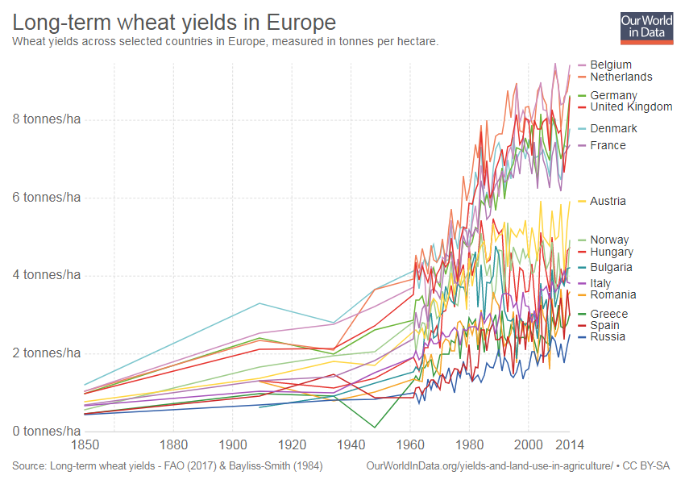

Slide 16
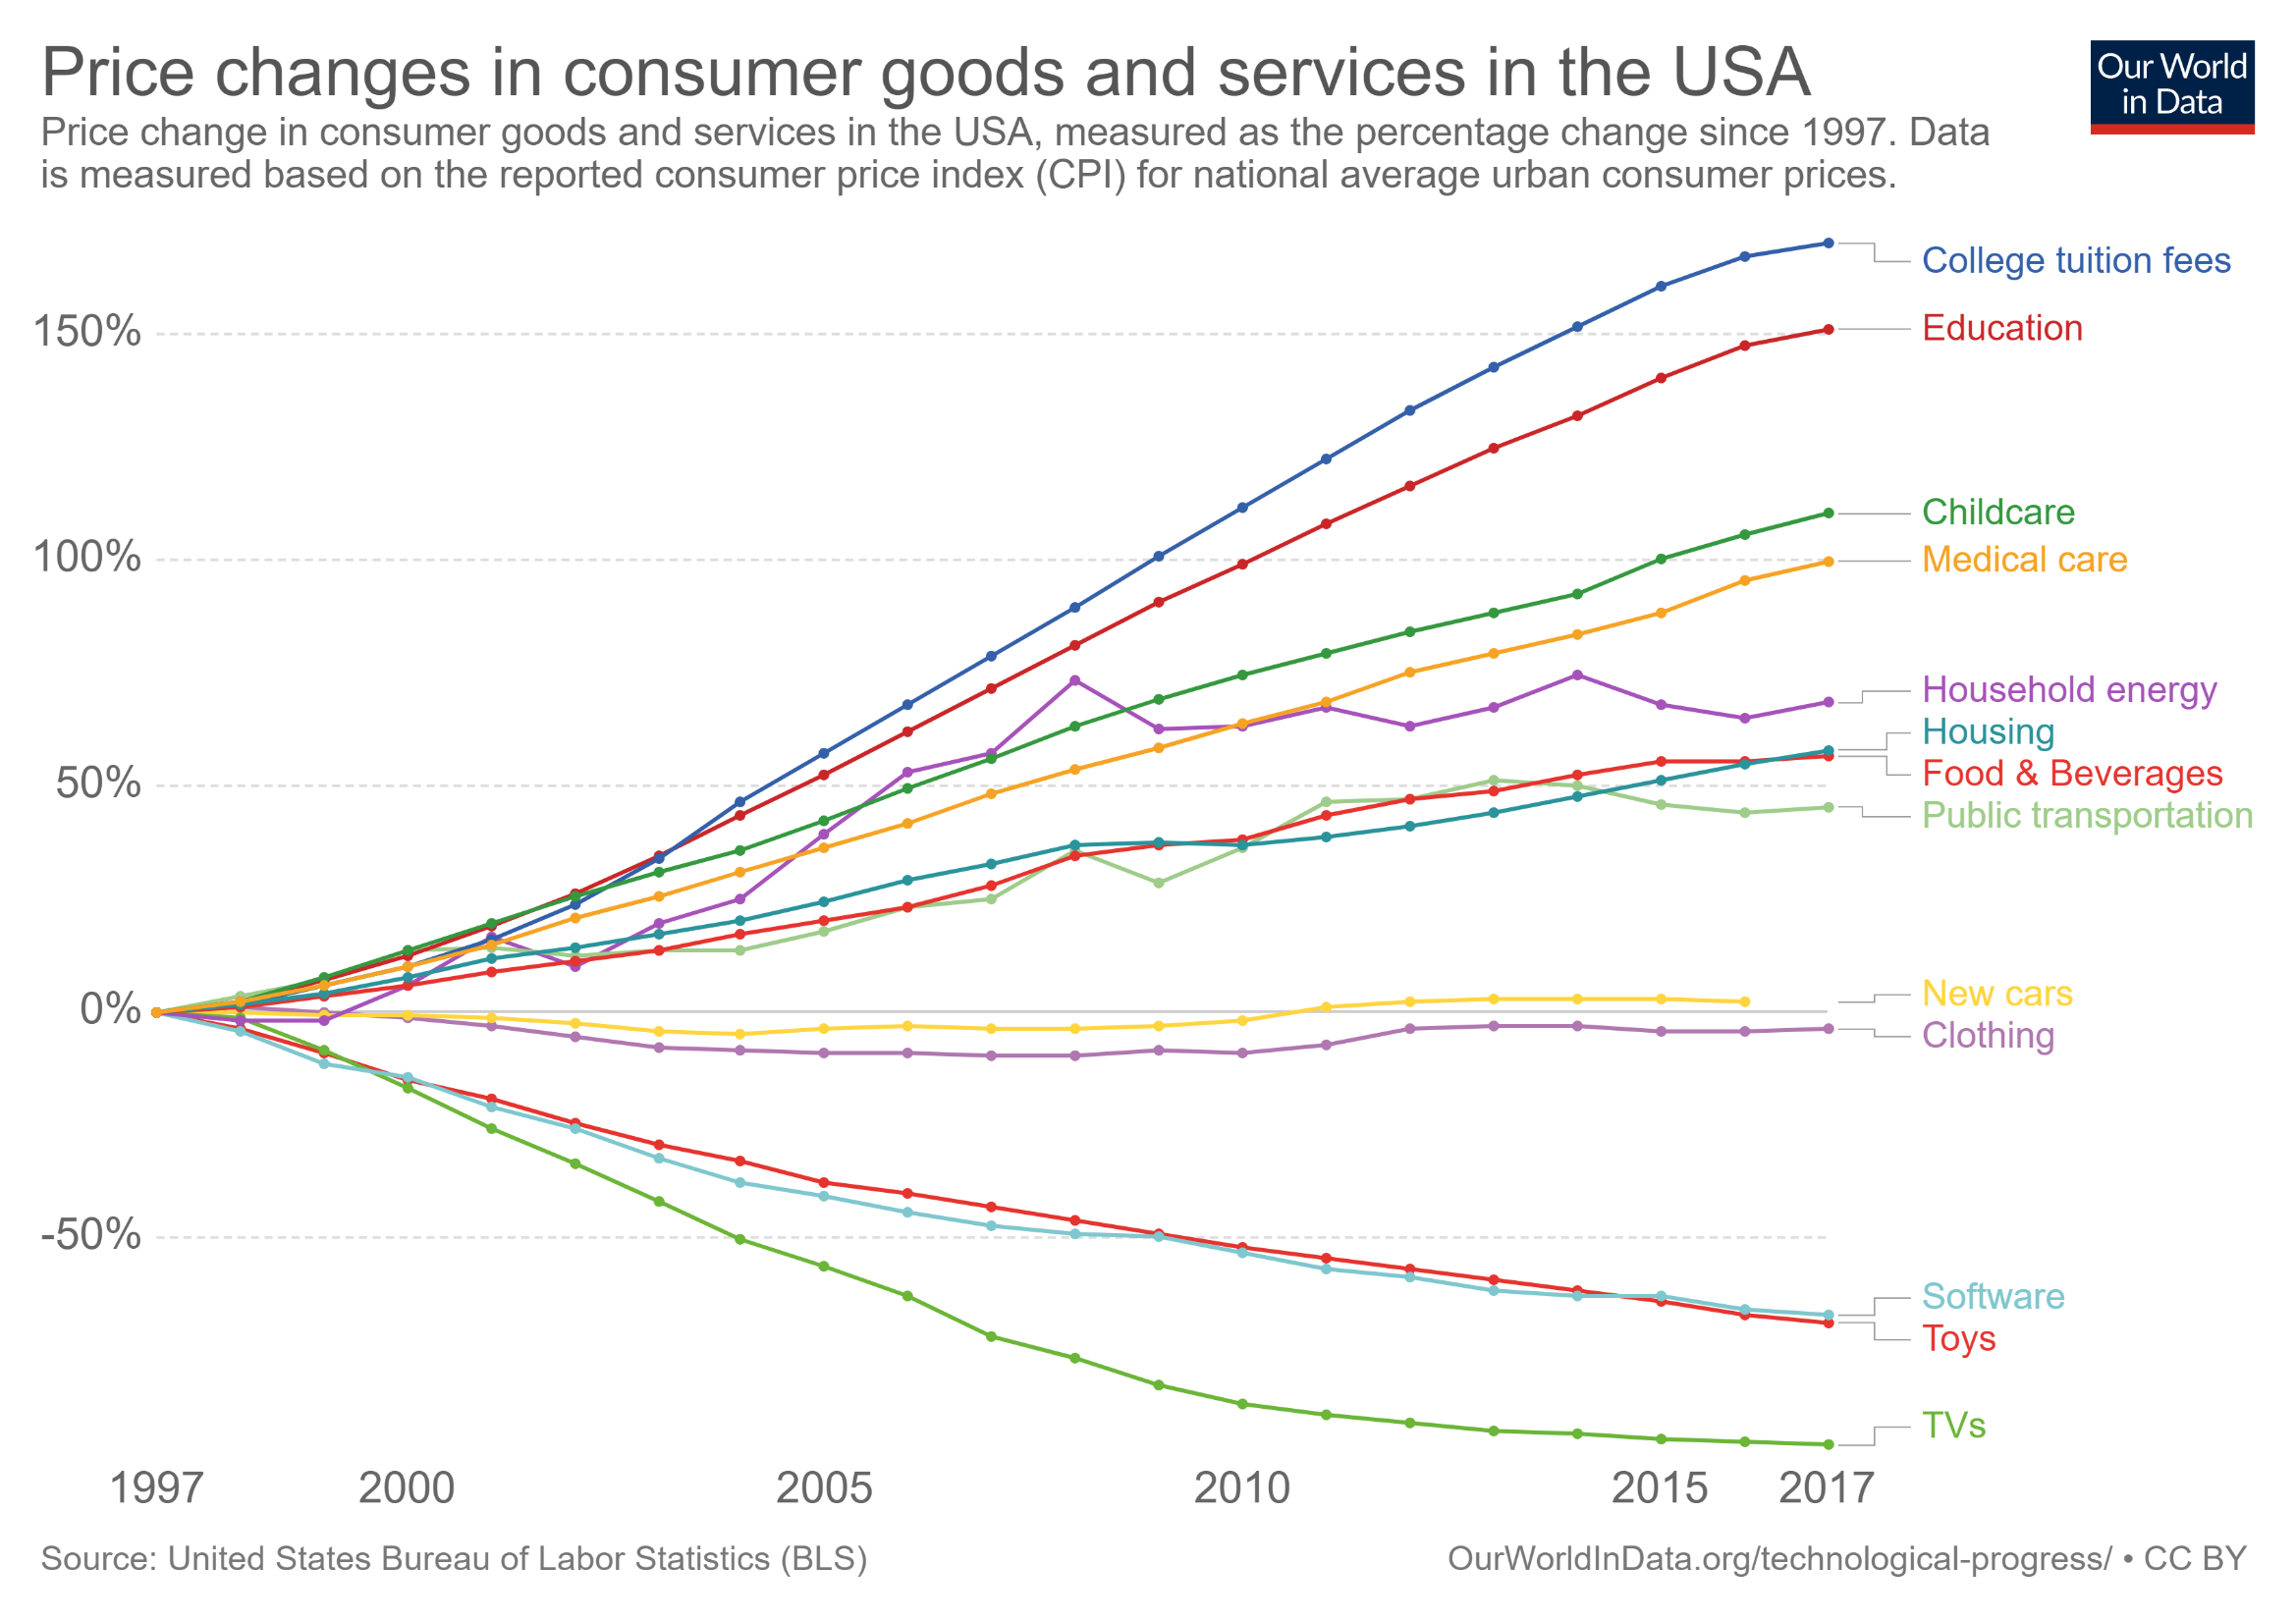

Slide 17
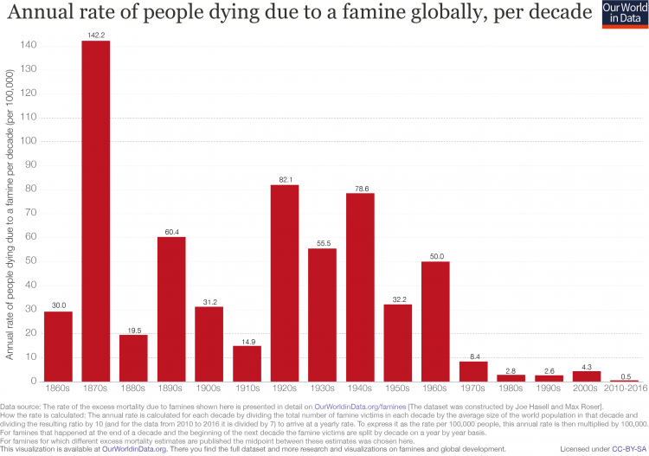

Slide 18
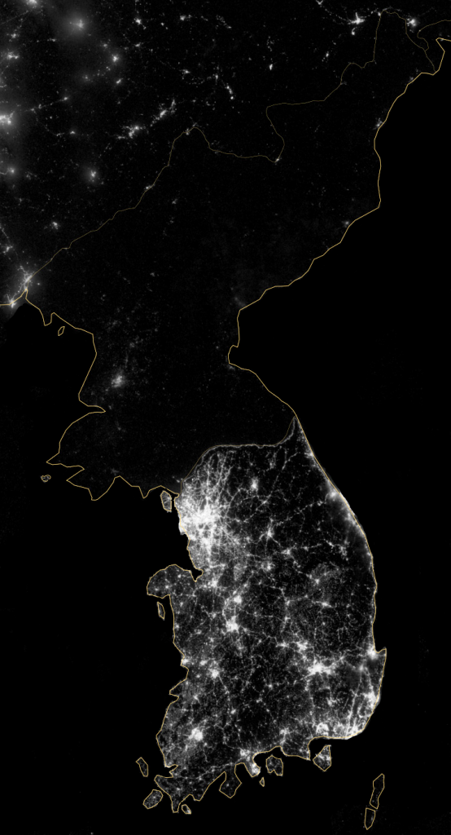
What is this image?

Slide 19
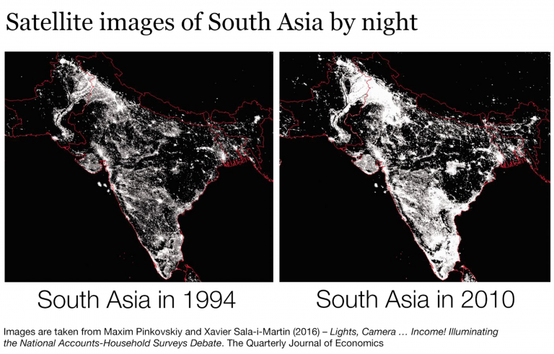

Slide 20
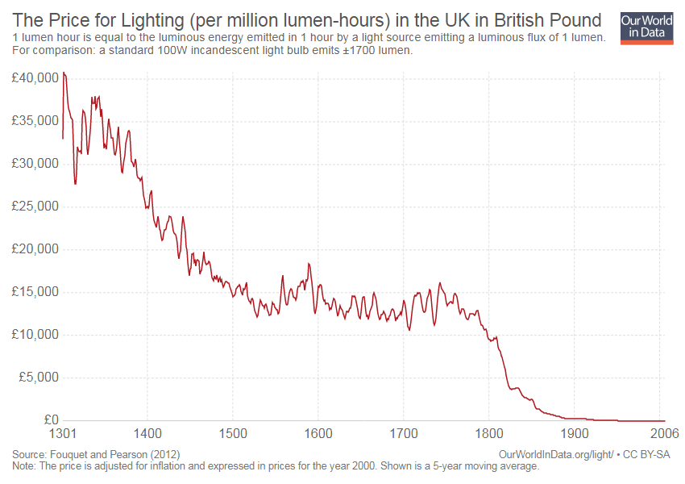

Slide 21
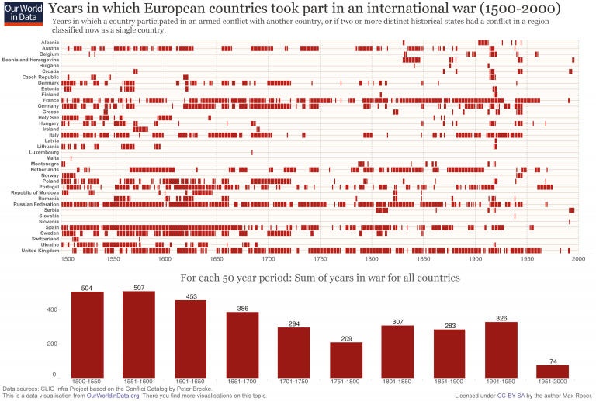

Slide 22
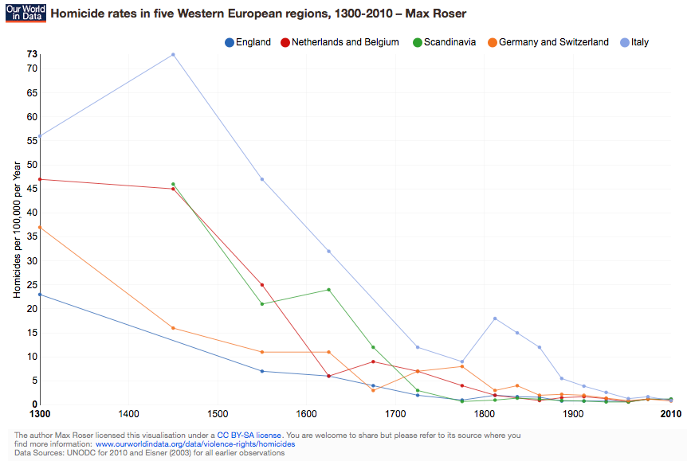

Slide 23
Inequality and Growth in Recent History

Slide 24
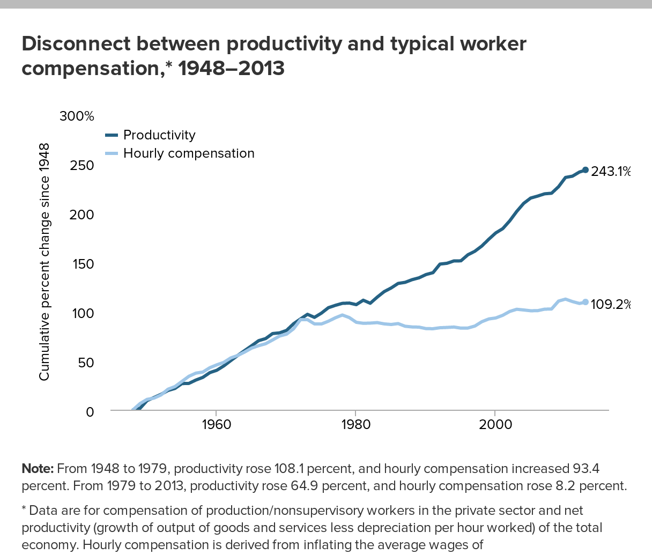

Slide 26
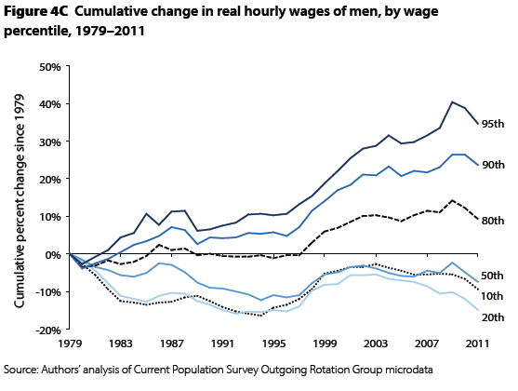
Source: Mishel et al (2012)

Slide 27
Source: Mishel et al (2012)

Slide 28
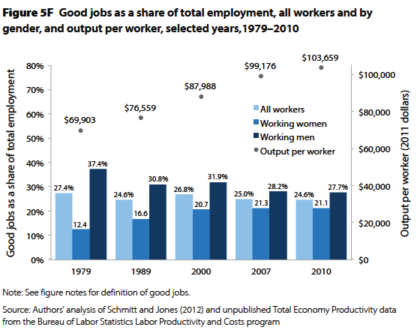
Source: Mishel et al (2012).
“Good job” is $18.50/hr, health and retirement benefits.

Slide 29
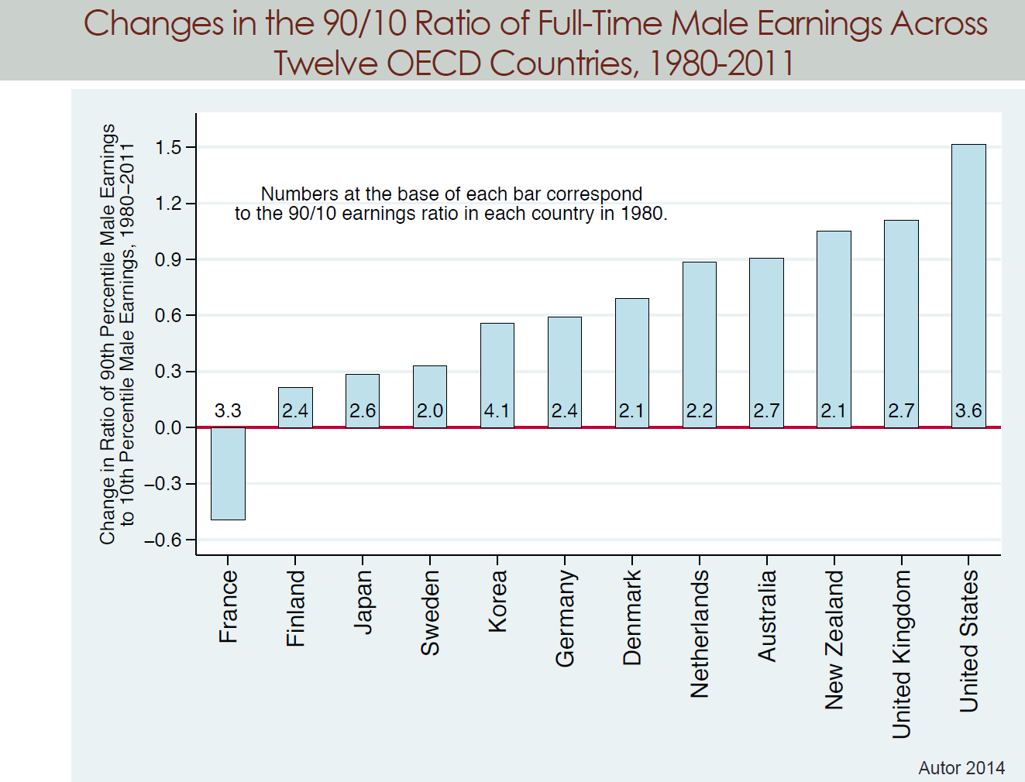

Slide 30
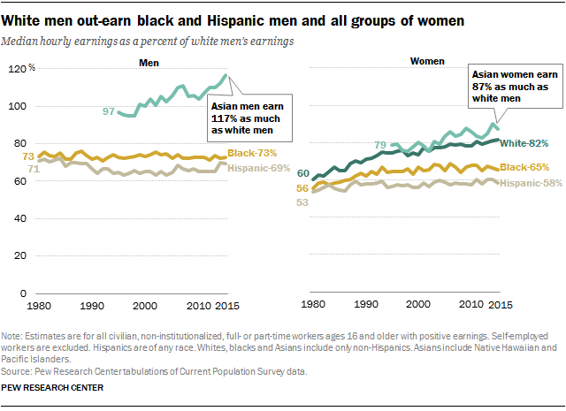

Slide 31
Source: Mishel et al (2012)

Slide 32
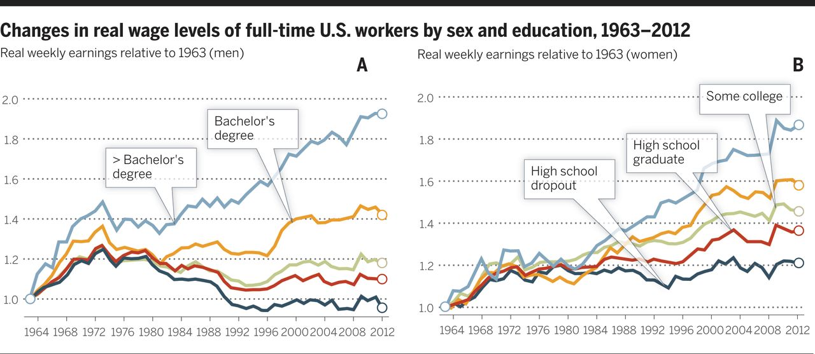

Fig. 6 Change in real wage levels of full-time workers by education, 1963–2012.
David H. Autor Science 2014;344:843-851
Published by AAAS
Notes:
Change in real wage levels of full-time workers by education, 1963–2012. (A) Male workers, (B) female workers. Data and sample construction are as in Fig. 3.

Slide 33
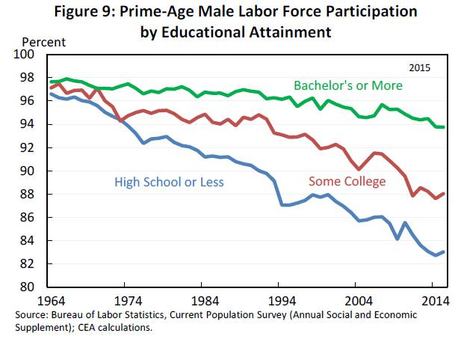

Slide 34
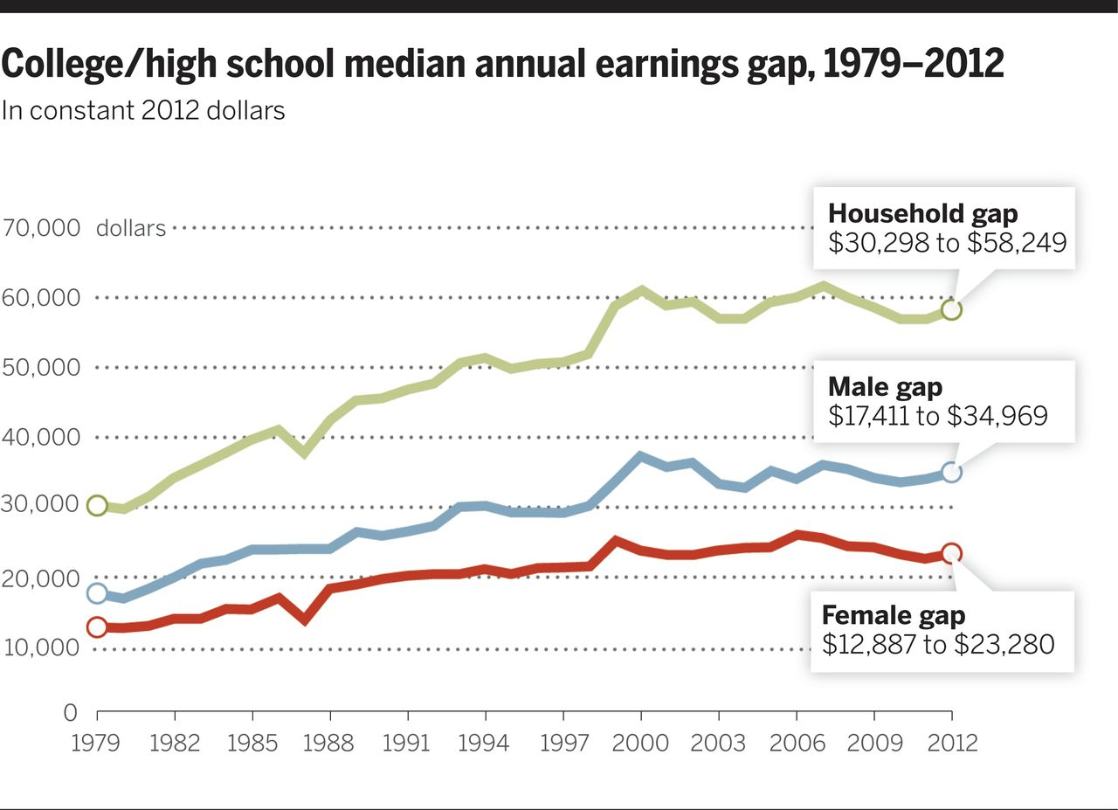
Fig. 1 College/high school median annual earnings gap, 1979–2012.
David H. Autor Science 2014;344:843-851
Published by AAAS
Notes:
College/high school median annual earnings gap, 1979–2012. Figure is constructed using Census Bureau P-60 (1979–1991) and P-25 (1992–2012) tabulations of median earnings of full-time, full-year workers by educational level and converted to constant 2012 dollars (to account for inflation) using the CPI-U-RS price series. Prior to 1992, college-educated workers are defined as those with 16 or more years of completed schooling, and high school–educated workers are those with exactly 12 years of completed schooling. After 1991, college-educated workers are those who report completing at least 4 years of college, and high school–educated workers are those who report having completed a high school diploma or GED credential.

Slide 35
Wage inequality
A global phenomenon
  Widening gaps in employment and LFP, job quality
Racial gaps large, but constant
Striking gender differences – inequality growing much more for men
Tremendous growth in wage inequality by education
Is this what you expected to see?

Slide 39
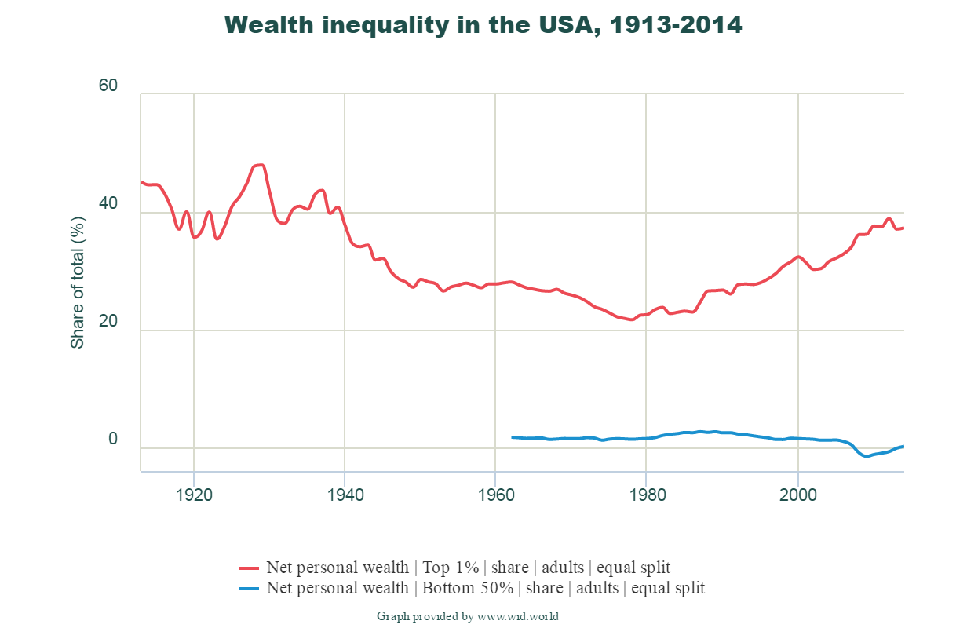

Slide 40
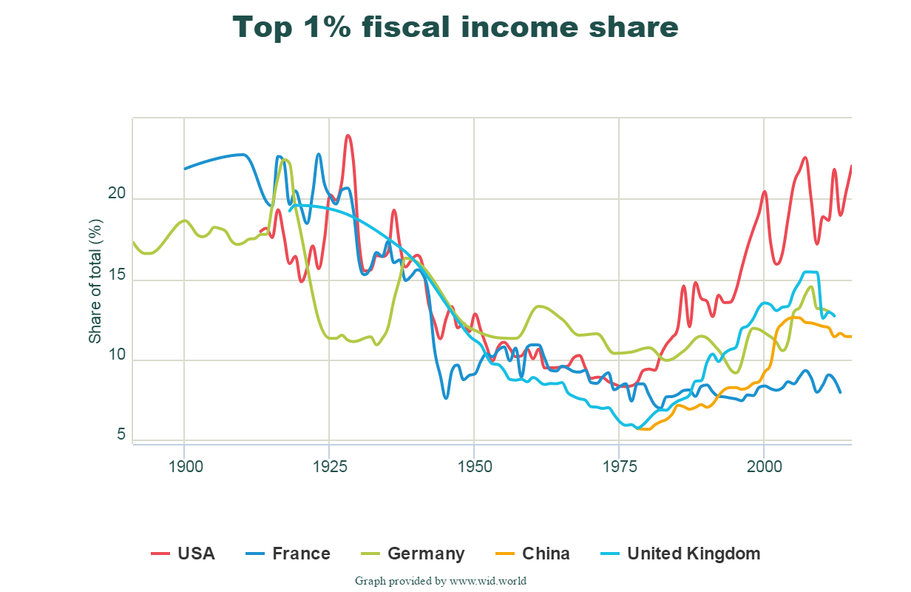

Slide 41
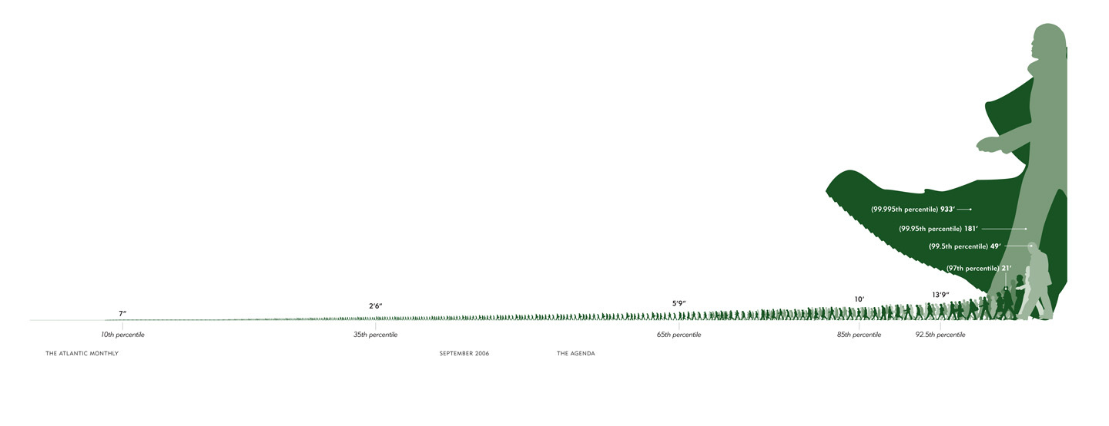
Jan Pen (1971) – Income Distribution
Imagine that height is proportional to income, so avg. height = avg. income.
Now imagine that the entire U.S. population walks past you in 1 hour – arranged by height.
First come the jobless and the poor, they are almost invisible.
After 30 minutes, people are only waist high (median income is half of mean income). It takes 45 minutes for normal-sized people to appear.
With 6 minutes to go, people are 12 feet tall.
The height of the 400 highest earners? More than two miles tall.

Slide 42
Wealth inequality and the top 1 percent
Incredible work by Atkinson/Piketty/Saez/Zucman to catalog LR trends in income and wealth inequality
  Customized charts at http://wid.world/
Growth of top 1 percent income/wealth share is largest in U.S., but happening everywhere to some extent
Wealth inequality is almost unfathomably large
  Is this why the public tolerates policies that promote such inequality?

Slide 43
U.S. Life Expectancies by Percentile in Comparison to
Mean Life Expectancies Across Countries
United States - P100
San Marino
United States - P50
Canada
United Kingdom
United States - P25
China
Libya
Pakistan
United States - P1
Sudan
Iraq
India
Zambia
Lesotho
60
65
70
75
80
85
90
Source: Chetty et al (2016)
Expected Age at Death for 40 Year Old Men

Slide 44
Expected Age at Death vs. Household Income Percentile
By Gender at Age 40
90
Top 1% Gender Gap
1.6 years
85
Expected Age at Death for 40 Year Olds in Years
80
75
Bottom 1% Gender Gap
6.1 years
Women, Bottom 1%: 78.8
Women, Top 1%: 88.9
Men, Bottom 1%: 72.7
70
Men, Top 1%: 87.3
0
20
40
60
80
100
Household Income Percentile
Source: Chetty et al (2016)
Men
Women

Slide 45
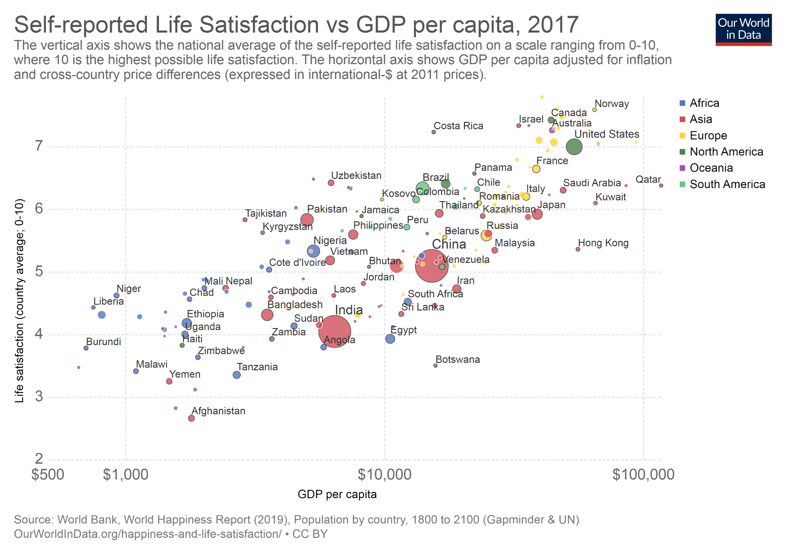

Slide 46
Measuring inequality
90/10 and other gaps
Gini coefficient
Across countries, between countries, ignoring countries
  Aggregation and Simpson’s paradox
Conceptual issues in the measurement of inequality

Slide 47
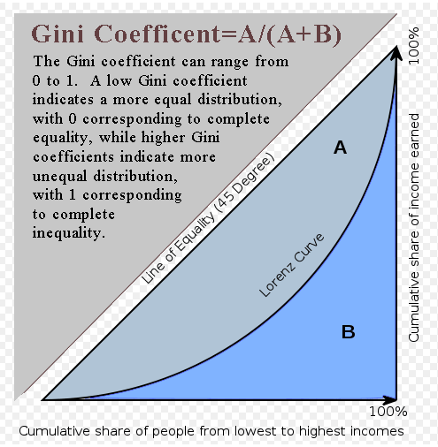
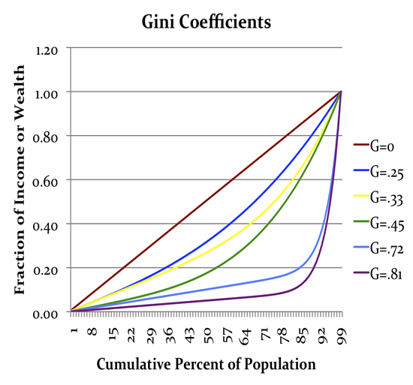

Slide 48
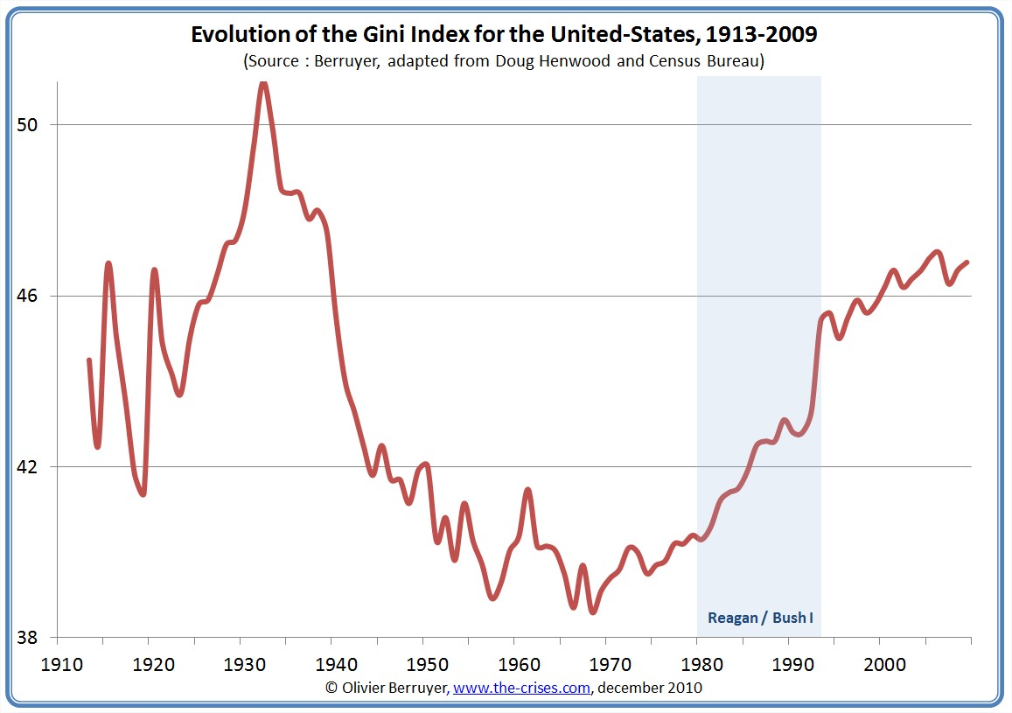

Slide 49
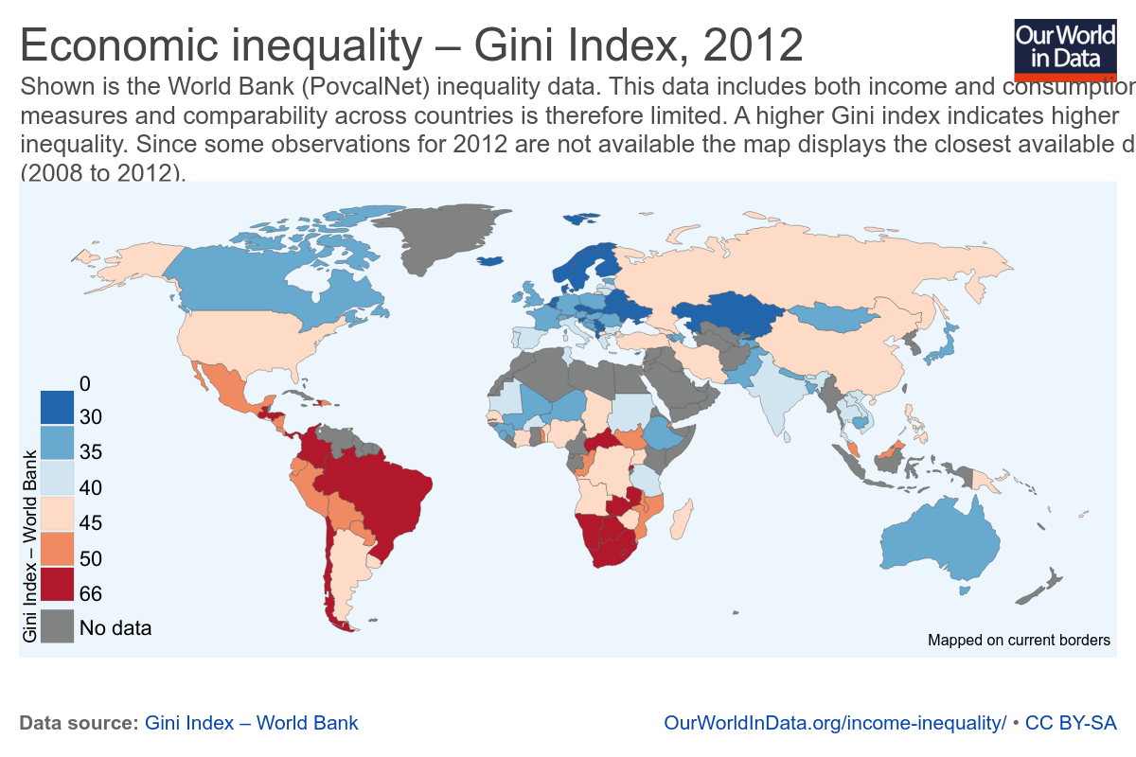

Slide 50
Three ways to measure global inequality
Inequality within countries
Inequality across countries
Inequality across people, ignoring country borders

Slide 52
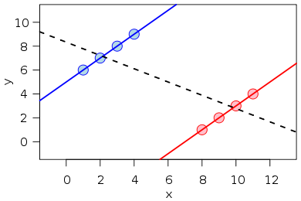
Simpson’s paradox
Trend within groups ≠ Trend across groups
Key is changing group size and composition, when groups are starting from different means
  USA – rising inequality - rich, slow population growth
  China – rising inequality – poorer, fast population growth

Slide 53
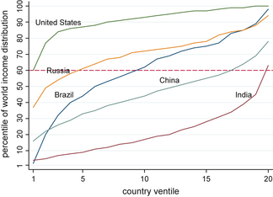
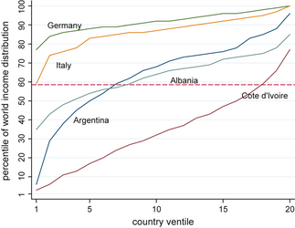
Where each country’s income distribution falls in the global income distribution
Source: Milanovic (2013)

Slide 54
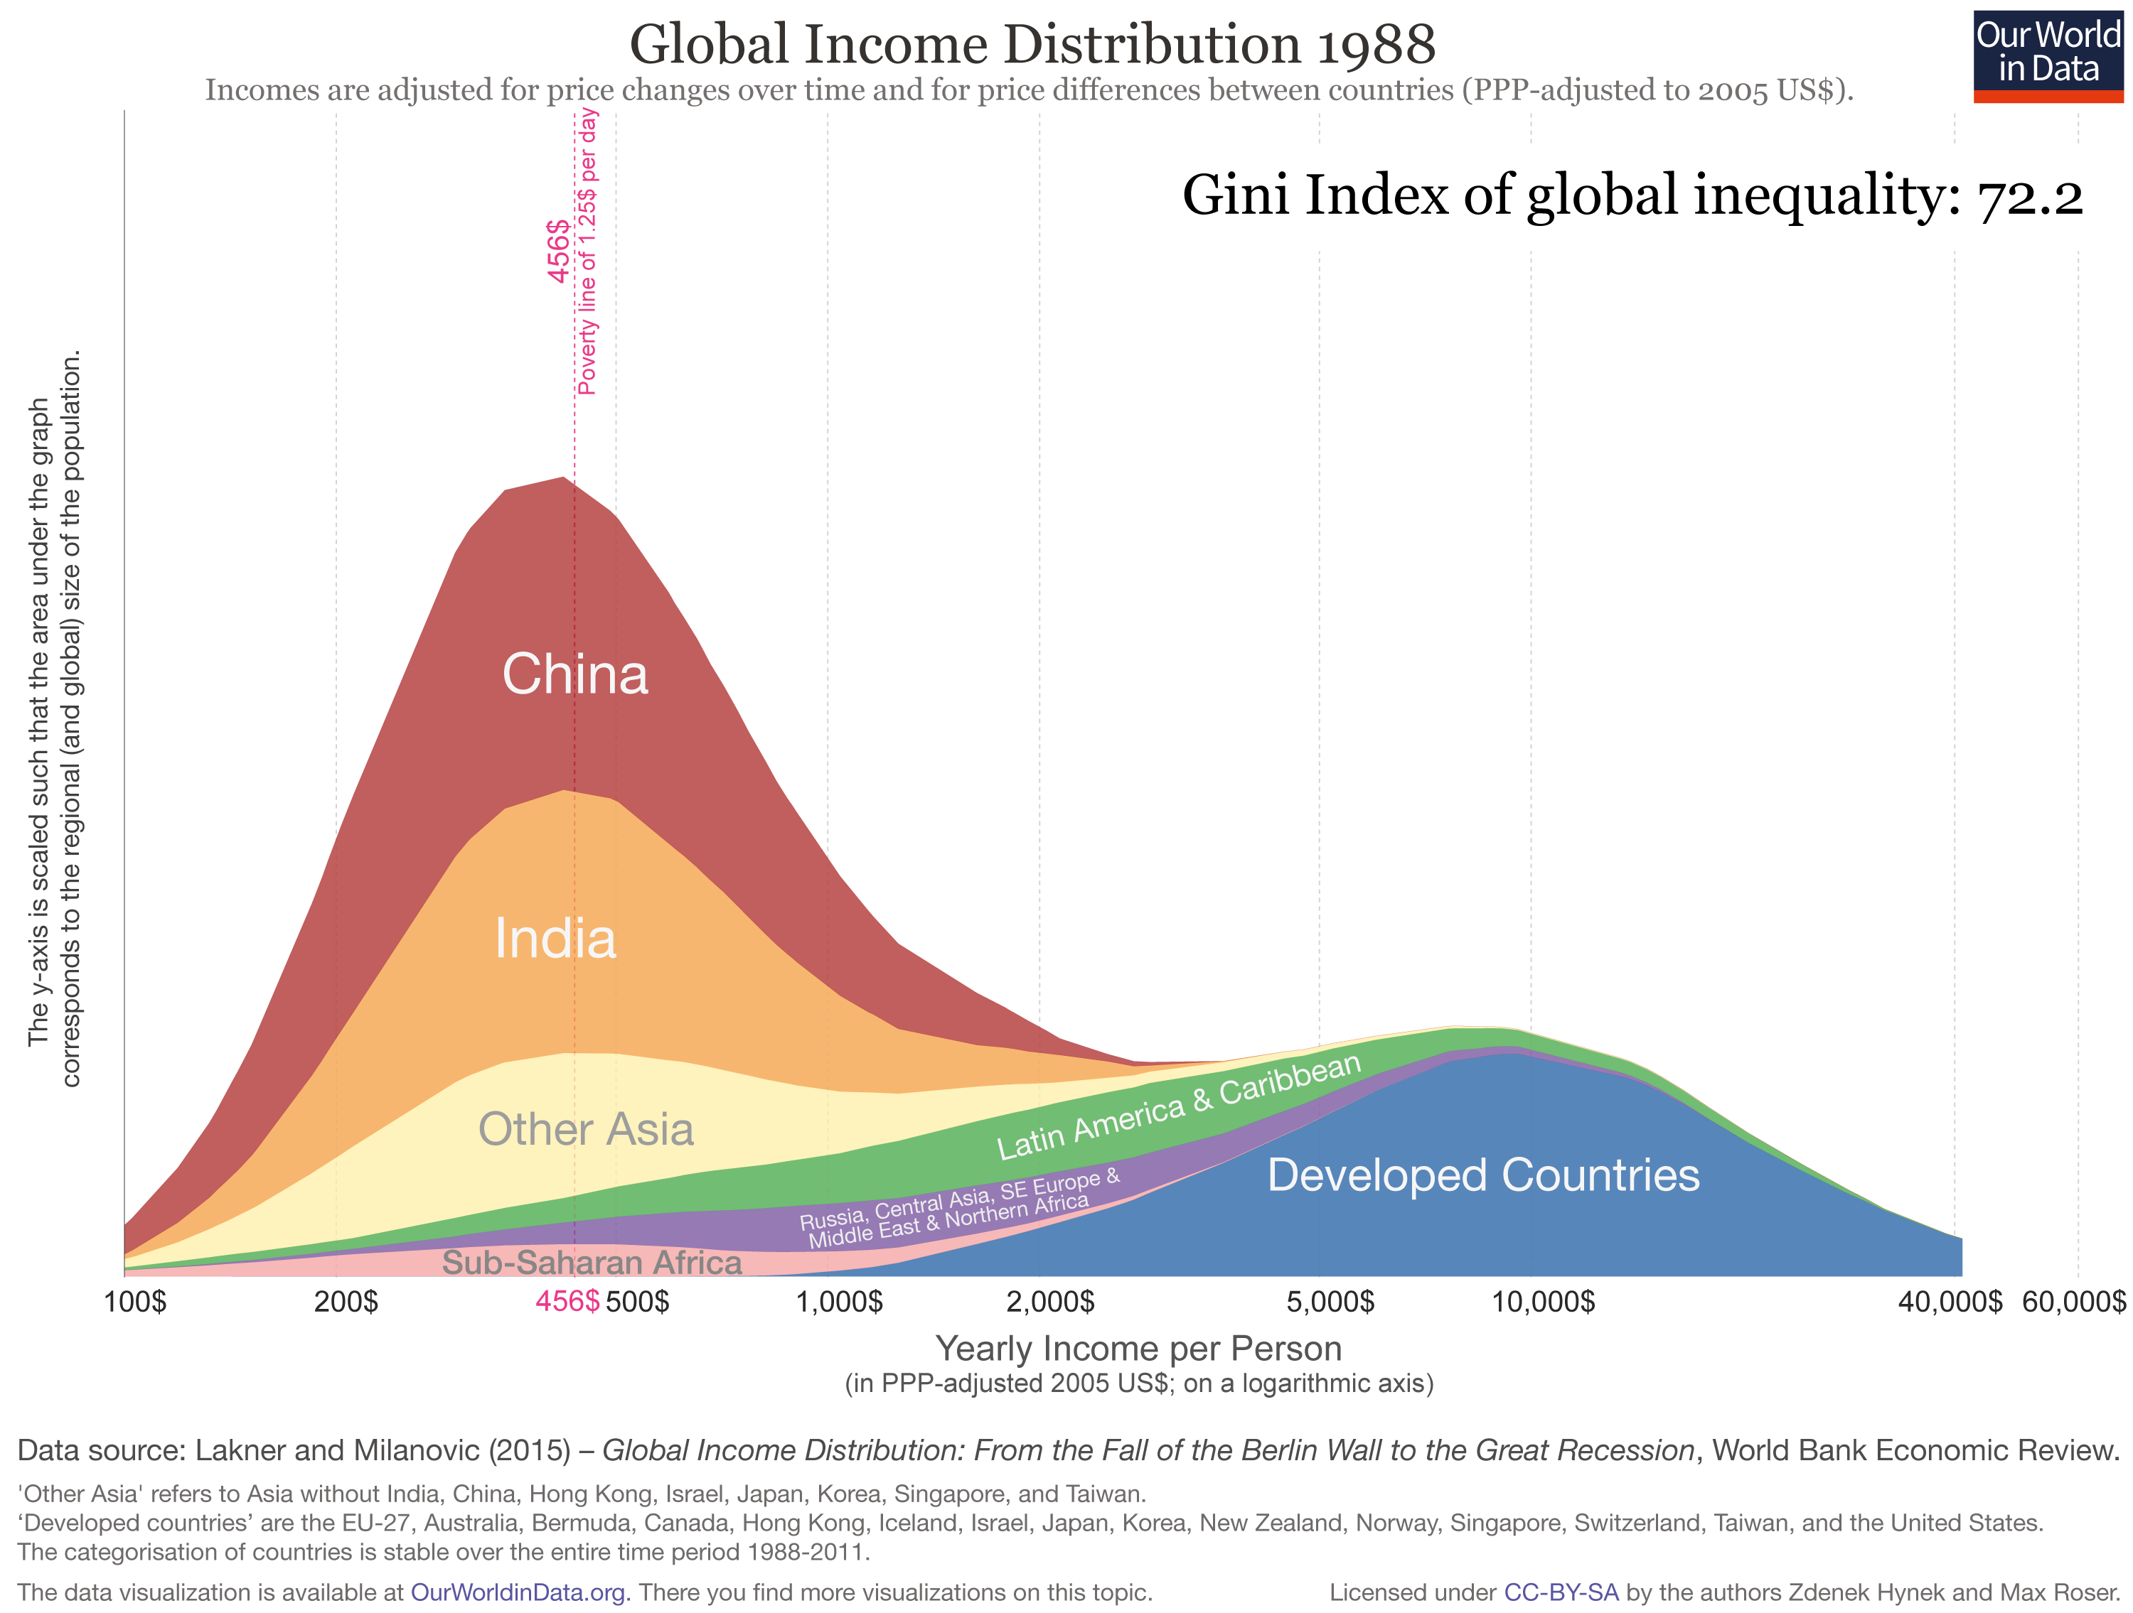

Slide 55
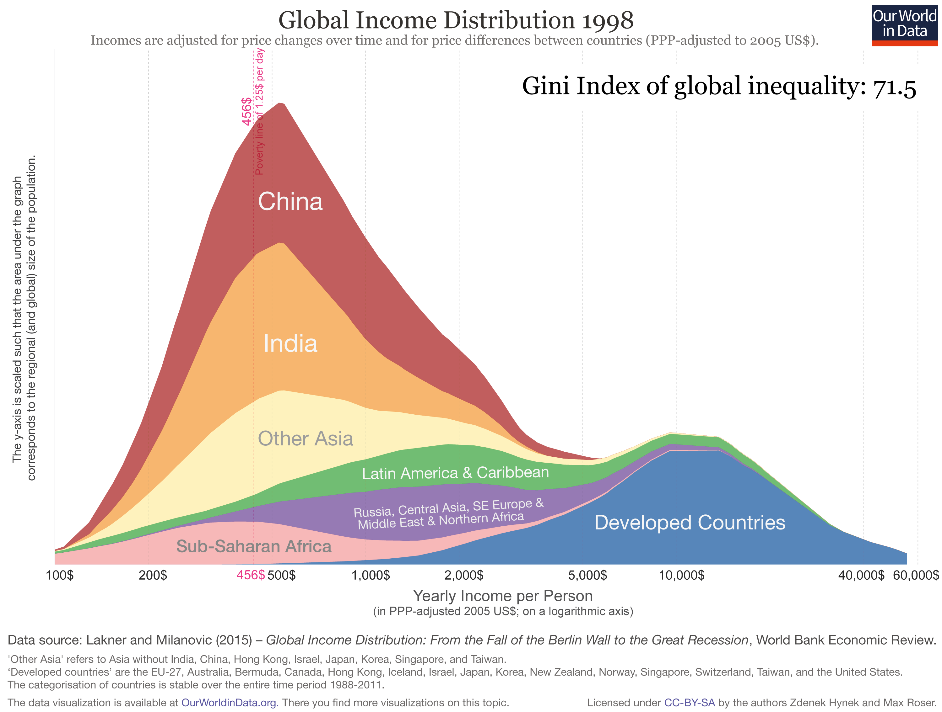

Slide 56
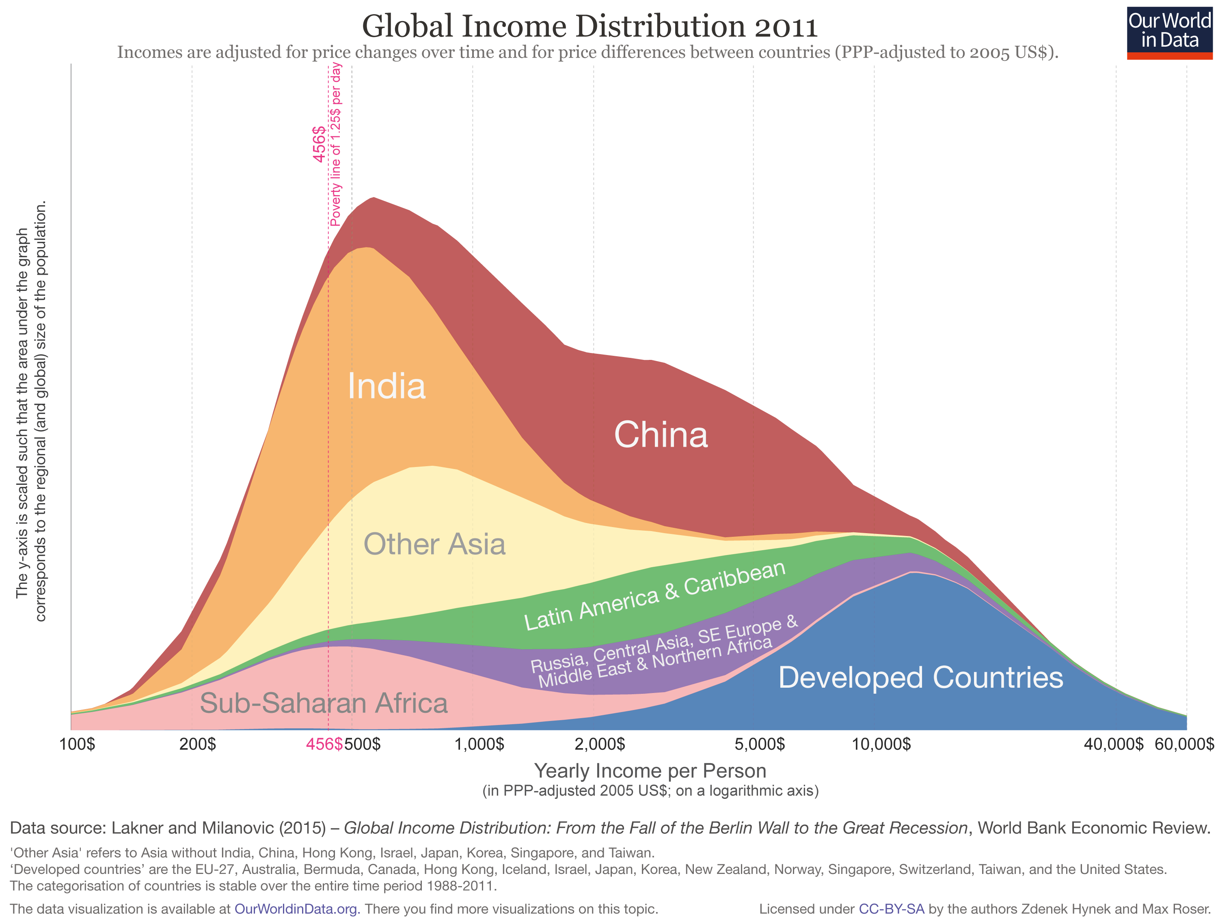

Slide 57
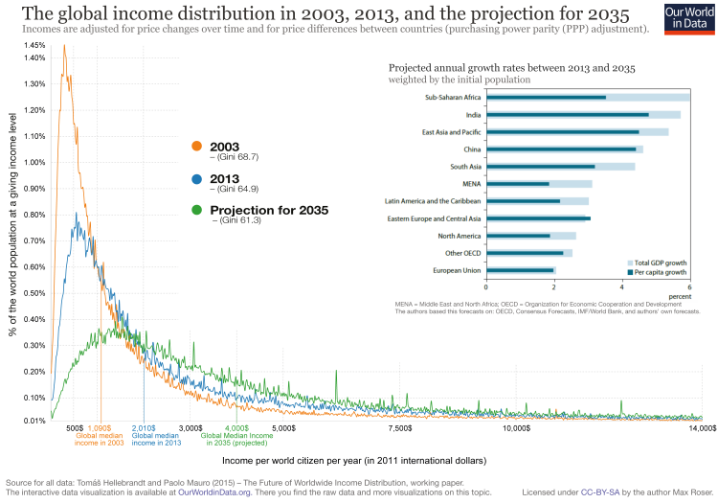

Slide 58
Global inequality
Global 1 percent – top 12 percent of America, mostly “old world”
  Even the poorest Americans are in the 60th percentile
Ignoring country borders changes the picture dramatically
  Rise of the global middle class (mostly China)
  Declining upper middle income growth, but not driven by U.S.
  Population growth and rising incomes moving together
Should borders matter? Should population size matter?

Slide 59
Measuring inequality
Accounting for income and purchasing power differences across countries
What does income miss?
  Social benefits and income transfers
  Employment rates
  Job quality (benefits, flexibility etc.)
  Household structure
  Income volatility
  Health, civil rights, etc…
Revealed preferences – immigrants often give up a place relatively high in the income distribution to come to the U.S. or to other Western European nations
Development as freedom (Sen 1999)

Slide 60
Summing up
Inequality is growing rapidly along many dimensions
In thinking about causes, must account for:
  Stagnant real wage growth is a male, low-skilled (or low-education) phenomenon
  It is happening all around the world
Inequality is increasing a lot within countries – but the pattern across countries and around the world is less clear
  Variation across countries in population size, baseline levels of income
More broadly – what is the relationship between economic growth, poverty and inequality?
  Will the gains from globalization be widely shared?
  Does it depend on how we measure gains in human welfare?

