Slide 1
Normative Dimensions of Inequality and Intergenerational Mobility
David J. Deming
SUP-206, Fall 2019

Slide 2
The plan
Positive and normative frameworks for thinking about inequality
Case study – effective altruism and child mortality
Case study – innovation and inequality
Intergenerational Mobility in the US and around the world
  Does inequality decrease mobility?
  What is the relationship between inequality, mobility and growth?

Slide 3
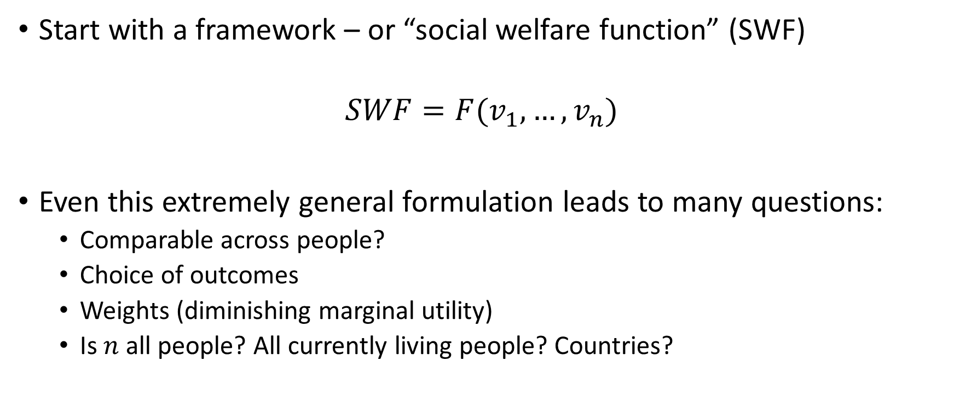
How should we think about inequality?
Start with a framework – or “social welfare function” (SWF)
$$SWF=F(v_{1},…,v_{n})$$
Even this extremely general formulation leads to many questions:
  Comparable across people?
  Choice of outcomes
  Weights (diminishing marginal utility)
  Is $n$ all people? All currently living people? Countries?

Slide 4
Utility maximization
Individuals maximize their own utility by choosing among a set of actions, subject to constraints
  Actions can be purchases, time use, helping others, etc…
  Constraints are usually money, or time
Utility function describes preferences over a set of possible choices
Utility is a conceptual device – we never actually observe it
  Assume that individuals maximize utility
  Infer preferences from data on choices and constraints

Slide 5
Utility maximization
Economists are comfortable assuming that individuals maximize utility; uncomfortable going beyond that
  Preferences, social context and inequality
  Behavioral economics – when actions don’t match preferences (or when preferences are “irrational”)
Pareto improvements – a rare “free lunch”
  Economics has little to say about how to make efficiency/equality tradeoffs
Utilitarian philosophy (e.g. Singer) is about aggregating individual utility up to get a SWF
  Willing to redistribute; often silent about efficiency/equity tradeoff

Slide 6
The Leaky Bucket
What percent leakage would you be willing to accept? How does your answer change at different places in the distribution?

Slide 7
The big tradeoff
Do you accept the premise?
Markets and rights/responsibilities are both allocation mechanisms, and the choice between them is often a tradeoff between efficiency and equality
  Reasons for rights – liberty, pluralism, humanism
  Making something a right doesn’t free one from economic considerations (education, health care etc.)

Slide 8
Equality/efficiency tradeoffs around the world

Slide 9
Resources, or rights?
Consumption, GDP are outcomes we can measure
Leisure, self-actualization etc. are also in the utility function
  “Primary goods” – income, but also health, civil/political rights, dignity (Rawls 1973)
  “Capabilities to function” (Sen 1995)
Consider practical scenarios where rights/capabilities gives you a different answer

Slide 10
Normative frameworks
Rawls (1973) - the veil of ignorance
  “Maximin” social welfare function
Dworkin (2002) and the “thin veil”
  Social welfare as insurance against the original position
From what age does the veil of ignorance apply? How does that change your views on social insurance and redistribution?

Slide 11
Bob and the Bugatti
Utilitarianism judges whether acts are right or wrong solely by their consequences
What is the ethical distinction between saving a child’s life in person and doing it through an impersonal charitable donation?
Radical utilitarianism implies that we maximize the SWF by completely equalizing resources across individuals

Slide 12
Effective Altruism
Utilitarianism meets science/program evaluation
Givewell.org
  Rates charities based on demonstrated evidence of effectiveness (RCTs)
  Malaria, Deworming, Schistosomiasis, GiveDirectly
How to monetize? Lives saved, DALYs….utility?
“Earning to give”

Slide 13
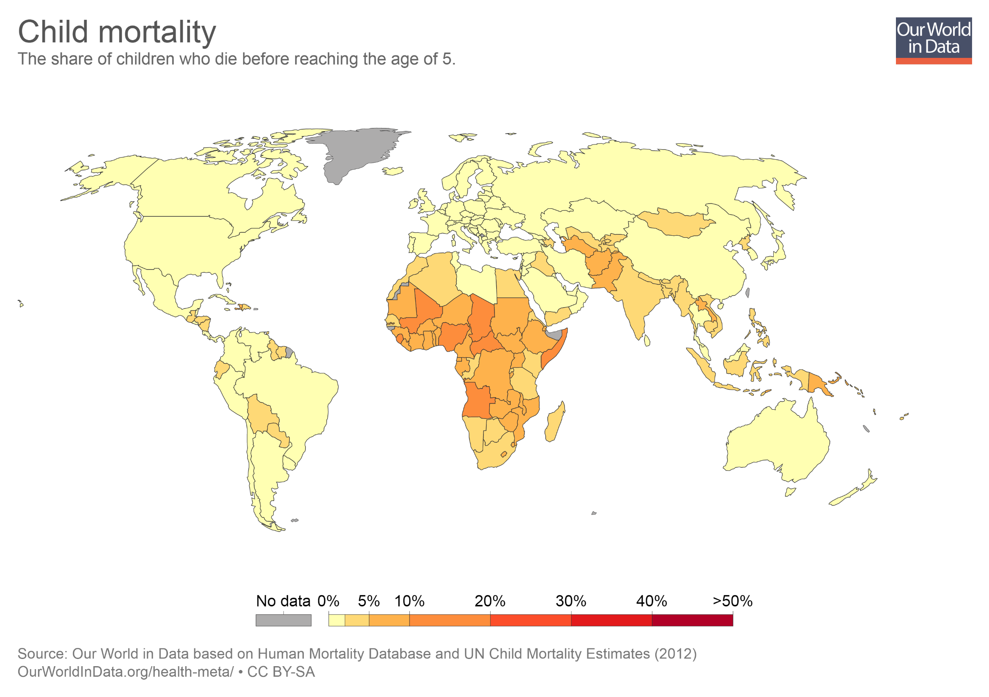

Slide 14
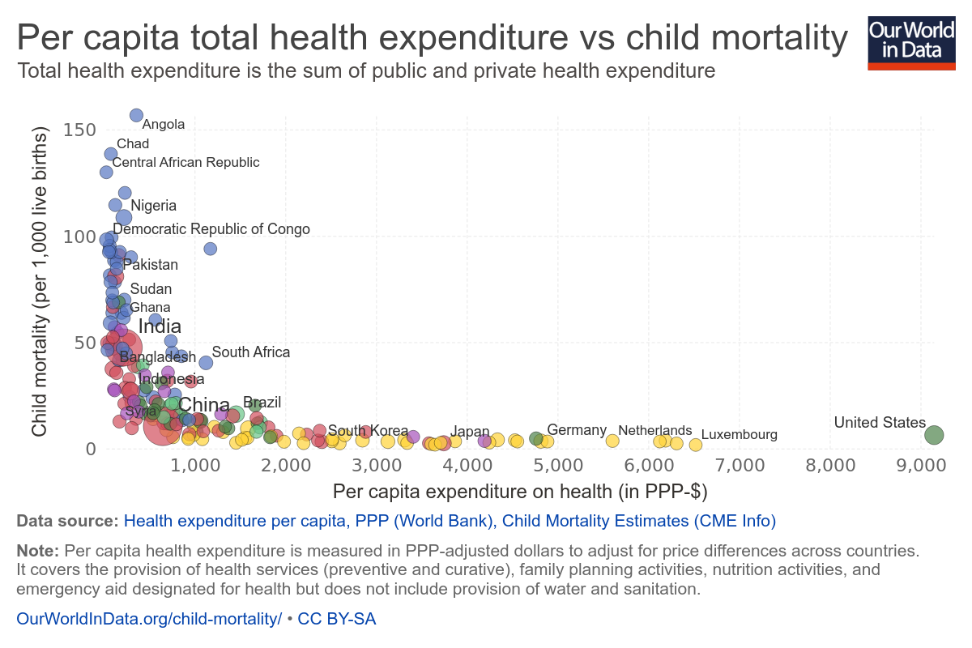

Slide 15
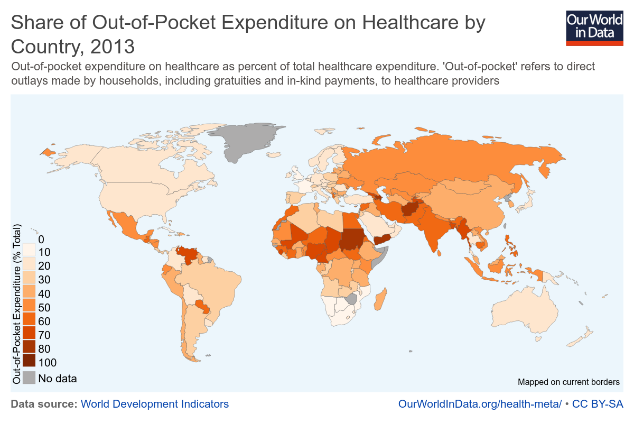

Slide 16
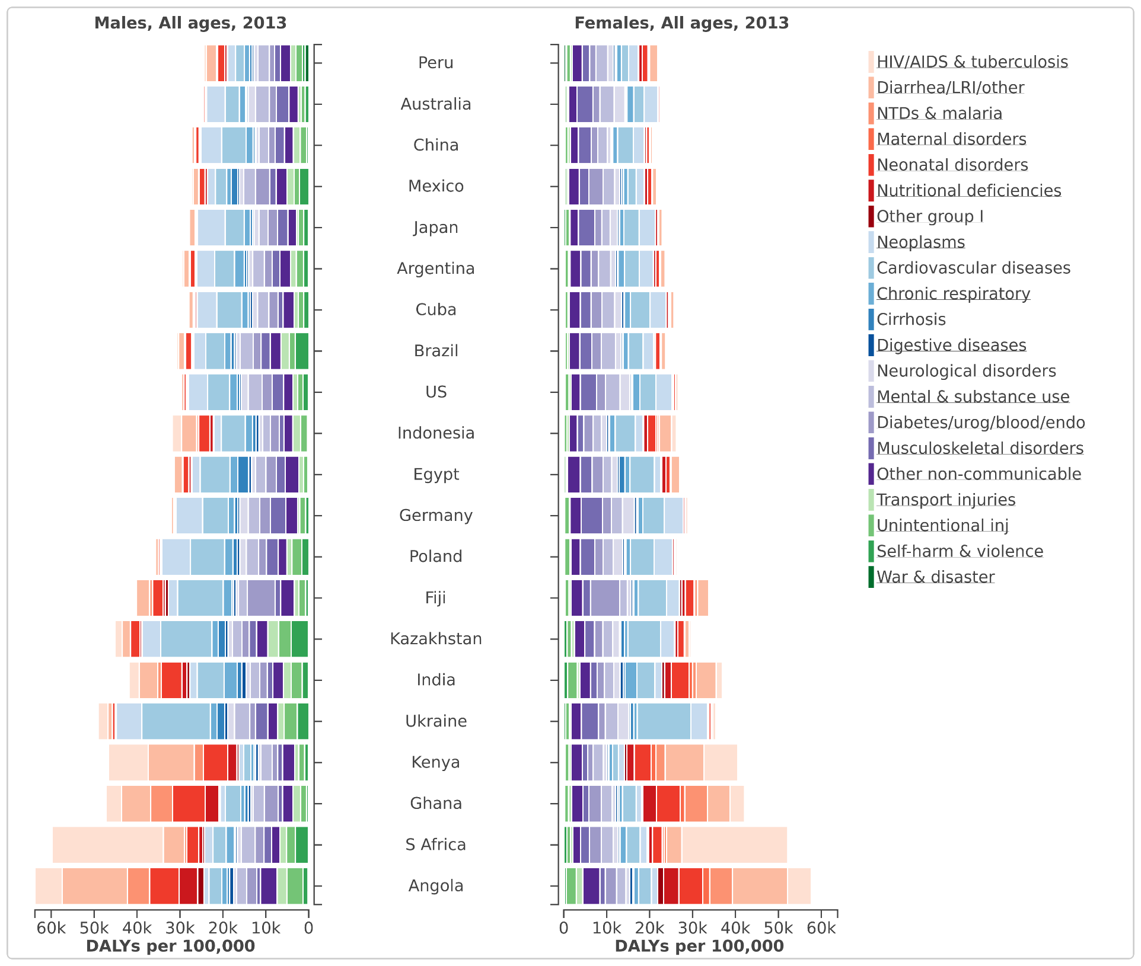
Red = communicable
Blue = chronic
Purple – other
Green – physical

Slide 17
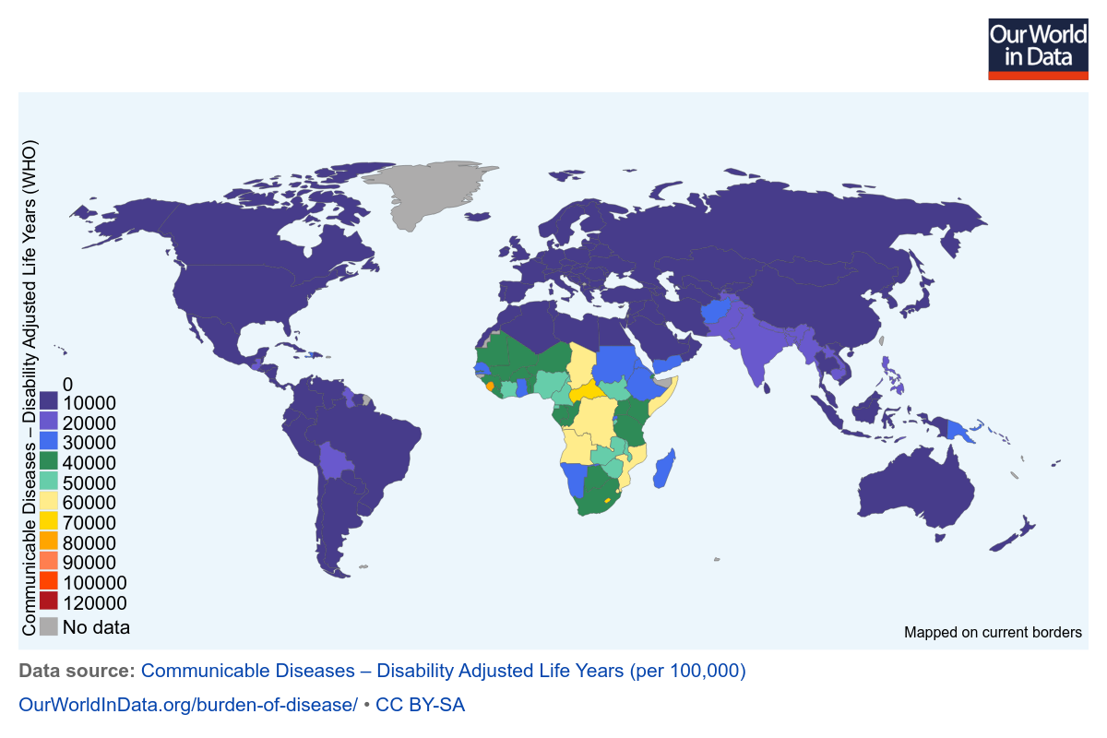

Slide 18
Disability-adjusted life years (DALYs)
DALY = Years of Life Lost (YLL) + Years lost due to disability (YLD)
YLL = life expectancy – age at death
YLD = (# of disabilities) * (disability weight (DW)) * (avg. life duration of case)
Example DWs – AIDS (no ART) = 0.547; TB = 0.271; Hepatitis = 0.075

Slide 19
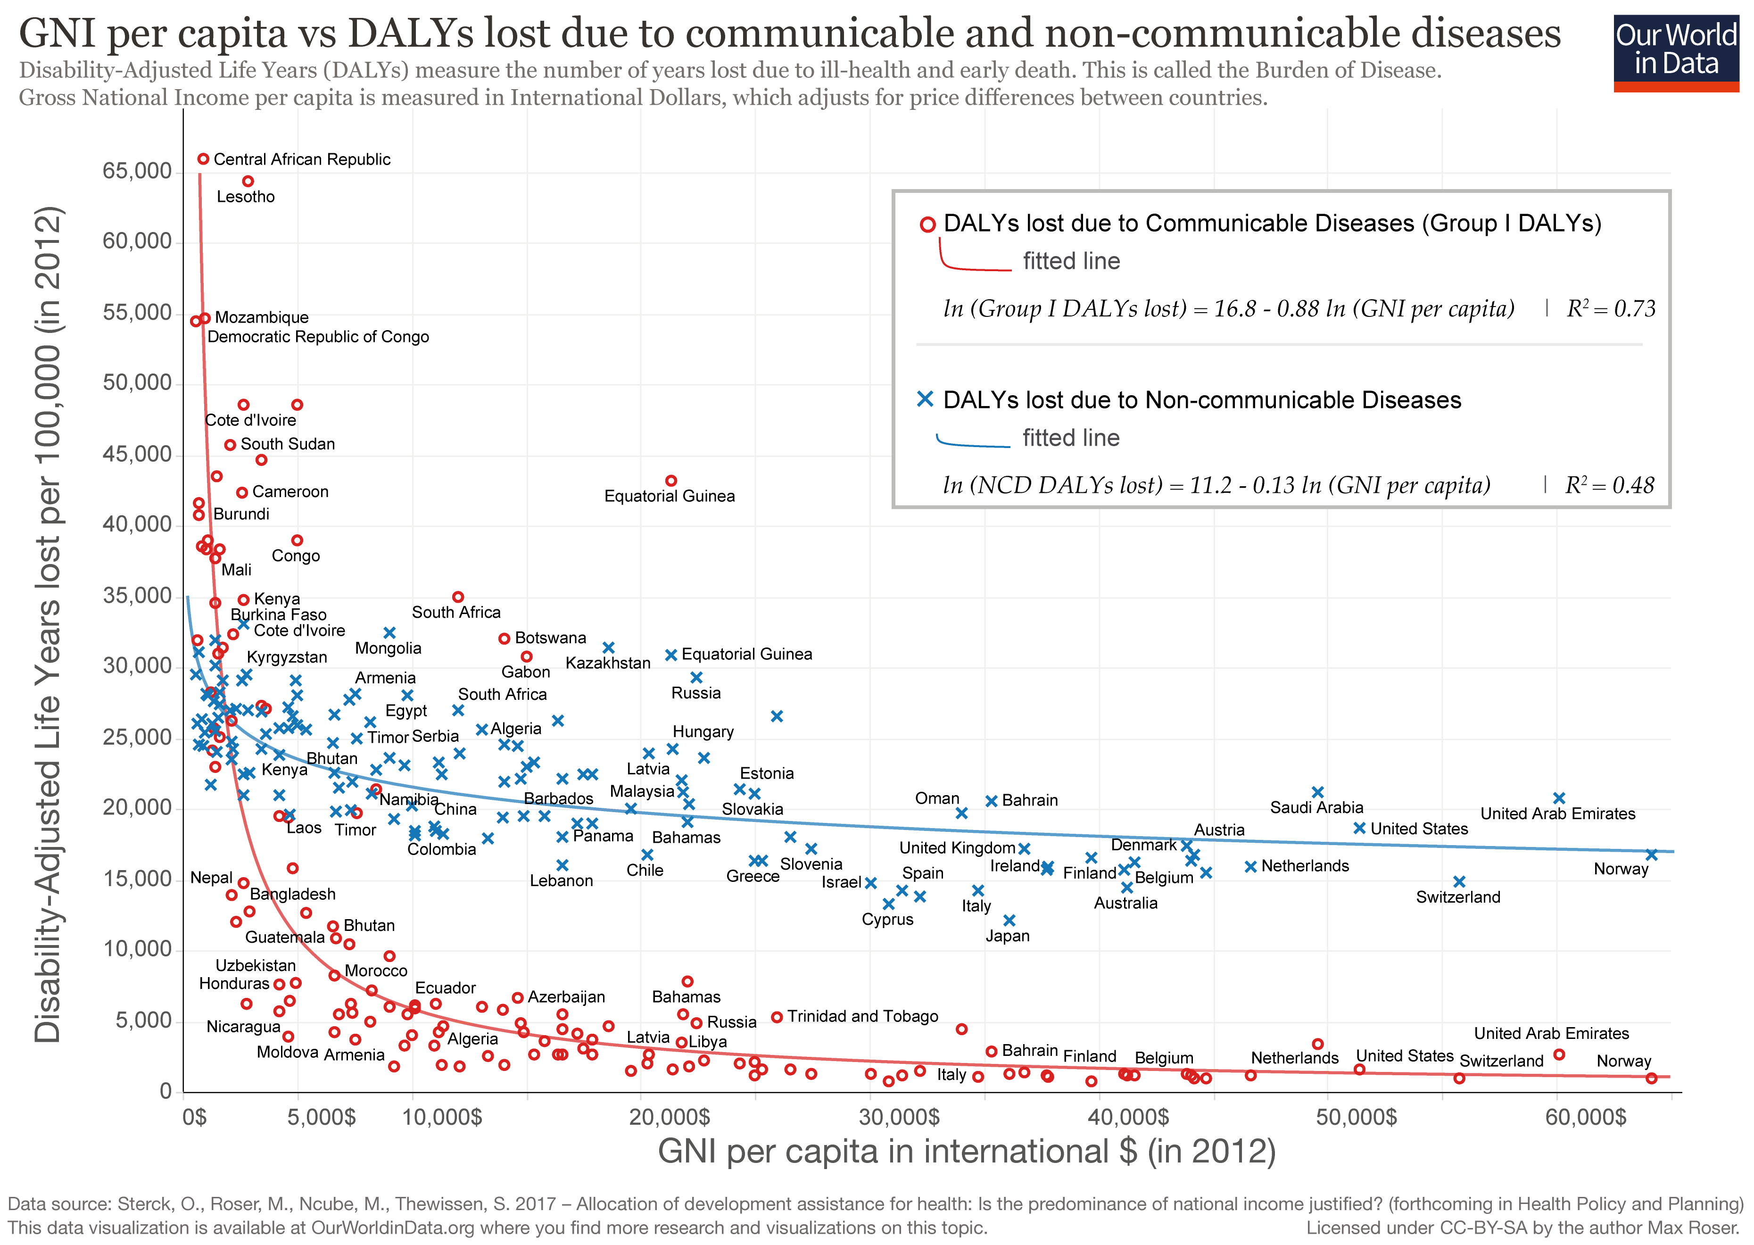

Slide 20
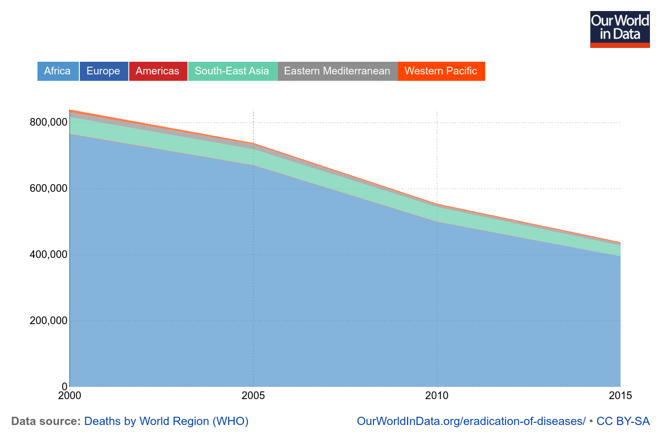
Malaria Deaths by Region, 2000-2015

Slide 21
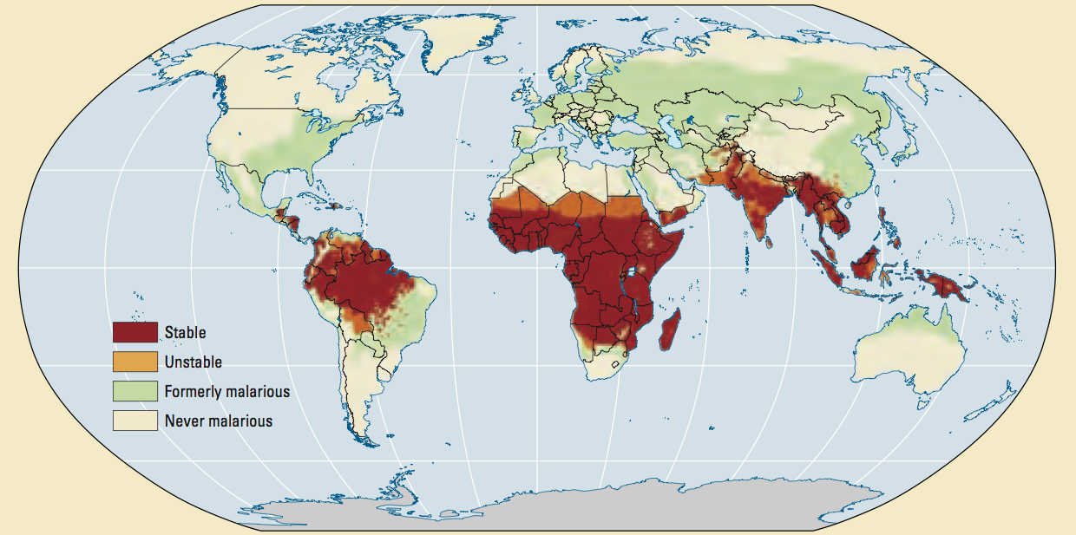

Slide 22
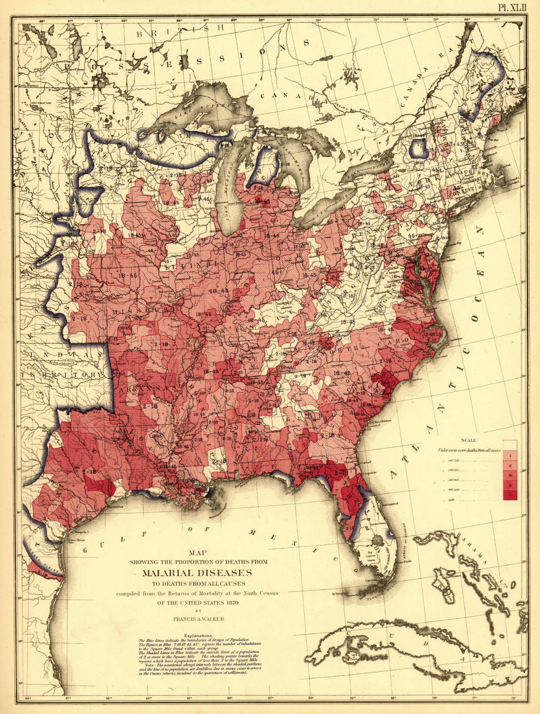
Eastern U.S. in 1870
National Malaria Eradication Program launched in 1947.
Malaria gone by 1951.

Slide 23
The utilitarian case for malaria eradication
Child mortality highly unequally distributed across countries
Clearly related to extreme poverty
  Constraints, not preferences
  Estimate of ~$7,500 per life saved (compare to Singer)
Causes of child mortality - communicable diseases that are easily preventable
Long-run? Malaria can be eradicated, because we did it in the U.S.

Slide 24
Criticisms of Effective Altruism
I presented the clearest case
  Impacts of “scaling up” charitable giving are not so clear
Conceptual critiques
  Social trust and individuals vs. the state
  Affects choices and personal morality
Practical
  Measurement – privileging what can be tracked and studied
  Studies always have context – leaning hard on the evidence
Development is a problem of politics, not of resources
  Foreign aid makes leaders less responsive to their people (Deaton, Easterly)

Slide 25
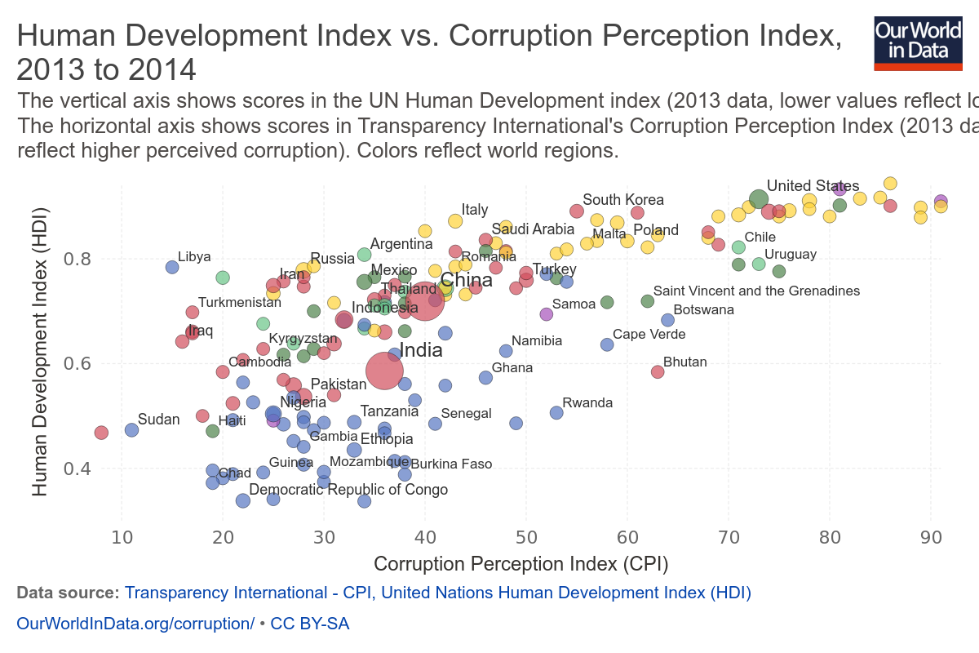

Slide 26
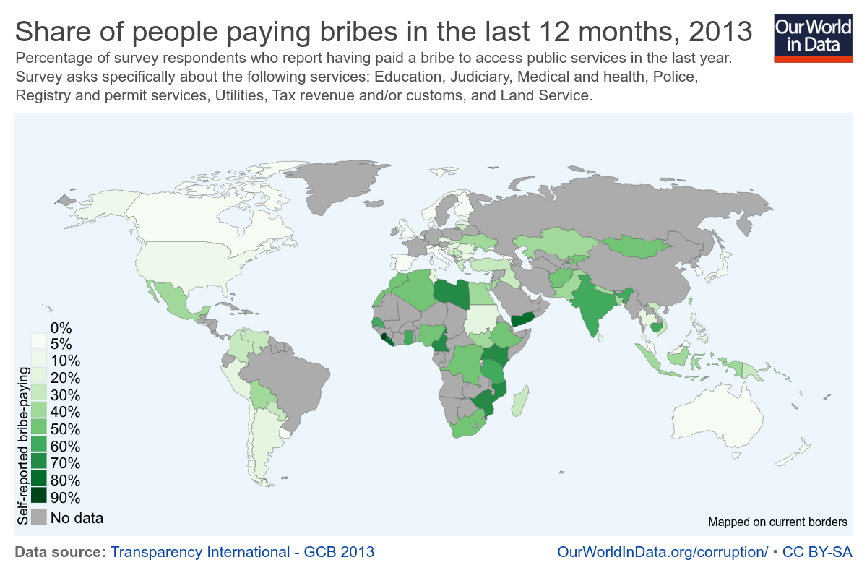

Slide 27
Innovation and Inequality
In the long-run, economic growth is primarily about innovation
  Penicillin; Vaccines
  Electricity, indoor plumbing and sanitation
  Mobile phones enable the GiveDirectly technology
Two views on how to support innovation
  “The best and the brightest” – most inventions come out of wealth and intensive investment in research
  “Lost Einsteins” – need to widen the talent pipeline

Slide 28
Patent Rates vs. Parent Income Percentile
8
Patent rate for top 1% parent income:
8.3 per 1,000
6
No. of Inventors per Thousand Children
4
2
Patent rate for below
median parent income:
0.84 per 1,000
0
0
20
40
60
80
100
Parent Household Income Percentile
Notes: Sample of children is 1980-84 birth cohorts. Parent Income is mean household income from 1996-2000.
Notes:
Fig 1a

Slide 29
Patent Rates vs. 3rd Grade Test Scores by Parental Income
8
90th Percentile
6
Inventors per Thousand
4
2
0
-2
-1
0
1
2
3rd Grade Math Test Score (Standardized)
Parent Income Below 80th Percentile
Parent Income Above 80th Percentile
Notes:
Fig4a
Top 10% - High-Income: 5.08 vs. Low-income: 2.59 Inventors per Thousand
Below p90 - High-Income: 1.04 vs. Low-income: 0.43 Inventors per Thousand

Slide 30
Patent Rates vs. 3rd Grade Math Test Scores by Gender
8
90th Percentile
6
Inventors per Thousand
4
2
0
-2
-1
0
1
2
3rd Grade Math Test Score (Standardized)
Female
Male

Slide 31
Income of Inventors by Characteristics at Birth
1
0.8
0.6
Inventors per Thousand
0.4
0.2
0
0
20
40
60
80
100
Distance from Father's Technology Class
Notes:
Fig 6: Children whose fathers are inventors (1980-84), dropping children who were listed as co-inventors with there fathers
For Distance 0: Magnitude = 0.94
For Distance 1-100: Magnitude = 0.06

Slide 32
Patent Rates of Children who Grow up in a CZ vs. Patent Rates of Adults in that CZ
6
San Jose
5
Madison
Minneapolis
4
3
Newark
Num. of Inventors per 1000 Children
Portland
2
Houston
1
Brownsville
0
0
0.2
0.4
0.6
0.8
Annual Patent Rate per Thousand Working Age Adults in CZ
Notes:
Fig 7

Slide 33
Summing up
The data on innovation present a mixed picture
  Innovators = rich + high test scores + attend elite college
  Does this reflect efficiency, or inequity? Or both?
  Answer hinges on an alternative state of the world that we don’t easily observe
Key underlying question – does the distribution of resources reflect inequality of opportunity?
  Are there “lost Einsteins”?

Slide 34
Intergenerational Mobility

Slide 35
The plan
Why measure intergenerational mobility?
Issues with measurement – IGE, inequality and the Great Gatsby curve
What drives mobility?
  Policy puts “thumb on the scale”
Recent evidence on intergenerational mobility
  opportunityinsights.org

Slide 36
Measuring Intergenerational Mobility
Correlation between father’s earnings and son’s earnings is around 0.5
  Similar to father/son height
  Chance of going from bottom 10 percent to top 10 percent equivalent to being 5’6 and having a son that is over 6’1.
Intergenerational Earnings Elasticity (IGE)
  Multiply by father’s income percentile to get son’s predicted income percentile in next generation
  IGE for U.S. and U.K. around 0.5, 0.25 for Canada (Corak 2013)
Rank-rank measures (Chetty et al 2016)
  Rank children based on their incomes relative to others in their cohort
  Rank parents based on incomes of other parents
  Holds distributions constant, deals with zeroes

Slide 37
Mean Child Percentile Rank vs. Parent Percentile Rank
70
60
50
Mean Child Income Rank
40
30
Rank-Rank Slope (U.S) = 0.341
(0.0003)
20
0
10
20
30
40
50
60
70
80
90
100
Source: Chetty et al (2014)
Parent Income Rank

Slide 38
Intergenerational Mobility in the United States vs. Denmark
70
60
50
Mean Child Income Rank
40
30
Rank-Rank Slope (U.S) = 0.341
Rank-Rank Slope (Denmark) = 0.180
20
0
10
20
30
40
50
60
70
80
90
100
Parent Income Rank
Source: Chetty et al (2014)
Denmark [Boserup, Kreiner, Kopczuk 2013]
United States

Slide 39
“Great Gatsby” curve
What is the relationship between inequality and intergenerational mobility?
  Hypothesis – high inequality perpetuates advantage
  Narrowing the pipeline, the rich get richer etc…
What processes might generate a Great Gatsby curve?
  Genetics; family/social networks
  Investment in education/skills
  Changing returns to skills (incl. institutions)
  Social policy transfers

Slide 41
Upward Mobility vs. Inequality in CZ
The “Great Gatsby” Curve Within the U.S.
55
50
Correlation = -0.578
(0.093)
45
Upward Mobility $(\overline{y}$₂₅ )
40
35
0.3
0.4
0.5
0.6
Source: Chetty et al (2014)
Gini Coef. for Parent Family Income (1996-2000)

Slide 42
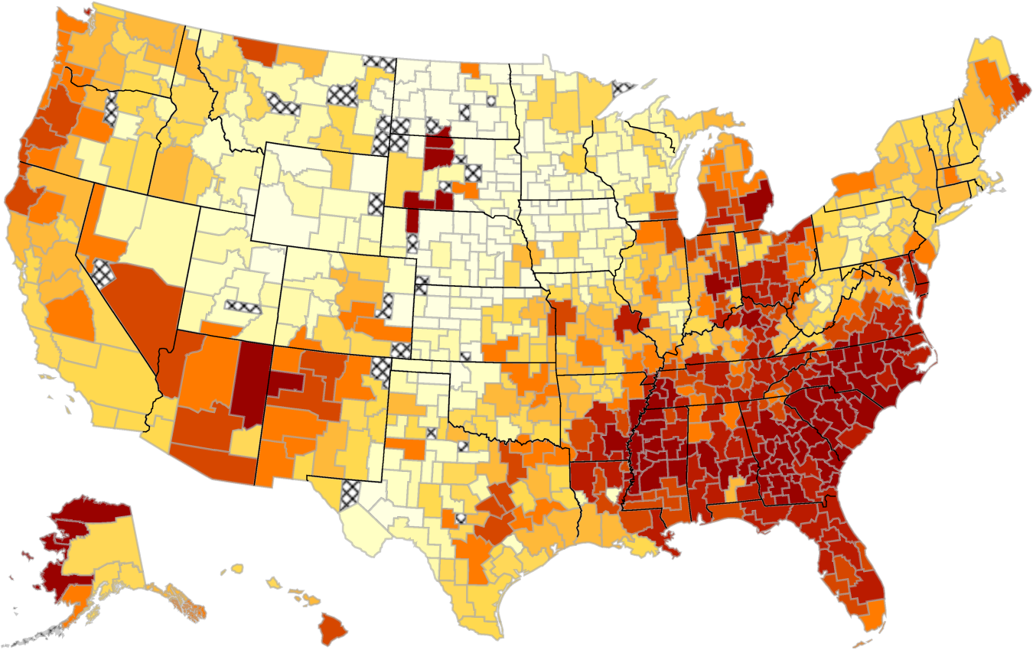
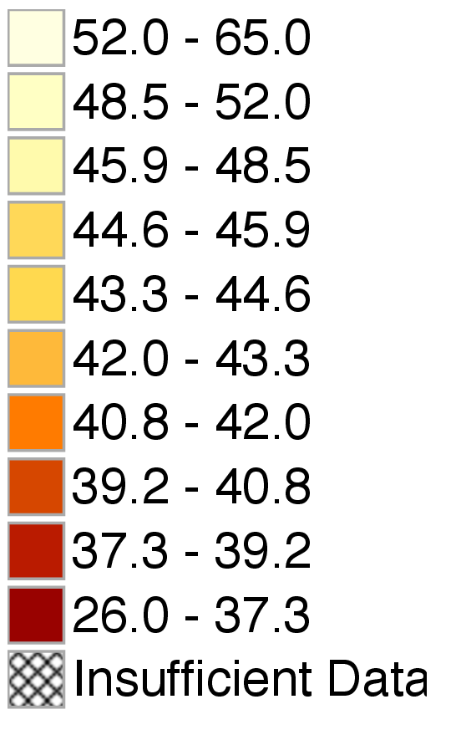
The Geography of Upward Mobility in the United States
Mean Child Percentile Rank for Parents at 25th Percentile (Y₂₅)
Note: Lighter Color = More Absolute Upward Mobility
Source: Chetty et al (2014)

Slide 43
Highest Absolute Mobility In The 50 Largest CZs
Upward Mobility | CZ Name | Y₂₅ | Y₁₀₀ – Y₀ | P(Child in Q5|
Rank |  |  |  | Parent in Q1)
1 | Salt Lake City, UT | 46.2 | 0.264 | 10.83%
2 | Pittsburgh, PA | 45.2 | 0.359 | 9.51%
3 | San Jose, CA | 44.7 | 0.235 | 12.93%
4 | Boston, MA | 44.6 | 0.322 | 10.49%
5 | San Francisco, CA | 44.4 | 0.250 | 12.15%
6 | San Diego, CA | 44.3 | 0.237 | 10.44%
7 | Manchester, NH | 44.2 | 0.296 | 10.02%
8 | Minneapolis, MN | 44.2 | 0.338 | 8.52%
9 | Newark, NJ | 44.1 | 0.350 | 10.24%
10 | New York, NY | 43.8 | 0.330 | 10.50%
Source: Chetty et al (2014)

Slide 44
Lowest Absolute Mobility In The 50 Largest CZs
Upward Mobility | CZ Name | Y₂₅ | Y₁₀₀ – Y₀ | P(Child in Q5|
Rank |  |  |  | Parent in Q1)
41 | Nashville, TN | 38.2 | 0.357 | 5.73%
42 | New Orleans, LA | 38.2 | 0.397 | 5.12%
43 | Cincinnati, OH | 37.9 | 0.429 | 5.12%
44 | Columbus, OH | 37.7 | 0.406 | 4.91%
45 | Jacksonville, FL | 37.5 | 0.361 | 4.92%
46 | Detroit, MI | 37.3 | 0.358 | 5.46%
47 | Indianapolis, IN | 37.2 | 0.398 | 4.90%
48 | Raleigh, NC | 36.9 | 0.389 | 5.00%
49 | Atlanta, GA | 36.0 | 0.366 | 4.53%
50 | Charlotte, NC | 35.8 | 0.397 | 4.38%
Source: Chetty et al (2014)

Slide 45
Absolute Upward Mobility vs. Racial Segregation
55
50
Correlation = -0.361
(0.068)
45
Upward Mobility $(\overline{y}$₂₅ )
40
35
0.01
0.02
0.05
0.14
0.37
Theil Index of Racial Segregation in 2000 (log scale)
Source: Chetty et al (2014)

Slide 46
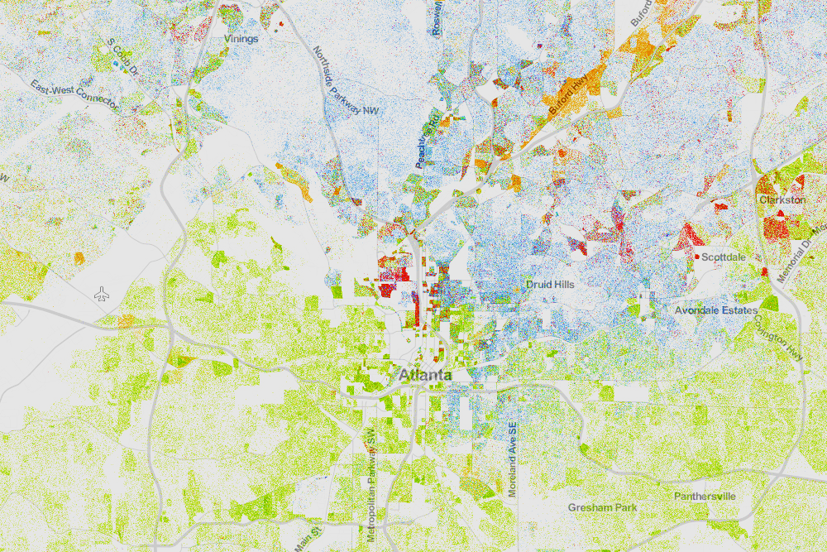
Racial Segregation in Atlanta
Whites (blue), Blacks (green), Asians (red), Hispanics (orange)
Source: Cable (2013) based on Census 2010 data

Slide 47
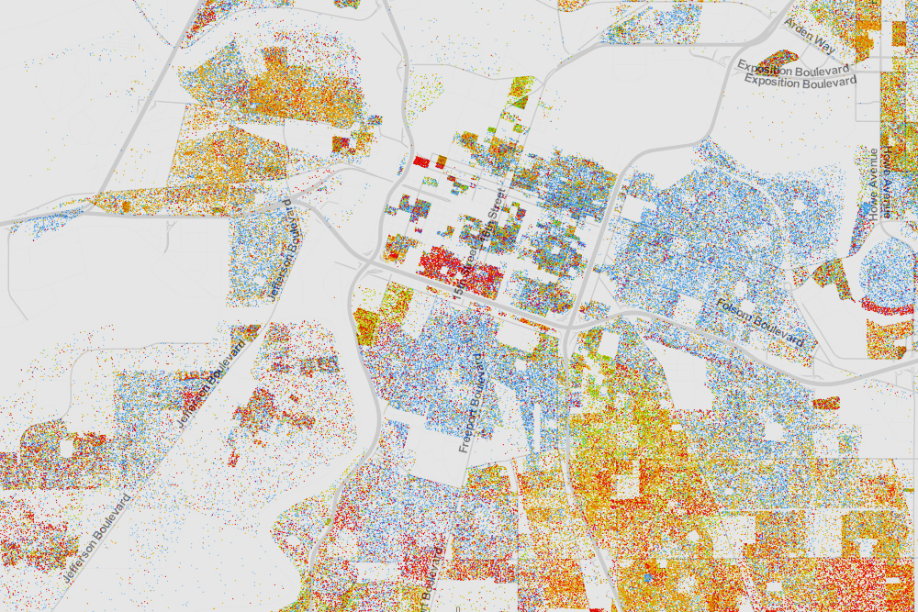
Racial Segregation in Sacramento
Whites (blue), Blacks (green), Asians (red), Hispanics (orange)
Source: Cable (2013) based on Census 2010 data

Slide 48
College and intergenerational mobility
College as a ticket to the middle class (e.g. GI Bill)
  Yet inequality in access may limit mobility, or even reduce it (Marx- social reproduction)
Separate colleges’ role in mobility into two factors:
  Access – what is the income distribution of students accepted into colleges (especially top colleges)
  Success – what is the impact of attending college on income, mobility
Chetty et al (2017) present descriptive statistics on access and success in the 1980-1982 birth cohorts for all colleges in the U.S. – call them “mobility report cards”

Slide 49

Parent Income Distribution at Harvard
1980-82 Child Birth Cohorts
80
70.3%
60
Percent of Students
40
20
15.4%
13.2%
Top 1%
8.1%
5.3%
3.0%
0
1
2
3
4
5
Parent Income Quintile
Notes:
Fig_G8

Slide 50
Parent Income Distribution by Percentile
Ivy Plus Colleges
15
14.5% of students from top 1%
10
Percent of Students
More students from the top 1% than the bottom 50%
5
13.5% of students from bottom 50%
0
0
20
40
60
80
100
Parent Rank
Notes:
Figure 1b

Slide 51
Parent Income Distribution by Percentile
Ivy Plus Colleges
15
14.5% of students from top 1%
10
Percent of Students
Probability of attending an elite private college is
77 times higher for children in the top 1% compared to the bottom 20%
5
3.8% of students from bottom 20%
0
0
20
40
60
80
100
Parent Rank
Notes:
Figure 1b

Slide 52
Parent Income Distributions by Quintile for 1980-82 Birth Cohorts
At Selected Colleges
80
Harvard University
UC Berkeley
SUNY-Stony Brook
60
Glendale Community College
Percent of Students
40
Top 1%
20
0
1
2
3
4
5
Parent Income Quintile
Notes:
Fig 1a
paper_fig_1a

Slide 53
Distribution of Access Across Colleges (Enrollment-Weighted)
p10 = 3.7%
p50 = 9.3%
p90 = 21.0%
Density
Income Segregation Across Colleges is
Comparable to Segregation Across
Census Tracts in Average American City
0
20
40
60
Percent of Parents in Bottom Quintile
Notes:
Figure 1c
paper_fig_1c

Slide 54


Mobility Report Cards
Columbia vs. SUNY-Stony Brook
80%
Columbia
SUNY-Stony Brook
60%
Percent of Students
Success Rates (Students' Outcomes)
40%
Access (Parents' Incomes)
20%
0%
1
2
3
4
5
Parent Income Quintile
Notes:
Figure 4a
Paper_fig_4a

Slide 55
Notes:
Fig_h1
(.do File: $dropbox\ota_cqa\recode\code\indiv_figs\figs for slides\scatters.do)

Slide 56
Notes:
Fig Hiib
(.do File: $dropbox\ota_cqa\recode\code\indiv_figs\figs for slides\scatters.do)

Slide 57
Notes:
Fig_h2c
(.do File: $dropbox\ota_cqa\recode\code\indiv_figs\figs for slides\scatters.do)

Slide 58
Top 10 Colleges by Mobility Rate (Bottom to Top 20%)
Rank | Name | Mobility Rate | = Access x | Success Rate
1 | Cal State University – LA | 9.9% | 33.1% | 29.9%
2 | Pace University – New York | 8.4% | 15.2% | 55.6%
3 | SUNY – Stony Brook | 8.4% | 16.4% | 51.2%
4 | Technical Career Institutes | 8.0% | 40.3% | 19.8%
5 | University of Texas – Pan American | 7.6% | 38.7% | 19.8%
6 | CUNY System | 7.2% | 28.7% | 25.2%
7 | Glendale Community College | 7.1% | 32.4% | 21.9%
8 | South Texas College | 6.9% | 52.4% | 13.2%
9 | Cal State Polytechnic – Pomona | 6.8% | 14.9% | 45.8%
10 | University of Texas – El Paso | 6.8% | 28.0% | 24.4%
Notes:
Table B
Updated 01182017
Count > 1000

Slide 59
Top 10 Colleges by Mobility Rates for Upper-Tail Success (Top 1%)
Rank | Name | Mobility Rate | = Access x | Upper-Tail Success
1 | University of California – Berkeley | 0.76% | 8.8% | 8.6%
2 | Columbia University | 0.75% | 5.0% | 14.9%
3 | MIT | 0.68% | 5.1% | 13.4%
3 | Stanford University | 0.66% | 3.6% | 18.5%
4 | Swarthmore College | 0.61% | 4.7% | 13.0%
6 | Johns Hopkins University | 0.54% | 3.7% | 14.7%
7 | New York University | 0.52% | 6.9% | 7.5%
8 | University of Pennsylvania | 0.51% | 3.5% | 14.5%
9 | Cornell University | 0.51% | 4.9% | 10.4%
10 | University of Chicago | 0.50% | 4.3% | 11.5%
Notes:
Table C
Updated 01042016
Note: All CUNYs are combined
Count > 1000

Slide 60
What about absolute income mobility?
What share of children earn more than their parents ?
  Inflation-adjusted
Key – this is the intersection of GDP growth and inequality
  How widely shared are the gains from economic growth?
Chetty et al (2016) – again….

Slide 61
Percent of Children Earning More than their Parents
By Parent Income Percentile
100
1940
80
1950
60
1960
Pct. of Children Earning more than their Parents
40
1970
1980
20
0
0
20
40
60
80
100
Source: Chetty et al (2016)
Parent Income Percentile (conditional on positive income)
Notes:
Fig 1a

Slide 62
Trends in Absolute Mobility: Including Taxes and Transfers
100
Baseline: Pre-Tax Income
Including Taxes
Including Taxes and Transfers
90
80
Pct. of Children Earning more than their Parents
70
60
50
1940
1950
1960
1970
1980
Source: Chetty et al (2016)
Child's Birth Cohort
Notes:
Fig 3b

Slide 63
Trends in Absolute Mobility: Adjusting for Family Size
100
90
80
Pct. of Children Earning more than their Parents
70
60
Baseline: No Adjustment
Divide by Family Size
50
Divide by Sqrt(Family Size)
1940
1950
1960
1970
1980
Source: Chetty et al (2016)
Child's Birth Cohort
Notes:
Fig S3_slides

Slide 64
Counterfactual Rates of Absolute Mobility by Parent Income Percentile
100
Mean AM:91.5%
1940 Empirical
80
Mean AM:79.6%
60
Pct. of Children Earning more than their Parents
Mean AM:61.9%
40
Mean AM:50.0%
1980 Empirical
20
1980 GDP/family growth rate (1.5%), 1940 income shares
0
1940 GDP/family growth rate (2.5%), 1980 income shares
0
20
40
60
80
100
Source: Chetty et al (2016)
Parent Income Percentile (conditional on positive income)
Notes:
Fig 5a

Slide 65
Relative vs. absolute mobility
Economic growth generates rising living standards
For any given growth rate, greater inequality means gains are less widely shared
Chetty et al (2016) show that high inequality makes rising living standards for “most” workers very hard to achieve
  At current levels of inequality, need 6% GDP growth to return to 1940s levels of absolute mobility
  Intuition – when growth goes to the top, fewer people out-earn their parents
  https://www.nytimes.com/2016/12/08/opinion/the-american-dream-quantified-at-last.html

Slide 66
Inequality, mobility and growth
Evidence is suggestive, but points toward a causal relationship between higher inequality and lower intergenerational mobility.
Higher inequality may or may not cause lower economic growth.
Yet higher inequality definitely means that the gains from growth are less widely shared.
Cross-country and cross-time comparisons
  Hard to tell a simple story about genes / family networks
  Policy clearly plays an important role
  You will not be surprised to hear that I think higher education is a big part of this story.
We are now ready to start working on “causes”.

