Slide 1
Education and Skills –
Macro Perspective
David J. Deming
SUP-206, Fall 2019

Slide 2
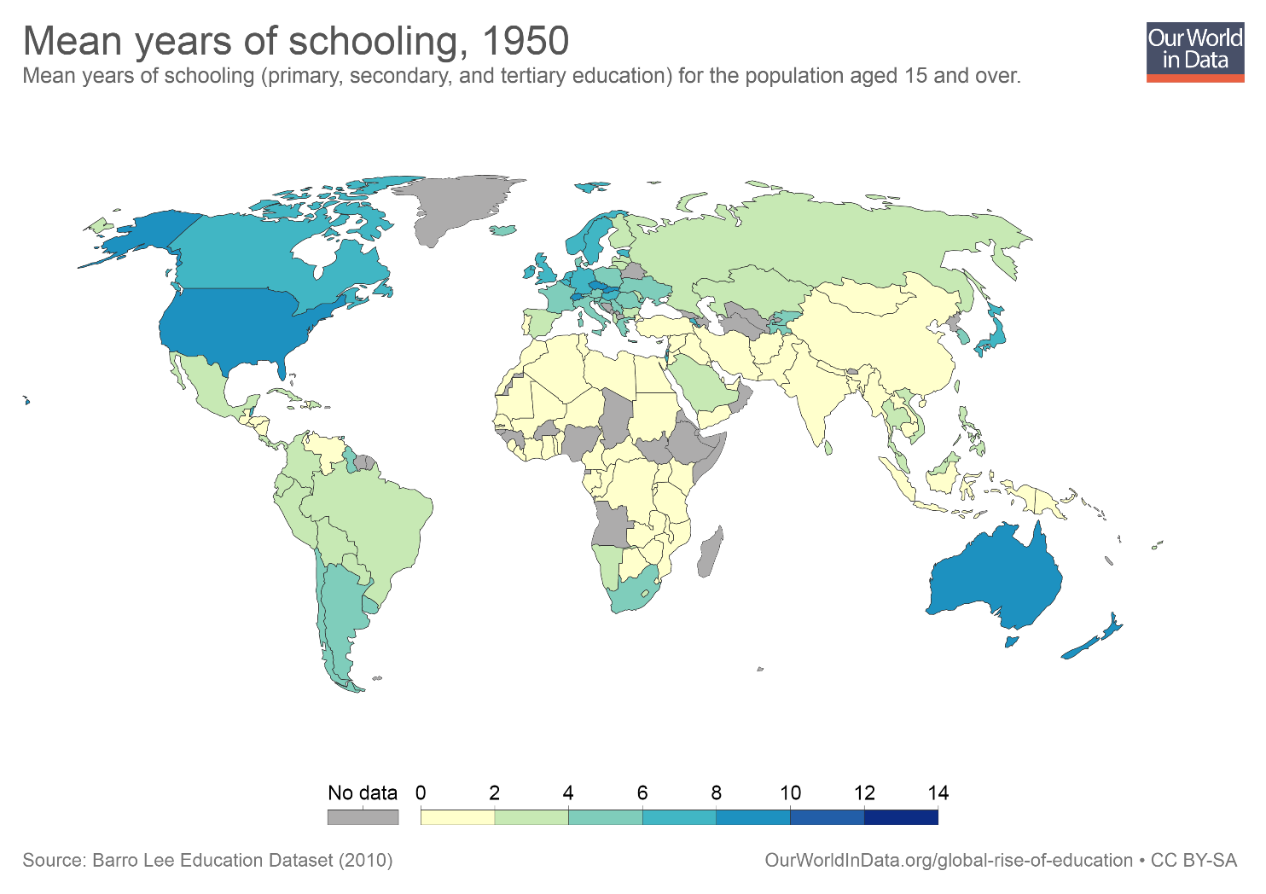

Slide 3
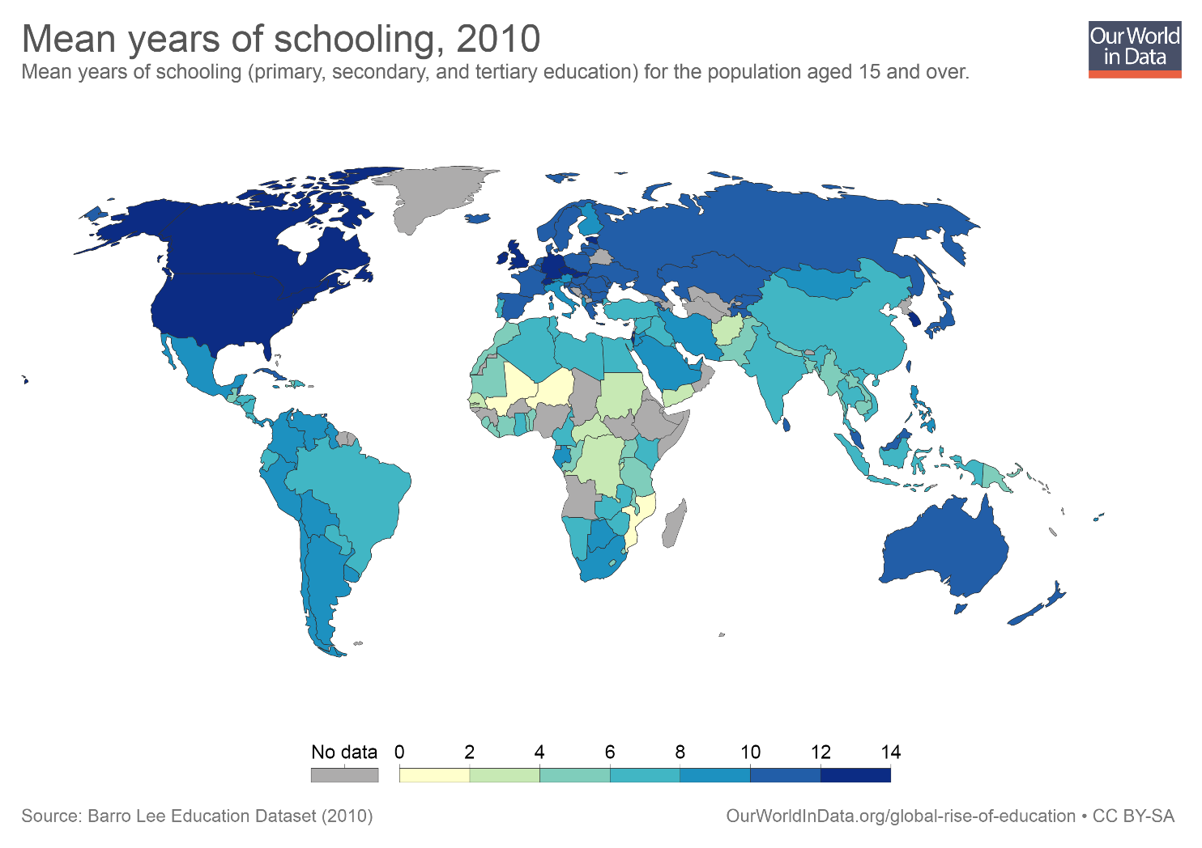

Slide 4
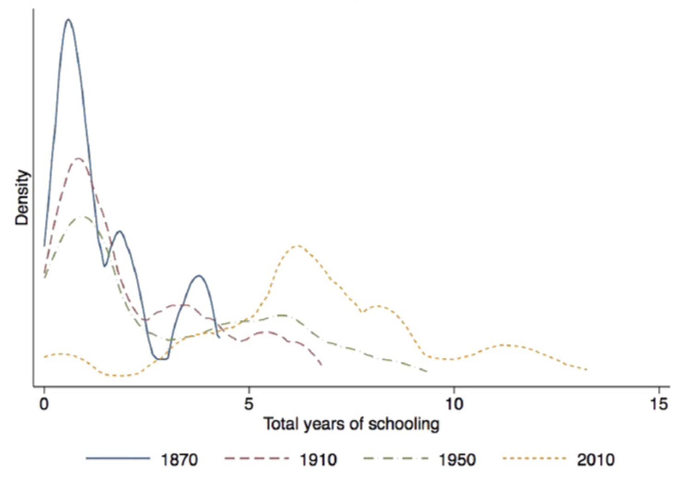
Source: Lee and Lee (2016)

Slide 5
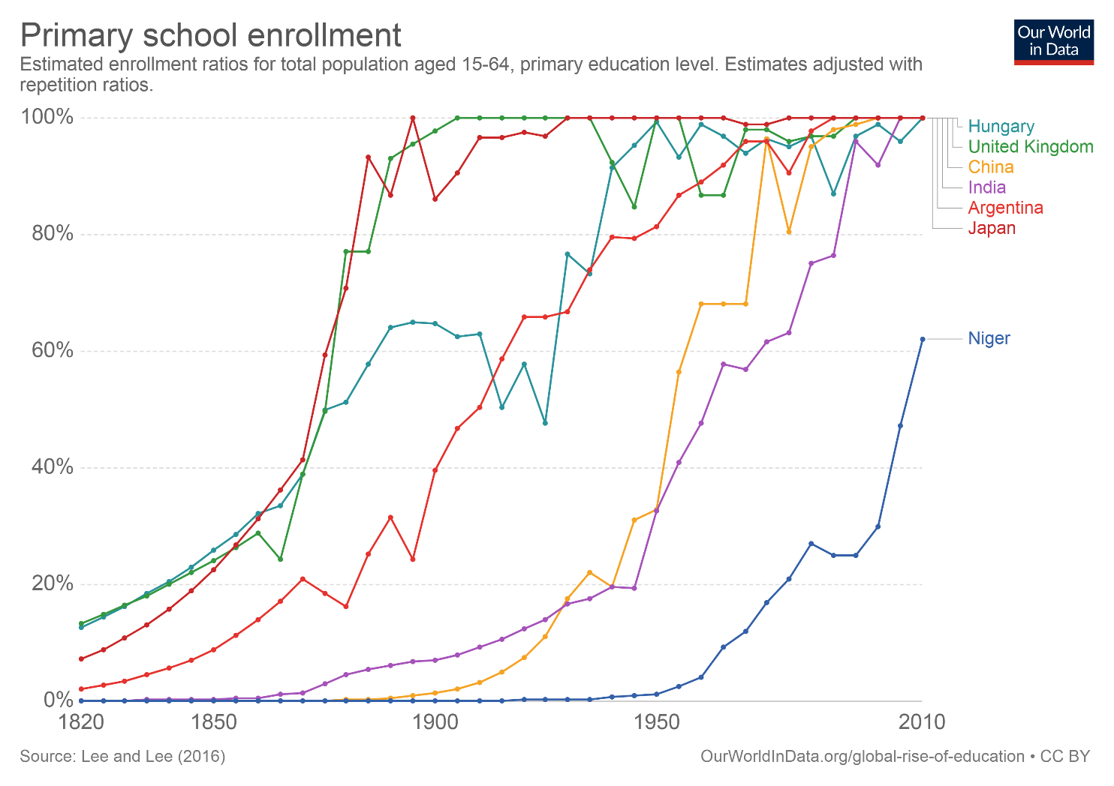

Slide 6
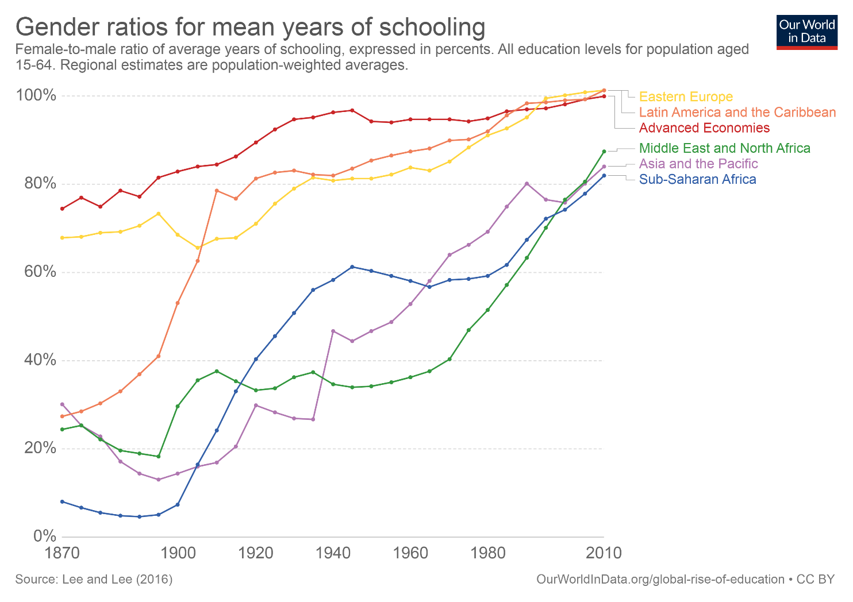

Slide 7
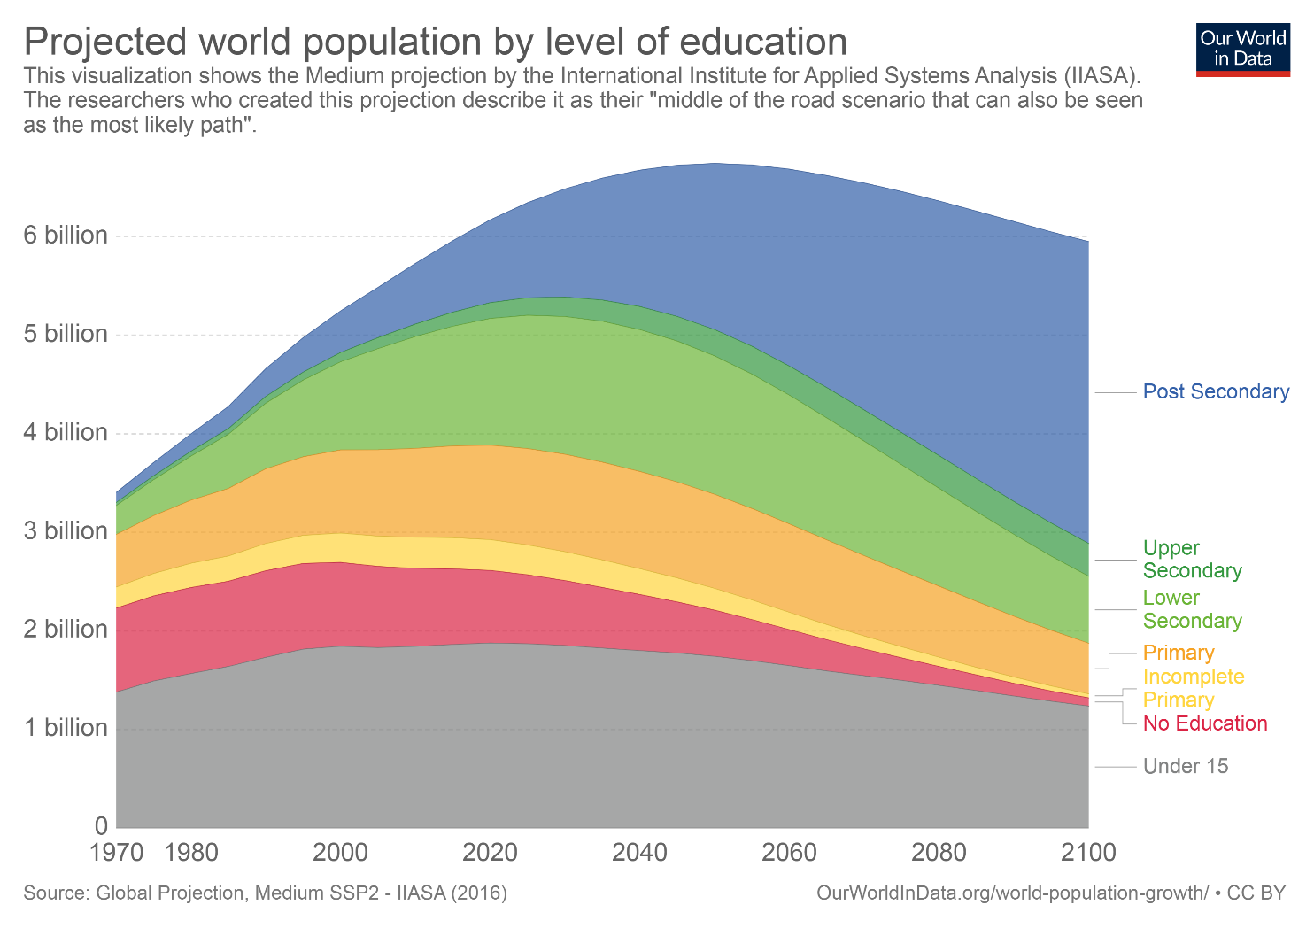

Slide 8
What does education do?
The human capital model
  More education = more productive
  This is surprisingly hard to prove!
Indirect evidence – wages
  Employers observe productivity, and pay accordingly
  Wage differential between college grad and HS grad is the skill premium

Slide 9
An alternative theory – signaling model
College doesn’t improve productivity – it is a sorting mechanism that helps employer identify the skilled
  Getting a college degree is hard
  Only the skilled make it through
  The degree acts as a signal of skill, even if one learns nothing in college
Evidence – returns to education highest early in career, declining thereafter as employers “learn” about productivity (Altonji and Pierret 2001)
  Counterpoint – employer learning model doesn’t work as well for recent cohorts
Caplan – The Case Against Education (2017)

Slide 10
Signaling Model
Evidence against
  Compulsory schooling laws (Krueger 2002)
  No signaling value of a HS diploma (Clark and Martorell 2014)
  Returns to college credits, not just “sheepskin” (Kane and Rouse 1995; Jacobson, LaLonde and Sullivan 2005)
Can clearly reject for some forms of education
Autodidacts among us are biased toward the signaling story
  But proof by introspection can be misleading
  Reality is probably somewhere in between
One test – does schooling increase measured skills?
  Cascio and Lewis (2006), Carlsson et al (2015) – in Sweden, 10 extra days of school increases “crystallized intelligence” by 0.01 SD
    An extra year of schooling = ~0.2 SDs

Slide 11
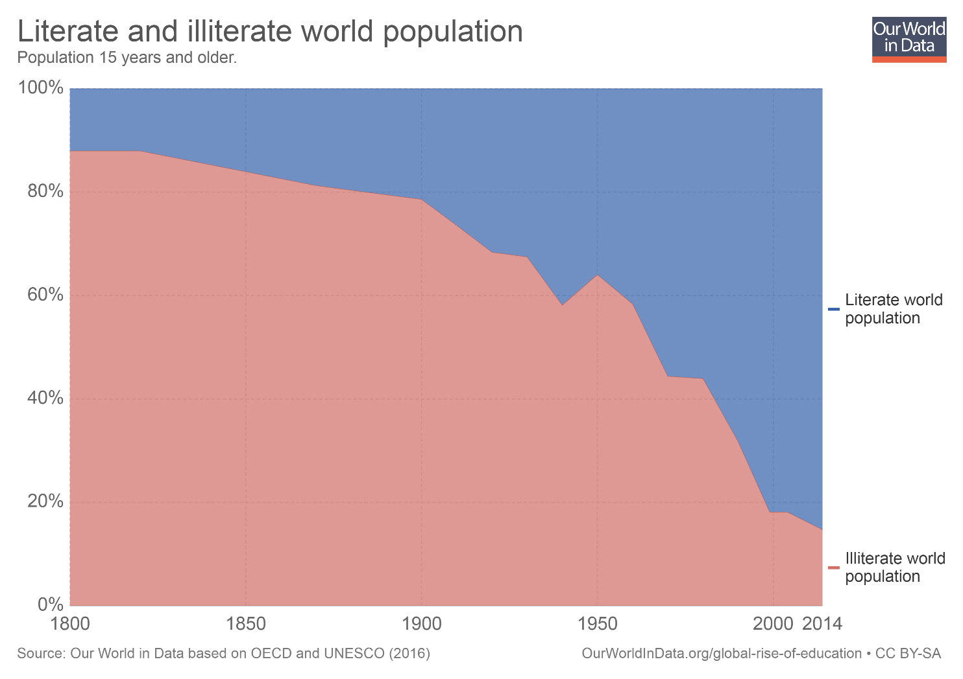

Slide 12
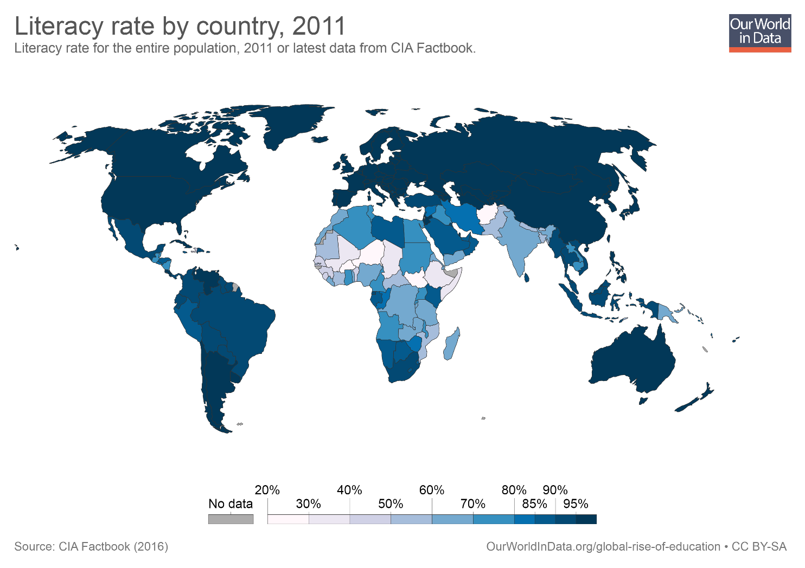

Slide 13
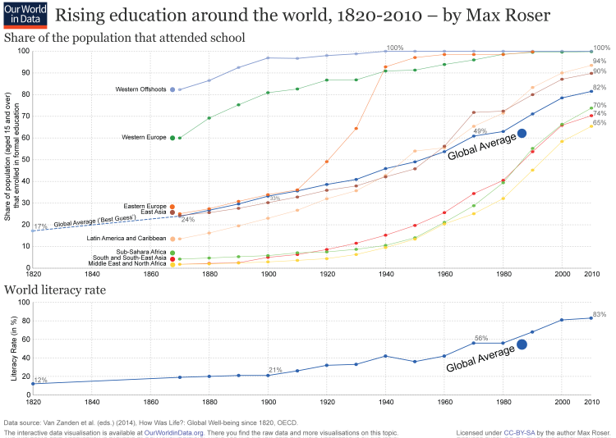

Slide 14
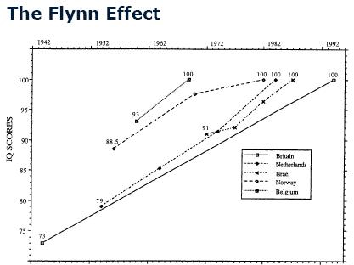
Source: Flynn (2007)

Slide 15
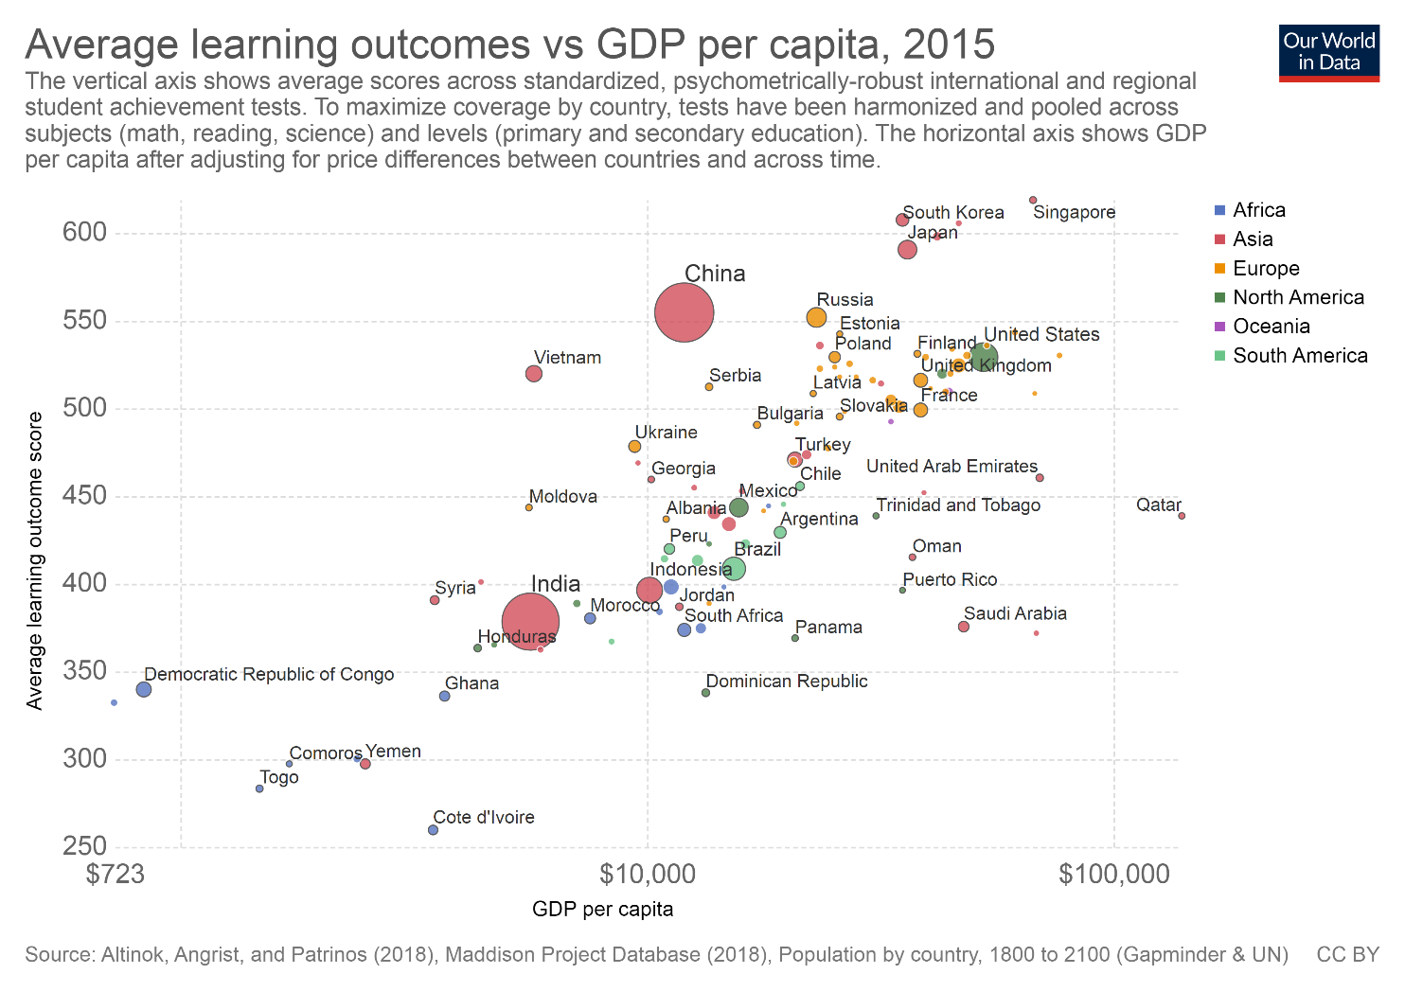

Slide 16
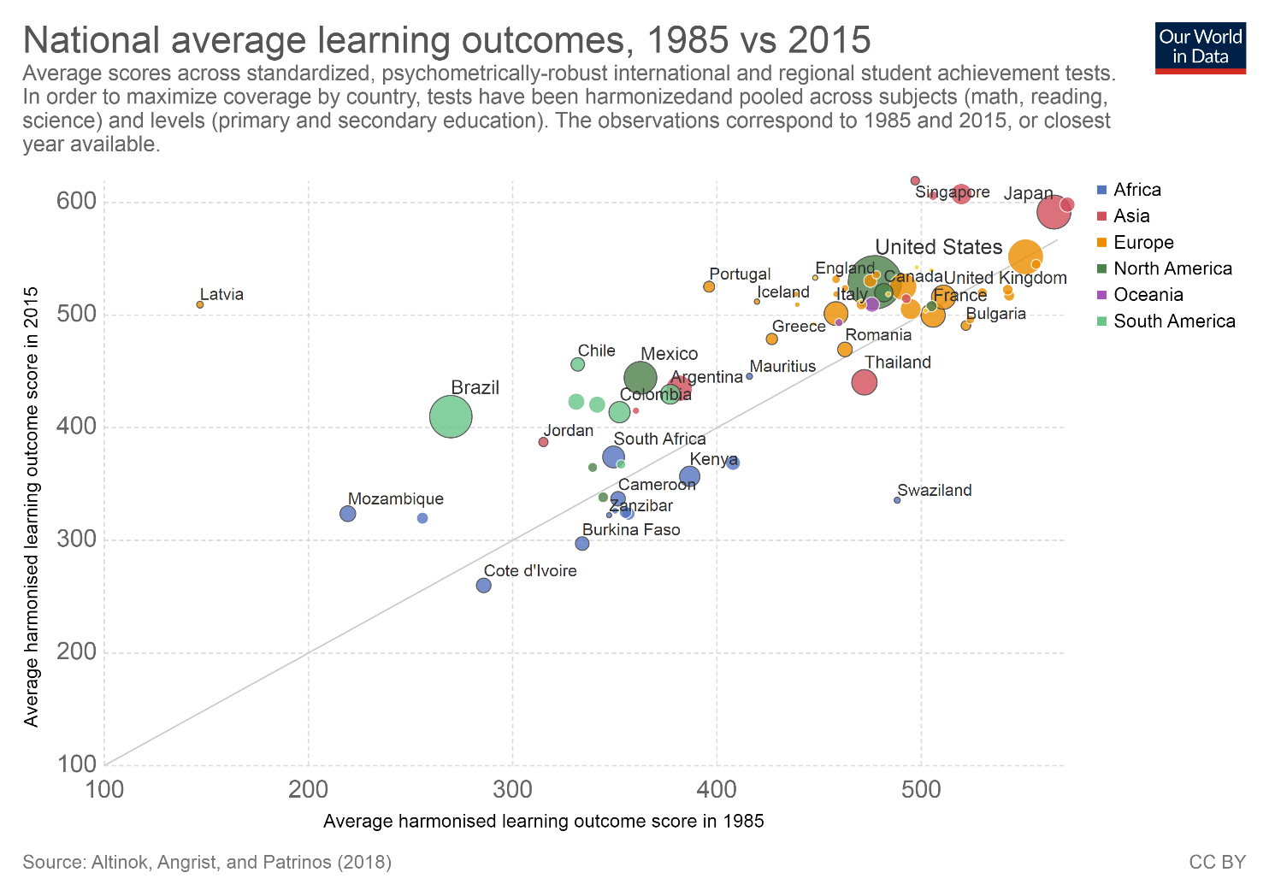

Slide 17
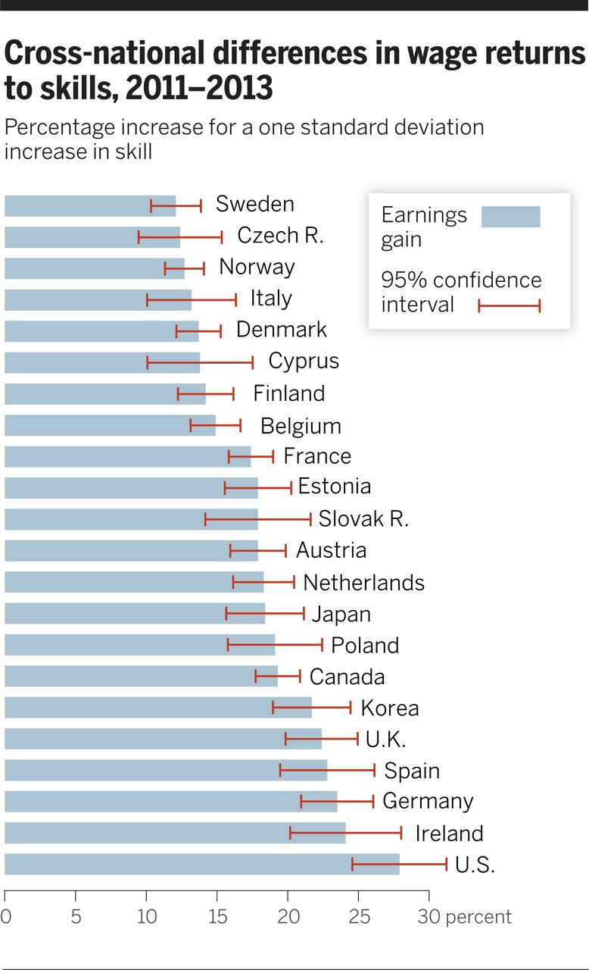

Fig. 2 Cross-national differences in wage returns to skills, 2011–2013.
David H. Autor Science 2014;344:843-851
Notes:
Cross-national differences in wage returns to skills, 2011–2013. Reproduced with permission from Hanushek et al. [(15), table 2]. Estimates are obtained by regressing the natural logarithm of workers’ weekly full-time earnings on test scores while controlling for sex and labor market experience (both a linear and a quadratic term). Regression estimates are performed separately for each country and test scores are normalized with mean zero and unit standard deviation within each country. Estimates that normalize test scores on a common basis across countries, or that use literacy or problem-solving scores rather than numeracy scores, yield qualitatively similar patterns.

Slide 18
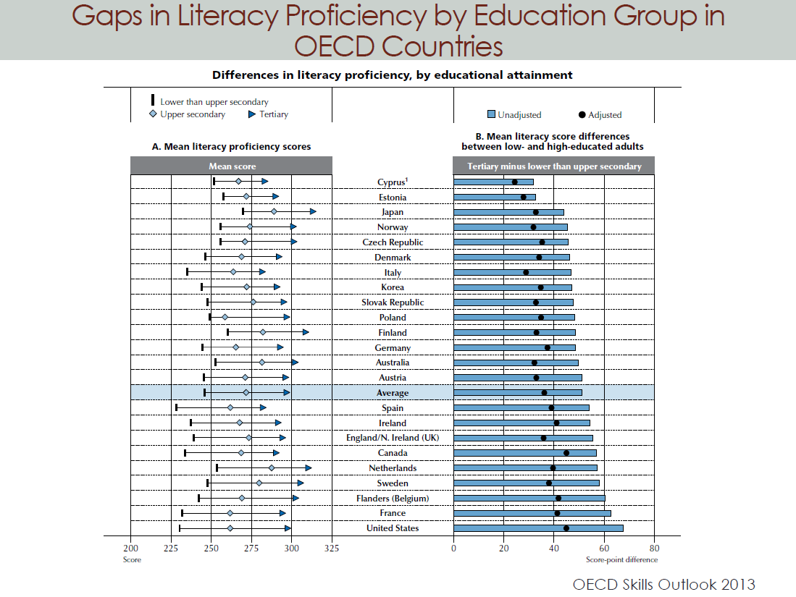

Slide 19
Connecting education and skills
Average education levels around the world have increased enormously over the last half-century
  Also true for test scores (skills)
How has the economic return to education changed over this period?

Slide 20
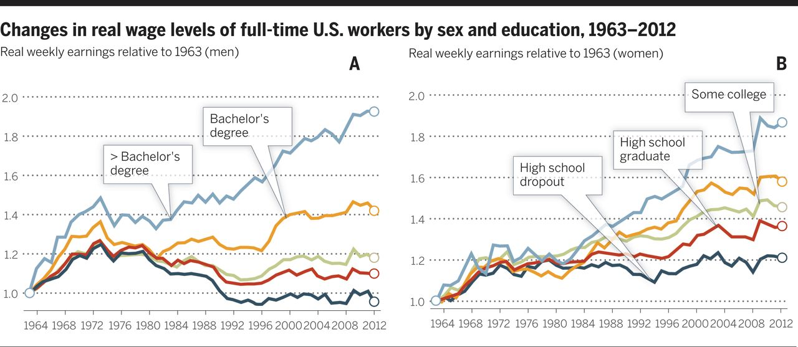
Fig. 6 Change in real wage levels of full-time workers by education, 1963–2012.
David H. Autor Science 2014;344:843-851
Published by AAAS
Notes:
Change in real wage levels of full-time workers by education, 1963–2012. (A) Male workers, (B) female workers. Data and sample construction are as in Fig. 3.

Slide 21
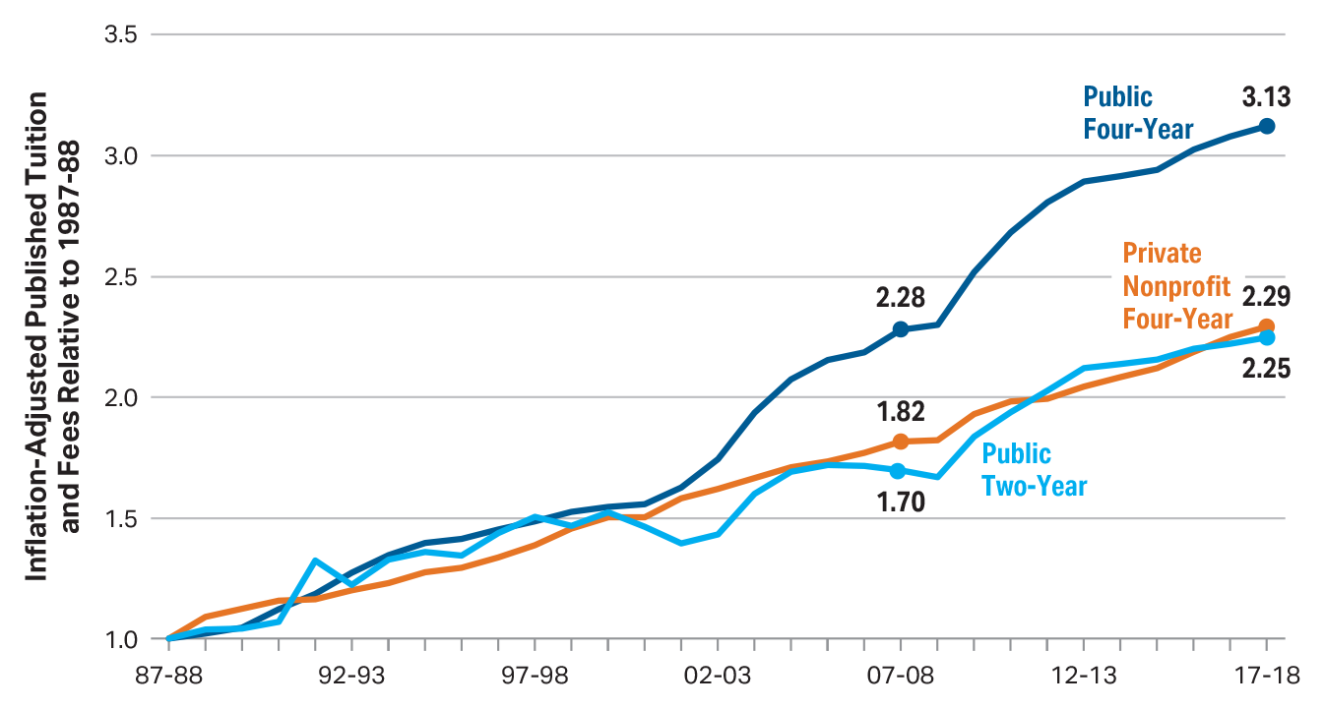
Inflation-Adjusted Published Tuition and Fees Relative to 1987-88, 1987-88 to 2017-18 (1987-88 = 1.0)
Source: The College Board, Trends in College Pricing 2017, Figure 4B.

Slide 22
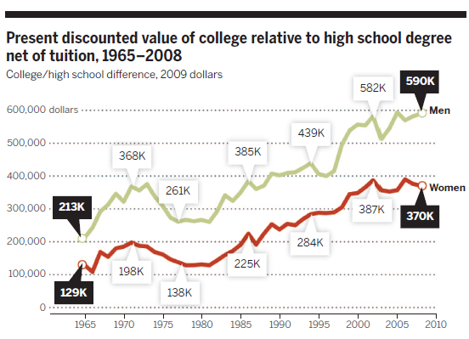

Slide 23
Education and the College Wage Premium
Worker earnings depend on relative productivity – skills required (demand) and scarcity of them (supply)
  Long view – skills clearly more important now than in 1900
College wage premium is determined by:
  Supply of college graduates relative to HS graduates
  Demand for college “skills”

Slide 25
The supply-demand framework
Predict college premium as a function of:
  Supply of skills – Ratio of college grads to high school grads
  Time trend (flexible)
Asks whether changes in the (relative) frequency of college grads is strongly correlated with (e.g. “explains”) changes in the economic return to a college degree.
“The race” – college premium increases when demand grows faster than supply

Slide 28
The Race
SDI framework fits the data remarkably well
Implies high return to college is due in part to slow supply growth
What is happening in the rest of the world?

Slide 30
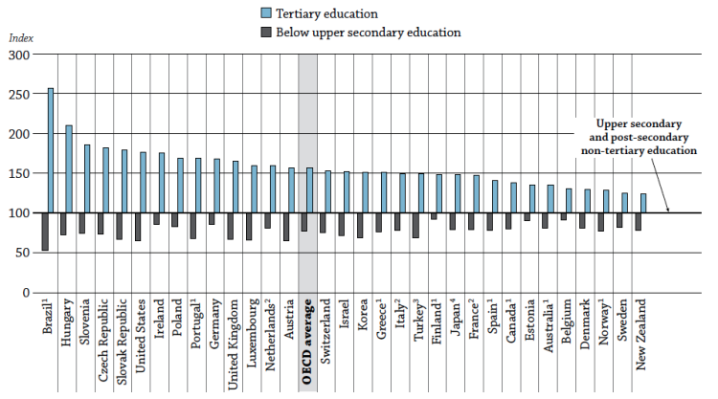

Slide 31
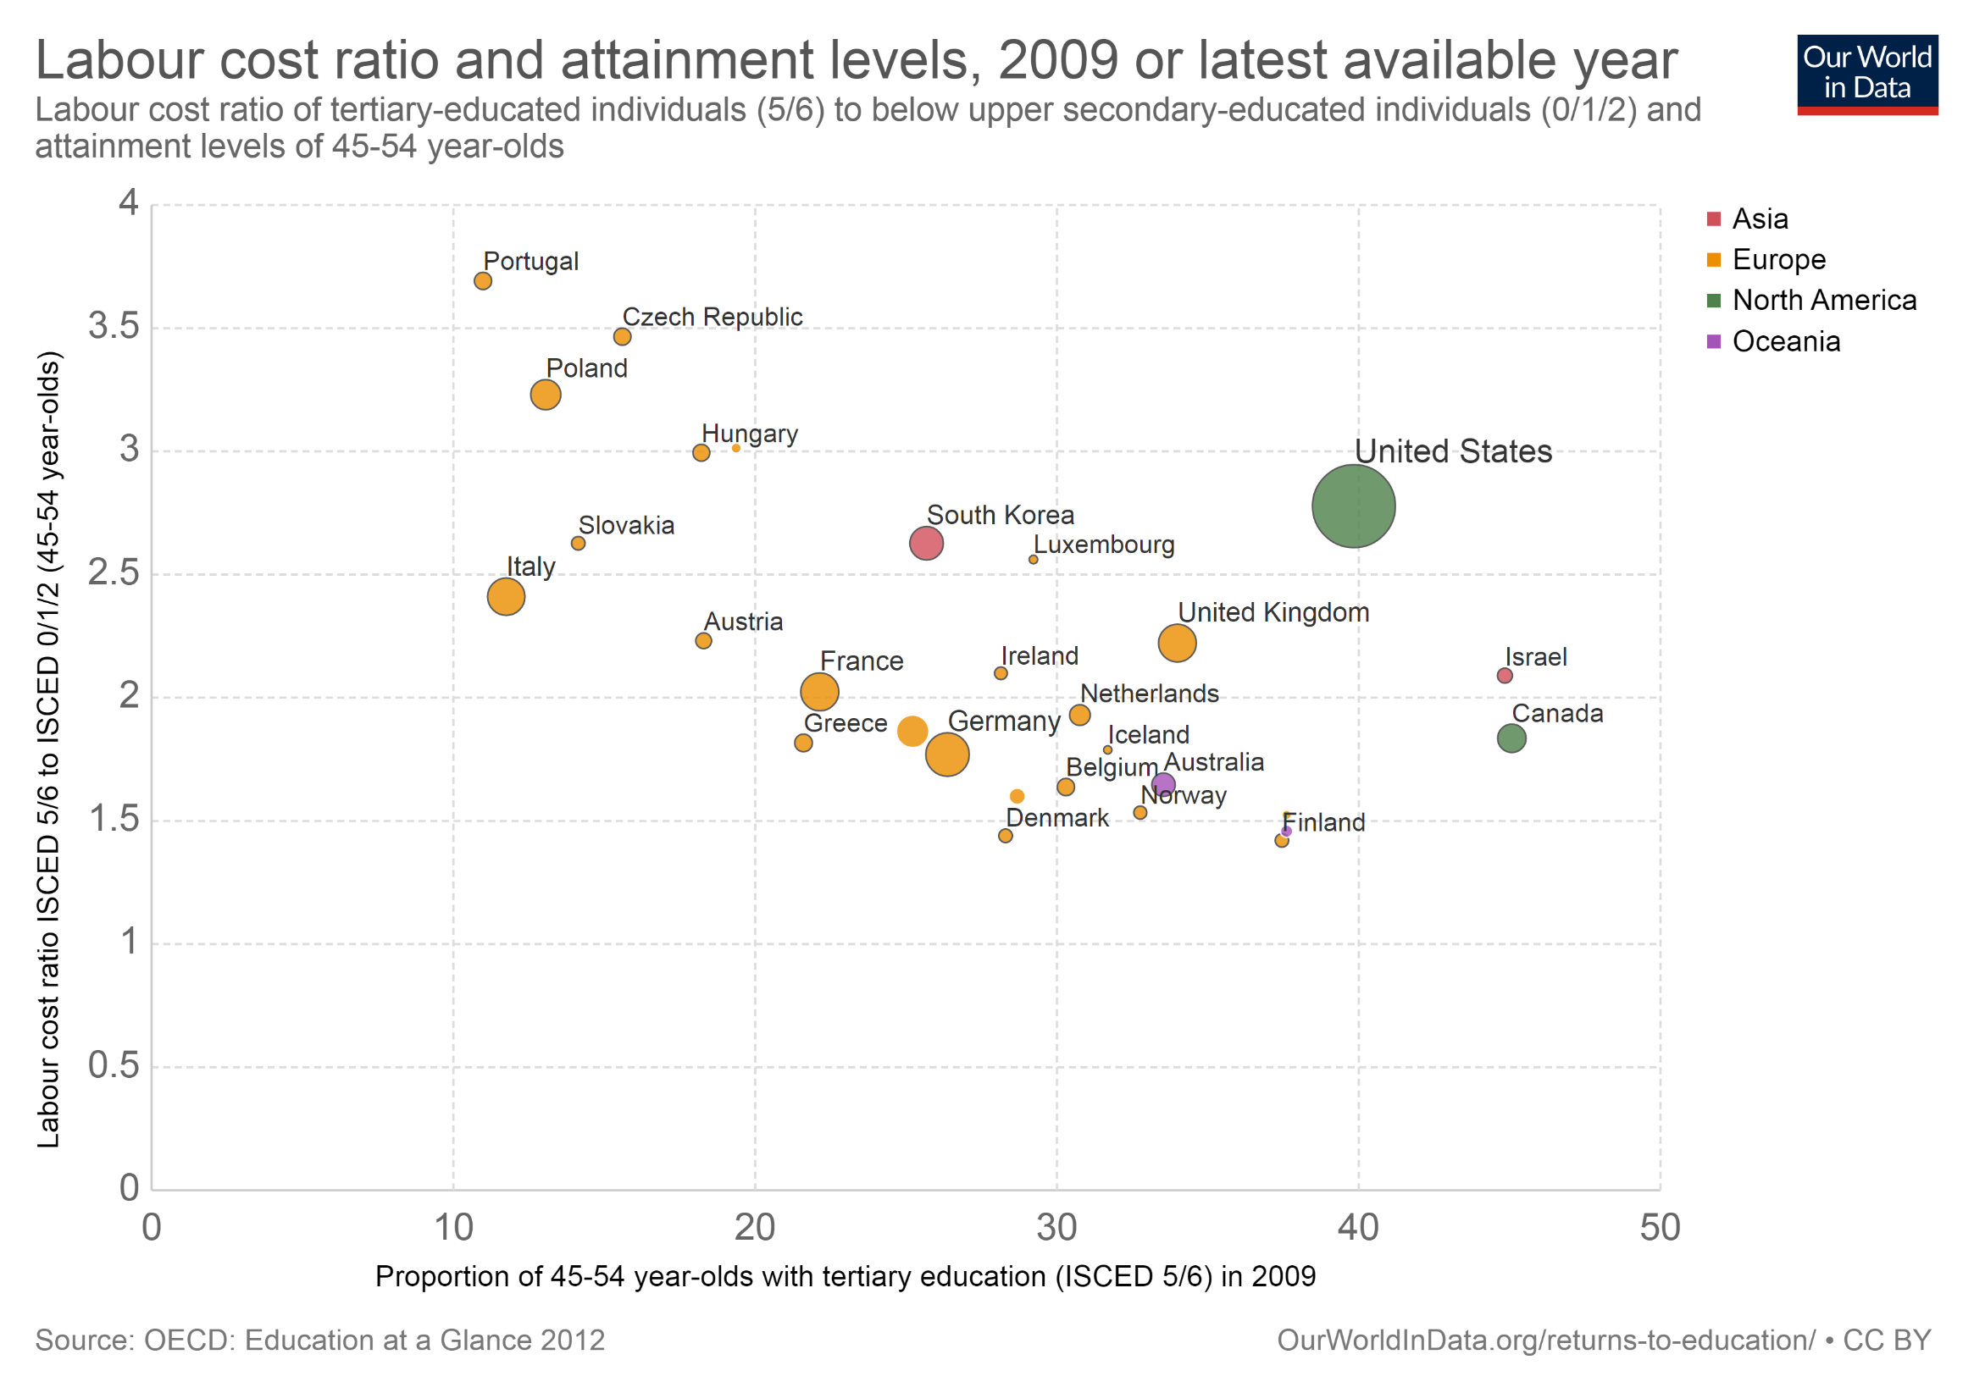

Slide 32
Why is the return to education rising?
Growing demand is inferred from the education race model
  If supply is growing, and college premium still rising, demand must have grown faster
  Not directly demonstrated
  Must be true in long view
  A worldwide phenomenon
Unsatisfying. What does education do?
  Skill-biased technological change (SBTC)

Slide 33
How have computers changed the labor market?
Computers execute procedural, rules-based logic with ruthless efficiency
  Substitute for human labor in such “routine” tasks
Can also make non-routine tasks (and the workers who perform them) more productive
  MS Excel
  Statistical analysis
  Google
  ICT and human resources
If computers replace routine tasks, how does this affects the returns to skills and the returns to education?

Slide 34
Source: World Bank (2016)

Slide 35
Source: World Bank (2016)

Slide 36
Technology in banking
Some tasks are difficult for humans, but easy for computers (calculus); but also vice versa (walking down stairs)
  “We know more than we can tell”
  What is meant by skilled?
Check processing – precision, accuracy
  OCR technology
  What about exceptions (3%)?

Slide 37
Upstairs, downstairs
Exceptions are nonroutine by definition
  If common, we develop a process for them!
  Sometimes, exceptions are rare but crucial
The production function and unbundling of tasks
  Assembly lines – easy to separate tasks
  “O-Ring”
  Ability to “see the whole picture”….
Bottom line – fewer jobs, but remaining jobs more interesting and higher-paying

Slide 38
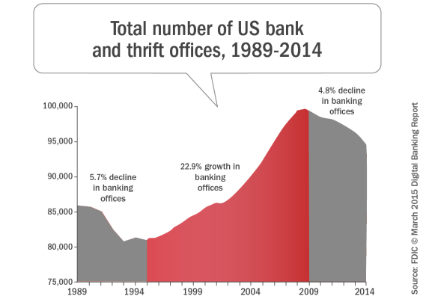

Slide 39
Discussion Exercise
What explains the fall, and then subsequent rise, in bank branches? How does this compare to technological change in other fields, such as agriculture?
Think of your own example of a workplace that was changed by technology.
  This could be from your own experience, or something you read about.
  Think carefully – which skills/tasks are substituted? Which are complemented?
  How does education interact with technological change in your example?

Slide 40
How do computers fit into the “race”?
Standard framework
  education = skill
  more skill = more productive
  No accounting of what workers and computers actually do
The task framework
  Computers are relatively more productive in routine tasks
  Computers complement high-skilled, abstract tasks
  Neutral impact on low-skilled, manual tasks
“Polarization” – the disappearing middle

Slide 41
Education and economic growth
Malthus – finite quantity of resources = no possibility of sustained progress
Ideas are different
  “Codified knowledge about the properties of one from a near-infinite set of possibilities”
  Recipes that can be copied and shared
    Can offset resource scarcity
    People are no longer our rivals
Knowledge is a non-rival good – not depleted by use

Slide 42
Romer - endogenous growth
Factory, materials, workers – constant returns to scale
  Double the inputs, double the outputs
Since ideas are non-rival, ideas + inputs creates increasing returns to scale
  Better idea about how to make a product or process = double output, without doubling input
  Result – more growth!
Why endogenous?
“the increasing returns associated with non-rivalry means that a perfectly competitive equilibrium with no externalities will not exist and cannot decentralize the allocation of resources. Instead, some departure is necessary.”
Translation – knowledge is underprovided by the free market.
  Knowledge investment determines long-run growth rate

Slide 43
Why don’t we have more ideas?
In a competitive economy, market prices are a “scarcity signal”
  Encourage private investment - for private gain - in goods that are valued by society
Skills/education have a private return on investment
Almost all private investments have diminishing returns….
What is the marginal cost of providing more knowledge?
  Zero – therefore this is “optimal” price that should be charged to access it
But private investments don’t get us there – thus knowledge is underprovided
How should we think about IP law? Teaching vs. research?

Slide 44
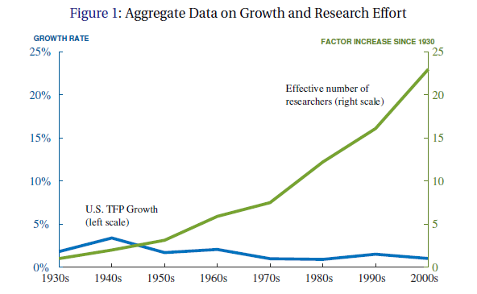
Are ideas getting harder to find?

Slide 45
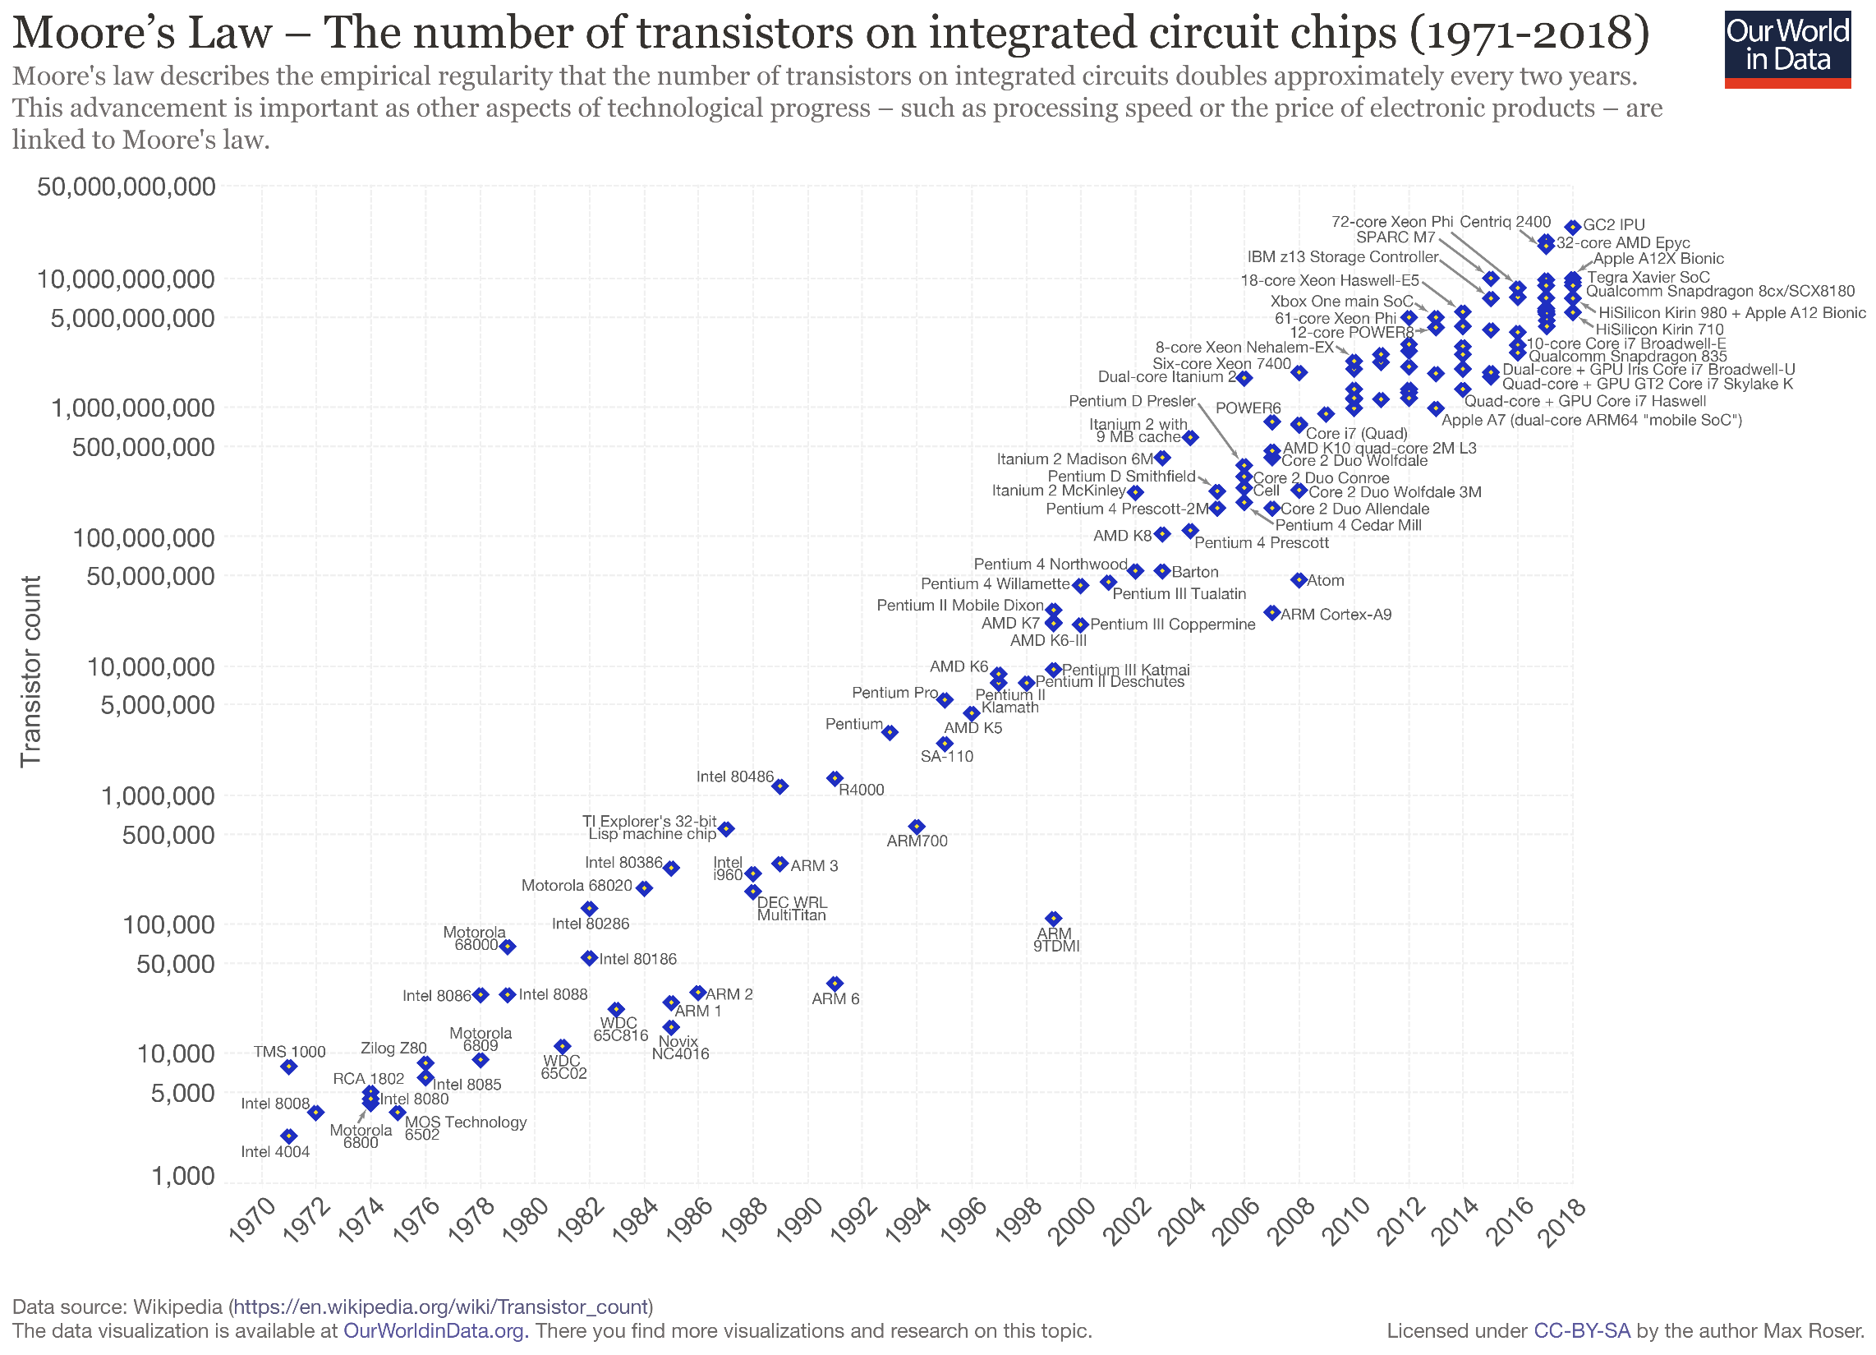

Slide 46
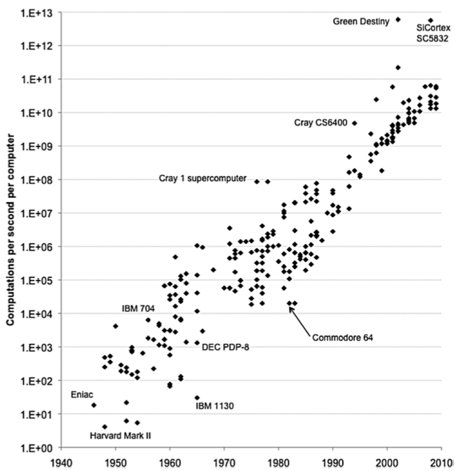

Slide 48
Other examples
Agricultural yields
Medical innovation
Why?
  Diminishing returns
  Basic vs. applied research
  Defensive R&D

Slide 49
If you think education is expensive, try ignorance.
My bottom line – the evidence that education increases skills/earnings is among the strongest and most robust relationships in social science.
Understanding what education does has obvious policy implications.
  Economists should understand this better than we do.
If education has such high returns, why don’t people invest more?
  Credit constraints
  Information
  Externalities and the accident of birth
If knowledge production has such high returns, why doesn’t society invest more?

