Slide 1
Families, Children and Early Environments
David J. Deming
SUP 206, Fall 2019

Slide 2
The Plan
Early life circumstances and child development
The Fetal Origins Hypothesis
Skill begets skill?
Return on investment, throughout the life cycle

Slide 3
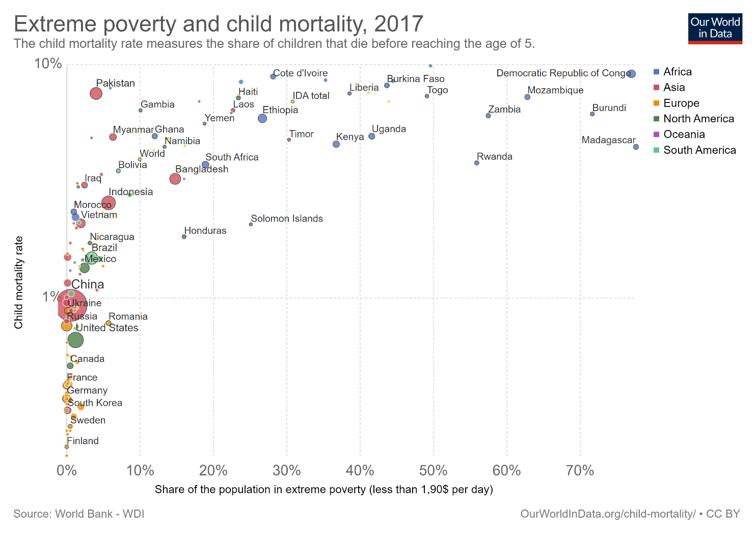

Slide 4
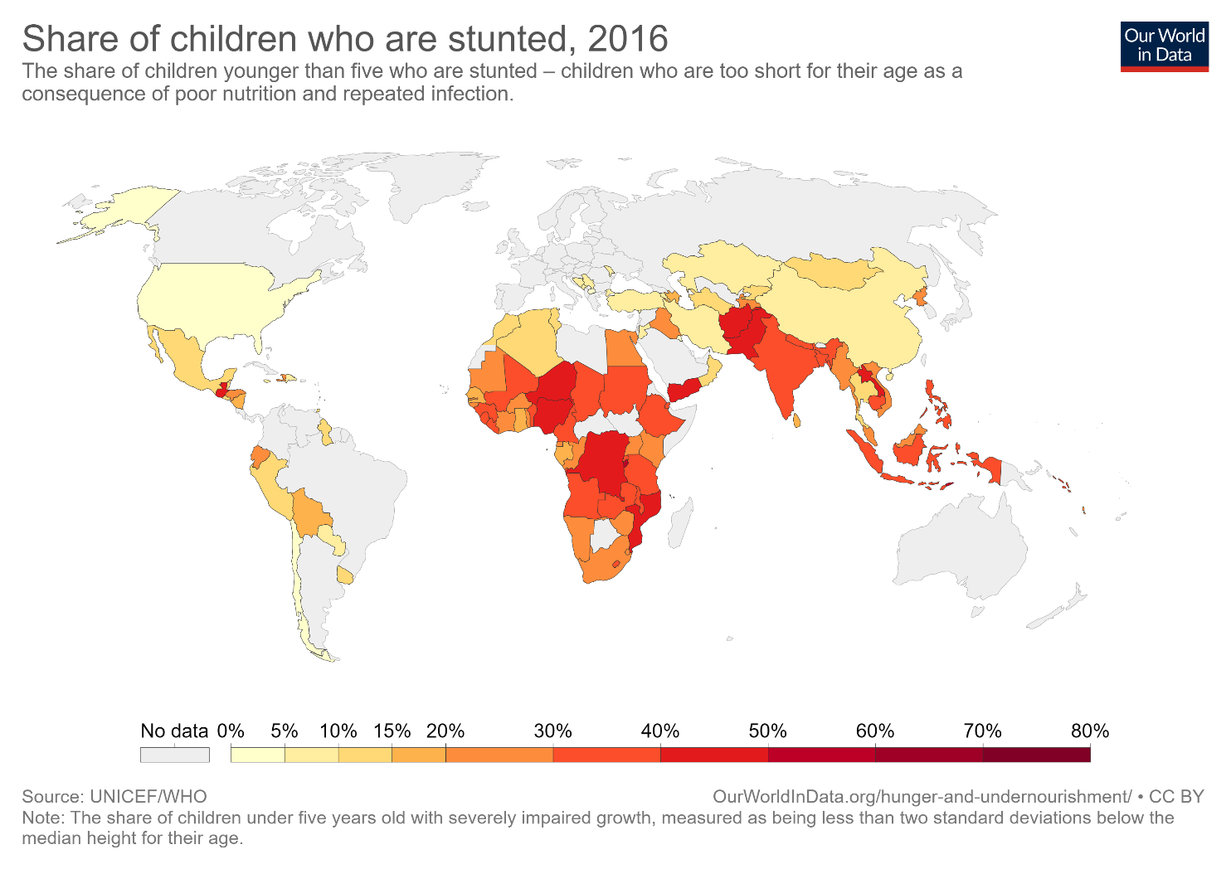

Slide 5
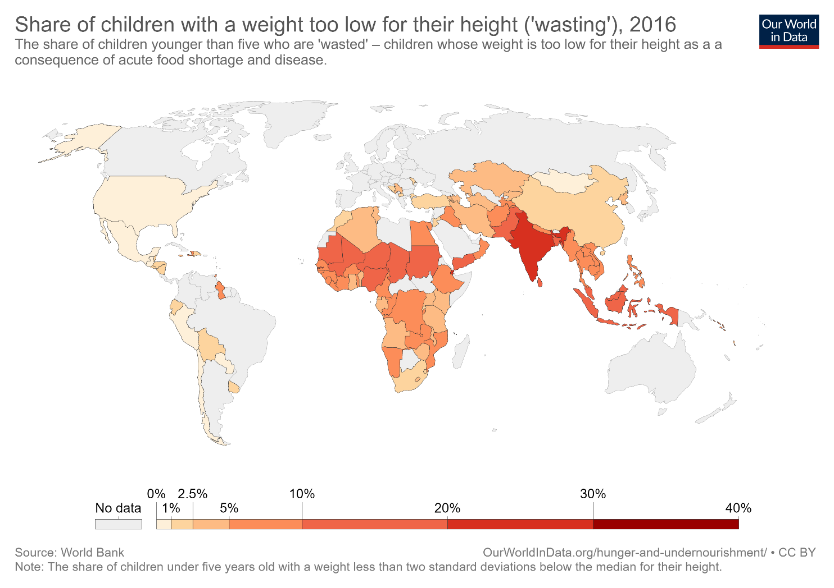

Slide 6
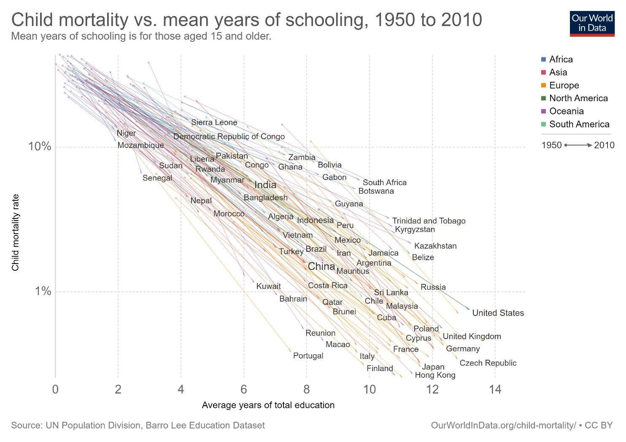

Slide 7
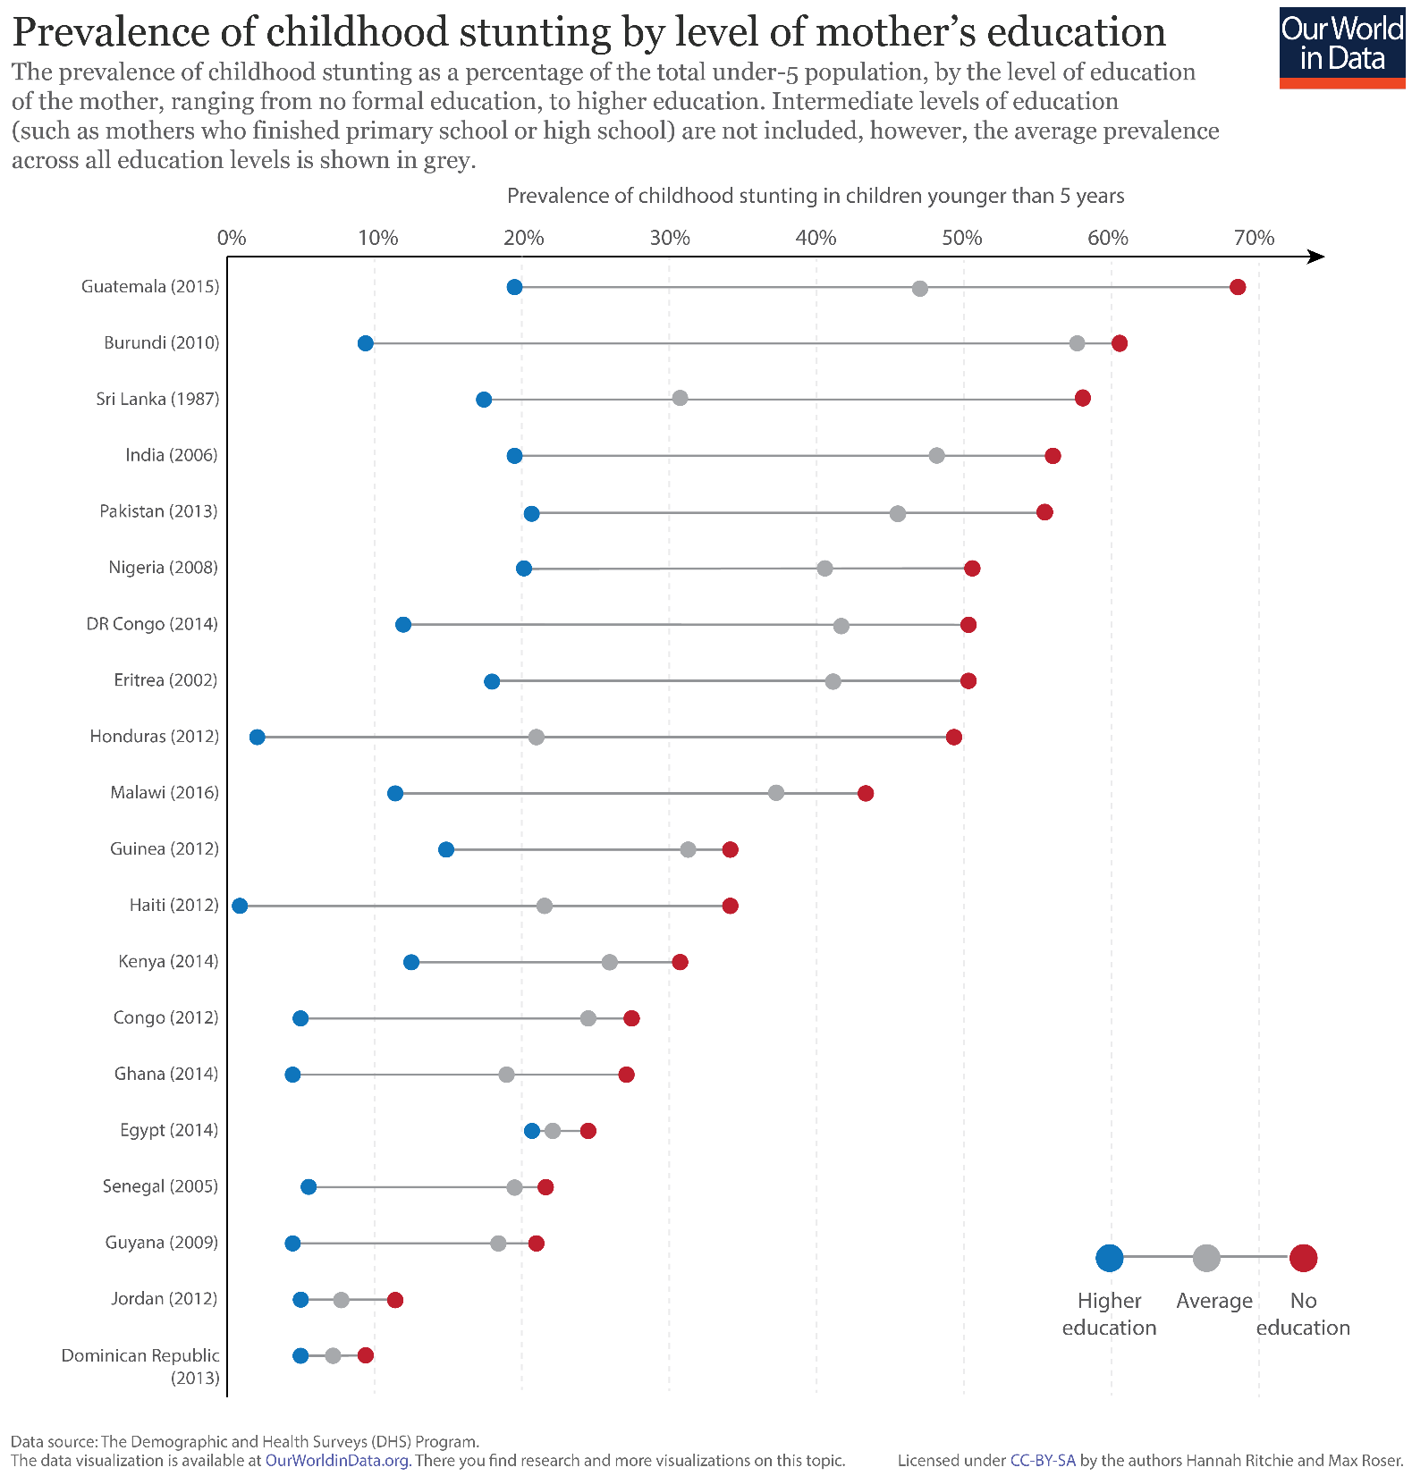

Slide 8
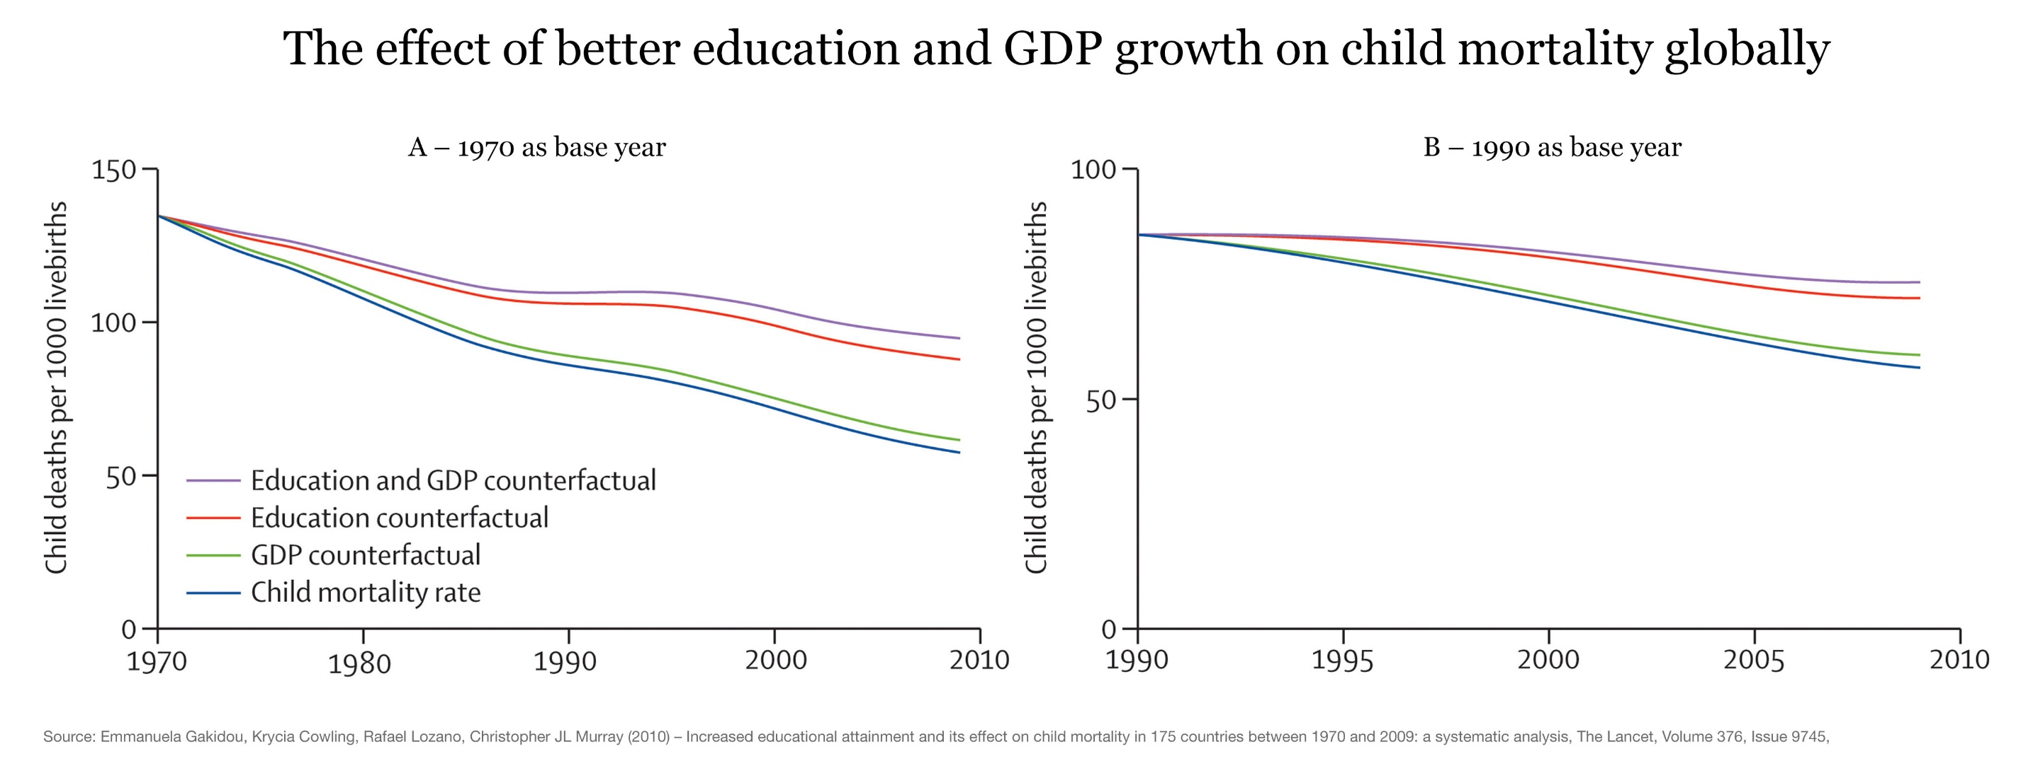

Slide 9
The Fetal Origins Hypothesis
Barker (1992) – adult health determined by in utero circumstances
  Link between poor fetal nutrition and chronic adult conditions such as diabetes, obesity
  Fetal “programming” - stress and cognitive development
  Impacts can be persistent and latent
Evidence mostly from extreme events – influenza pandemic, nuclear fallout, fasting, terrorism…

Slide 10
Source: Almond (2006)

Slide 11
Source: Almond (2006)

Slide 12
Source: Almond (2006)

Slide 14
Source: Almond, Edlund and Palme (2009)

Slide 15
Does the logic of fetal origins apply to “regular” life?

Slide 16
Source: Currie (2011)

Slide 17
Source: Figlio et al (2016)

Slide 18
Source: Figlio et al (2016)

Slide 19
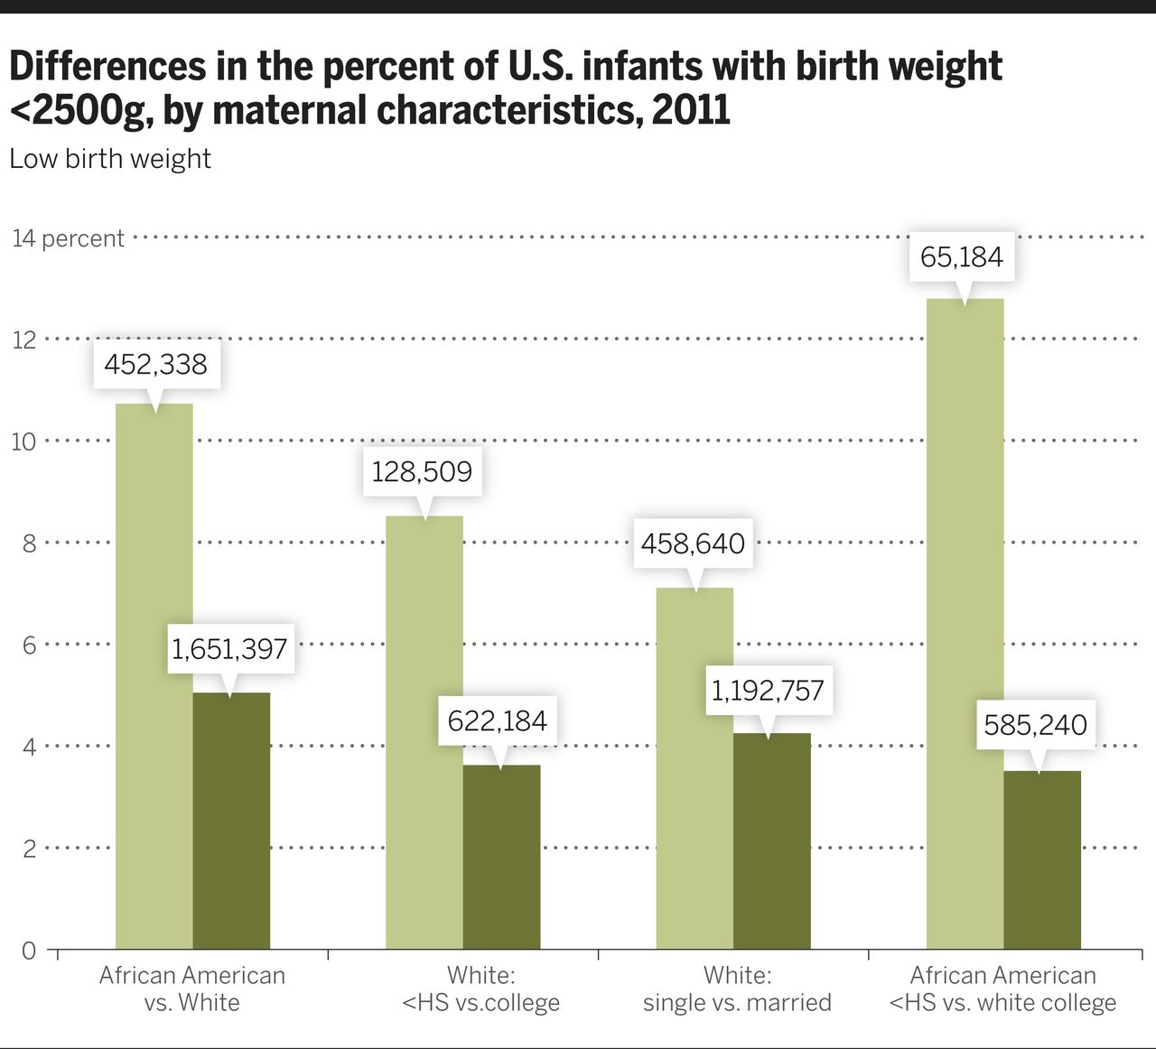
Source: Aizer and Currie (2014)

Slide 20
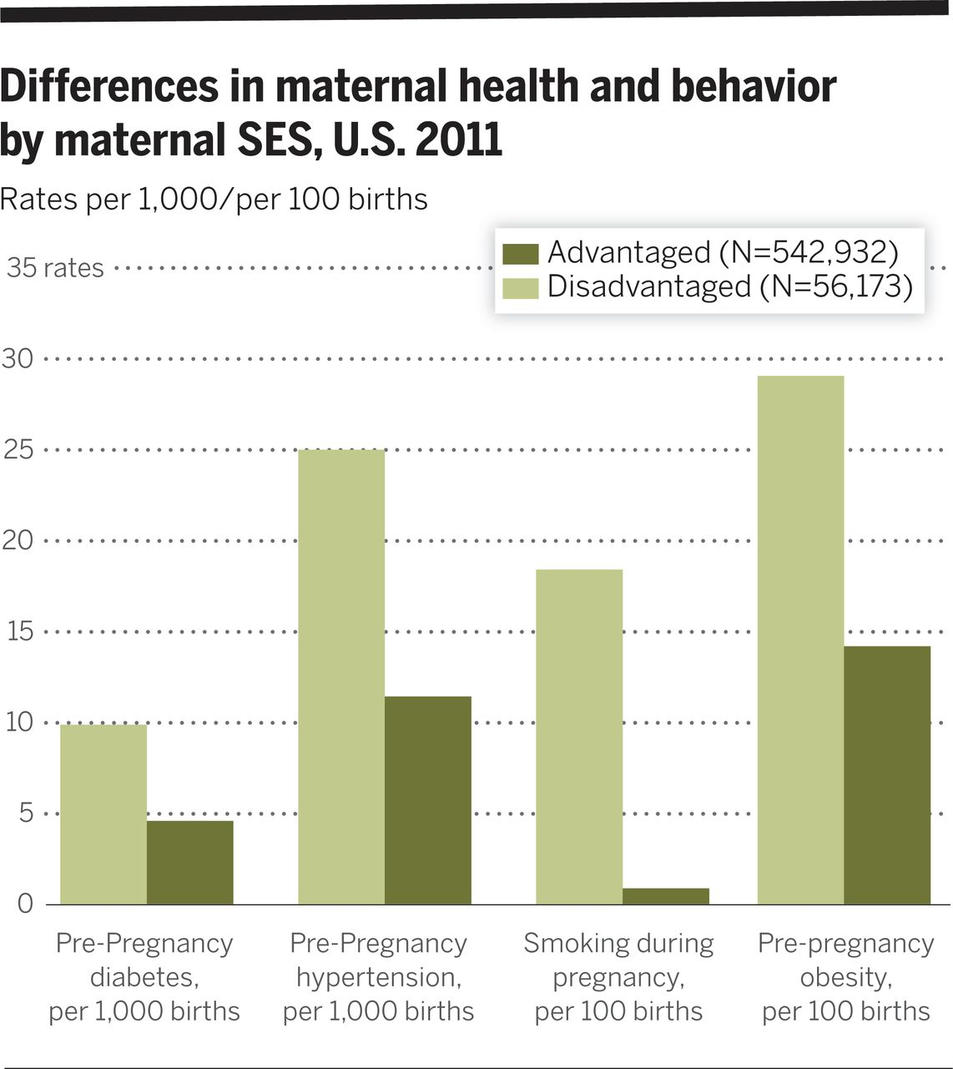
Source: Aizer and Currie (2014)

Slide 21
Health and human capital
Early life health strongly linked to later life development
Stunting, low birthweight, other markers of distress
Many of these are linked to child poverty
What is the role of child care and schooling? Can early intervention help?

Slide 22
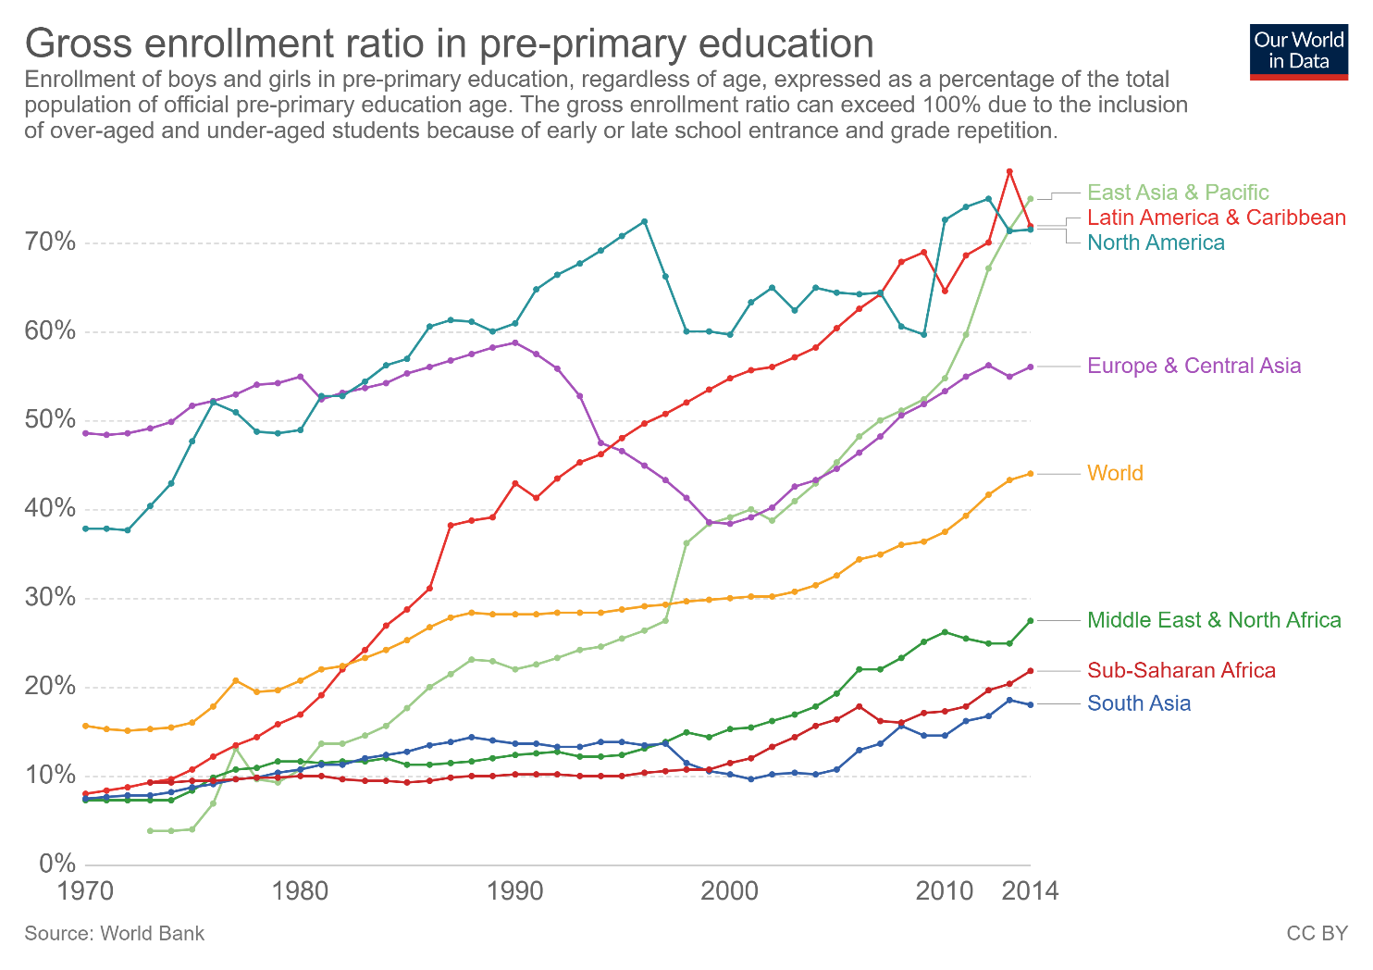

Slide 23
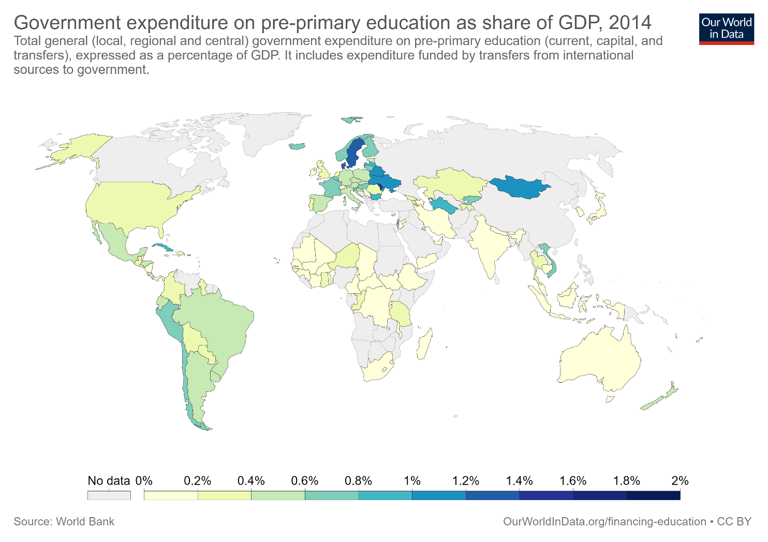

Slide 24
Source: Duncan and Magnuson (2011)

Slide 26
Human capital investments over the life cycle
Large achievement/attainment gaps by race, income, parental education
Gaps emerge very early, little evidence that they widen over time
Does this imply that it is “too late” to intervene?

Slide 27
“Skill begets skill”
Adult health and cognitive development are clearly responsive to early life conditions
  Are we more responsive at earlier stages of life?
Critical and sensitive periods
  Vision, language development, IQ
Heckman – human capital investments at one life stage make later stage investments more productive
  Skill begets skill
Implication is that earlier investments have a higher rate of return

Slide 28
Source: Cunha et al (2006)

Slide 29
Source: Cunha et al (2006)

Slide 33
The Perry Preschool Project
123 low-income African-American children from Ypsilanti, MI
  58 received two years of preschool at ages 3 and 4, 5 days a week, 2.5 hours per day
    Teachers had BA degrees; home visitation and parental involvement component
  65 received nothing
  Sample was selected for low child IQ, low income, low parental education
High/Scope curriculum – “active learning”, planning, collaboration
Large initial impacts on IQ, but “fade out” over time

Slide 34
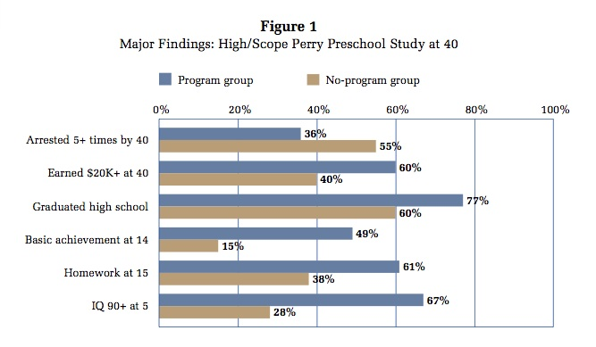
Source: Schweinhart et al (2011)

Slide 35
How to calculate the “rate of return”
Administrative costs – salaries, training, facilities etc..
  This is usually straightforward
Benefits – education, earnings gains, health, etc.
  Private benefits – was the child better off?
  Social benefits – was society made better off?
    Savings from grade promotion
    Reduced social assistance payments
    Increased tax revenues
    Criminal victimization
If the social returns are high enough, there is no equity-efficiency tradeoff

Slide 36
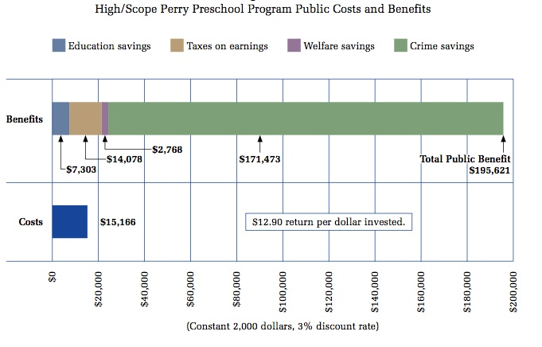
Source: Schweinhart et al (2011)

Slide 37
Interpreting Perry
Other programs (Carolina Abecedarian) have shown long-term benefits
  Also a small, “model” program targeted toward extremely disadvantaged children
Head Start (Deming 2009)
  Long-run impacts on attainment, health
  No impact on crime; effect sizes vs. monetary value of benefits
What can we learn from these studies?
  Higher return for more disadvantaged children
  Access more important than quality diffs (e.g. Kline and Walters 2016)

Slide 38
“Life After Lead” - Source: Billings and Schnepel (2018)

Slide 39
Does skill beget skill?
Large, long-run impacts of early life interventions
But the theory also implies:
  Widening skill gaps over time
  Diminishing returns to later life interventions
Evidence lags behind theory
  NAEP, other sources show constant skill gaps
  Big impacts of spending (K-12 and higher ed)
  Charter schools and school quality diffs
The Heckman theory is surprisingly difficult to test
  Need same intervention at different stages
  Or show that interventions are complements
Rossin-Slater and Wust (2016) – large LT gains from pre-K in Denmark, but smaller gains for children who were also in a home visiting program
  Implies that interventions are substitutes

Slide 40
What about later life interventions?
We will talk about K-12 and higher education interventions in more detail in the next class
To answer the Heckman question directly, we need a common framework with which we can compare all potential public investments
“A Unified Welfare Analysis of Government Policies”

Slide 41
The Marginal Value of Public Funds (MVPF)
Public because the government has to tax citizens to pay for social programs
Marginal because every dollar spent has an opportunity cost

Slide 42
The Marginal Value of Public Funds (MVPF)
Cash payment of $1 from gov’t to individual has an MVPF of 1.
  Would you rather have the cash, or the “in kind” benefit (e.g. housing, food stamps)?
  If cash, MVPF is probably less than 1
MVPF is a positive benchmark. We might still support policies with MVPF<1 for normative reasons
  E.g. SSI for disabled children and families – goal is explicitly redistributive

Slide 44
The Infinite MVPF
As net cost to the government approaches zero, MVPF→∞.
The policy “pays for itself” through increased tax receipts
One example – admission to Florida International University (FIU)
  Admissions criteria written into statute – minimum SAT and GPA
  Zimmerman (2014) compares students on either side of the GPA cutoff

Slide 45
Source: Zimmerman (2014)

Slide 51
Bottom Line
Policies targeted toward children are investments
  Policies for adults are transfers, and MVPFs are useful for quantifying tradeoffs
With an infinite MVPF, there is no tradeoff
  Using policy to change behavior
  Free college vs. Pell Grants vs. debt forgiveness…..
Notice that MVPFs are high throughout childhood.
Do we invest in childhood?

Slide 53
Child Poverty in the US
Poverty line data can be found here
  Current threshold is ~$25k for a family of four (varies by state)
  Absolute threshold
“The poverty thresholds were originally developed in 1963-1964 by Mollie Orshansky of the Social Security Administration. Orshansky took the dollar costs of the U.S. Department of Agriculture’s economy food plan. She followed somewhat different procedures to calculate thresholds for one- and two-person units in order to allow for the relatively larger fixed costs that small family units face. (The economy food plan used by Orshansky is included in a 1962 Agriculture Department report .)
“Orshansky used a factor of three because the Agriculture Department’s 1955 Household Food Consumption Survey found that for families of three or more persons, the average dollar value of all food used during a week (both at home and away from home) accounted for about one third of their total money income after taxes.
In May 1965, the U.S. Office of Economic Opportunity adopted Orshansky’s poverty thresholds as a working or quasi-official definition of poverty. In August 1969, the U.S. Bureau of the Budget (predecessor of the Office of Management and Budget) designated the poverty thresholds with certain revisions as the federal government’s official statistical definition of poverty.”

Slide 54
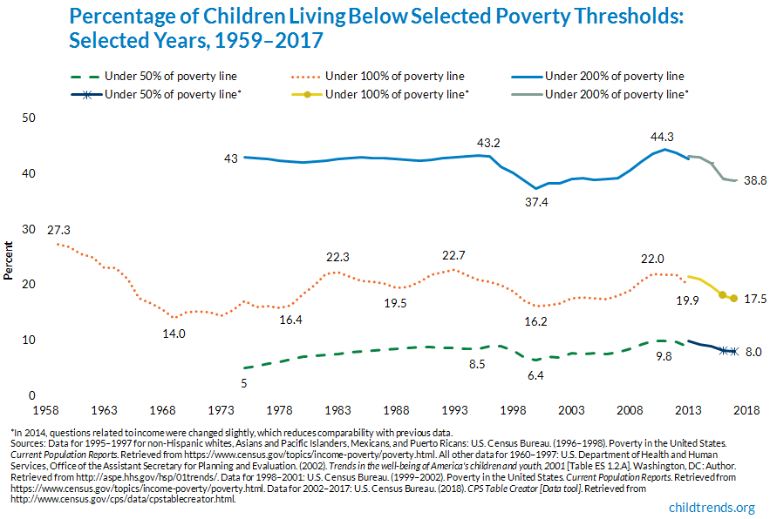

Slide 55
