Slide 1
K-12 and Higher Education
David J. Deming
SUP-206, Fall 2019

Slide 2
The plan
Large and growing inequality in school achievement
  Income gaps widening
  Racial gaps narrowing
Matched by growing inequality in childhood/family investments
Do schools mitigate – or reproduce – inequality?
College access and rationing

Slide 3
Source: Duncan and Murnane (2011)

Slide 4
Test score gaps by family income

Slide 5
Test score gaps by family income
Strong correlation between SES and achievement (by district)
Large racial gaps within districts
Racial gaps smaller – but still sizeable – after accounting for SES
What is the time trend?

Slide 6
Source: Duncan and Murnane (2011)

Slide 7
NAEP Long-Term Trend
The “Nation’s Report Card”
  Reading and math, ages 9, 13 and 17
Consistent administration since 1970s; vertically scaled
No good measures of family income
  Race, parental education

Slide 15
What can we learn from test score trends?
Large differences in achievement by race and family income
Narrowing black/white and Hispanic/white achievement gaps
  For 9-year olds, incremental progress
  For 17-year olds, lots of progress in the 1970s and then stalled out
  Test-based accountability (Dee and Jacob 2011), school reform most effective in earlier grades
More generally, test score distribution has narrowed over the last 30 years
  Driven by gains at the bottom, little progress at the top
  Must mean that income is more predictive
An unexpected finding?

Slide 16
No evidence of widening inequality in academic achievement
Comparison of NLSY waves also finds narrowing race/income achievement gaps (Altonji, Bharadwaj and Lange 2012, Nielsen 2018)
Three possibilities:
Schooling and skills don’t matter
Gaps have grown, but after age 17
Gaps exist, but inaccurately measured by tests of academic skills
Notes:
How to reconcile with Reardon (2011)? Most of the action in Reardon is between the 1940 and 1960 birth cohorts (Project Talent)

Slide 17
Education clearly “matters”
Long-run impacts of early intervention (Deming 2009, Heckman et al 2010)
School finance reform and impacts of spending on LR outcomes (Jackson, Johnson and Persico 2016; Hyman 2017; Lafortune, Rothstein and Schanzenbach 2018; Biasi 2018)
Teachers and classrooms (Chetty et al 2011; 2014)
Charter schools (Dobbie and Fryer 2011; 2015; Angrist et al 2016)
School quality and long-run outcomes (Deming 2011, Billings et al 2013, Deming et al 2014)
Are resources equally distributed?

Slide 18
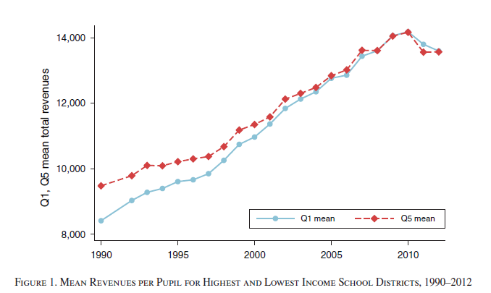
Source: Lafortune, Rothstein and Schanzenbach (2018)

Slide 19
K-12 per pupil spending ranges from $8k in UT to $23k in NY
Most states are progressive
Most regressive is IL ($14,359 vs. $14,820)
Source: Blagg and Chingos (2017)

Slide 20
Test scores – levels vs. growth

Slide 21
Test scores – levels vs. growth
“Value added” methodology

Slide 22
Source: Gates Foundation (2013)

Slide 23
Bottom line on achievement
Large gaps in achievement by income, race
Income gaps have increased over time, but no overall widening, and narrowing by race
  “value added” story is more positive
Decent circumstantial case that K-12 schooling acts to mitigate, or at least not further widen, inequality
So why is achievement inequality rising anyway?

Slide 24
Source: Duncan and Magnuson (2011)

Slide 25
Source: Ramey and Ramey (2010)

Slide 31
The “Rug Rat Race”
Ramey and Ramey (2010), Duncan and Magnuson (2011) show widening inequality in resources and parental time devoted to childhood
Childhood as “concerted cultivation” (Lareau 2001)
Different issues at different life stages
Why so competitive?

Slide 32
Inequality in Postsecondary Attainment
Unlike K-12 schooling, access is not guaranteed
Private market is much larger
Almost everyone pays something – costs rising rapidly
Bailey and Dynarski (2011) study trends in college attainment by income

Slide 33
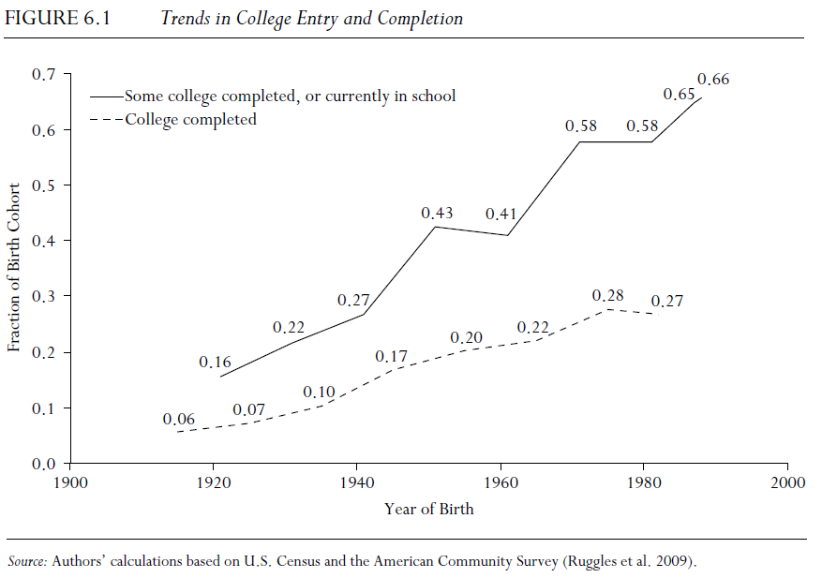
Source: Bailey and Dynarski (2011)

Slide 34
Source: Bailey and Dynarski (2011)

Slide 35
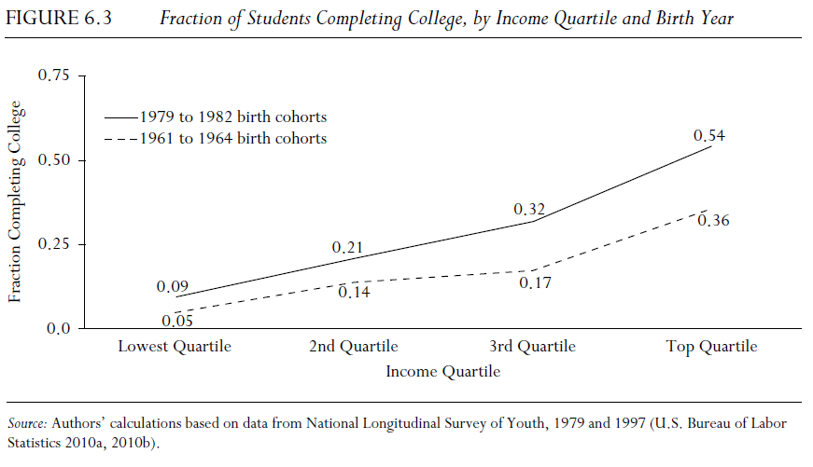
Source: Bailey and Dynarski (2011)

Slide 36
Mobility report cards
Separate colleges’ role in mobility into two factors:
  Access – what is the income distribution of students accepted into colleges (especially top colleges)
  Success – what is the impact of attending college on income, mobility
Chetty et al (2017) present descriptive statistics on access and success in the 1980-1982 birth cohorts for all colleges in the U.S. – call them “mobility report cards”

Slide 37


Mobility Report Cards
Columbia vs. SUNY-Stony Brook
80%
Columbia
SUNY-Stony Brook
60%
Percent of Students
Success Rates (Students' Outcomes)
40%
Access (Parents' Incomes)
20%
0%
1
2
3
4
5
Parent Income Quintile
Notes:
Figure 4a
Paper_fig_4a

Slide 38
Notes:
Fig_h1
(.do File: $dropbox\ota_cqa\recode\code\indiv_figs\figs for slides\scatters.do)

Slide 39
Notes:
Fig Hiib
(.do File: $dropbox\ota_cqa\recode\code\indiv_figs\figs for slides\scatters.do)

Slide 40
Notes:
Fig_h2c
(.do File: $dropbox\ota_cqa\recode\code\indiv_figs\figs for slides\scatters.do)

Slide 41
Notes:
Fig 5c
Paper_fig_5c

Slide 42
Trends in Low-Income Access from 2000-2011 at Selected Colleges
40
35
30
25
Percent of Parents in the Bottom Quintile
20
15
10
5
0
2000
2002
2004
2006
2008
2010
Year When Child was 20
Harvard
Stanford
UC Berkeley
SUNY Stony Brook
Glendale CC
Notes:
Updated 070717
fig_A8

Slide 43
Some facts about U.S. college attainment
37 percent of age 25-29 have a four-year college degree
  Up from 29 percent in 2000
Almost all of the expansion has been in less-selective colleges
  “Ivy Plus” is not expanding
  About 75 percent of postsecondary enrollment is in public colleges
In K-12, rationing is on quality; In higher ed, rationing is on price

Slide 45
Source: Carnevale and Stroh (2010)

Slide 46
Source: Digest of Education Statistics (2017)
Grad rate in publics has increased from 52 percent in 1996 to 60 percent in 2011
  63 to 66 percent in private not-for-profits
  28 to 21 percent in for-profits
Most selective publics – 71 percent
Most selective privates – 92 percent

Slide 47
Discussion Exercise - Rationing Opportunity
1. Selective schools have higher graduation rates. Is this because of differences in student characteristics, or differences in institutional performance?
2. What would happen if we substantially expanded enrollment at selective state flagships in California, Texas, Virginia, Michigan etc.?
Would these “marginal” students succeed?
How would expansion change the college wage premium?
Does your answer change depending on the level of funding provided to meet increased enrollment demands?

Slide 48
Source: Deming (2017)

Slide 49
Source: Deming and Walters (2017)

Slide 53
Summing up
Large and persistent differences in achievement and attainment, by face and family income
  The value of investment in young people has risen a lot
  Families know this, but policy has not responded – which widens inequality
My view– there’s no unifying theory, and no silver bullet
  Biggest gains from remediating extreme disadvantage, and increasing access (both pre-K and college)
  It all counts
Resource differences much greater in postsecondary than K-12
  Also true for pre-K, but “resources” are different and harder to deploy
  K-12 is also the place where public sector plays the largest role….

