Slide 1
Segregation and Neighborhoods
David J. Deming
SUP-206, Fall 2019

Slide 2
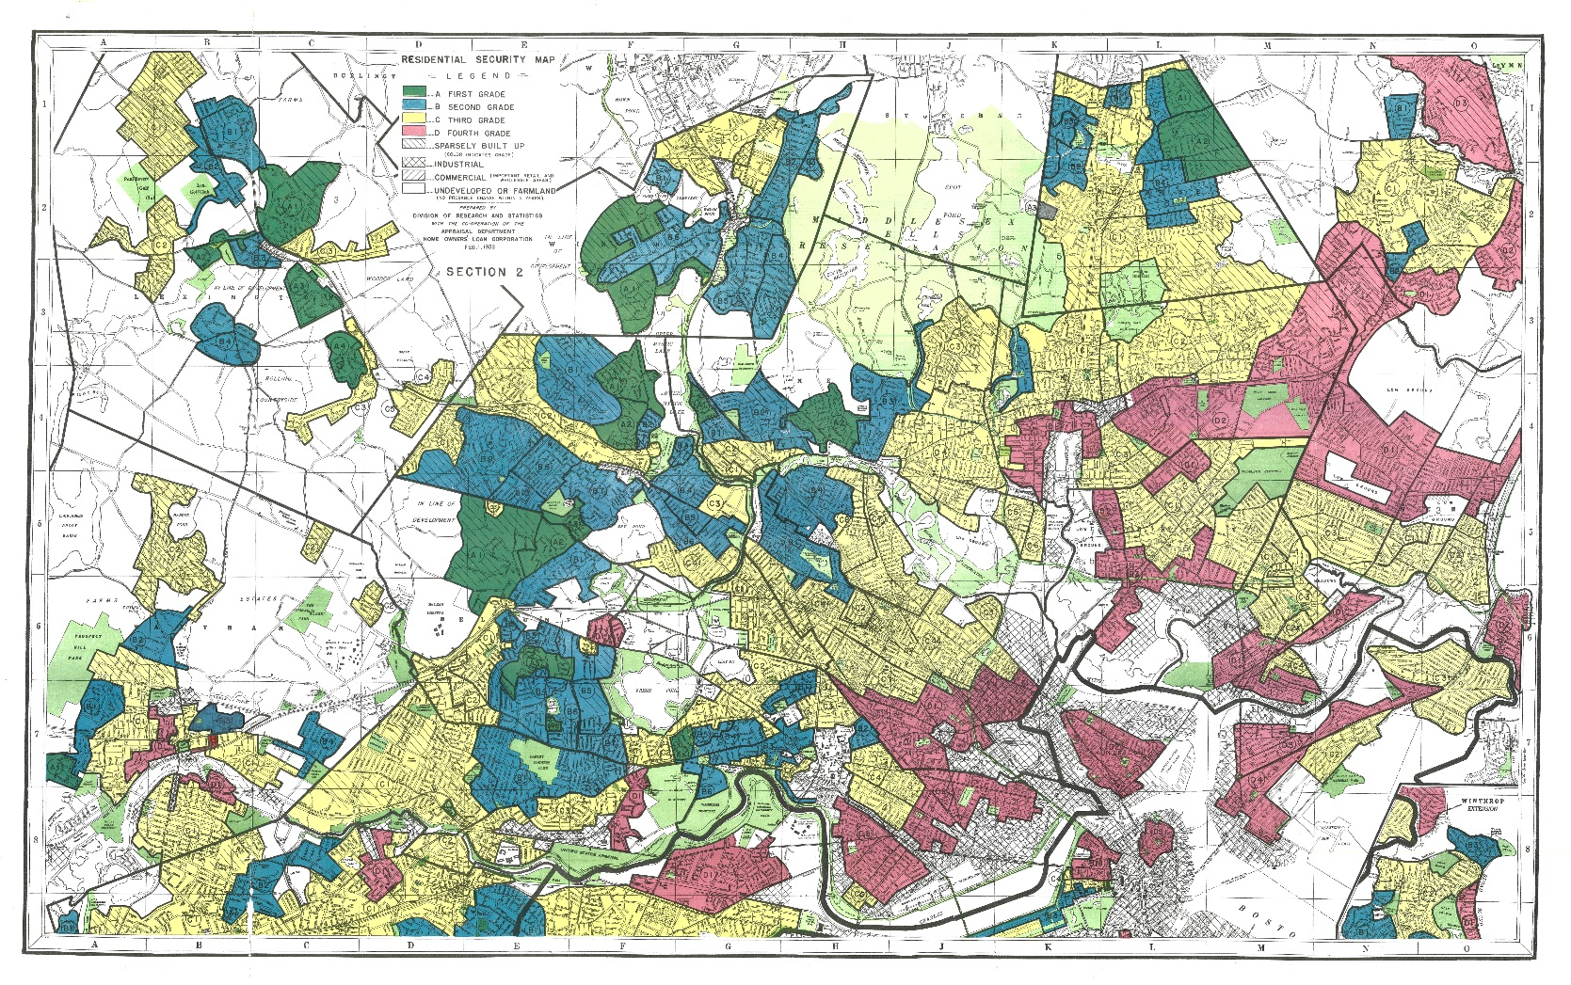

Slide 3
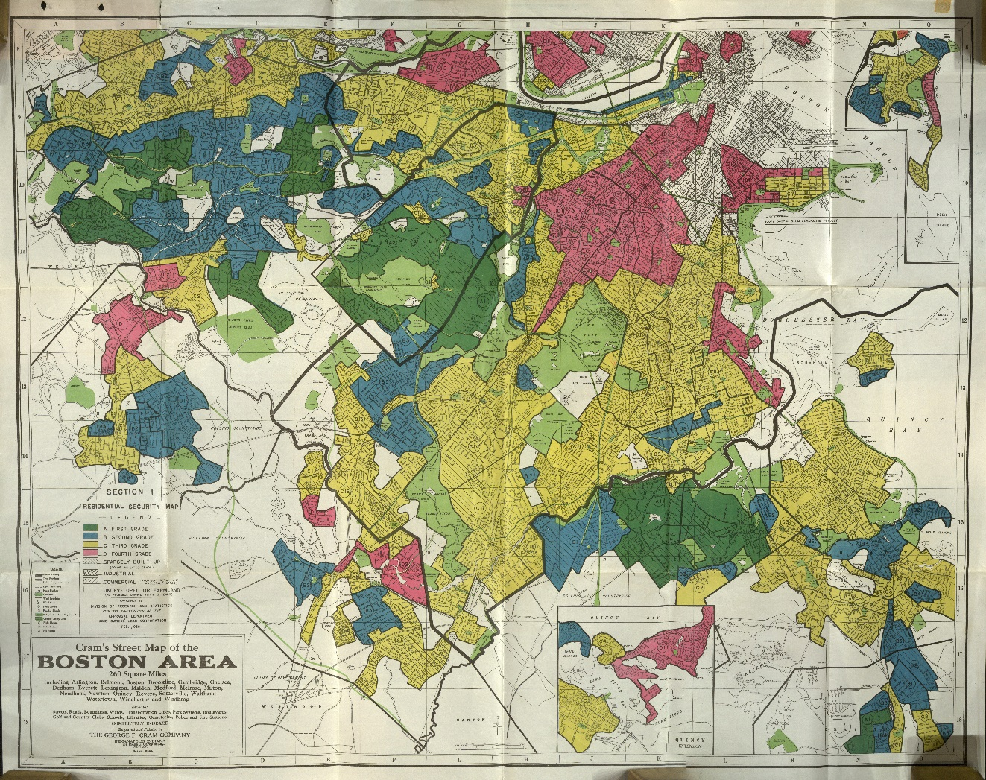

Slide 4
Mapping Inequality
“Security Maps” produced by Home Owners’ Loan Corporation (HOLC) during the New Deal
  HOLC created during the depression – provided low-interest mortgages to >1 million homeowners who were in default or foreclosure
  HOLC color-coded neighborhoods for credit-worthiness and assessed risk
    Green = “Best”
    Blue = “Still Desirable”
    Yellow = “Declining”
    Red = “Hazardous”
Did HOLC maps cause redlining, or just codify existing sentiments?
  How much of the segregation we observe is due to policy choices and institutions, compared to personal preferences?
    Does it matter?

Slide 5
“The Color of the Law” – Richard Rothstein
“Redlining” – denying or restricting services to residents of a particular area, based on its racial/ethnic composition
  Bank loans, insurance
Levittown and the Fair Housing Administration (FHA)
  FHA funded $120 billion in new housing between 1934 and 1962
    98% to whites
  In 1953, Levittown (FHA funded) was the largest city (~70,000) without a single black resident

Slide 6
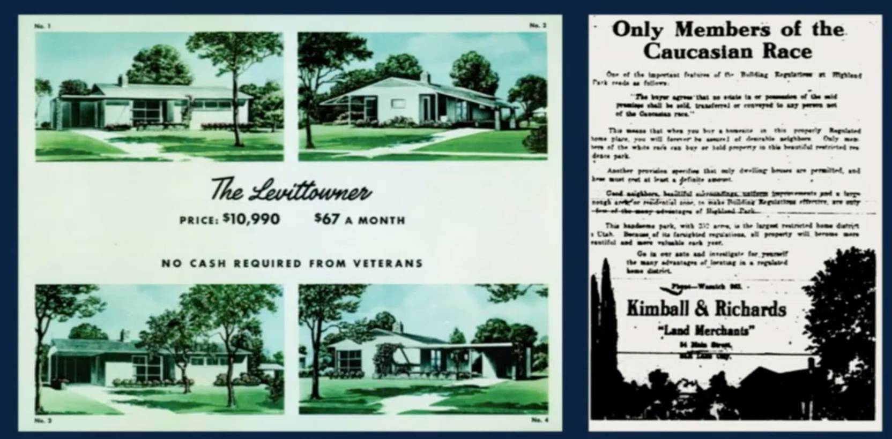

Slide 7
Source: Ananat (2011)

Slide 8
Ananat (2011) calculates a “Railroad Division Index (RDI)”, which measures the rail-induced division of a city’s land into subunits.
Segregation is measured by the dissimilarity Index – “what percent of blacks would have to move for the shares to be equal in all subunits?”

Slide 9
Segregation today – the role of preferences
Clear historical pattern – intentional and unintentional – of explicit racial segregation
Fair Housing Act of 1968 – makes redlining and related practices illegal
  Only prohibits future discrimination – the past is baked in
  Then why isn’t segregation gradually undone?
Preferences and social interactions

Slide 10
The Schelling model
Two types of agents (X and O) placed randomly on a grid
  Agents are satisfied if at least T% of neighbors are the same as them
    Can build in different preferences by type (X v. O), or even individually
  If not satisfied, move (all at once) to a (random) open space on the grid
Equilibrium = everyone is satisfied, no one wants to move

Slide 11
Discussion Exercise
Experiment with the Schelling model. Address the questions below:
How does the equilibrium change when group proportions are more or less equal (e.g. 50/50 vs. 80/20), and what does this tell you about the impact of changing demographics on segregation?
How does the equilibrium share of completely segregated agents (e.g. same color all around them) change as the similarity threshold rises? What does this say about the stability of mixed neighborhoods?
What happens when you reduce/increase the share of empty spaces, and what does this tell you about segregation in urban vs. rural areas?
After you reach an equilibrium, don’t reset – just move the similarity percentage up or down. How does this change the equilibrium, and what does it say about the impact of initial conditions on observed segregation?

Slide 12
Tipping and the dynamics of segregation
Implication of the Schelling model is that mixed environments are inherently unstable
Implication is that areas can “tip” in response to in/outmigration, changes in preferences, or increasing density

Slide 16
The Impact of Segregation
We have learned that modest preferences for similarity can lead to a large degree of observed segregation
  We’ve also learned that whites had (have?) *more than* modest preferences to live apart from blacks
Initial segregation is hard to “undo” even with changes in preferences
  Suggests that a decentralized solution is unlikely to work
  Demographic change is the best (long-run) hope for undoing the effects of residential segregation
What is the impact of living in a segregated neighborhood?
How much does place matter?

Slide 17
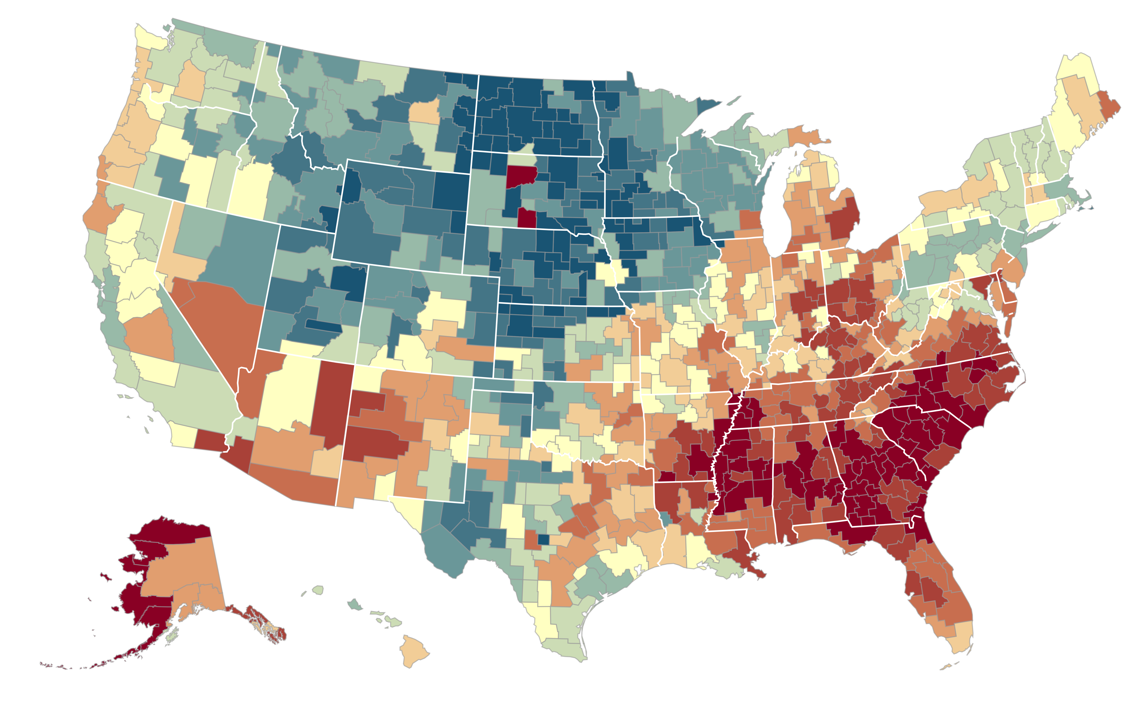

The Geography of Upward Mobility in the United States
Average Household Income for Children with Parents Earning $27,000 (25th percentile)
Seattle
$35.2k
Salt Lake City $37.2k
Dubuque
$45.5k
Cleveland
$29.4k
Boston $36.8k
New York City $35.4k
San Francisco
Bay Area
$37.2k
Washington DC
$33.9k
> $44.8k
Los Angeles
$34.3k
Atlanta
$26.6k
$33.7k
Note: Blue = More Upward Mobility, Red = Less Upward Mobility
< $26.8k

Slide 18
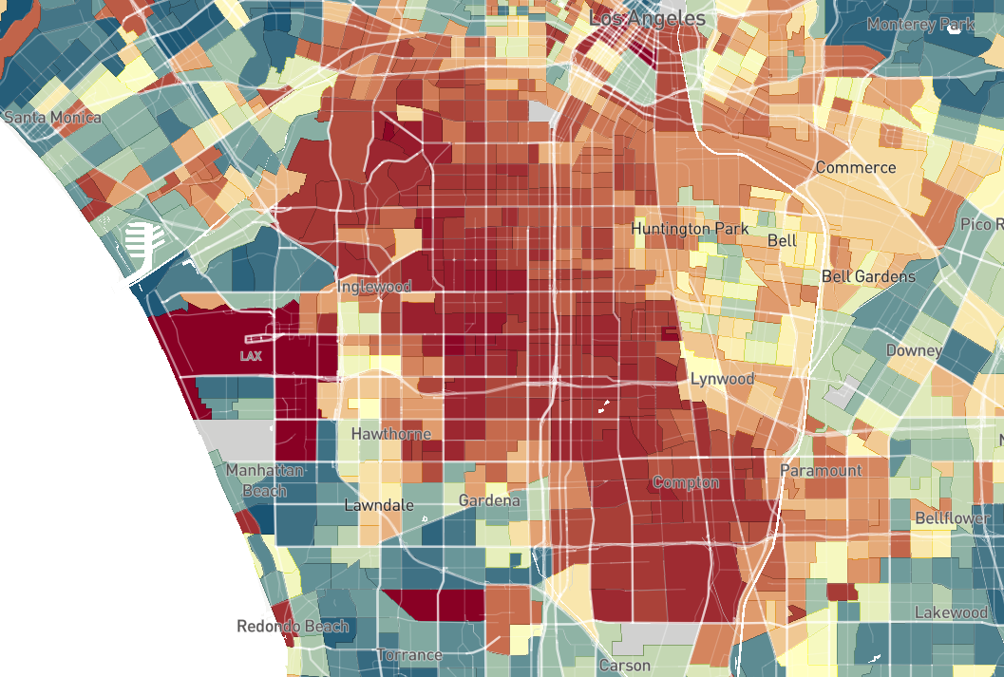

Mean Household Income for Children in Los Angeles with Parents Earning $27,000 (25th percentile)
> 59.4 ($55k)
43.7 ($35k)
< 27.5 ($18k)

Slide 19
Highest Absolute Mobility In The 50 Largest CZs
Upward Mobility | CZ Name | Y₂₅ | Y₁₀₀ – Y₀ | P(Child in Q5|
Rank |  |  |  | Parent in Q1)
1 | Salt Lake City, UT | 46.2 | 0.264 | 10.83%
2 | Pittsburgh, PA | 45.2 | 0.359 | 9.51%
3 | San Jose, CA | 44.7 | 0.235 | 12.93%
4 | Boston, MA | 44.6 | 0.322 | 10.49%
5 | San Francisco, CA | 44.4 | 0.250 | 12.15%
6 | San Diego, CA | 44.3 | 0.237 | 10.44%
7 | Manchester, NH | 44.2 | 0.296 | 10.02%
8 | Minneapolis, MN | 44.2 | 0.338 | 8.52%
9 | Newark, NJ | 44.1 | 0.350 | 10.24%
10 | New York, NY | 43.8 | 0.330 | 10.50%

Slide 20
Lowest Absolute Mobility In The 50 Largest CZs
Upward Mobility | CZ Name | Y₂₅ | Y₁₀₀ – Y₀ | P(Child in Q5|
Rank |  |  |  | Parent in Q1)
41 | Nashville, TN | 38.2 | 0.357 | 5.73%
42 | New Orleans, LA | 38.2 | 0.397 | 5.12%
43 | Cincinnati, OH | 37.9 | 0.429 | 5.12%
44 | Columbus, OH | 37.7 | 0.406 | 4.91%
45 | Jacksonville, FL | 37.5 | 0.361 | 4.92%
46 | Detroit, MI | 37.3 | 0.358 | 5.46%
47 | Indianapolis, IN | 37.2 | 0.398 | 4.90%
48 | Raleigh, NC | 36.9 | 0.389 | 5.00%
49 | Atlanta, GA | 36.0 | 0.366 | 4.53%
50 | Charlotte, NC | 35.8 | 0.397 | 4.38%

Slide 21
Upward Mobility vs. Job Growth in the 50 Largest Commuting Zones
46
San Francisco
Salt Lake City
Boston
Minneapolis
Newark
San Jose
44
New York
Manchester
Seattle
Pittsburgh
Los Angeles
Washington DC
Providence
Sacramento
Houston
42
Bridgeport
San Diego
Portland
Denver
Buffalo
Children’s Mean Hhold. Inc. Rank Given Parents at 25th Pctile
Miami
Fort Worth
40
Philadelphia
Kansas City
San Antonio
Chicago
Grand Rapids
Fresno
Phoenix
Milwaukee
Dallas
Orlando
Cleveland
Port St. Lucie
38
New Orleans
St. Louis
Nashville
Dayton
Tampa
Detroit
Cincinnati
Baltimore
Columbus
Raleigh
36
Indianapolis
Jacksonville
Charlotte
Atlanta
0
20
40
60
Job Growth Rate from 1990 to 2010 (%)
Correlation (across all CZs): -0.03

Slide 22

Absolute Upward Mobility vs. Racial Segregation
55
50
Correlation = -0.361
(0.068)
45
Upward Mobility $(\overline{y}$₂₅ )
40
35
0.01
0.02
0.05
0.14
0.37
Theil Index of Racial Segregation in 2000 (log scale)

Slide 23
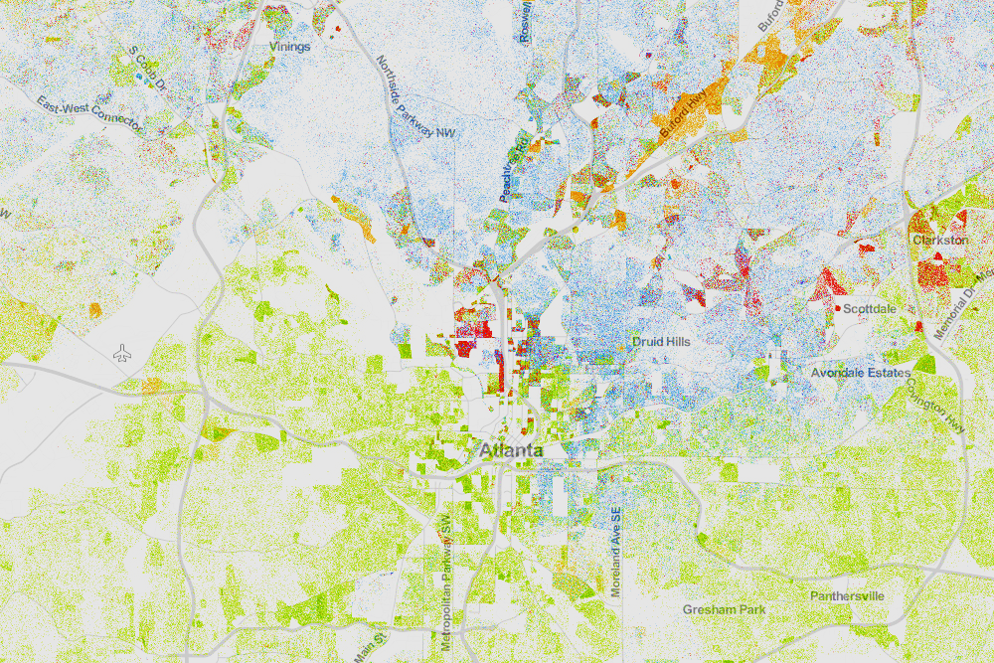
Racial Segregation in Atlanta
Whites (blue), Blacks (green), Asians (red), Hispanics (orange)
Source: Cable (2013) based on Census 2010 data

Slide 24
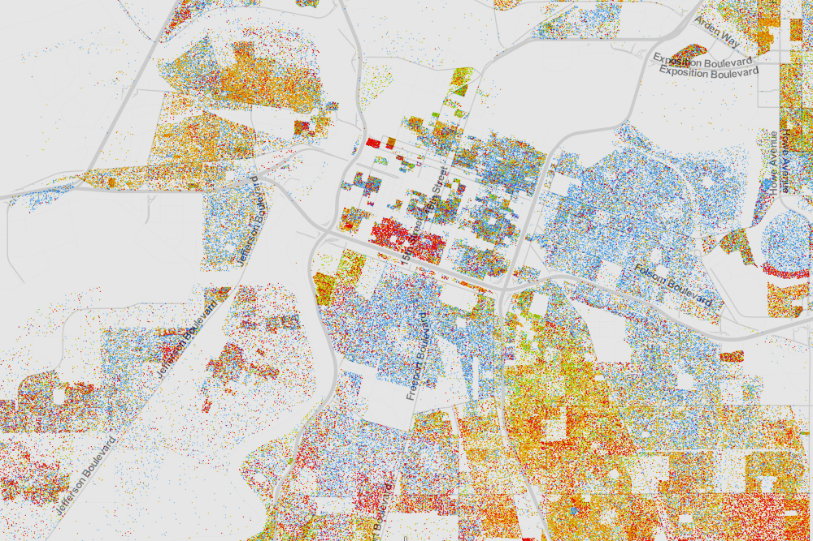
Racial Segregation in Sacramento
Whites (blue), Blacks (green), Asians (red), Hispanics (orange)
Source: Cable (2013) based on Census 2010 data

Slide 25
Chetty and Hendren (2017)
They are interested in the causal effect of living in one neighborhood relative to another
  Some of the observed difference in outcomes between people residing in different neighborhoods is sorting
  Some is the true “impact” of living there
  How to separate?
Ideal experiment: randomly assign children to new neighborhoods for the rest of childhood
They study families that move across CZ’s with children at different ages in observational data
  Choice of neighborhood probably reflects sorting
  But they assume that timing w.r.t. child’s age is “as good as random”
  Calculate exposure impacts by year – “placebo” is older ages

Slide 26
Movers’ Outcomes vs. Predicted Outcomes Based on Residents in Destination
By Child’s Age at Move, Income Measured at Age 26
0.8
0.6
Coefficient on Predicted Rank in Destination
0.4
0.2
10
15
20
25
30
Age of Child when Parents Move
Income at Age 26

Slide 27
Movers’ Outcomes vs. Predicted Outcomes Based on Residents in Destination
By Child’s Age at Move, Income Measured at Age 26
0.8
0.6
Coefficient on Predicted Rank in Destination
b_{m} > 0 for m > 26: Selection Effects
0.4
b_{m} declining with m Exposure Effects
0.2
10
15
20
25
30
Age of Child when Parents Move
Income at Age 26

Slide 28
Movers’ Outcomes vs. Predicted Outcomes Based on Residents in Destination
By Child’s Age at Move, Income Measured at Age $=$ 24
0.8
0.6
δ: 0.226
Coefficient on Predicted Rank in Destination
Slope: -0.038
Slope: -0.002
(0.002)
(0.011)
0.4
0.2
Assumption 1: δ_{m} = δ for all m
→ Causal effect of moving at age m is β_{m} = b_{m} – δ
10
15
20
25
30
Age of Child when Parents Move

Slide 29
Family Fixed Effects: Sibling Comparisons
0.8
0.6
Coefficient on Predicted Rank in Destination
0.4
δ (Age > 23): 0.008
Slope (Age ≤ 23): -0.043
Slope (Age > 23): -0.003
(0.003)
(0.013)
0.2
0
10
15
20
25
30
Age of Child when Parents Move

Slide 30
Annual Exposure Effects on Income for Children in Low-Income Families (p25)
Top 10 and Bottom 10 Among the 100 Largest Counties in the U.S.
Top 10 Counties |  |  |  |  | Bottom 10 Counties
Rank | County |  | Impact from Birth (%) |  | Rank | County | Impact from Birth (%)
1 | Dupage, IL |  | 16.00 |  | 91 | Wayne, MI | -11.39
2 | Fairfax, VA |  | 14.98 |  | 92 | Orange, FL | -12.10
3 | Snohomish, WA |  | 14.02 |  | 93 | Cook, IL | -12.79
4 | Bergen, NJ |  | 13.77 |  | 94 | Palm Beach, FL | -13.01
5 | Bucks, PA |  | 12.39 |  | 95 | Marion, IN | -13.09
6 | Norfolk, MA |  | 11.47 |  | 96 | Shelby, TN | -13.15
7 | Montgomery, PA |  | 9.74 |  | 97 | Fresno, CA | -13.50
8 | Montgomery, MD |  | 9.47 |  | 98 | Hillsborough, FL | -13.82
9 | King, WA |  | 9.33 |  | 99 | Baltimore City, MD | -13.98
10 | Middlesex, NJ |  | 9.13 |  | 100 | Mecklenburg, NC | -14.46
Exposure effects represent % change in adult earnings from growing up from birth (i.e. 20 years of exposure) in county

Slide 31
Exposure Effects for College Attendance, Ages 18-23
0.8
0.6
0.4
Coefficient on Predicted College Attendance Rate in Destination
d (Age = 23): 0.092
Slope (Age = 23): -0.037
Slope (Age = 23): -0.021
(0.003)
(0.011)
0.2
0
10
15
20
25
30
Age of Child when Parents Move

Slide 32
Exposure Effects for Marriage Rate, Age 26
0.8
0.7
Coefficient on Change in Predicted Marriage Rate
0.6
δ (Age > 23): 0.464
Slope (Age ≤ 23): -0.025
Slope (Age > 23): -0.002
(0.002)
(0.005)
0.5
0.4
10
15
20
25
30
Age of Child when Parents Move

Slide 33
Moving to Opportunity Experiment
Large-scale housing voucher program administered by HUD from 1994-1998
4,600 families at 5 sites (Baltimore, Boston, Chicago, LA, New York)
Families randomly assigned to one of 3 groups
  Housing voucher
  Housing voucher with restriction that new census tract must be <10% poor
  No voucher – sample is public housing residents in ~50% poor areas
MTO is a different population than Chetty-Hendren (2017)
  Also includes impact of disruption (only 47% of 2nd group took up voucher)

Slide 34
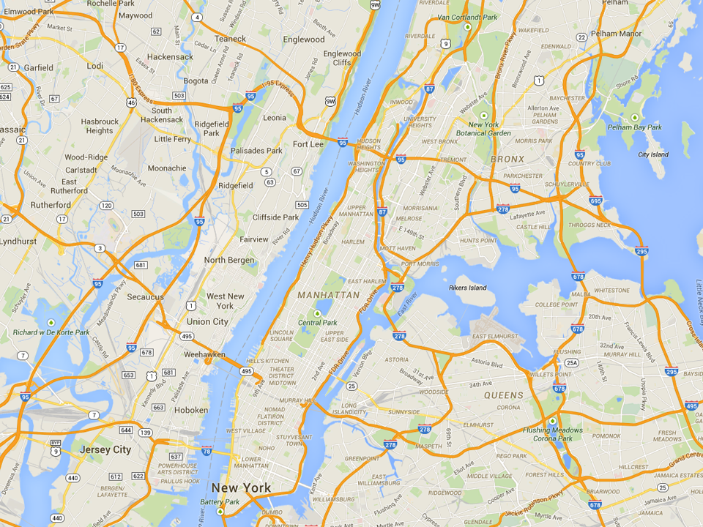
Most Common MTO Residential Locations in New York
Experimental
Wakefield Bronx
Section 8
Soundview Bronx
Control
King Towers
Harlem

Slide 35
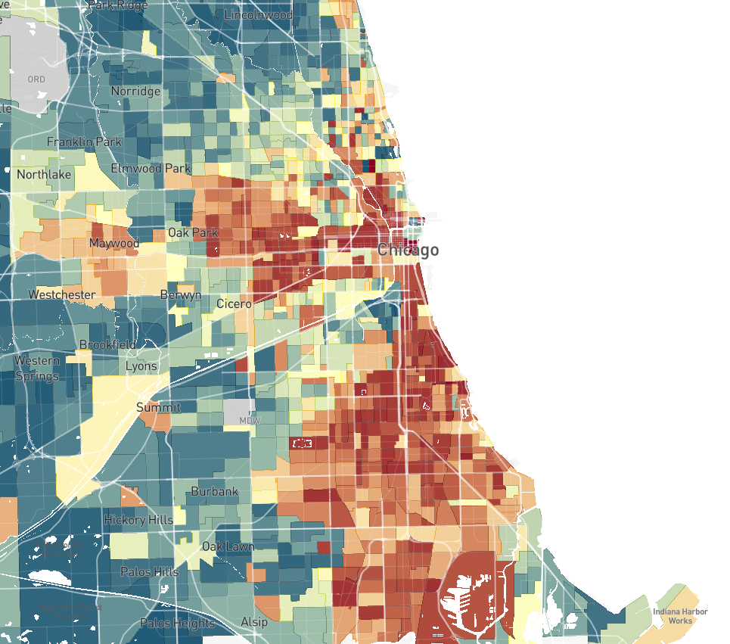
Moving To Opportunity Experiment: Origin (Control Group) Locations in Chicago
= Control
= Section 8
= Experimental
Ida B. Wells Homes
Stateway Gardens
Robert Taylor Homes

Slide 36
Moving To Opportunity Experiment: Origin and Destination Locations in Chicago
= Control
= Section 8
= Experimental
Oakland
Washington Park
Grand Crossing
Calumet Heights
Cottage Grove Heights
Riverdale

Slide 37
Prior Research on MTO
Gautreaux v. Chicago Housing Authority (1966); Hills v. Gautreaux (1976)
  CHA gave 7,500 housing vouchers to black families on welfare – might have been random…
  Perceived success of Gautreaux spawned the MTO demonstration
Opportunity – original theory of action was based on job opportunities for MTO parents (mostly mothers)
  Spatial mismatch hypothesis
Qualitative work suggested that mothers were motivated primarily by fear of violence
  Moved to neighborhoods that were demographically similar, but safer

Slide 38
MTO today
Original MTO studies found:
  No impact on adult earnings
  Initial decline in violent crime among teens, followed by subsequent increases in property crime
  No impact on kids’ academic outcomes
  Significant increases in maternal health, wellbeing and self-reported happiness
Results were disappointing for “neighborhood effects” scholars
  Some criticize MTO for not being a true test of whether place matters
Chetty, Hendren and Katz (2016) match MTO participants to tax data, track long-run earnings and other outcomes….

Slide 39
Impacts of MTO on Children Age 13-18 at Random Assignment
(a) Individual Earnings (ITT)
(b) Individual Earnings (TOT)
17000
17000
15000
15000
13000
13000
Individual Income at Age ≥ 24 ($)
Individual Income at Age ≥ 24 ($)
11000
11000
9000
9000
$15,882
$14,749
$14,915
$15,882
$13,830
$13,455
7000
p = 0.219
p = 0.259
7000
p = 0.219
p = 0.259
5000
5000
Control
Section 8
Experimental
Voucher
Control
Section 8
Experimental
Voucher

Slide 40
Impacts of MTO on Children Age 13-18 at Random Assignment
(a) College Attendance (ITT)
(b) College Quality (ITT)
22000
20
21000
15
College Attendance, Ages 18-20 (%)
Mean College Quality, Ages 18-20 ($)
20000
10
5
11.4%
19000
$21,638
$21,041
15.6%
12.6%
$20,755
p = 0.091
p = 0.013
p = 0.168
p = 0.022
0
18000
Control
Section 8
Experimental
Voucher
Control
Section 8
Experimental
Voucher

Slide 41
Impacts of MTO on Children Age 13-18 at Random Assignment
(a) ZIP Poverty Share in Adulthood (ITT)
(b) Birth with no Father Present (ITT)
Females Only
25
50
23
37.5
21
Zip Poverty Share (%)
Birth No Father Present (%)
25
19
17
23.6%
22.7%
23.1%
12.5
41.4%
40.7%
45.6%
p = 0.184
p = 0.418
p = 0.857
p = 0.242
15
0
Control
Section 8
Experimental
Voucher
Control
Section 8
Experimental
Voucher

Slide 42
Impacts of MTO on Children Below Age 13 at Random Assignment
(a) Individual Earnings (ITT)
(b) Individual Earnings (TOT)
17000
17000
15000
15000
13000
13000
Individual Income at Age ≥ 24 ($)
Individual Income at Age ≥ 24 ($)
11000
11000
9000
9000
$11,270
$12,380
$12,894
$11,270
$12,994
$14,747
7000
p = 0.101
p = 0.014
7000
p = 0.101
p = 0.014
5000
5000
Control
Section 8
Experimental
Voucher
Control
Section 8
Experimental
Voucher

Slide 43
Impacts of MTO on Children Below Age 13 at Random Assignment
(a) College Attendance (ITT)
(b) College Quality (ITT)
22000
20
21000
15
College Attendance, Ages 18-20 (%)
Mean College Quality, Ages 18-20 ($)
20000
10
5
16.5%
17.5%
19.0%
19000
$20,915
$21,547
$21,601
p = 0.435
p = 0.028
p = 0.014
p = 0.003
0
18000
Control
Section 8
Experimental
Voucher
Control
Section 8
Experimental
Voucher

Slide 44
Impacts of MTO on Children Below Age 13 at Random Assignment
(a) ZIP Poverty Share in Adulthood (ITT)
(b) Birth with no Father Present (ITT)
Females Only
25
50
23
37.5
21
Zip Poverty Share (%)
Birth with no Father on Birth Certificate (%)
25
19
17
23.8%
22.4%
22.2%
12.5
33.0%
31.7%
28.2%
p = 0.047
p = 0.008
p = 0.610
p = 0.042
15
0
Control
Section 8
Experimental
Voucher
Control
Section 8
Experimental
Voucher

Slide 45
Impacts of Experimental Voucher on Adults’ Individual Earnings
by Years Since Random Assignment
4000
3000
2000
1000
Experimental Vs. Control ITT on Income ($)
0
-1000
-2000
-3000
-4000
2
4
6
8
10
Years since Random Assignment

Slide 46
Impacts of Experimental Voucher by Age of Random Assignment
Household Income, Age ≥ 24 ($)
4000
2000
0
Experimental Vs. Control ITT on Income ($)
-2000
-4000
-6000
10
12
14
16
Age at Random Assignment

Slide 47
Impacts of Experimental Voucher by Age of Earnings Measurement
3000
2000
Below 13 at RA
Experimental Vs. Control ITT on Earnings ($)
1000
0
Above 13 at RA
-1000
20
21
22
23
24
25
26
27
28
Age of Income Measurement

Slide 48
Lessons from the study of MTO and neighborhood effects
Still no long-run impact on adult earnings
  But impacts on physical and mental health should not be dismissed!
Impact of moving = one time disruption + cumulative impact of better neighborhood
Lesson for science – tie your hands with research design, be open-minded about how to interpret results

Slide 49
Earnings of Young Children in MTO Experiment vs. Observational Predictions from
Opportunity Atlas
= Control
$11,000
= Section 8
= Experimental
Mean Indiv. Earnings in MTO (with site FE)
$8,000
Correlation = 0.60
Slope = 0.71
(0.26)
$5,000
$7,000
$9,000
$11,000
$13,000
Mean Indiv. Earnings for Children with Parents at p=10 in Opportunity Atlas (with site FE)
Baltimore
Boston
Chicago
LA
NY
Chetty, Hendren, and Katz (2016, Online Appendix Table 7, Panel B)

Slide 50
Predicted Impacts of Moving to “Opportunity Bargain” Areas in MTO Cities
= Control
= Section 8
$14,000
= Experimental: Poverty Rate-Based Targeting
= Opp. Bargain: Outcome-Based Targeting
$11,000
Mean Indiv. Earnings in MTO (with site FE)
  Creating Moves to Opportunity RCT
$8,000
$5,000
$7,000
$10,000
$13,000
$16,000
$19,000
Mean Indiv. Earnings for Children with Parents at p=10 in Opportunity Atlas (with site FE)
Baltimore
Boston
Chicago
LA
NY

Slide 51
School Segregation
From Brown v. Board of Education (1954) to Swann (1971)
  Coleman Report showed that achievement gaps related to peers, not resources
  Shifted desegregation rationale toward closing achievement gaps
Court-ordered desegregation, busing in the 1960s and 1970s
  LR impacts on attainment, earnings, health (e.g. Guryan 2004, Johnson 2011)
  Integration also coincided with funding increases, especially in the south (Reber 2010)
End of busing, rolling back of court orders beginning in the 1990s

Slide 53
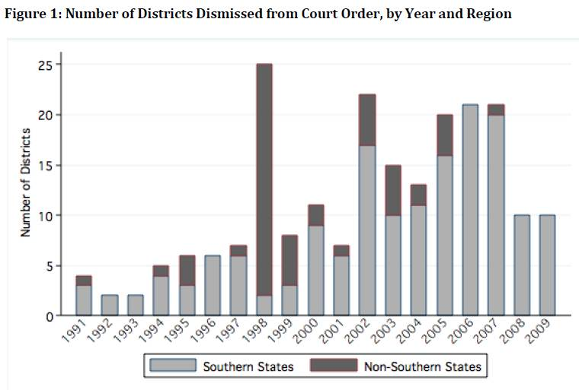
Source: Reardon et al (2012)

Slide 54
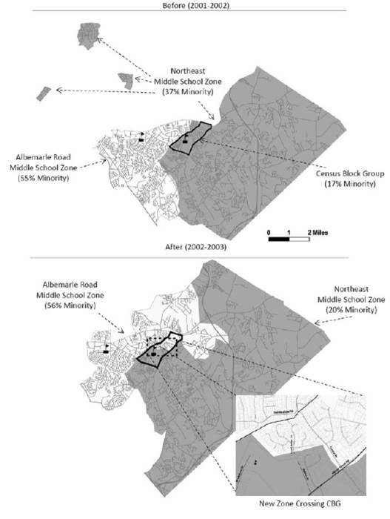
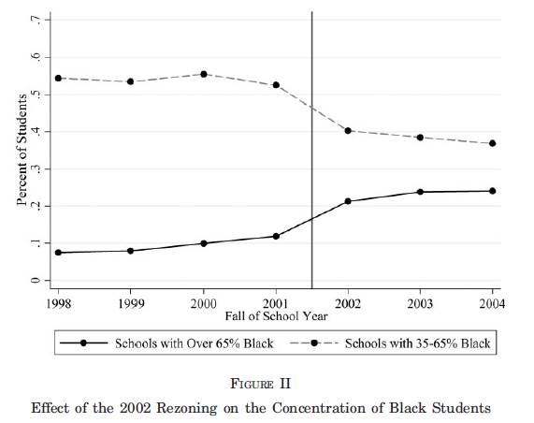

Slide 55
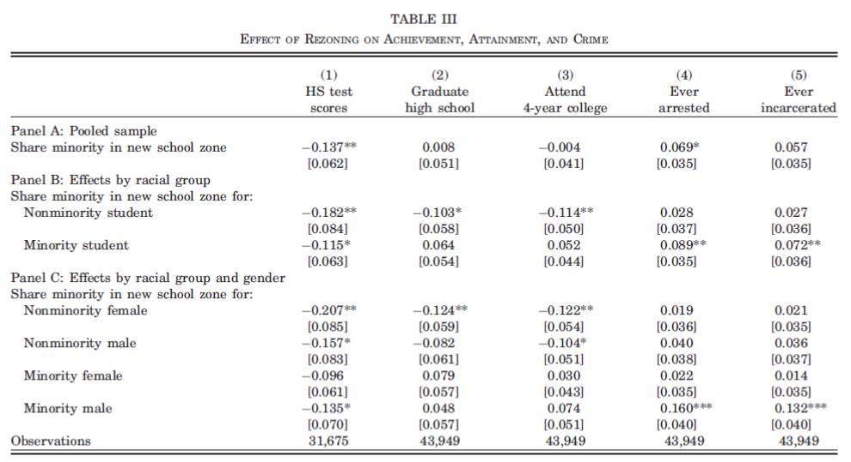

Slide 56
What was the impact of resegregation in CMS?
Widened racial achievement and attainment gaps
  But larger impacts for earlier cohorts who were less exposed to segregation
CMS targeted resources to high-poverty schools starting around 2005
We show evidence that spending increases may have closed gaps in academic outcomes
  But impacts on crime do not diminish with time
  Peers, not teachers/curriculum
  What are the goals of schooling?

Slide 57
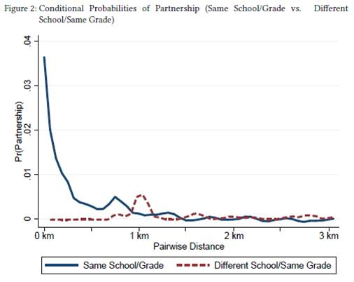
Source: Billings, Deming and Ross (2016)

Slide 58
Segregation and social preferences
In 2007, government of Delhi requires private schools to reserve 20% of seats for low-income students
  No tracking or fees allowed
Rao (2013) conducts a series of field and lab experiments designed to measure changes in generosity, prosociality and trust
  Volunteering for charity
  Dictator games
  Team selection (relay race)
  Play dates

Slide 62
Summing up
Segregation is a thorny social problem
  Policy and institutions play a role, but small differences in preferences lead to large differences in outcomes
Much to be learned about the mechanisms underlying neighborhood effects
  Policy implications are first order
  Resource allocation can be compensatory (separate but equal?)
  Peers and social networks can only be addressed directly
In the case of schools, the outcome matters
  The “doll test” in Brown – very little to do with achievement gaps

