Slide 1
Unions, Minimum Wage and Worker Bargaining Power
David J. Deming
SUP-206, Fall 2019

Slide 2
The plan
Facts – rising wage inequality - a low-educated, male phenomenon
  Minimum wage – a direct way to address falling real wages
What happens if we just force employers to pay more?
  Depends on whether the labor market is competitive
  The importance of market power
Earned Income Tax Credit (EITC)
Monopsony, labor unions and inequality

Slide 3
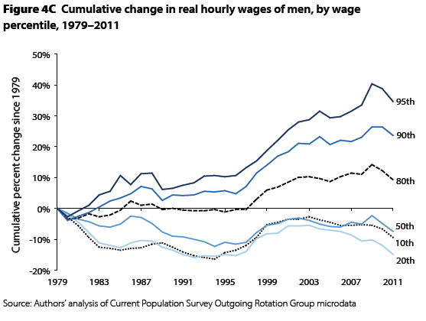
Source: Mishel et al (2012)

Slide 4
Source: Mishel et al (2012)

Slide 6
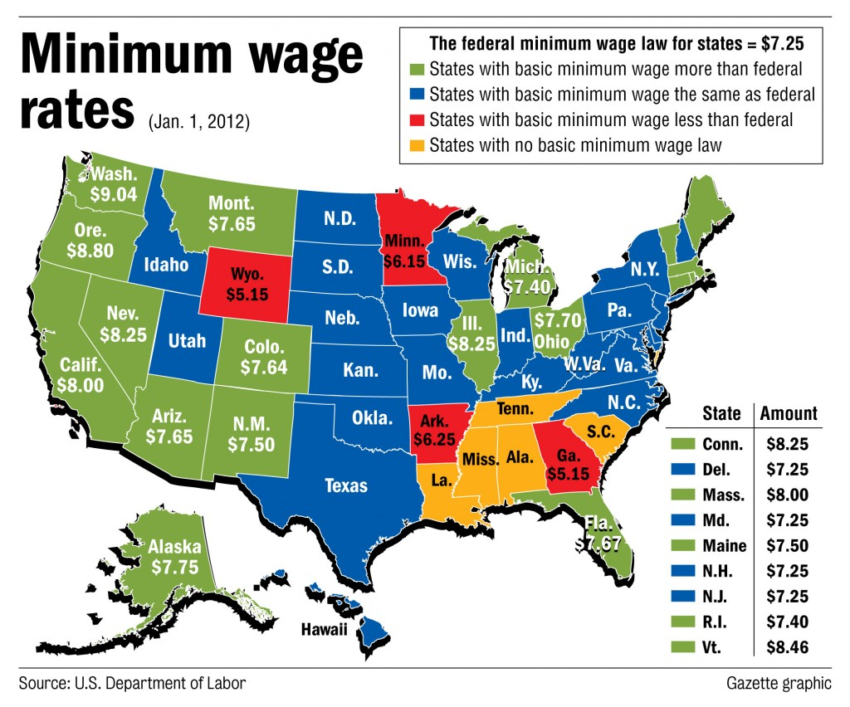

Slide 7
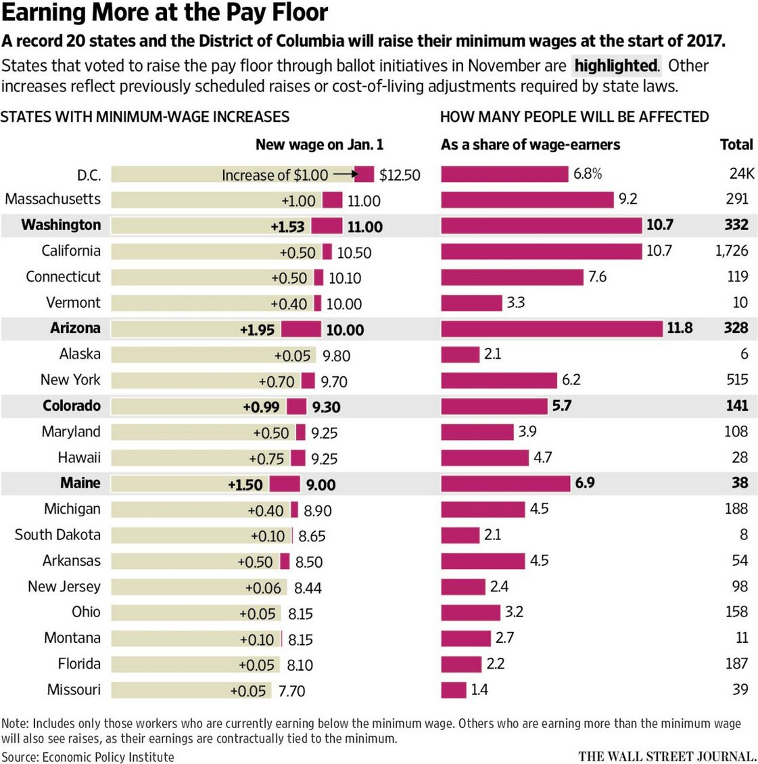

Slide 10
Source: Autor, Manning and Smith (2016)

Slide 12
Facts about the minimum wage
Declining real value since 1980 ($7.25 today)
  10 percent higher in 8 states
Has fallen further behind the 25th and 10th percentile of wages since the 1970s
  Further behind the OECD average, especially in the last 15 years
About 5 percent of all work hours are at or below minimum wage
  Higher for females, younger and part-time workers
  But impact of minimum wage is broadly felt among those with less than a college degree

Slide 13
What is the impact of increasing the minimum wage?
Benefits
  Higher wages for workers!
    Can also have “spillover” impacts higher up the wage distribution
Costs
  Labor is an input into production
    Increase input costs → higher prices, choose different inputs (if you can)

Slide 15
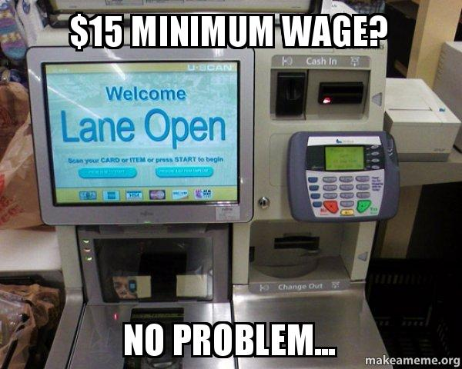

Slide 17
Minimum wage and wage inequality
Could we reverse the trends of the past several decades with a substantial increase in the minimum wage?
“Horse race” between supply and demand elasticities
  Demand – how easy is to substitute capital for labor?
  Supply – how much slack in the low-wage labor market? Are we close to full employment?

Slide 18
Seattle minimum wage study
Between 2014 and 2016, Seattle increased the city-wide minimum wage from $9.47 to $11 to $13 per hour
Key question – what happened to low-wage employment over this period?
  Jardim et al (2017) study using WA-ESD data, collects employment, earnings hours all across the state
  Can look at (almost) all industries, employers
Key challenge – what is the right comparison group for Seattle?
  Booming labor market, fueled by high-tech
  Idea is to compare trends in Seattle to trends somewhere else – “differences in differences”
  Card and Krueger (1992) – surveyed restaurants in NJ and PA
  Consider substitution possibilities

Slide 20
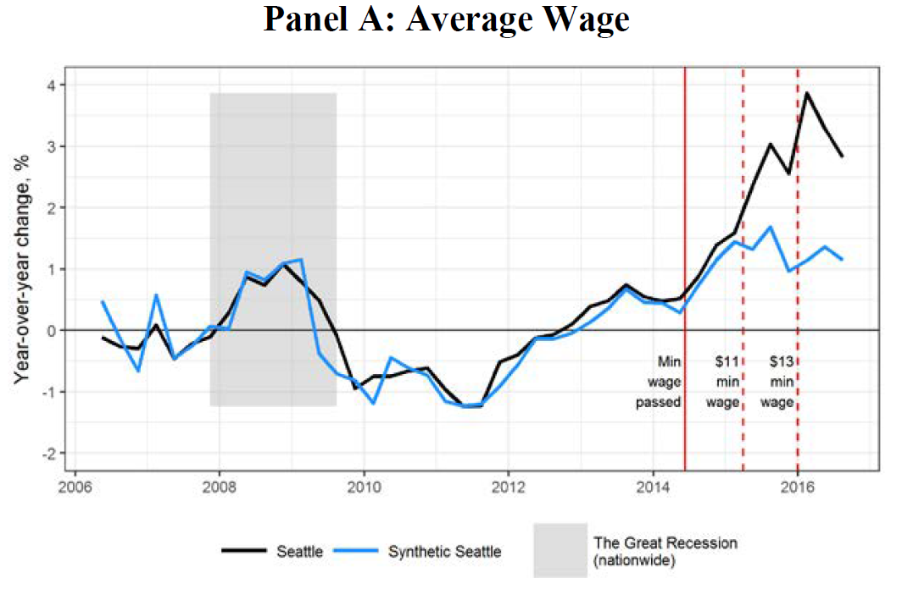

Slide 21
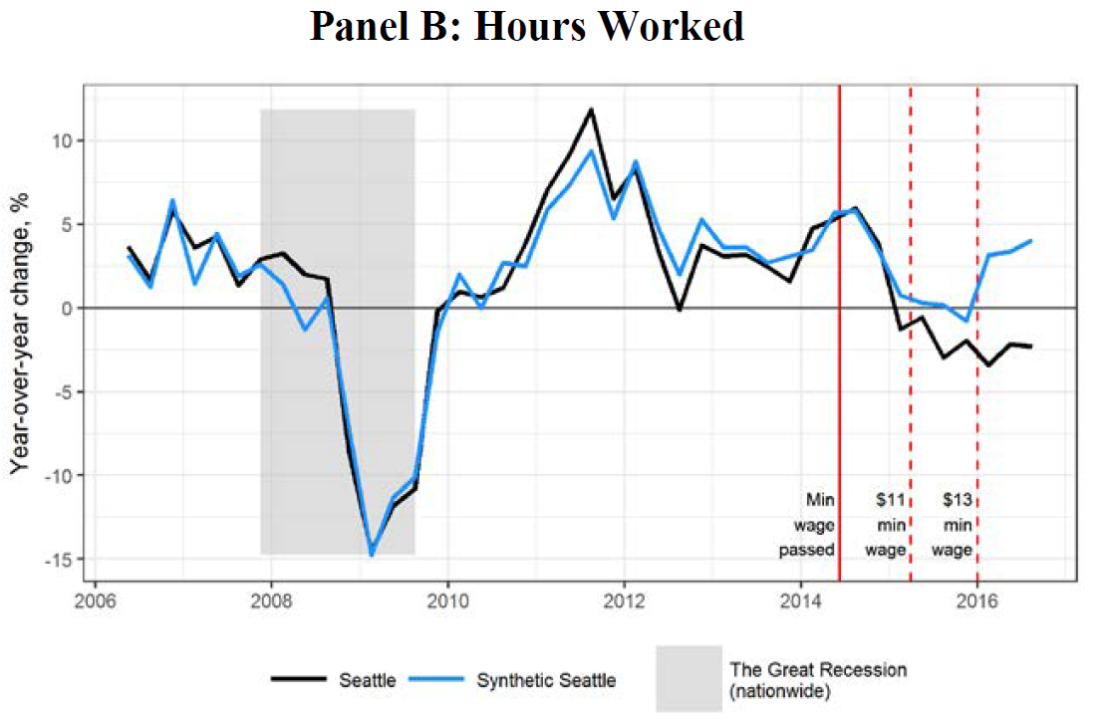

Slide 23
How can policymakers use the information gathered from the Seattle studies to make informed decisions for low-wage employees? It seems there is an inflection point, at least based on the Seattle data, where you can minimize job losses but maximize hourly wages for low-wage employees?
Is there a lag in how long in takes an economy to fully incorporate the effects of a minimum wage change? The Seattle study was conducted within a year of the implementation of the higher minimum wage. Is it reasonable to assume that employers adjust wages and employment hours immediately? Or is it more reasonable to assume that there are lags in employers’ reactions?
Has anyone looked into the impact of minimum wage increase on overall product price increase (for the policy impacted sectors)? If companies end up passing the cost of labor wage increase to the consumers, then the workers are not really materially better off and the policy is less effective.
Opponents of raising the minimum wage argue that although employment may not dip in the short term, it will eventually incentivize employers to automate jobs sooner. Do you find validity in the argument that a higher minimum wage will ultimately hasten automation?

Slide 24
Does the Seattle example generalize?
Cengiz, Dube, Lindner and Zipperer (2019) study 138 state-level minimum wage changes between 1979 and 2016
They use a “bunching” approach
  Distributes job gains and losses across all workers
  If minimum wage laws affect *very* high wage jobs, you may have a problem….

Slide 27
Thoughts on minimum wage studies
Synthetic control finds the “best” pre-period data, but always a concern
  Harder when estimating off a strong secular trend (how steep should the curve be?)
  Restriction to lower-wage jobs is sensible, but also may hide the issue
Average earnings for workers in Seattle grew by 21 percent between 2014 and 2016
  Seattle may not generalize
Trust the direction, beware the elasticities
Clearly the minimum wage binds at some level!

Slide 28
Earned Income Tax Credit (EITC) - basics
Tax credit for low-wage workers
  Depends on number of children; earned income; marital status
Administered by IRS – no caseworkers, but (for-profit) tax preparers
  Lump sum payment in the spring – increases purchase of durables (autos, furniture)
Unlike “welfare”, EITC is a work-based wage subsidy
  Increases incentive to work, especially for single moms with kids
  Incomes around 75-150% of poverty

Slide 35
Research on the impacts of EITC
Large increase in labor supply for unmarried women
  May discourage work for 2nd member of married couple
  Extensive/intensive margin (working at all vs. number of hours)
Kleven (2019) argues that the impact on labor supply is overstated
Large impacts on:
  Poverty reduction and consumption
  Health (both maternal and child)
  Student achievement
Rothstein (2010) finds that employers capture about 36 cents of every dollar through reduced wages

Slide 36
Minimum wage vs. EITC
Admin costs of EITC are low, but even lower for minimum wage
  Unfunded mandate – costs of minimum wage harder to see
When EITC leads to big impacts on labor supply, implication is that employers are capturing some of the credit by lowering wages
  Tradeoff with wage “mandate”
  Increased flexibility
  Important point – employers don’t need to know who is getting EITC
    Supply increase pushes wages down for everyone

Slide 37
Do wage subsidies always lead to lower employment?
At some level, yes
  It’s a question of tradeoffs
Key assumption – perfect competition, tight labor markets
  Firms are “price takers” – don’t set wages
Monopsony – monopoly, but for the labor market
  The “company town”
Monopsonistic firms employ fewer workers at lower wages than in a competitive market
  No longer a “law of one price” for skills, productivity

Slide 38
Monopsony power in practice
Employer collusion, non-compete and non-disclosure agreements
  18 percent of the U.S. labor force currently covered by non-competes (Starr, Bishara and Prescott 2016)
  Common in tech
  Even in fast food?
Health insurance and “job lock”
Occupational licensing and certification
Declining labor market dynamism

Slide 43
Why should we care about market power?
Firms with market power can pay lower wages without fear of exit
  Same logic applies to working conditions
Why might monopsony be on the rise?
Market power is relative – unions represent worker bargaining power
  have historically been a counterweight to monopsonistic firms….
Unions also play a direct role in reducing inequality at the bottom by compressing wages for members

Slide 45
The Two Faces of Unionism
“Monopoly” view
  Unions are labor cartels that restrict entry, raising wages for members at the expense of other workers
  monopoly=product market; monopsony=labor market
“Collective voice/Institutional response” view
  Unions create labor market power for workers – force firms to share rents from product market power
  Unions provide an option for worker voice, rather than just exit
    Collective bargaining, working conditions, incumbency and corruption
Key – is the labor market relatively competitive otherwise?

Slide 52
Unions and Product Quality
The Case of Bridgestone/Firestone Tires
  1988 – Bridgestone buys Firestone
  1991 – three-year union contract amicably negotiated
  1994 – Bridgestone asks for a “turnaround agreement”
    12 hour shifts (rather than 8); 7 days per week
    30 percent pay reduction for new hires (faster 3-year increase); lower benefits
    Plant-wide performance pay system
    URW asks to be tracked with Goodyear (COLAs only)
  Workers strike on July 12, 1994 – Bridgestone hires replacement workers
  May 1995 – URW ends strike; Bridgestone imposes July 1994 offer
    Labor strife continues – Bridgestone retains replacement workers, URW goes bankrupt
    Replacement and union workers are side-by-side
  December 1996 – final settlement

Slide 55
Engineering Tests
Overinflate tires, run them at >100 degrees with >80% max load
Run until it bursts, tread separates

Slide 59
Unions and product quality
Clear connection between labor strife and product quality, with deadly implications
Yet not a simple story of unionized workers being better than replacements
Highest number of defects during period where workers mixed and outcome of negotiations was uncertain
  Labor strife, unrest itself appeared to lower product quality
Tire recall cost the company more than 50% of its valuation; all top managers were replaced….

Slide 60
What are the racial dynamics and impacts of unions? Do they serve to reduce racial inequalities? How does minority membership vary with regards to union type?
Can we go into more detail on the future of unions and collective bargaining, especially when considering new forms of work (e.g. gig economy) that make unionisation harder?
What are the takeaways you are hoping we draw from the “Strikes, Scabs, and Tread Separations” paper? I didn’t find it particularly compelling as evidence for the role of unions in addressing inequality.
Unions can protect workers from exploitation in the workplace. Others argue that unions stifle innovation and prevent managerial autonomy. How do policymakers reconcile this tension?

Slide 61
Summing up
Minimum wage, EITC are important labor market institutions
  “Small” increase in minimum wage is probably welfare-enhancing – how small?
  EITC more flexible, but incidence varies and may benefit employers more than intended
Textbook econ theory suggests that wage subsidies have tradeoffs – can harm those they are intended to help
  Yet these models also assume perfect competition
  Strong circumstantial evidence that market power balance has shifted toward firms
  Just think about how hard cities compete for Amazon….
Declining unionization and falling value of wage subsidies probably an important part of the story for 50/10 inequality, at least for men
  90/50 is harder to explain this way
  Low wages are only part of the problem for low-wage workers
    Workplace flexibility, health care, safety
    Need to modernize labor laws for 21st century work

