Slide 1
Globalization, International Trade and Immigration
David J. Deming
SUP-206, Fall 2019

Slide 2
The plan
Basic facts about international trade
  Trade patterns, trade agreements, tariffs and other barriers
Why do countries trade?
  Ricardian model and comparative advantage
  North-north vs. North-south trade
The China Shock – theory, meet data
  Jobs, votes…..
Immigration

Slide 4
Countries – especially larger ones – mostly trade with themselves.
Home shares have declined since 1996.
Gains from trade (as a percentage of all mfg) larger for smaller countries.

Slide 8
Facts about Trade
Countries – especially larger ones – mostly trade with themselves
U.S. is a major exporter (2nd largest) – focus on skill-intensive goods
  Computers, complex machinery, vehicles
  Top high-skilled service exporter
U.S. nonetheless has a large net trade deficit
  Mostly with China, but other countries too
Gains from trade larger for smaller economies

Slide 9
Tariffs and Trade Barriers
A tariff is a tax on imported goods
  Tariffs raise prices for consumers while “protecting” native industry
    Agricultural subsidies are a huge source of US protectionism
  Currency manipulation is an indirect trade barrier because it affects the relative price of goods across countries
    “Strong dollar” makes imports cheaper and taxes exports
Trade barriers can also be technological or geographic
  shipping costs, perishables, translating into foreign languages etc…
Intermediate inputs and the global supply chain
  Firstronic – MI company that makes circuit boards for auto components
    Buys capacitor from a CO company (Arrow Electronics, which imports from multiple suppliers in Asia)
    Capacitors shipped to Ciudad Juarez, Mexico for installation in circuit boards
    Sent to El Paso, TX “in bond” to avoid tariffs
    Circuit board back to Mexico, where a Norwegian company installs the board into a seat control component
    Part ships to seat manufacturing plants in Arlington, TX and Toronto, Canada
    Seats are installed in nearby auto plants

Slide 10
How have U.S. protectionist policies (e.g. agricultural subsidies) affected the efficiency of international trade, especially with low-income countries where their comparative advantages lie in these protected goods?
Can we talk about the current events of U.S.-China trade war that has been going on for a little over a year now. Who are the winners and losers of these tariffs.
One major debate that defined international trade is intellectual property theft. Some argue that China (and others) should be disciplined for stealing US intellectual property. When IP theft is considered part of the equation, is trade really wholly and mutually beneficial? Are barriers to trade justified then?

Slide 11
U.S. – China trade war
Timeline:
Jan-March 2018 – President Trump announces tariffs on steel, aluminum, solar panels, washing machines
  All products with high import shares from China
April 2018 – China retaliates with tariffs on 128 U.S. products – pork, meat, fruit, steel pipes….
  Trump admin responds with tariffs on another ~$50 billion of Chinese goods in aerospace, technology, machinery – punishment for alleged IP theft
  China responds by threatening in-kind response; White House declares additional tariffs that will take hold if China retaliates
July-September 2018 – China retaliates, U.S. retaliates, China retaliates again – a trade war begins
May 2019 – White House increases existing tariffs in Sept-18 agreement from 10% to 25%; notice published in the Federal Register
  In June, China levies another set of tariffs on $60 billion worth of U.S. goods
August 2019 – U.S. Treasury declares China a currency manipulator; China orders state-owned enterprises to stop buying U.S. agricultural products
  Trump delays some May tariffs from Sept until December 15th
October 11th 2019 – President Trump announces that the U.S. and China have reached a tentative agreement on the “first phase” of a trade deal – details TBD
  Most current analysis of the impact of the trade war

Slide 12
Questions for discussion
Why do we have such a large trade deficit with China? Is it a problem? Why or why not?
What is the likely impact of steel and aluminum tariffs on the U.S. economy? Be specific. Think about steel/aluminum producers, intermediate users (e.g. car makers), workers in both industries, and consumers.
What is the likely impact of a “trade war” on the U.S. economy? What about the Chinese economy? Again, think about all the relevant parties.

Slide 13
WTO and trade agreements
Trade agreements are mutual disarmament pacts
U.S. has about 12 bilateral trade agreements
  Coverage of goods (e.g. US-South Korea, rice excluded, beef phased in)
  Reduced tariffs or “duty-free”
  Environmental and labor standards
Regional agreements – NAFTA, TPP, CAFTA etc…
WTO is a framework for trade liberalization, not a specific set of rules
  Most favored nation (MFN) status for all WTO members
  Similar technical standards for domestically produced and imported goods
  Transparency and formalized dispute resolution

Slide 14
Why do countries trade?
Differences in factor endowments, technologies (productivity), tastes
  Think of two equally-sized economies like Ireland and Portugal producing beer and wine – could be all three explanations
    U.S. agriculture
  Consumers like both kinds of products – what happens in a world without trade (e.g. autarky)?
Consumers in both countries are better off with specialization and trade
Orthodoxy – trade increases total welfare, but is not Pareto-improving
  Winners – consumers, Irish beer brewers, Portugese wine makers
  Losers – Irish vintners, Portugese brewers (firms, and workers)
  Adjustment costs – do workers and firms reallocate?

Slide 15
A simple Ricardian example
 | Franks | Buns
U.S. | 10 | 10
China | 3 | 6
Only two countries and one final good (hot dogs)
  No consumption value to franks and buns separately – 1:1 proportions
U.S. has absolute advantage in production of both goods
  China has a comparative advantage in bun-making
Autarky: China (2,2) and US (5,5).
Free Trade: China (0,6) and US (8,2).
One extra hot dog produced under free trade. Who gets the surplus?

Slide 16
Ricardo and comparative advantage
Winners – consumers in both countries (if the dog is split), Chinese bun producers, U.S. hot dog producers
Losers – Chinese hot dog producers and U.S. bun producers
In the previous example, free trade increases hot dog production by 14%.
  What happens if the countries are equally productive?
  Try (3,6) and (6,3). Now try (3,6) and (3,6).
North/North vs. North/South trade
  The extra hot dog is 50 percent of China’s economy but only 20 percent for US
  Gains from trade shrinking in country size, but disruption to affected industry stays constant
  Free trade most helpful for smaller countries with unique comparative advantage
Don’t just look at the affected industry – Paul Krugman’s “The Accidental Theorist”
  Krugman partly walks this back in 2007 article

Slide 17
Given that economists knew about the ‘trouble with trade’ well in advance, why wasn’t more done by governments to mitigate the impact of trade on those who were likely to lose out from it?
To what extent does the US and other powerful economies have a responsibility to workers in other countries? (i.e. supporting labor rights, etc.)
Low-wages are one of several factors that enabled China to take its place as one of the world’s leading exporters. Several of these articles list low prices of consumer goods as a benefit of free trade, but I’m not sure what to make of this. While it’s nice to have cheap goods, I am inclined to think that they are mostly produced on the backs of low-wage employees. Can you speak to government & labor policies in China and how they promote low-cost labor? It’s something I’ve always wondered about as an American consumer.

Slide 18
Economists’ consensus on trade as of 2000…
Free trade could not be responsible for growing wage inequality
  U.S. manufacturing jobs have been in decline for 70 years
    Manufacturing output has risen – it’s robots replacing people
  Trade openness wasn’t increasing overall between 1970 and 2000
  Scale was just too small
Assumption of textbook models – impacts of trade would be evenly distributed across the entire economy
  Trade-exposed workers would move to opportunity
  Trade-exposed firms would reallocate to other geographies and sectors

Slide 20
The China Shock – “a 500-ton boulder”
2001 – China enters the World Trade Organization (WTO)
  China already had most-favored nation (MFN) status with US and most of Europe
WTO conferred permanent MFN status bilaterally between US and China
  Prior to WTO entry, MFN status was subject to annual reauthorization
  Average tariffs were 3.4 percent for MFN, 37 percent non-MFN
  Permanent MFN status encouraged Chinese investment in US export markets
Other impacts of WTO
  Chinese firms no longer required to export through state intermediaries
  Increased access to intermediate inputs and raw materials

Slide 24
The China Shock
Increase in Chinese manufacturing was slow in the 1990s; sudden and swift in the 2000s
  China’s share of world manufacturing VA rose from 4 percent in 1991 to 7 percent in 2000 to 24 percent (!) in 2012
“The Global Factory”
  Other emerging economies specialize in natural resources
  Chinese comparative advantage is in industrial manufacturing
  ~250m workers migrated from farms to cities
Explicit government support – pro-export policies, currency manipulation

Slide 25
How do ADH estimate the impact of rising trade with China on U.S. labor markets?
Chinese products are a “shock” to the supply of manufactured goods in a region of the U.S. economy
This supply shock would lead to:
  More intense competition in product markets
  Lower prices, less production in U.S. firms
  Layoffs, plant closures and reduced hiring of trade-exposed workers
  Downstream impacts on trade-exposed communities
  Reallocation of workers and firms to other sectors

Slide 26
Supply shock or demand shock?
The furniture maker in Hickory, NC might have closed because their chairs are going out of style (demand shock)
  Or because all the good workers are migrating to larger cities (as with China)
“Autor et al propose using Chinese import growth in other high-income markets as an instrument for the growth in US imports from China to isolate the foreign-supply-driven component of changes in US important penetration.”
Intuition – Chinese furniture being sold in Germany or Australia can’t be about changes in product demand in Hickory, NC

Slide 31
Impact of a $1,000 per worker increase in import exposure

Slide 32
Theory meets data
Economic theory predicts that the China Shock should lead to employment losses in trade-exposed industries
Yet the same theory predicts that employment losses should be offset by gains in other sectors
  E.g. column 2 of Table 4 should be +0.60
  Yet no reallocation, even over a 17 year (!) period – coefficient is negative
  Large and significant negative local demand spillovers for non-college workers
What about internal migration? Do trade-exposed workers move to opportunity?

Slide 33
ADH (2014) follow trade-exposed workers in SSA data
Compare MFG workers (as of 1991) across industries with differential exposure to trade
Earnings impact gets worse over time – no evidence of recovery

Slide 34
Increase in job transitions
“China shock” continues and even accelerates through the 2000s

Slide 35
Workers stay in trade-exposed industries
Counterfactual is a shift to non-traded industry after first separation
Little or no geographic mobility

Slide 36
Davis and Hilsenrath (2016) put a human face on the persistence of the China Shock
“When layoffs hit, Mr. Shoun was surprised some coworkers asked for help deciphering instructions because they couldn’t read or write. “How would they even go and fill out [job] applications?” he recalls thinking. He was recruited to run a furniture plant in China and could have doubled his salary to about $100,000. “The offer said to me: ‘You might want to get out of North Carolina and go to China because that’s where the industry is going,’ ” he says. He didn’t want to leave his family and turned down the job.”
“In Hickory, laid-off workers went to community college but often came away without jobs in other industries. After losing his job in 2006, Mr. Shoun figured that learning architectural design would help him get a better job. The housing market collapsed by the time he finished his training in 2008. He went back to the furniture business. His ex-wife, Michelle Surratt, an eighth-grade dropout who lost her job in 2006, used Trade Adjustment Assistance to start earning a high-school diploma but never took the required math test because she was “scared about numbers,” she says.”
“Anthony “Tony” Crawford, an upholsterer, tore a knee and hurt his back tripping over wooden frames on a furniture-factory floor in 2009. During the boom, he made $29 an hour and worked overtime shifts for more money. Mr. Crawford, 45, now lives on a fraction of his old income. “I made my money with my hands,” he says. “Back to school wasn’t an option.””

Slide 38
Other margins of adjustment
Acemoglu et al (2016) estimate that Chinese import competition led to the loss of about 560k jobs between 1999 and 2011 in industries that directly competed with China
  About 10 percent of total decline in manufacturing jobs
Must account for job losses in “upstream” sectors that supply raw materials and intermediate goods
  Lumber, fabric, machinery etc..
  This increases the number of manufacturing jobs to 985k, and 2 million jobs in total
  Accounting for reduced consumption among trade-exposed workers increases the total to 2.4 million jobs
What about offsetting mechanisms?
  Hard to measure impacts on service sector and knowledge workers
  Short-run vs. long-run reallocation
  Competition and innovation

Slide 39
Economic Consequences of the China Shock
First order impact – an incredible increase in living standards in China
  Per capita GDP grows by 375 percent in China, 2000-2010
  33 percent growth in US too
Sectoral reallocation slower and more disruptive than most experts thought
Policy adjustments have been slow and nonexistent

Slide 40
Political consequences of the China Shock
We know that trade hits particular communities very hard, and that there is little or no adjustment
How does this affect politics? Goes beyond trade itself
Polarization – replacement of moderates with candidates holding more extreme views on both sides

Slide 41
Polarization much greater for GOP
  But disappearance of “blue dog” Dems as well
No overlap across the aisle after 2000
Trump won 89 of the 100 most trade-exposed counties in the Republican primary
  Sanders won 64 of 100 most trade-exposed counties in Democratic primaries in non-South

Slide 44
Summing up
International trade is an important source of welfare gains in the US and around the world
Yet trade creates winners and losers
  Economists and policymakers have been too cavalier about adjustment costs
“China Shock” likely a one-time phenomenon, but has important lessons
  Anticipate that labor – especially low-skilled – will not adjust
  Should the US enter trade agreements with small countries? Benefits small and very diffuse, costs are highly concentrated
“Panama’s entire annual economic output is only $26.7 billion a year, or about two-tenths of 1 percent of the U.S. economy. No one can legitimately make the claim that approving this free trade agreement will significantly increase American jobs. Then, why would we be considering a stand-alone free trade agreement with Panama, tiny little country? Well, it turns out that Panama is a world leader when it comes to allowing wealthy Americans and large corporations to evade U.S. taxes by stashing their cash in offshore tax havens. And the Panama free trade agreement will make this bad situation much worse.”
– Sen. Bernie Sanders (October 2011)

Slide 45
From an economic standpoint, is there a fundamental difference between offshoring and automation for “low-skilled” workers in the US labor market? It seems like both developments make them a relatively more expensive production factor. (Obviously distinction matters for trade policy, but what about outside of that?)
I’ve never really made the broad connection of a state like Mississippi or Tennessee’s economy potentially being so hurt by the rise of Chinese exports. Nor would I have expected that it was the whiter demographic that was affected the most (in addition to being less educated, older, and poorer, which makes sense since since those disadvantages put people in a vulnerable position for being hypersensitive to any change). Is it because whites were working in furniture/fixtures/games/toys/children’s car building factories or other industries that were highly affected by Chinese exports? Or what other reason is that it is not people of color who are being negatively affected the most in this specific scenario?
What kind of policies exist to assist workers who are replaced due to offshoring or automation? In the policy world, are there international examples that are thought to have done a good job at helping labor force adjust? The WSJ article offers some anecdotal evidence that re-training (government-assisted or otherwise) for laid off workers is unproductive or even counterproductive. Is there any empirical evidence to the contrary that you are aware of?

Slide 46
Trade and Inequality
Free trade cannot explain broad patterns of U.S. inequality since 1970
  ADH (2015) – “Untangling trade and technology”
  Computerization has gradually reallocated U.S. jobs away from routine tasks
    Affects nearly all sectors and jobs
  Trade leads to sudden and severe manufacturing job losses in some sectors and CZs
    Timing was mostly 2000 and later
Still, technology and trade have worked together to hammer non-college educated workers, especially males
  U.S. labor market has been fundamentally reshaped
  Our labor market institutions were designed for a different era – how should they look now?

Slide 47
Immigration
Basic facts
Analytics similar to trade, but for people
Who chooses to immigrate? What affects the decision to immigrate?
A cool visualization of the history of U.S. immigration, by year and country of origin

Slide 48
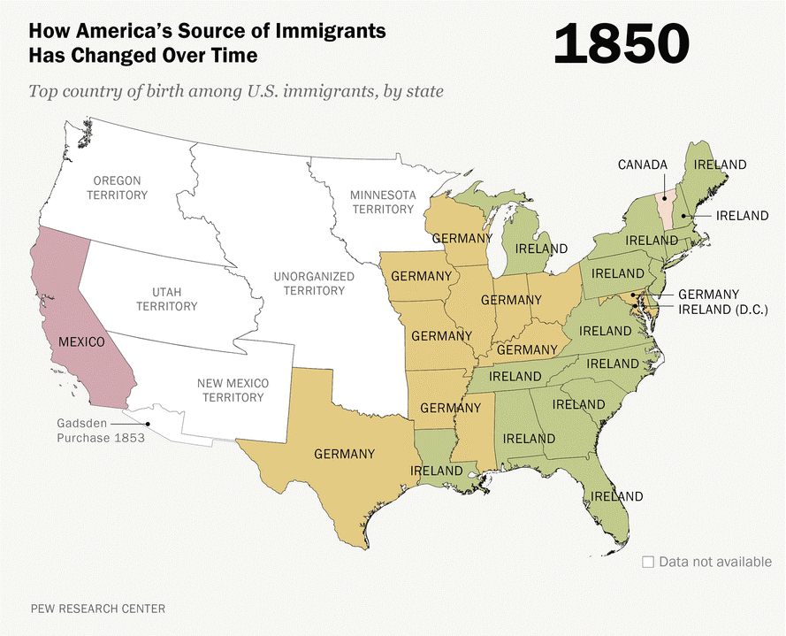


Slide 49
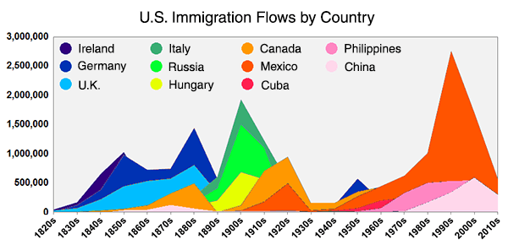
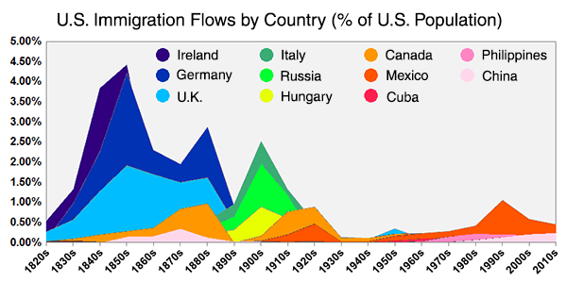

Slide 51
How are estimates of undocumented workers done? What sources are used?
The Hanson et al. piece mentions that the absolute number of undocumented low skilled immigrants has decreased since the Great Recession. Is the reason for this solely the increase (doubling) of U.S.-Mexico border patrol officers as well as deportation becoming more likely so as to disincentives that migration or do other factors have a more causal effect?

Slide 52
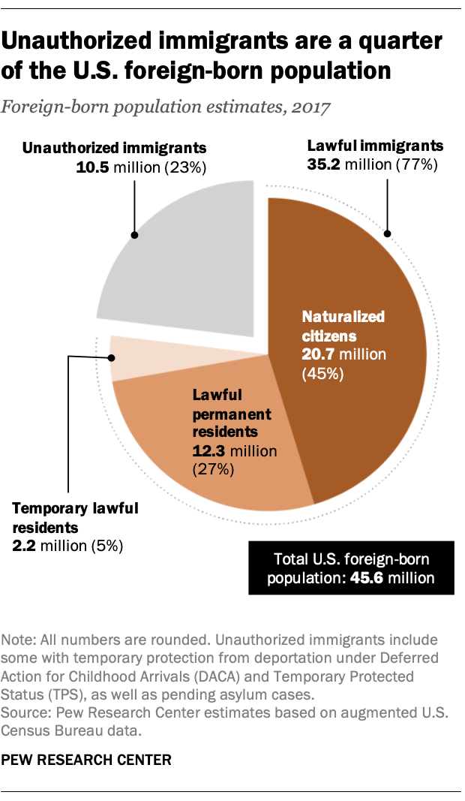

Slide 53
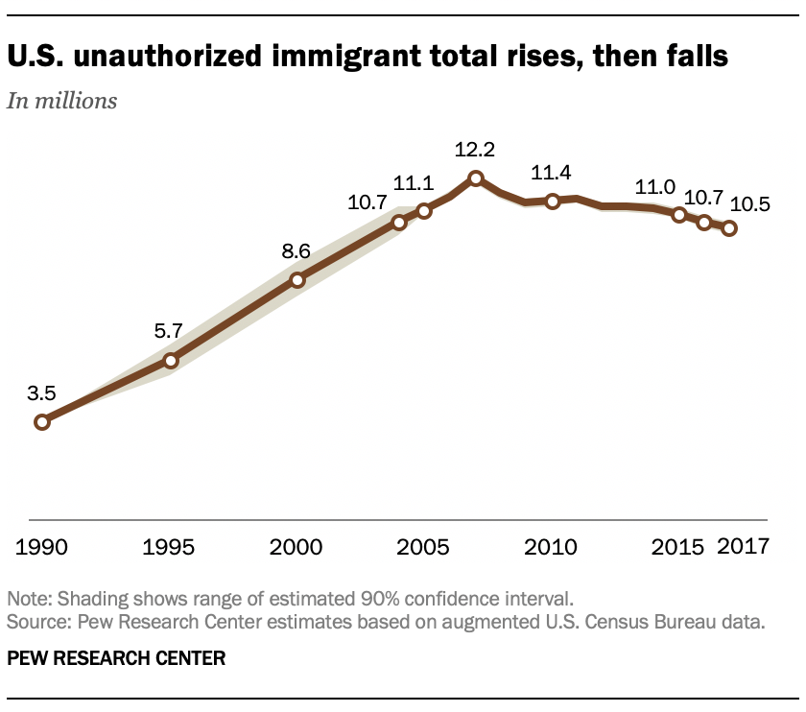

Slide 59
Summing up
The politics of immigration do not cleanly match up to reality on the ground
  Immigration from Mexico and Central America increased rapidly 1970-2000, and then has declined
  This decline is likely to continue, and is driven – perhaps primarily - by economic fundamentals
  “The policy dilemma facing the United States is thus not so much how to arrest massive increases in the supply of foreign labor, but rather how to prepare for a lower-immigration future.”
The impact of immigrants on natives is a much-studied question
  Like the minimum wage debate, the answer is usually “it depends”
Are immigrants complements or substitutes for natives? How does this vary by education and industry?

